Slide 1
Automated Detection of Atmospheric NO₂ Plumes From Satellite Data: A Tool to Help Infer Anthropogenic Combustion Emissions
Douglas Finch^{1,2}, Paul Palmer^{1,2} & Tianran Zhang³
1) National Centre for Earth Observation
2) School of Geosciences, University of Edinburgh
3) King‘s College London, now at Satellite Vu

Slide 2
Context
Quantifying GHG Emissions
An urgent need to reduce greenhouse gas emissions globally
Countries need to develop monitoring, reporting and verification systems of GHG emissions to comply with COP Aims (Paris & Glasgow)
Country level annual reporting of GHG emissions is OK but need more precise & more frequent reporting
We would like to be able to monitor CO2 emissions from hot spots (e.g. particular cities, a power station)

Slide 3
Context
Quantifying GHG Emissions
Satellite allow global, frequent and continuous observations of atmospheric gases
There are a number of satellites directly monitoring CO₂ (with more planned)
If you can detect a hot spot you can quantify emissions from one satellite overpass (with some other data)
However…
Extracting emissions of CO₂ by looking at satellite data is difficult
Concentrations of CO₂ are (relatively) homogenous over the globe and therefore its hard to detect a hot spot against the background level
Monitoring anthropogenic CO₂ from space is complicated by biogenic emissions
Look at co-emitted species from combustion (e.g. NO₂ or CO) to detect the hot spots and determine the emissions

Slide 4
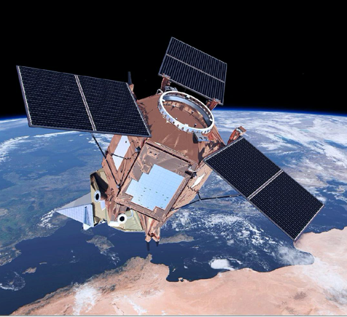
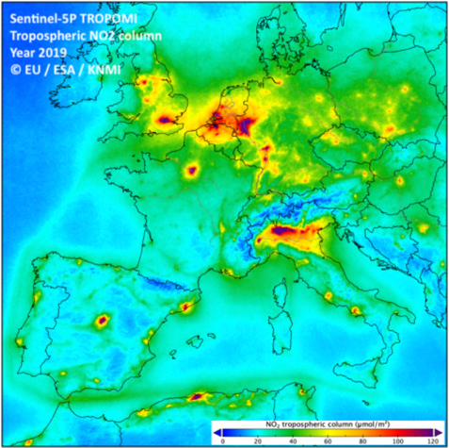
Finding NO₂ Hotspots
TROPOMI NO₂ Observations
TROPOspheric Monitoring Instrument – level 2 tropospheric column NO₂ observations
Launched 13th Oct 2017 (hopefully for at least 7 year mission)
Resolution of 5 x 3.5 km pixels, swath of 2600 km
13:30 local overpass time (near full earth coverage in a day in around 14 swaths)
Build up a database of location and time of hotspots from daily data

Slide 5
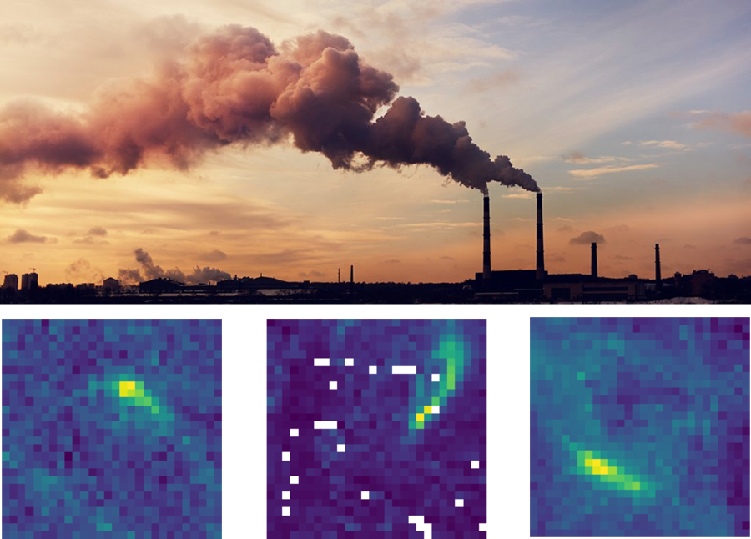
What are we looking for?
Finding Plumes
A plume is a long "cloud" of pollution spreading out from a point of origin.
A classic example of a plume is from a smoke stack from a power station or factory
Could also be large plumes from cities
From above they look like this:

Slide 6
Building a Machine Learning Model
Convolutional Neural Network
Aim: Train a machine learning model to detect plumes within the data
Same principle as any image recognition model (e.g. face recognition)
Using Google’s TensorFlow (Keras)
Open source Python module that is easy to use (but black box)
Create a convolutional neural network with multiple convolutional layers to detect features & nodes to find statistical patterns

Slide 7
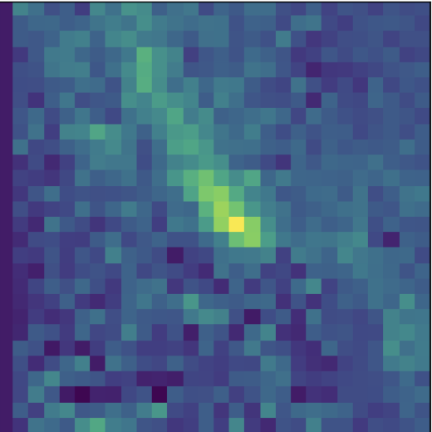
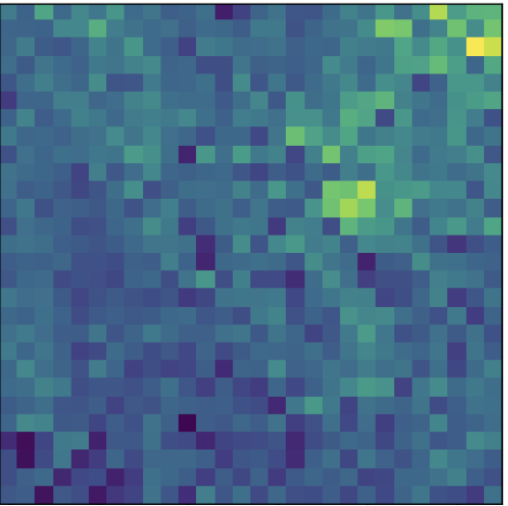
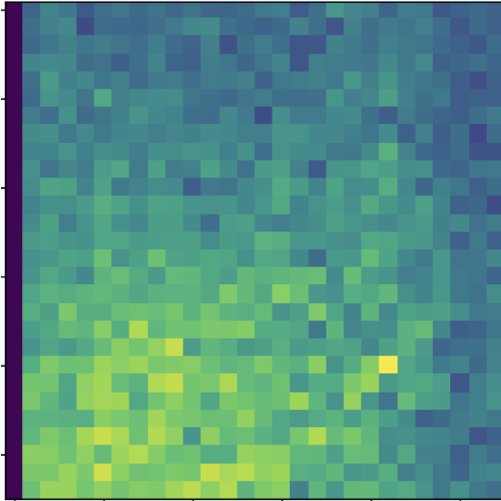
Training the Model
Needs examples of images of both plumes and no plumes (inc. confusing ones)
Created labelled database of 6,086 images. 50/50 split of plume/no plume
Tried crowd-sourcing but was unsuccessful
Global coverage (but skipped over oceans) & all times of year
Randomly split the data, 80% to train the model & 20% to test performance after training
Model configuration resulted in >90% accuracy

Slide 8
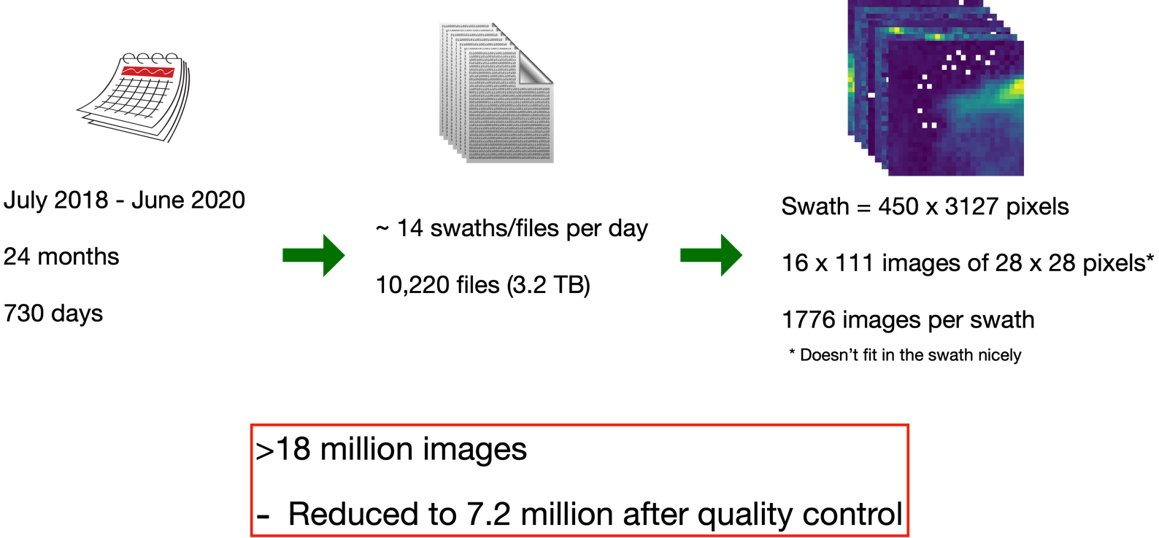
Processing the data

Slide 9
Example CNN Process
Iterates through satellite swath
Looks at 28 x 28 pixel image
Gives confidence that image contains a plume (i.e. 100% = defiantly contains a plume)
Can extract coordinates of the maximum value of the plume

Slide 10
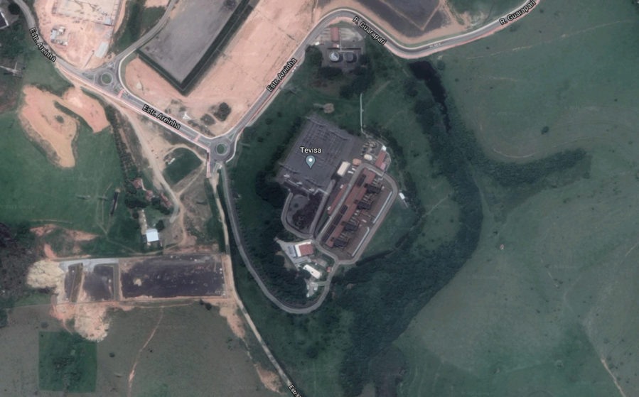
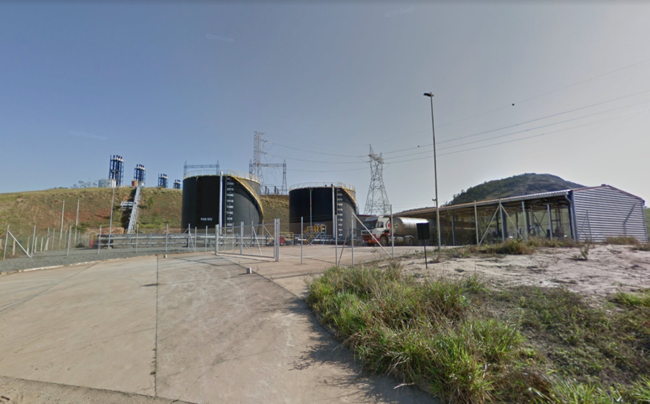
Example CNN Process
Latitude: -20.406º
Longitude: -40.498º
*Could be multiple sources within one pixel

Slide 11
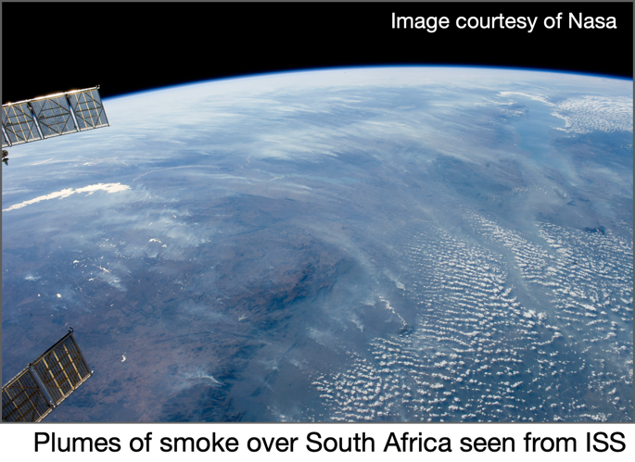
Separating Biomass Burning
Convolutional Neural Network
Biomass burning also produces NO₂ plumes. Especially large forest fires.
Using active fire data we can map where fires coincide with plumes spotted
Data from the Visible Infrared Imaging Radiometer Suite (VIIRS) - SUOMI NPP satellite (NASA/NOAA)
Give locations and times of fires (at 375 m resolution)
Any time a fire falls within a plume pixel it is labelled ‘biomass burning plume’
Errors could be introduced here - imperfect system but works ok for now

Slide 12
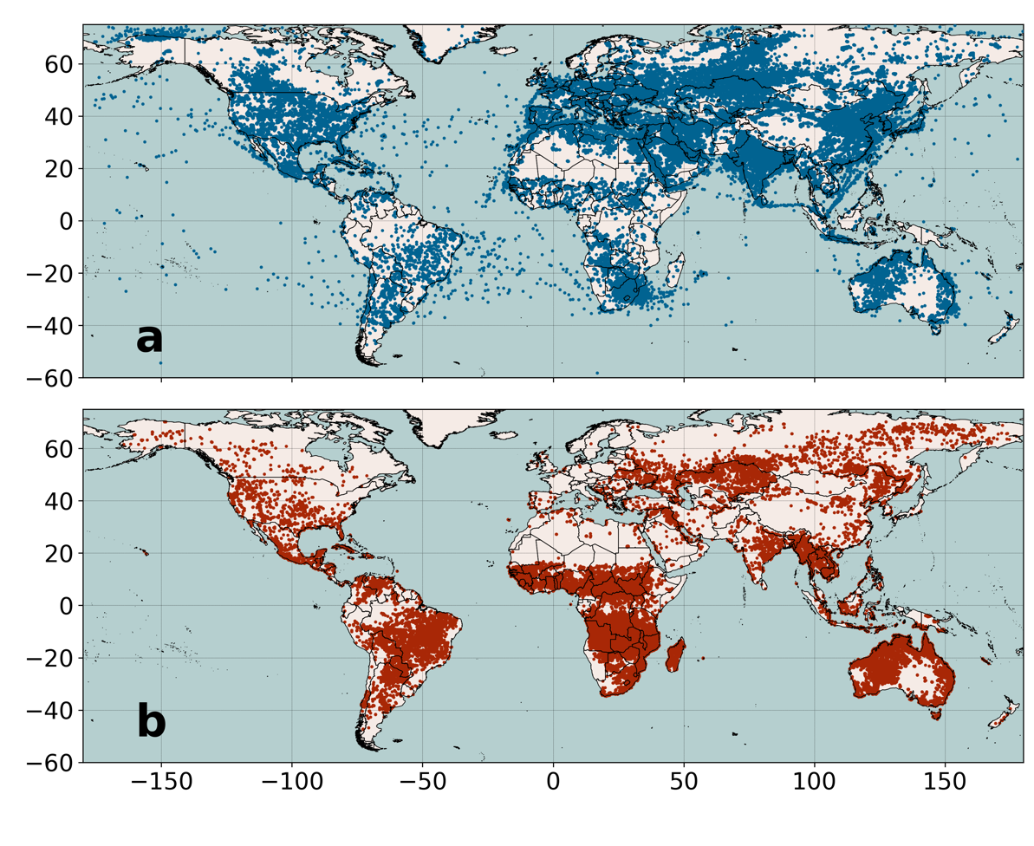
Results
Found > 310,000 plumes over two years
Focused around areas you would expect
Features appear on closer inspection
Anthropogenic Combustion
Dots on map much much larger than TROPOMI pixel - hence saturation
Biomass Burning

Slide 13
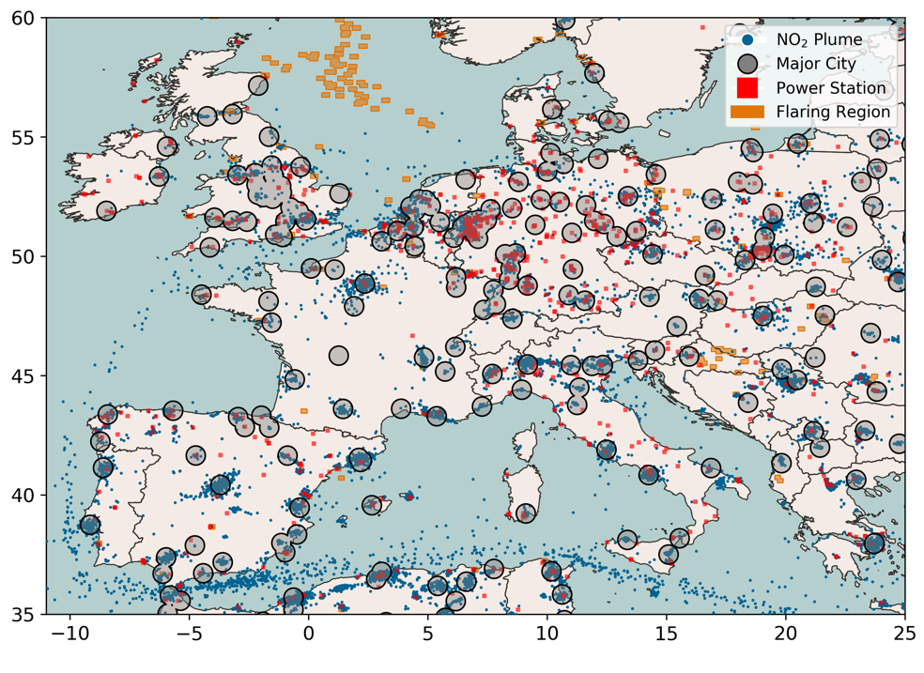
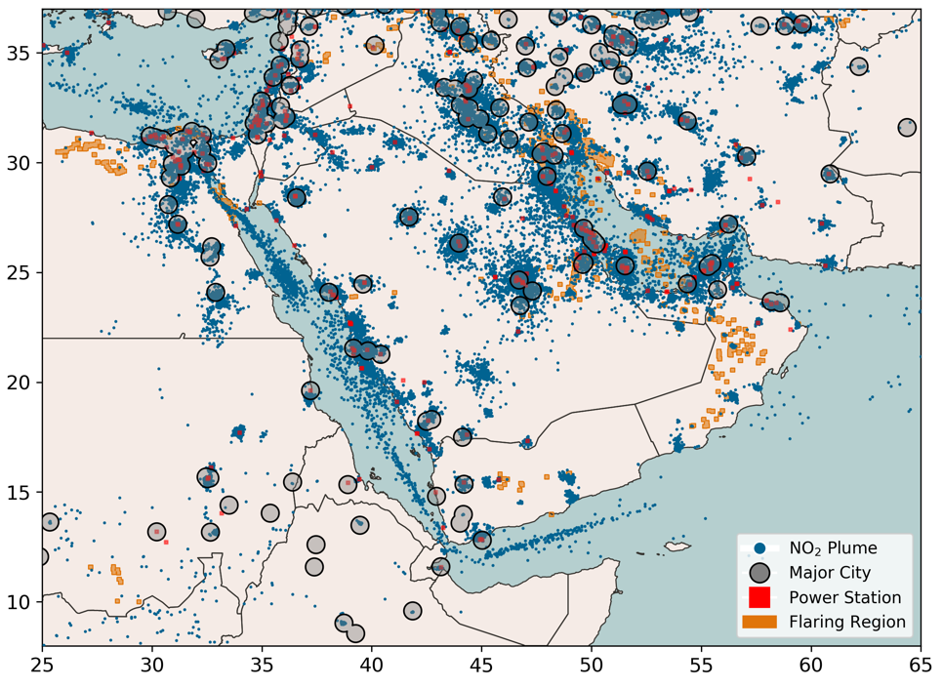
Plume Maps

Slide 14
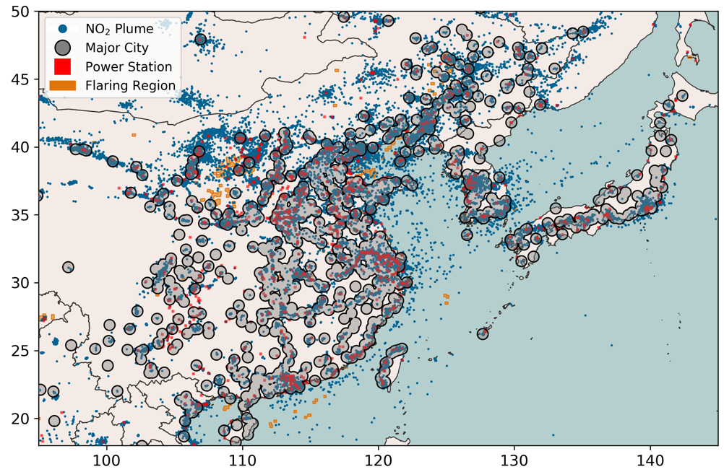
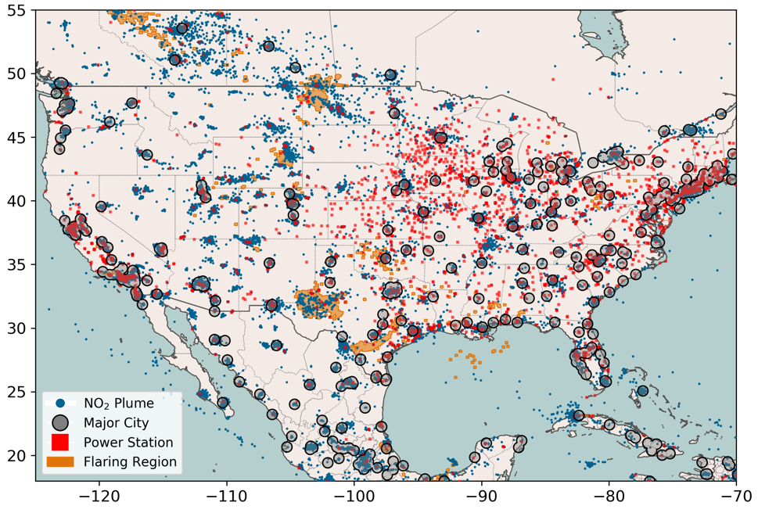
Plume Maps

Slide 15
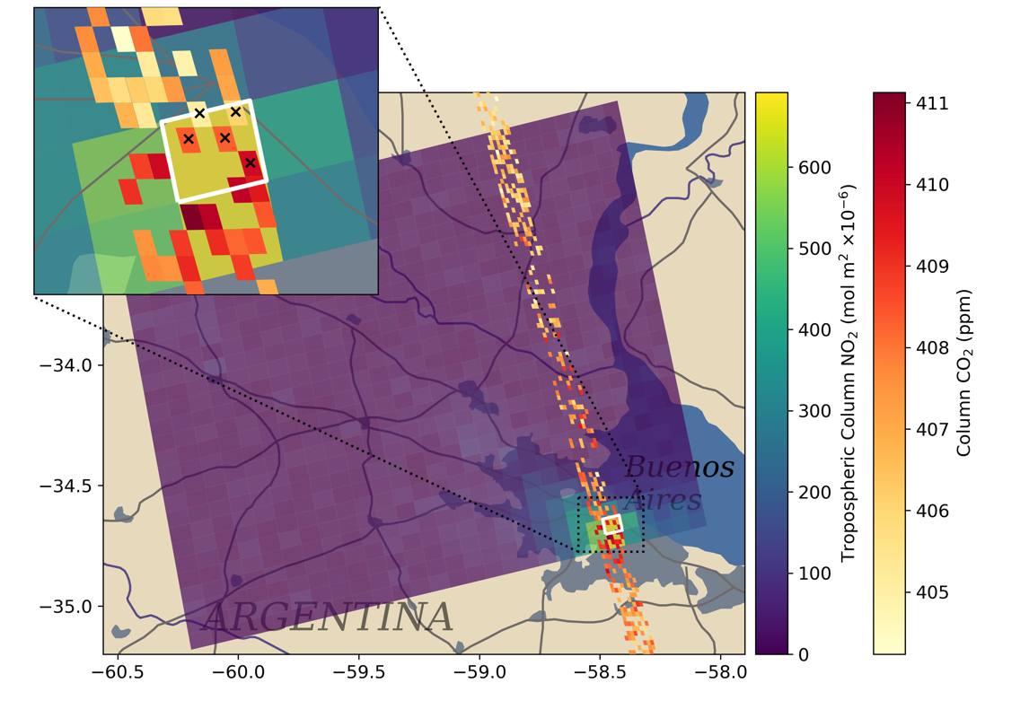
Relating Back to CO₂
Can look at coincident measurements & ratios between species
Gives us information on combustion efficiency & potential emissions
Not currently enough information - more satellites will help!

Slide 16
Summary
Using a convolutional neural network can be a really useful tool for helping to process large amounts of data
We’ve shown you can successfully locate major NO₂ emission globally
This will become more and more useful as there is more and more data
Lots of possible uses for this, directly & indirectly
Refinements can constantly be made to the model to improve output
Paper:
Automated detection of atmospheric NO2 plumes from satellite data: a tool to help infer anthropogenic combustion emissions
Atmospheric Measurement Techniques
Online plume map: ukatmosphere.org/dataplot/plume_map

