Slide 1
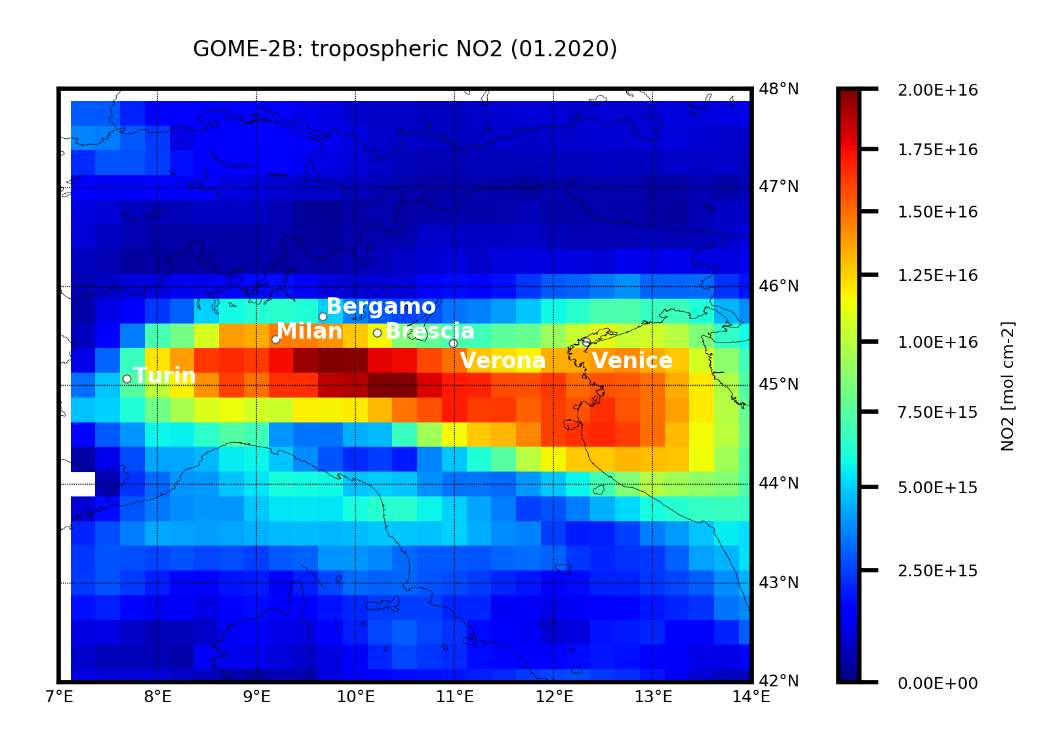
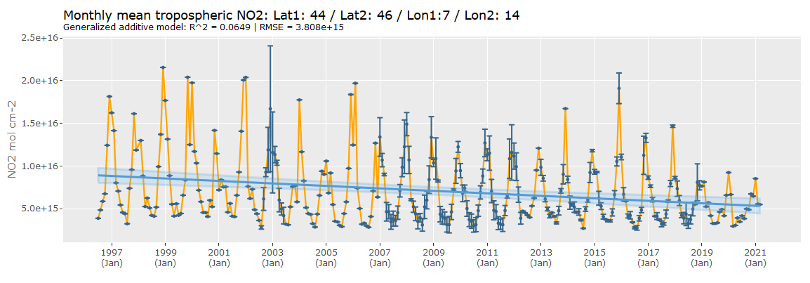
Comparison between economic growth and satellite-based measurements of NO₂ pollution over northern Italy Renée Bichler & Michael Bittner DLR Oberpfaffenhofen, department Atmosphere renee.bichler@dlr.de • michael.bittner@dlr.de

Slide 2
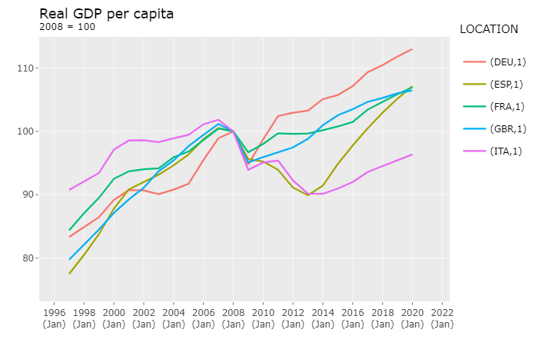
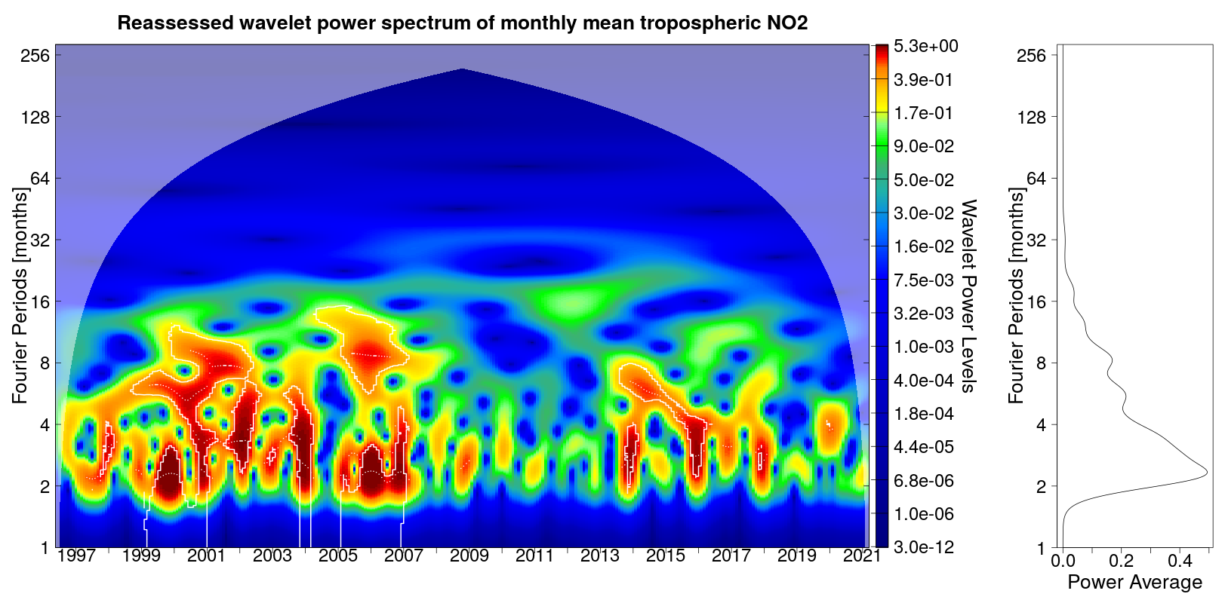
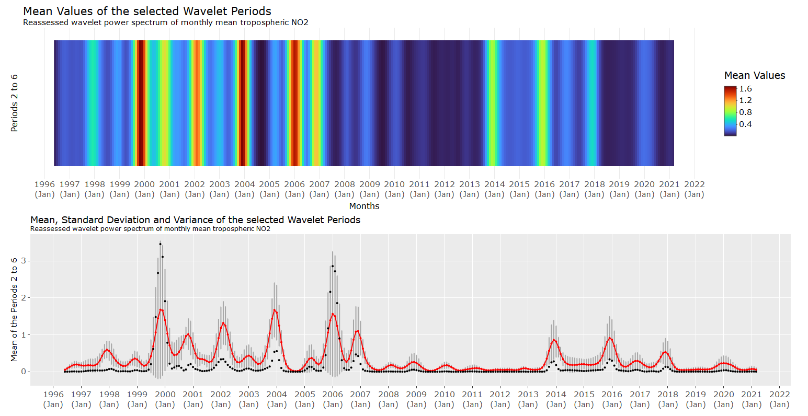
Economic activity and NO2 pollution
GDP decrease 2007 to 2009: -7,91%
GDP decrease 2011 to 2013: -5,23%
GDP decrease total: -11,67%
Reduction* of NO2 variability from A to B = 84,90%
Reduction* of NO2 variability from C to B = 72,25%
*reduction in integrated spectral intensity of the fluctuations of the tropospheric NO₂ column density
1
3
2
A
B
C
A
B
C
OECD, 2021. GDPVD_CAP: Gross domestic product per capita, volume in USD, at constant purchasing power parities. Online: https://stats.oecd.org/Index.aspx?DataSetCode=EO104_INTERNET (last received: 31.03.2021)

