Slide 1
T. Popp & the C3S_312b_Lot2 aerosol team
C3S_312b_Lot2, supported by ESA Aerosol_cci+

Slide 2
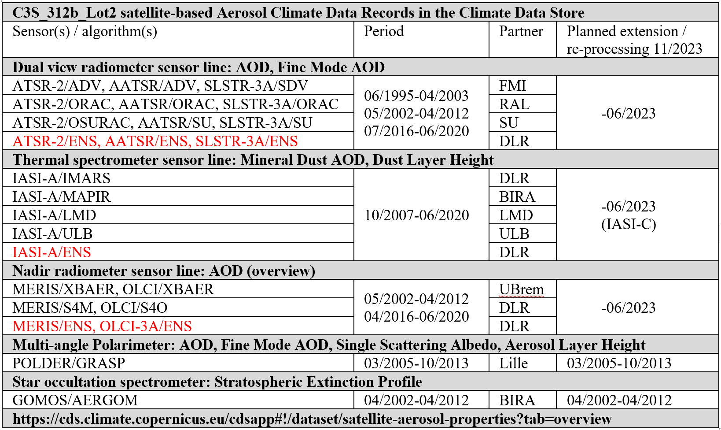
Aerosol CDRs in the Climate Data Store
(1)
(1) C3S2_312a_LOT2 (11/2021 – 04/2024) kicked off 01/12/2021

Slide 3
Ensemble approach (1)
Developed in ESA Aerosol_cci
Round robin evaluation showed:
No single algorithm is always the best
-> ensemble approach
Goals
Combine the best of several algorithms for one sensor
Aim for improved coverage
Use pixel level uncertainties for weighting
Required minimum of valid results from 2 algorithms

Slide 4
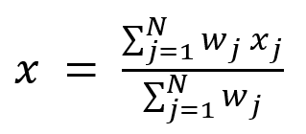
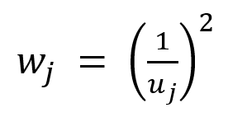
Ensemble approach (2)
Applied now in C3S for ATSR-2, AATSR, SLSTR, IASI, MERIS, OLCI
scoring by S. Kinne

Slide 5
Pixel-level uncertainty evaluation (1)
Pixel-level uncertainties must quantitatively represent true error distributions

Slide 6
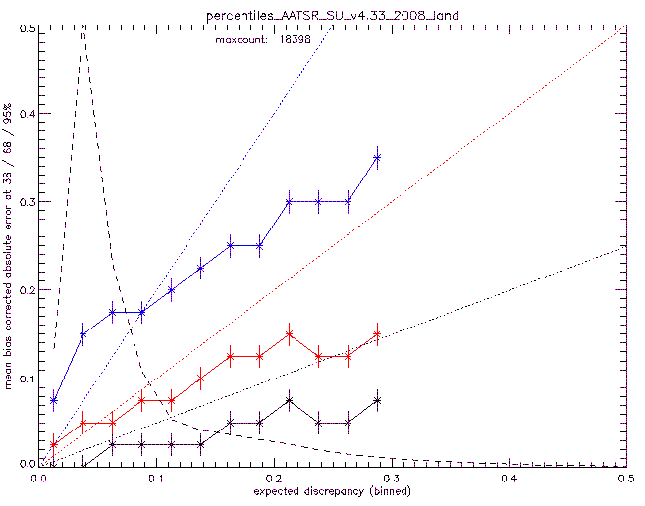
Pixel-level uncertainty evaluation (2)
Pixel-level uncertainties must separate “good” and “weak” pixels

Slide 7
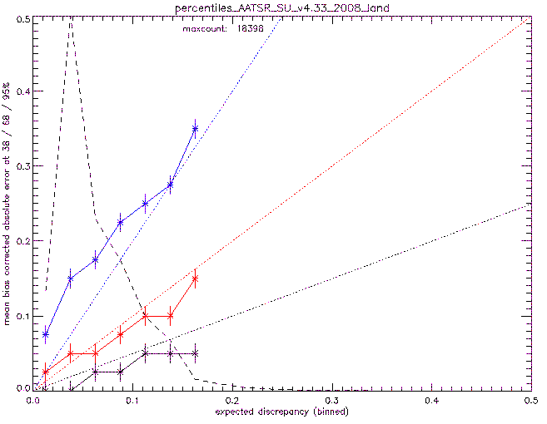
Uncertainty correction
Pixel-level uncertainties:
where needed apply piece-wise linear corrections
u’ = 0.6 * u; if u > 0.15

Slide 8
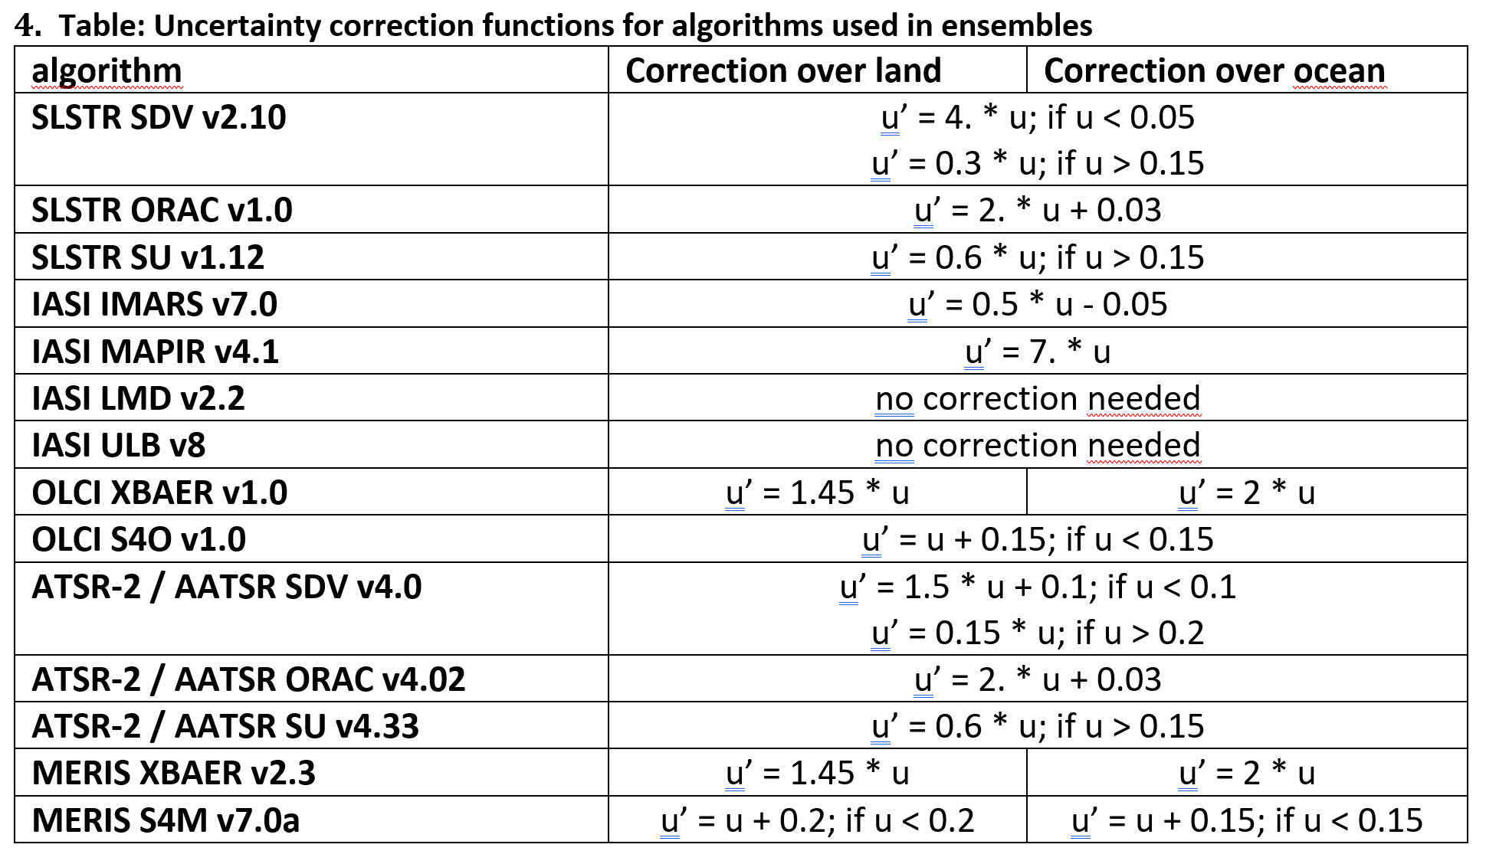
Uncertainty corrections (from ENS ATBD)

Slide 9
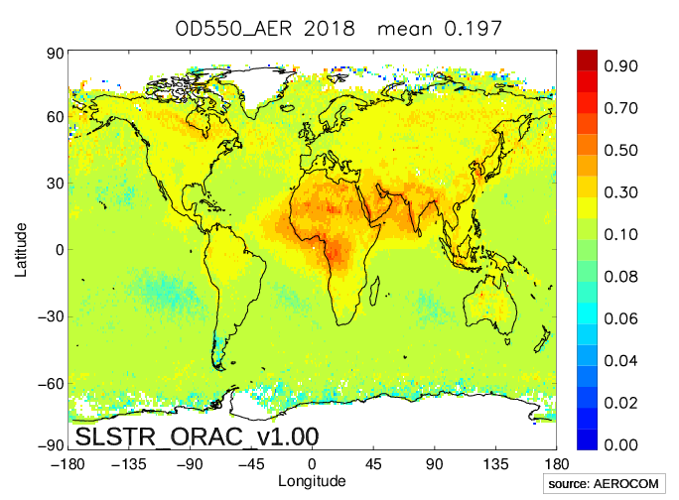
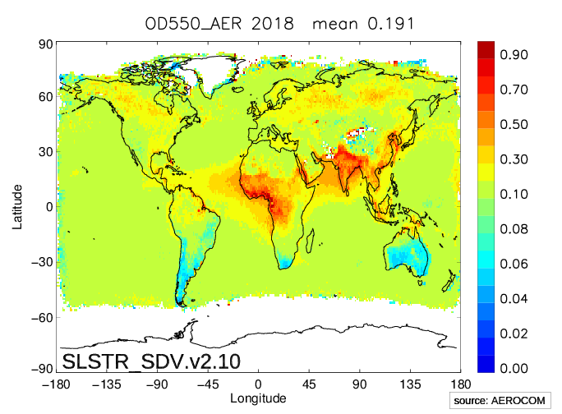
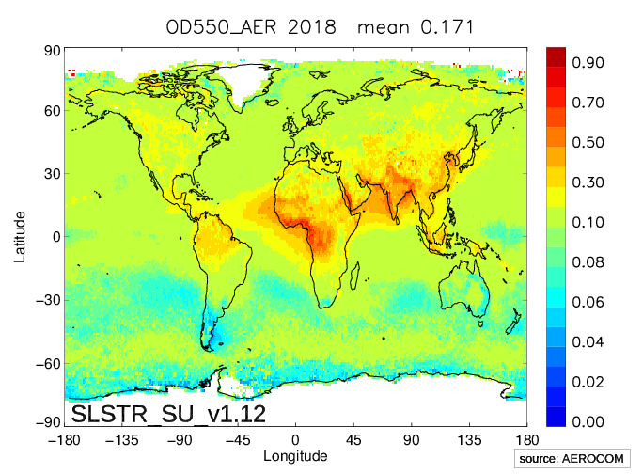
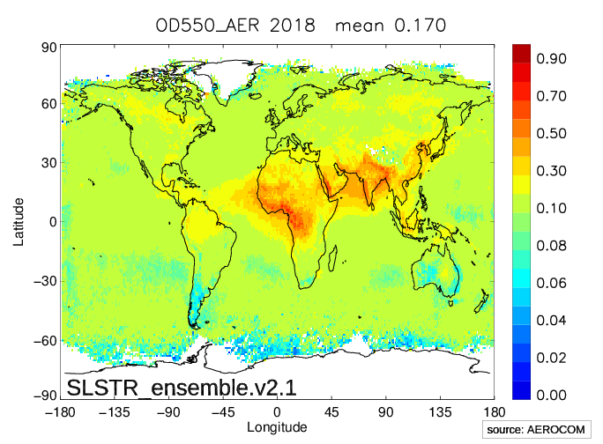
Ensemble L3 example results (1)
AOD mean 2018

Slide 10
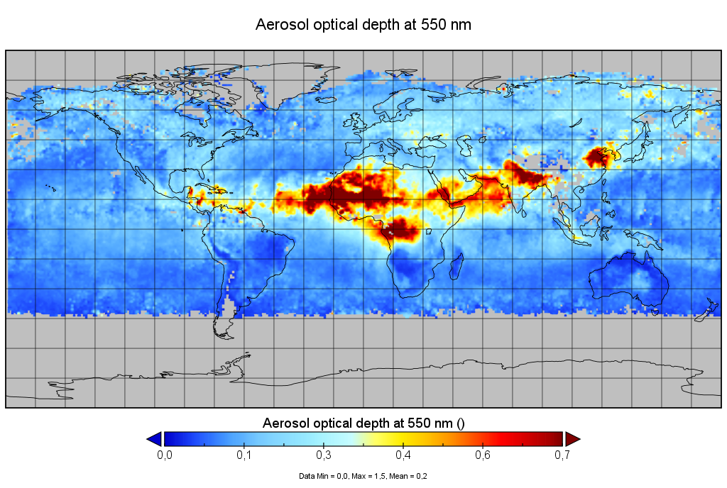
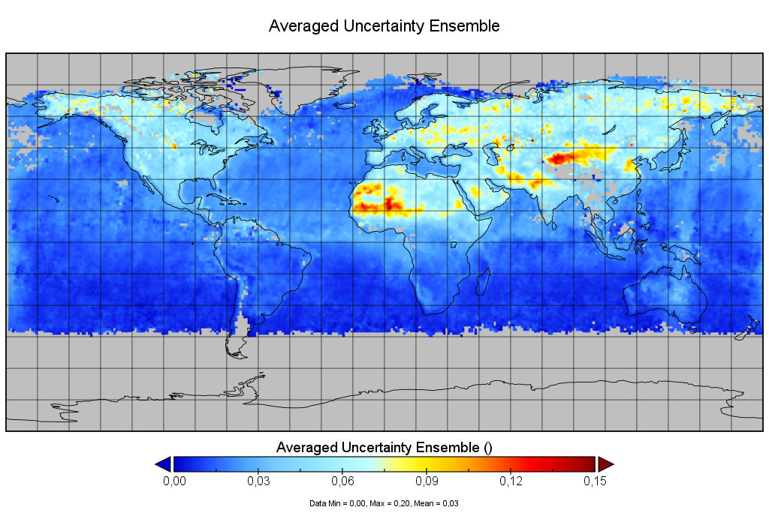
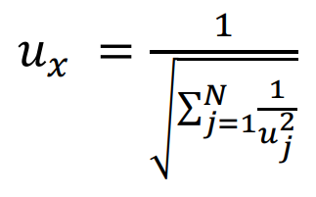
Ensemble L3 example results (2)
Ensemble AOD / uncertainty June 2020

Slide 11
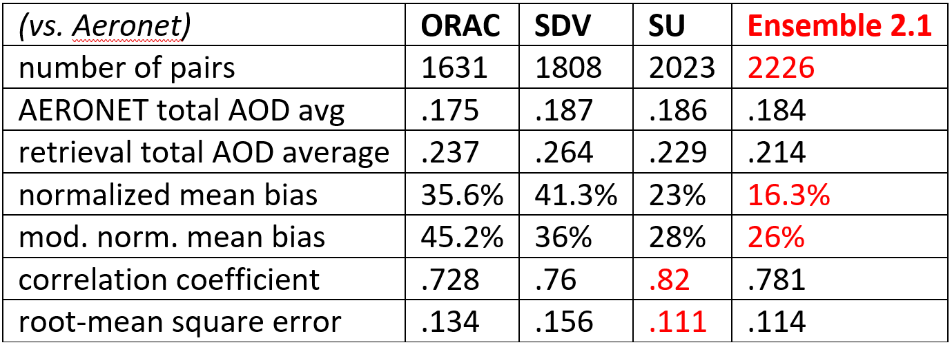
Ensemble L3 evaluation SLSTR 2019 AOD
In C3S done by J. Griesfeller / AEROOCM tools

Slide 12
Ensemble L3 evaluation IASI 2019 AOD
In C3S done by J. Griesfeller / AEROOCM tools

Slide 13
Conclusions
Ensemble approach to combine best of algorithms demonstrated
using (corrected) pixel-level uncertainties for weighting
requiring valid results from a minimum of 2 algorithms per pixel
Best results for IASI: 4 algorithms, improved coverage, mean quality
SLSTR and ATSR: 3 algorithms, smallest bias, best consistency (A)ATSR(-2)
No benefit for OLCI: 2 algorithms only
Regional reliability information

