Slide 1
Discrepancy between satellite- and ground-based measurements of SO₂ emissions from the Kilauea 2020/21 eruption
Juliette Delbrel, Mike Burton, Catherine Hayer, Ben Esse, Matthew Varnam
juliette.delbrel@postgrad.manchester.ac.uk

Slide 2
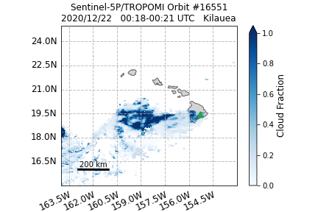
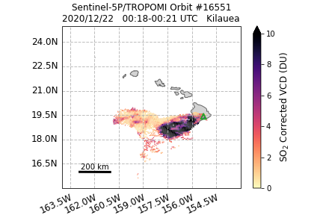
Discrepancy between satellite- and ground-based measurements of SO₂ emissions from the Kilauea 2020/21 eruption
Juliette Delbrel, Mike Burton, Catherine Hayer, Ben Esse, Matthew Varnam
(a)
(b)
juliette.delbrel@postgrad.manchester.ac.uk

