Slide 1
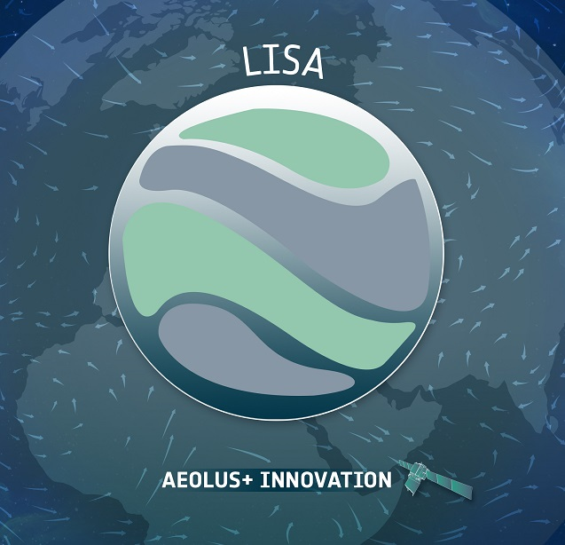
First results from comparison ERA5 and Aeolus measurements: Lidar measurements to Identify Streamers and analyze Atmospheric waves (LISA) (Aeolus+Innovation)
Michal Kozubek¹, Katerina Podolska¹, Jaroslav Chum¹, Tereza Sindelarova¹, Jan Lastovicka¹, Lisa Küchelbacher², Franziska Trinkl² , Sabine Wüst², Michael Bittner^{2,3}
1)Institute of Atmospheric Physics CAS
2) German Aerospace Center, DLR-DFD, Oberpfaffenhofen, Germany
3) Institute for Physics, University Augsburg, Augsburg, Germany

Slide 2
Motivation
Aeolus measurements provide wind data (meridional or zonal component) for the whole stratosphere
ERA5 is available for the whole AEOLUS period on hourly basis with grid points 0.25° in lat/lon
Streamer events occur mainly in the middle latitude over Atlantic
ERA5 will help us to see dynamics not only in the middle atmosphere but in polar region as well
Analysis of Doppler sounding or microbarographs can show us condition in lower or higher levels

Slide 3
Infrasound observations at WBCI
Frequency range of interest, f = 0.0033-0.4 Hz
Calm periods
02.03.-08.03.2020
09.03.-14.03.2020
28.03.-10.04.2020
19.04.-27.05.2020
09.11.-15.11.2020
12.12.-22.12.2020
30.12.20-06.01.21
21.01.-20.02.2021
28.02.-07.03.2021
13.03.-24.03.2021
29.03.-07.04.2021
∑ 153 days
Streamer(-like) events
06.02.-10.02.2020
31.08.-03.09.2020
05.09.-11.09.2020
03.11.-07.11.2020
21.11.-25.11.2020
23.02.-27.02.2021
09.03.-12.03.2021
∑ 35 days

Slide 4
Homogeneity testing Streamer 1
Statistical description ERA5 dataset
Homogeneity testing, using AIC (Akaike’s information criterion), Chapter 5.1.1
AIC = - (maximumlog - likelihood) + 2(number of free parameters)
statistics for whole AEOLUS measurements period but the comparison will be applied mainly on the streamer events.
the AIC of the pooled model is AIC_{A} = (T+T₁) log(σ _{A}²) + 2(p_{A} + intercept + 1), where σ _{A}² is the pooled error variance and p_{A} is the order chosen to fit the pooled data set.
Decision
If AIC_{J} < AIC_{A} switch to the new model, since there is a change in the structure of the time series.
If AIC_{J} ≥ AIC_{A} pool the two data sets, since two data sets are considered to be homogeneous

Slide 5
Homogeneity testing Streamer 1
Fit statistics comparison for streamer event 1.- 9.11. 2020
data segment 40º N - 60º N latitudes meets the homogeneity criterion slightly worse than whole file (40°N-90°N), larger variance,
Fit Statistics 40º N - 60º N
-2 RLL (Res Log Likelihood) | 655.62
AIC (Akaike’s information criterion) | 653.60
AICC (Corrected AIC) | 653.74
BIC (Bayesian information criterion) | 655.60
Fit Statistics 40º N - 90º N
-2 RLL (Res Log Likelihood) | 915.5
AIC (Akaike’s information criterion) | 913.5
AICC (Corrected AIC) | 913.48
BIC (Bayesian information criterion) | 915.5
Covariance Parameter Estimates
Cov Parm | Estimate | Standard Error
Var (RSmooth) | 174.19 | 56.7565
Residual | 1.4553 | 0.5628
Covariance Parameter Estimates
Cov Parm | Estimate | Standard Error
Var (RSmooth) | 137.23 | 42.78
Residual | 4.453 | 0.3638

Slide 6
Comparison of ERA5 and AEOLUS

Slide 7
Comparison of ERA5 and AEOLUS

Slide 8
Comparison of ERA5 and AEOLUS
Comparison of zonal wind at 150 and 175 hPa from AEOLUS and ERA5 show that Aeolus measurements are biased
The difference between ERA5 and Aeolus are different for each zonal bends (table bellow)
The biggest one is for higher latitudes
The main features are very similar
 | 65°-60°N | 60°-55°N | 55°-50°N | 50°-45°N
150 hPa | 20 | 20 | 15 | 9
175 hPa | 16 | 20 | 15 | 8

Slide 9
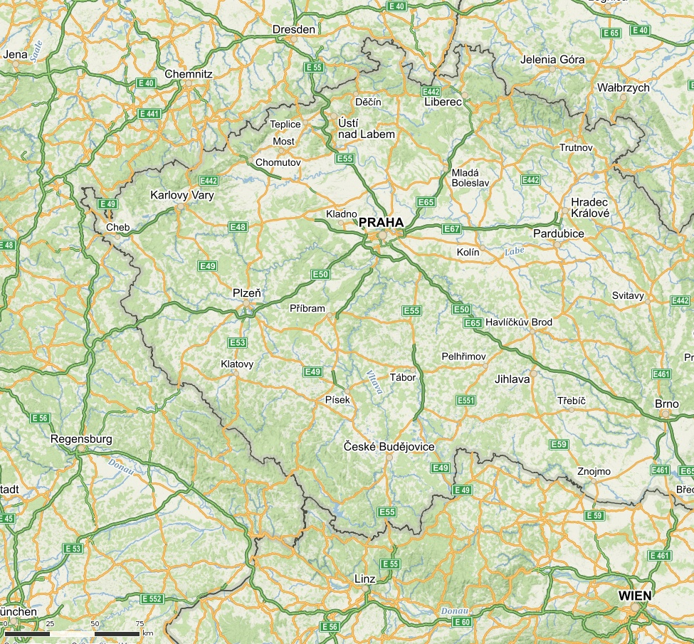
Measurement setup for GWs,
Absolute microbarometers and Continuous Doppler sounding
Small triangle, 3 freq. since 2014
Tx1, Tx2, Tx3
at each location, frequency of
3.59, 4.65 and 7.04 MHz transmitted
Digital ionosonde is close to Tx2.
Rx1 is at the Institute in Prague
Large array, since autumn 2019
( Tx4, Tx5; Rx2 added)
3.59 and 4.65 MHz
Large scale array of microbarometers around Tx5,
Tx3
Tx1
Tx5
Rx1
Tx2
Rx2
Tx4
Notes:
9
Introduction: Motivation was the investigation of the velocity and direction of wave propagation, and investigation of a characteristic scale sizes of disturbances

Slide 10
Infrasound arrivals at WBCI from NW
decrease of signal frequencies on 5-6 November from ~0.2 Hz to 0.04 Hz
signatures of an amplitude decrease at the same time, but not conclusive
Some considerations
signals possibly propagated through the streamer event region
propagation of infrasound against stratospheric winds
signal refraction at higher altitudes (thermospheric wave guide?)
increased signal absorption, at higher frequencies stronger

Slide 11
Azimuth of infrasound arrival, from January 2020 to April 2021
yellow fields = streamer events
grey fields = calm periods

Slide 12
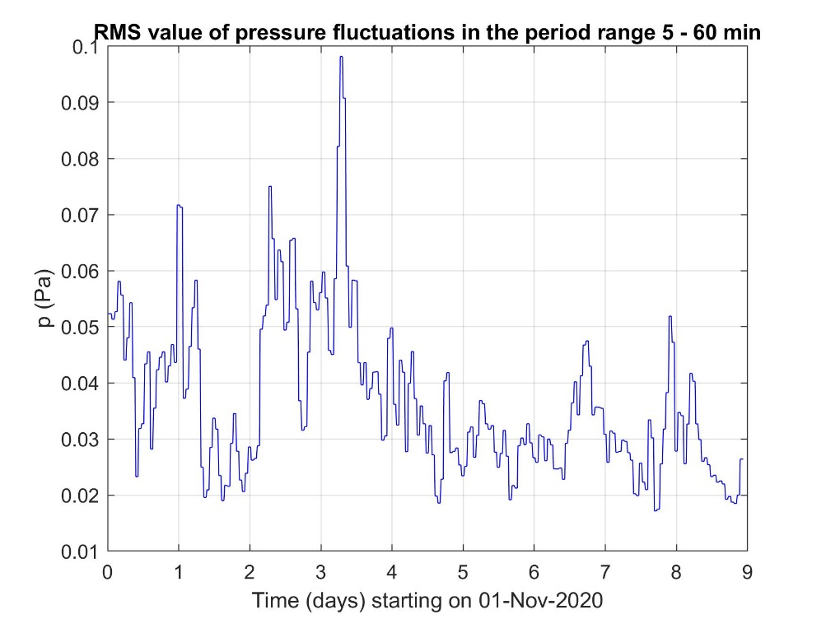
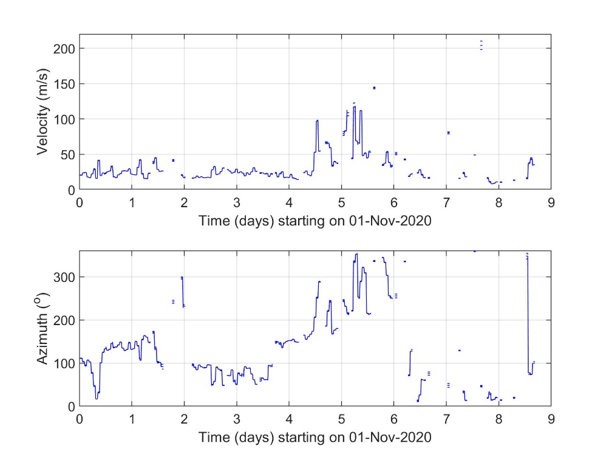
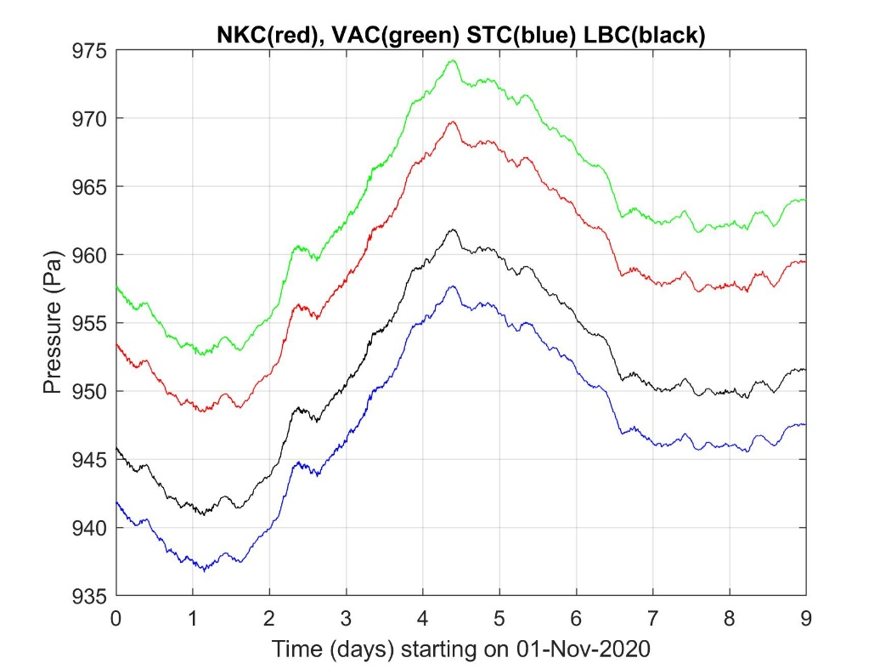
2-D GW analysis from
microbarometer network
Interval: 1 - 9 November 2020
Amplitude (RMS pressure) in the range 5-60 min
Velocity (apparent horizontal velocity) and azimuths.
(120 min intervals, 1-hour step)
Criteria for displaying results:
>0.02 Pa , v> 7 m/s
std of AZ<10º,
relative std of |v|<5%

Slide 13
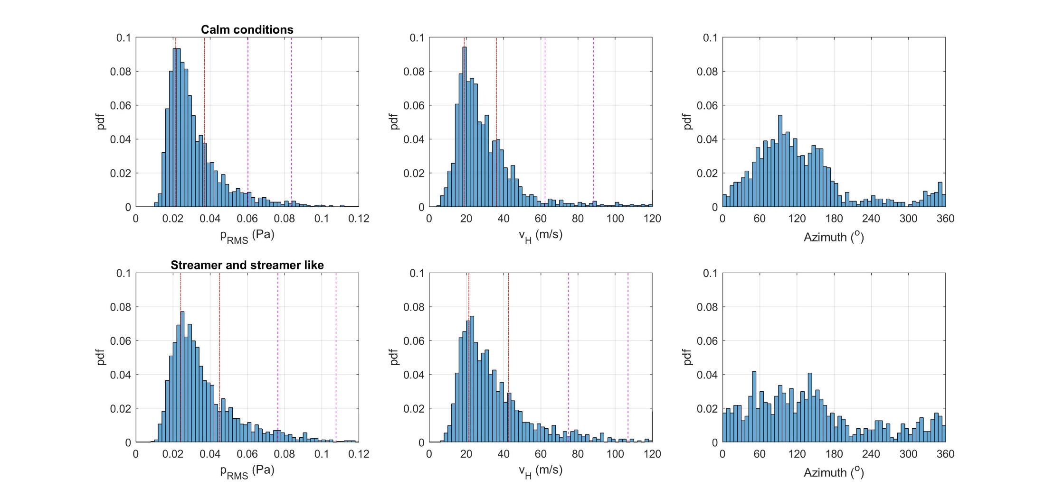
Comparison of GW characteristics in the troposphere,
from microbarographs for calm and streamer&streamer-like periods
RMS pressure fluctuations
in 5-60 min band
(3248/2140 intervals)
Observed
horizontal velocity
(1517/1102 intervals)
Observed
azimuth of propagation
(1517/1102 intervals)
X
X difference
Vertical lines mark Q1, Q3, Q3+1.5(Q3-Q1), Q3+3(Q3-Q1); where Q1(Q3) is lower (upper) quartile

Slide 14
Conclusions
ERA5 dataset streamer event 1 meets the conditions of global homogeneity using AIC.
BIC does not give much better results and is computationally more demanding
Streamer events are rather small-scale phenomena (cf. SSW). Variations of stratospheric winds related to streamer events influence signals propagating through the region of the streamer event
The observations can strongly depend on the mutual location of the infrasound source, the region influenced by the streamer event, and the infrasound array
Insufficient statistics for pure streamer event
Some detection for 2-D GW analysis from microbarometer network

Slide 15
Thank you for attention
Support by the Czech Science Foundation via Grant 21-03295S and LISA - Lidar measurements to Identify Streamers and analyze 459 Atmospheric waves, AEOLUS-INNOVATION, Contract No. 4000133567/20/I-BG

