Slide 1
RETRIEVAL OF AEROSOL SINGLE SCATTERING ALBEDO BASED ON TIME-SPACE SEQUENCE DATA OF HIMAWARI8 GEOSTATIONARY SATELLITE
Xingxing Jiang, Yong Xue, Chunlin Jin
Xuzhou, Jiangsu Province, China
11/25/2021

Slide 2
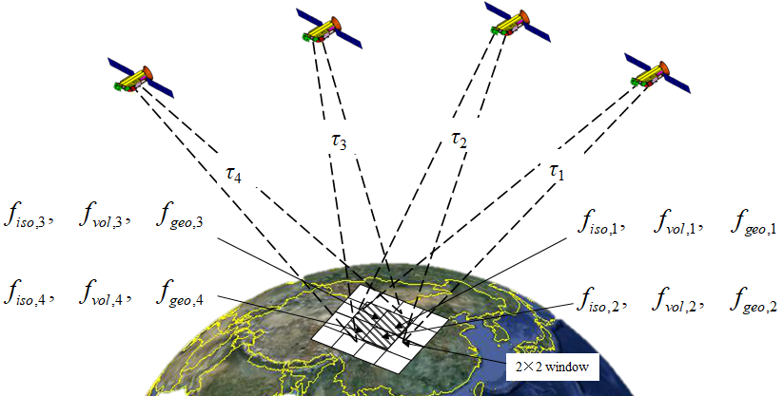
RETRIEVAL OF AEROSOL SINGLE SCATTERING ALBEDO BASED ON TIME-SPACE SEQUENCE DATA OF HIMAWARI8 GEOSTATIONARY SATELLITE
1. Atmospheric Radiative Transfer Model
3. Time-Space Method
2. BRDF Model
Fig.1. Schematic diagram of 4 observations and 2*2 window in the algorithm
For a single band, K observations, N * N pixel window, only KN² ≥ 3N² + 2, and there is a minimum integer solution when K = 4 and N = 2.

Slide 3
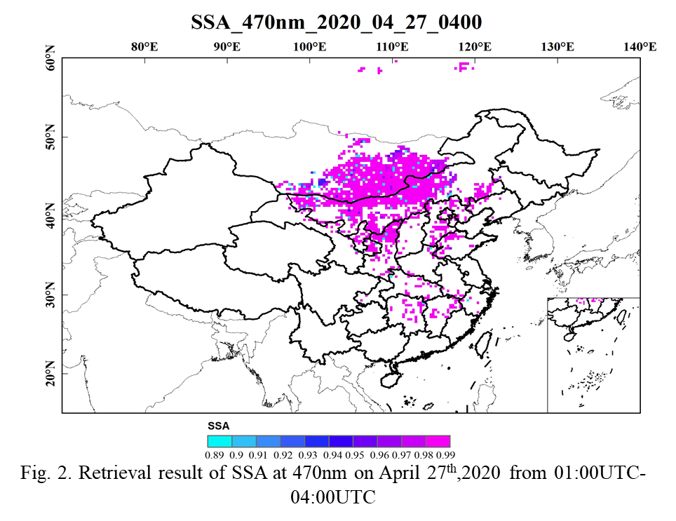
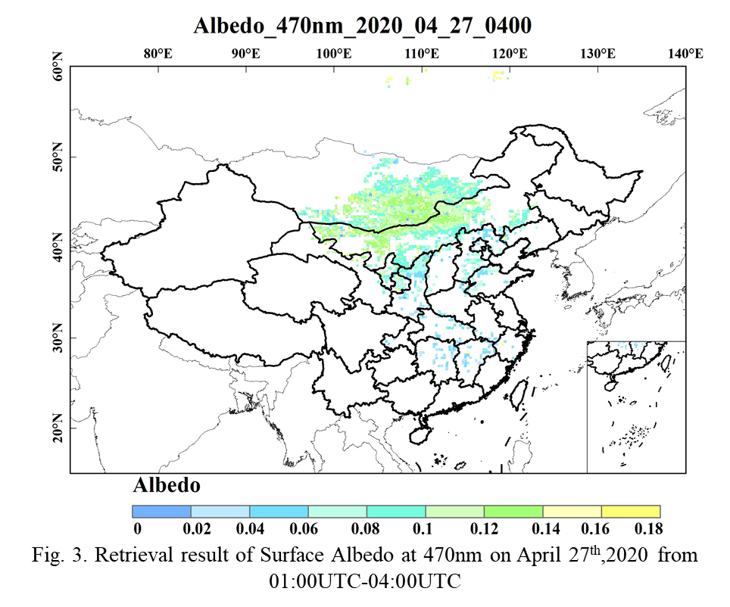
RETRIEVAL OF AEROSOL SINGLE SCATTERING ALBEDO BASED ON TIME-SPACE SEQUENCE DATA OF HIMAWARI8 GEOSTATIONARY SATELLITE
4. Results
5. Conclusion
From the results obtained, we have obtained the current SSA inversion results with the best temporal resolution and spatial resolution.
However, the algorithm still has many areas to be improved.
Only a single band is used.
The model itself requires 4 cloud-free observations.
A long-term sequence analysis is required to ensure the stability of the verification results.
Table.1. SSA inversion error verification result
N | R | Q_0.05
156 | 0.38 | 55.6%

