Slide 1
Regional trends of stratospheric ozone evaluated using the MErged GRIdded Dataset of Ozone Profiles (MEGRIDOP)
Viktoria F. Sofieva¹, Monika Szelag¹, Johanna Tamminen¹, Erkki Kyrölä¹, Doug Degenstein², Chris Roth², Daniel Zawada², Alexei Rozanov³, Carlo Arosio³, John P. Burrows³, Mark Weber³, Alexandra Laeng⁴, Gabriele Stiller⁴, Thomas von Clarmann⁴, Michel van Roozendael⁵, and Christian Retscher⁶
¹Finnish Meteorological Institute, Helsinki, Finland
²Institute of Space and Atmospheric Studies, University of Saskatchewan, Saskatoon, Canada
³Institute of Environmental Physics, University of Bremen, Bremen, Germany
⁴Karlsruhe Institute of Technology, Institute of Meteorology and Climate Research, Karlsruhe, Germany
⁵Royal Belgian Institute for Space Aeronomy (BIRA-IASB), Brussels, Belgium
⁶ESA/ESRIN, Frascati, Italy
ESA Climate Change Initiative

Slide 2
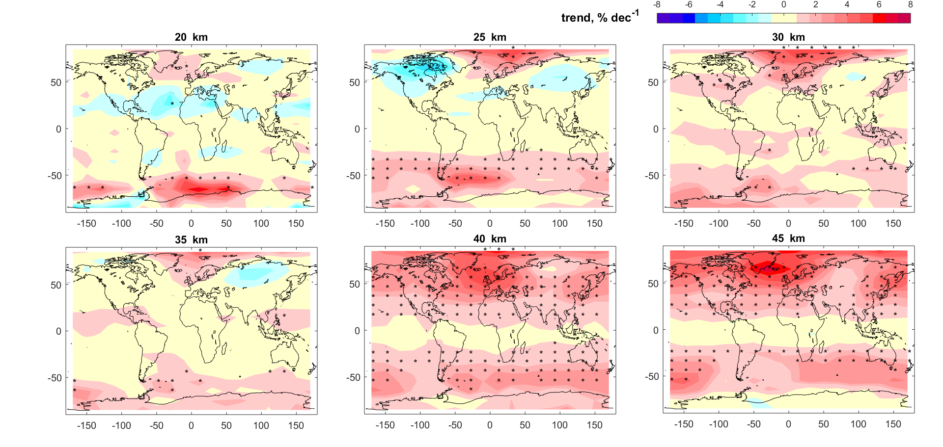
Regional trends in ozone profiles
Merged GRIdded Dataset of Ozone Profiles (MEGRIDOP) is created
Combined data from 6 limb-viewing satellite instruments: MIPAS, SCIAMACHY, GOMOS, OSIRIS, OMPS-LP, MLS
The monthly means in 10°x20 ° latitude-longitude bins and altitudes 10-50 km, it covers years 2001-2020
The dataset is in open access: https://climate.esa.int/en/projects/ozone/data/
More details:
Sofieva et al: Measurement report: regional trends of stratospheric ozone evaluated using the MErged GRIdded Dataset of Ozone Profiles (MEGRIDOP), Atmos. Chem. Phys., 2021
Our analyses have shown positive statistically significant trends in the upper stratosphere, as expected
We found that stratospheric trends show a longitudinal structure at NH middle and high latitudes, with enhanced trends over Scandinavia/Atlantic ocean.
We made the first attempt to evaluate the trends in ozone profiles in polar regions
Positive, statistically significant trends in the upper stratosphere and in the SH middle stratosphere

