Slide 1
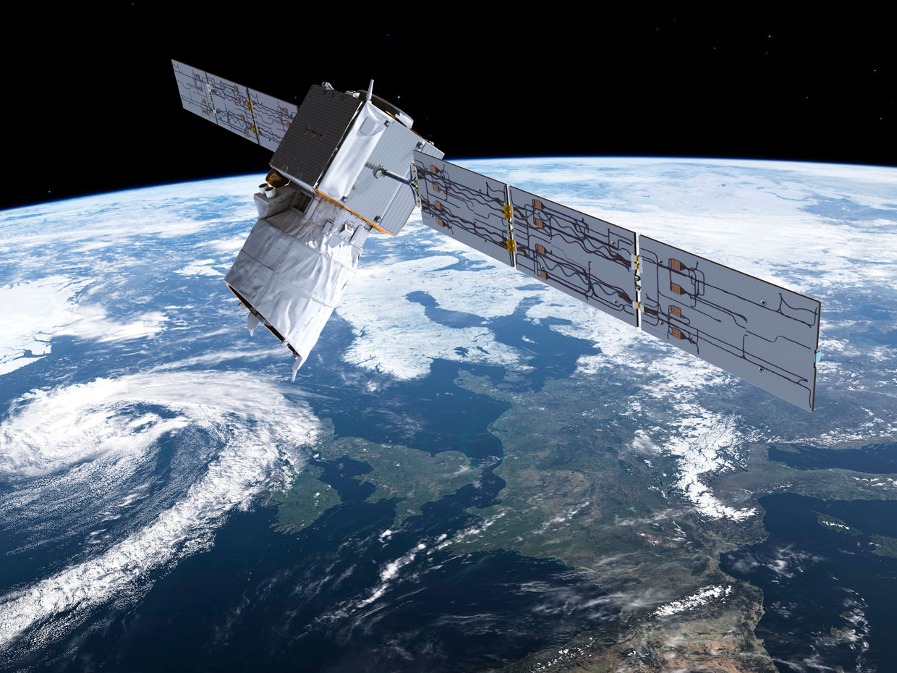
First results from AOD retrieval based on Ocean Lidar Surface Returns from Aeolus
L. Labzovskii*, G. J. van Zadelhoff, D. Donovan, D. Josset
24.11.2021 |ATMOS 2021

Slide 2
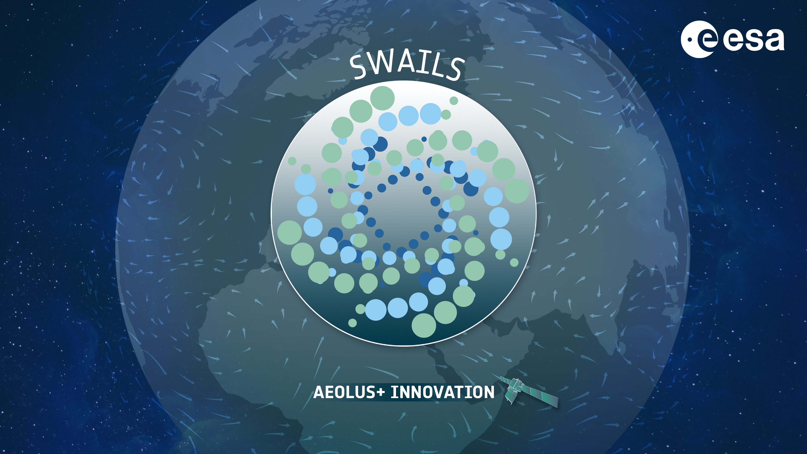
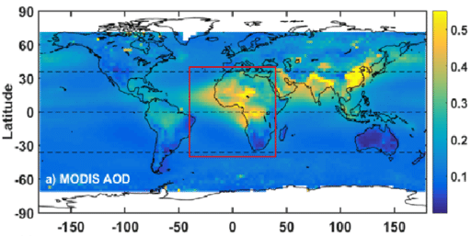
RESEARCH AIM AND MOTIVATION
AOD distribution [Wang et al., 2018]
LARISSA – Lidar Aerosol Retrieval Based on Information from Surface Signal of Aeolus
RESEARCH AIM
To introduce independent AOD retrieval using lidar surface returns (LSR) from ocean for Aeolus
IMPLICATIONS
New AOD estimates from lidar surface returns -> No assumption about lidar ratio or microphysics
Empirically untested AOD retrieval at these lidar settings -> 37.5º incidence, UV wavelength, LSR-based method
Support future aerosol-oriented spaceborne instruments -> such as ATLID on EarthCARE

Slide 3
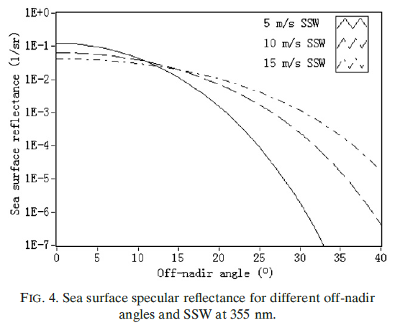
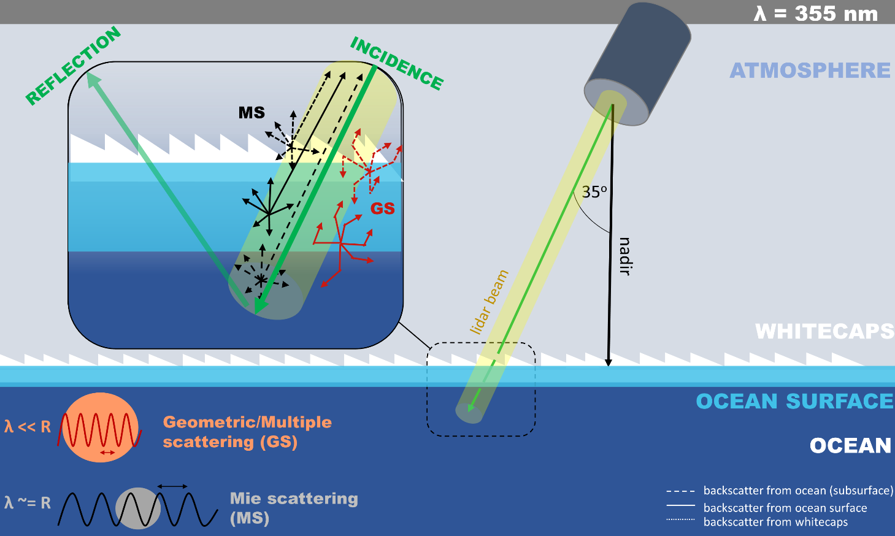
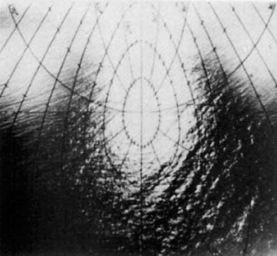
FUNDAMENTALS OF LSR-BASED AOD RETRIEVAL FOR AEOLUS
Aeolus
Li et al., 2010
[Cox and Munk, 1954]
Light reflected away -> 2% of remaining backscattered light can be used for AOD retrieval
In simple words -> Inverse relationship between LSR and surface wind speed
Why complicated? -> Highly non-nadir angle of incidence, subsurface contribution at 355 nm

Slide 4
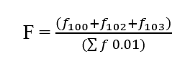
METHODOLOGY
1. Opening the data
Aeolus: L1, L2 data, AUX_MET
2. Detection of ground signal
DEM Intersection = index ground
Filtering strong LSR signal
3. Horizontal Averaging
n = 60 |Sliding Window
4. Quality Flagging
5. LARISSA AOD retrieval
${AOD}_{LARISSA}=$ $\frac{1}{2} ln(\frac{specular+whitecaps+subsurface}{γ}$) - OD_{m}
Josset et al, [2010]
γ – SIAB (Surface Integrated Attenuated Backscatter) is LSR or input from lidar-> Calculated at the step (2)
Quality flagging is based on the Aeolus L2a AEL-PRO quality flag (attenuated features forfeited)
LARISSA retrieval (step 5) -> Based on Josset et al., 2010 equation from previous slides

Slide 5
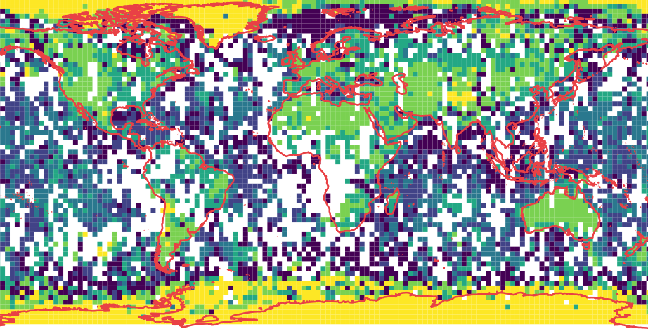
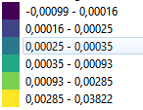
LSR WITH RELATION TO LAND COVER: FIRST 10 DAYS OF IOP
USEFUL OBS. OVER OCEANS (%)
26.13 %
26.96 %
22.42 %
30.70 %
33.63 %
21.50 %
18.78 %
35.92 %
29.54 %
28.50 %
LSR (sr⁻¹)
Very clear gradient between land, ocean and ice surface
Many strong returns over oceans (19-34%)
As expected -> Strongest UV returns over white surface (Albedo > 0.90 for fresh snow [Varotsos et al., 2014; Weiler, 2017])
Beyond expectations -> A week of LSR reflects land cover patterns (dark forests and arid areas are discernible)

Slide 6
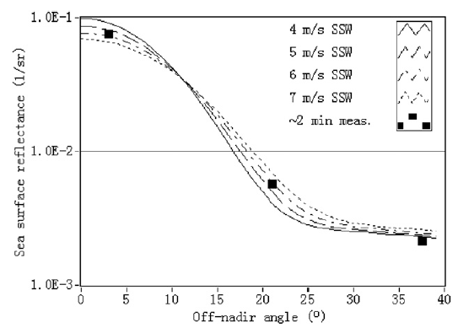
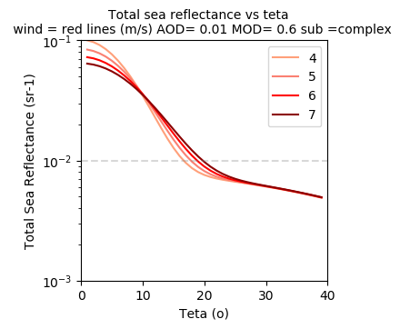
SUMMARIZED SURFACE REFLECTANCE CALCULATION
Li et al., 2010
Menzies et al., 1998
Good agreement with previous works [Li et al., 2010] - > while Josset-2010 equation applied
Despite good agreement in pattern/magnitude -> Potential overestimation of subsurface component at 37.5º

Slide 7
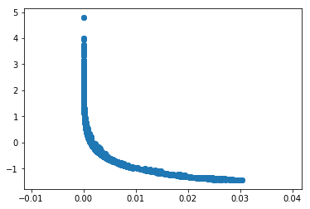
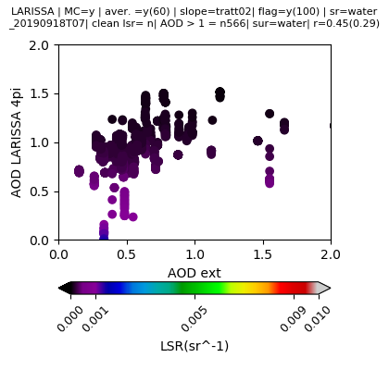
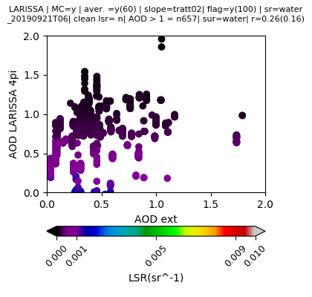
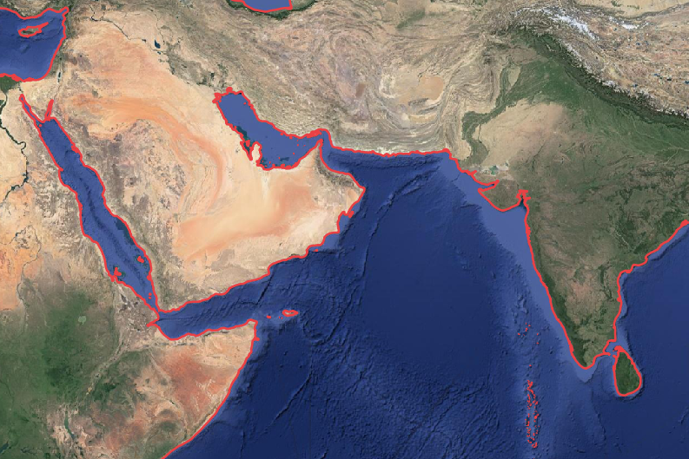
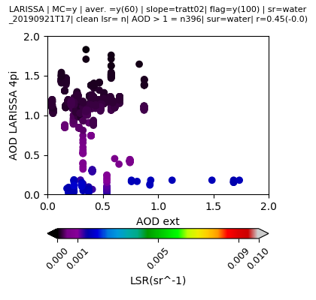
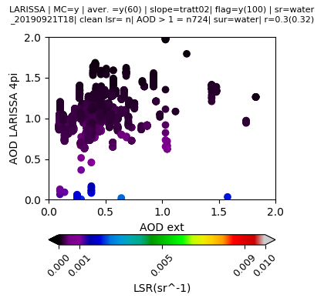
ANALYZING SELECTED CASES OVER ARABIAN SEA
STEP 2: SIAB calculation from detection of surface and cloud removal
POSITIVE LARISSA AOD = WEAK RETURNS
Arabian Sea
NEGATIVE LARISSA AOD = STRONG RETURNS
lon_mn = 60.50083
lon_mx = 66.30578
lat_mn = 3.30934
lat_mx =25.01479
LSR(sr^-1)
Quasi-linear relationship between AODLARISSA and AOD-EXT is seen -> r = 0.26 – 0.45
Lack of stronger relationship -> Two distinct LSR populations (weak and strong LSR)
Strong ocean LSR (undetected sea ice/clouds/ocean color cluster?) > e-stimated maximum surface return -> negative AOD
No expected sensitivity to near surface wind speed detected -> Winds are too weak or moderate

Slide 8
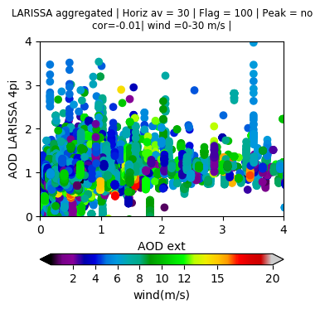
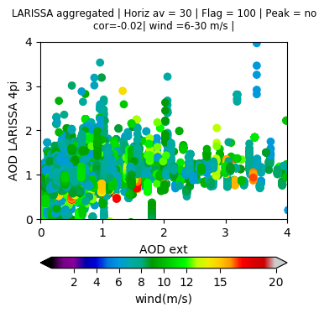
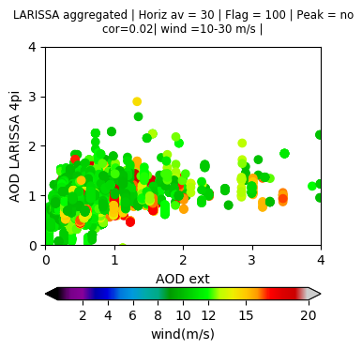
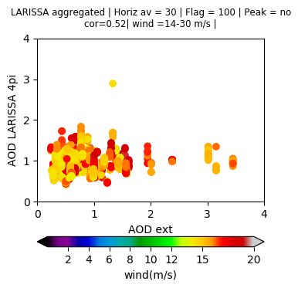
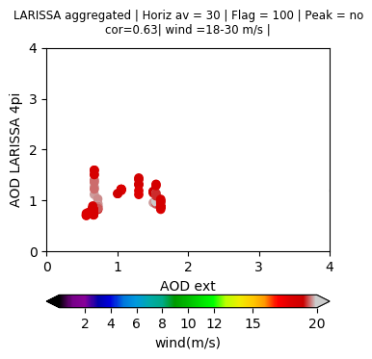
GLOBAL SCALES: NO STRONG SENSITIVITY TO WIND SPEED
Every plot -> Binning based on wind range
At 10-30 m/s -> Visible improvement
At 14-30 m/s -> Quantitative improvement (r = 0.52)
Is 0.52 good correlation?

Slide 9
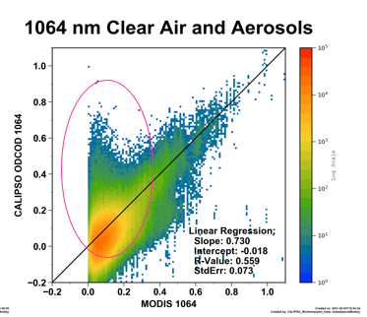
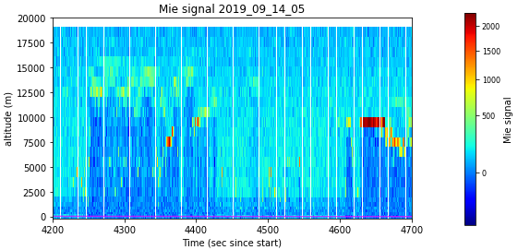
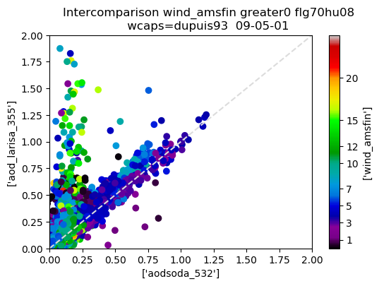
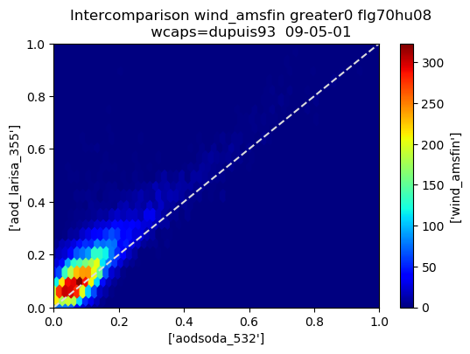
HOW TO COMPARE THESE RESULTS WITH PREVIOUS EFFORTS? CALIPSO EXAMPLE
B4. Screening out clouds (Aeolus example)
CLOUDS
B4. Screening out clouds (Aeolus example)
CLOUDS
CALIPSO
CALIPSO
ODCOD = Ryan et al., 2021 LSR-based AOD retreival
LARISSA agrees well with SODA (5 km SODA*) -> r = 0.65 (outliers are minor according to right plot)
All the outliers are related to clouds that were undetected
Day: 2009-05-01 (all orbits during this day)
SODA* - Synergistic Optical Depth Retrieval

Slide 10
CONCLUSIONS AND FURTHER PLANS
CONCLUSIONS
Non-nadir LSR-based AOD retrieval from Josset et al., 2010 tested with unique lidar setup (37.5º incidence, UV wavelength) -> tested for Aeolus for the first time
The signal strength of the Aeolus ocean LSR is weak and dominated by sub-surface reflectance
Sea surface reflectance model -> Fair agreement with previous expectations -> Subsurface might be overestimated
AOD retrieval implies developed block for detecting strong LSR, quality flagging, parametrization with wind created -> Fair agreement of AOD_{LARISSA} with AOD_{AEL2PRO} estimates from extinction coefficients
Agreement between AOD_{LARISSA} and AOD_{AEL-PRO} varies depending on the case (r = 0.01 – 0.89)
The sensitivity of LSR from Aeolus to near-wind speed is lower than expected -> Some sensitivity exists at 13-30 m/s wind (r = 0.52 for IOP global aggregated data
Additional result -> Unexpectedly clear gradient between not only land and sea, but between different land cover types when LSR is averaged on 1x1 degree grid
TO DO
Validate both AOD_{LARISSA} and AOD_{AELPRO} vs independent AOD estimate (AERONET, maritime AERONET, TROPOMI)
Estimate the sensitivity of AOD_{LARISSA} to subsurface conditions
Use wind input not from model, but from collocated observations (HY-2A / HY-2B)
Evaluate the robustness of LSR (i.e., potentially Bidirectional Reflectance Distribution Function and surface albedo due to land cover)

Slide 11
THANK YOU FOR ATTENTION

Slide 12
THANK YOU FOR ATTENTION

Slide 13
THANK YOU FOR ATTENTION

Slide 14
THANK YOU FOR ATTENTION

Slide 15
ADDITIONAL SLIDES

Slide 16
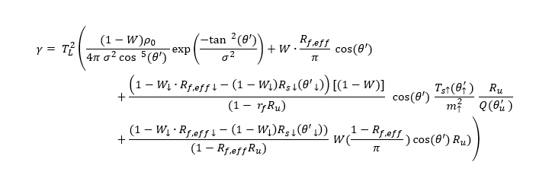
DETAILS: EXTINCTION AND ATTENUATED BACKSCATTER VS LARISSA AOD
“Simple” LARISSA
$$AOD=μ\frac{1}{2}\ln\left(\frac{μ kC_{L}ρ_{fr}}{4π<S2>γ}\right)$$
“Complex” LARISSA
${AOD}_{ }=$ $\frac{1}{2} ln(\frac{Rs+Rw+Ru}{γ}$)
The problem last time was the lack of complex subsurface formulation (simplified)
In fact -> Simple = nadir, complex = non-nadir

Slide 17
METHODOLOGY AND INSTRUMENT
AOD calculation from summarized ocean reflectance
Originally formulated: Josset et al., 2010
Advantages: Subsurface considered
Used: never in empirical studies
Specular
Whitecaps
Subsurface
Instrument and data
Instrument: ALADIN (Atmospheric Laser Doppler Instrument) onboard Aeolus
Wavelength: ~355 nm
Period: Intensive Observation Period (IOP: 14 – 23 September 2018)
Input data:
L2 data: Surface Integrated Attenuated Backscatter (from Mie Signal)
AUX_MET: Simulated near-surface wind speed
Validation data:
AEL PRO_L2: Extinction Coefficient, Rayleigh Backscattering

Slide 18
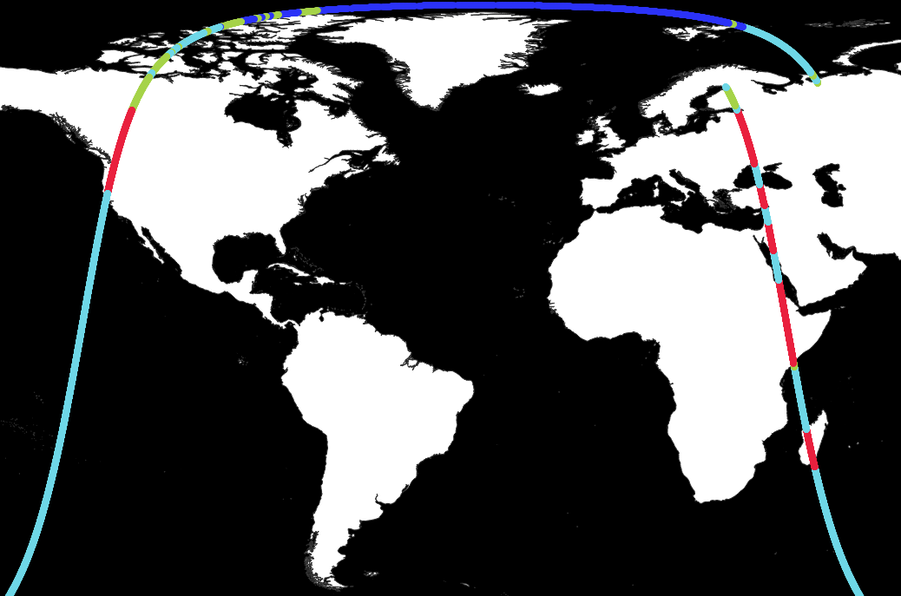
SEA FLAGGING STRATEGY IS SIMPLIFIED
We use these flags to distinguish sea surfaces from land
1 and 2 are sea surfaces, 0 and 3 are land

Slide 19
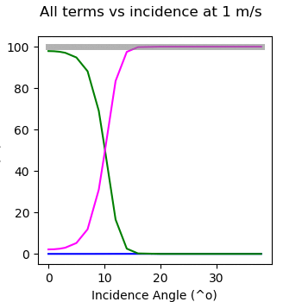
ALL TERMS VS INCIDENCE ANGLE AT WIND SPEED = 4 M/S
Total term
Specular
Subsurface (simplified)
Whitecaps (Rf,eff = 0.22)
Relative Contribution to Total Reflectance (%)
Whitecaps -> Negligible at 1-5 m/s, importance increases with angle as well
Subsurface term dominates at low winds (> 99%) for > 10º incidences
Specular term is basically in counterphase with subsurface

Slide 20
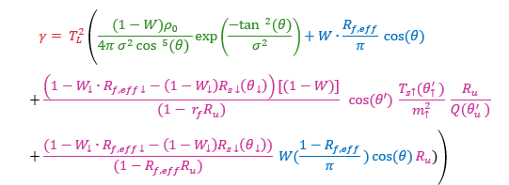
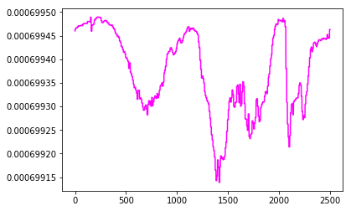
SUBSURFACE TERM TESTING: JOSSET-2010 PARAMETRIZATION
SUBSURFACE TERM
$$R_{u}= \frac{R_{0} \cos{(θ)}}{π}$$
0.002236
SUBSURFACE ANALYTICAL = 0.000377 (Ru = 0.01 assumed)
Subsurface Term (JOSSET)
SUBSURFACE JOSSET PARAMETRIZATION = 0.0006991 – 0.0006994
Reasonable agreement with analytical formulation
Josset formulation > Analytical formulation (as expected)
Seconds

Slide 21
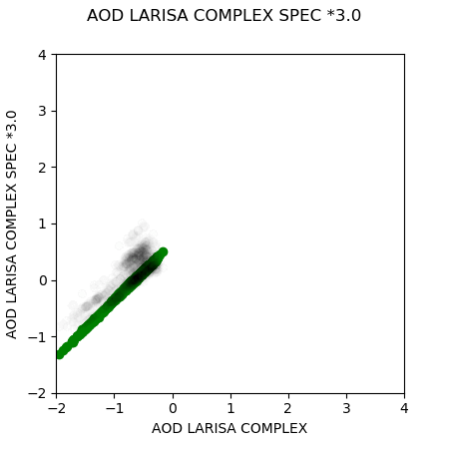
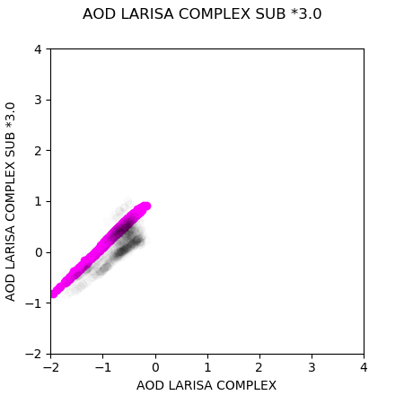
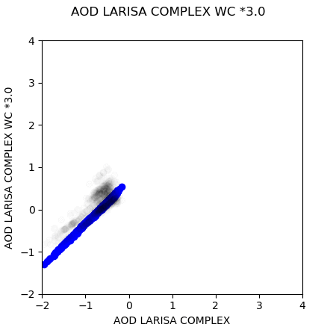
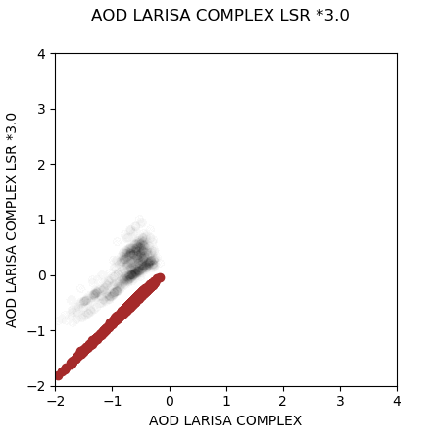
ALL AOD TERMS VS WIND SPEED RANGE (MEANS)
If specular term is too high, complex LARISSA becomes similar to simple LARISSA
Subsurface strongly affects AOD magnitude
AOD LARISSA SIMPLE
Angle = 37.5º, fixed
Every plot -> Modification of single term: sub, whitecap, spec.
If subsurface changed -> Offset of AOD
If specular changed -> Spread along y-axis (that is why non-nadir is not effective)
Similar effect to specular enhancement
Stronger LSR at fixed “summarized term” ->
dwindling AODD

Slide 22
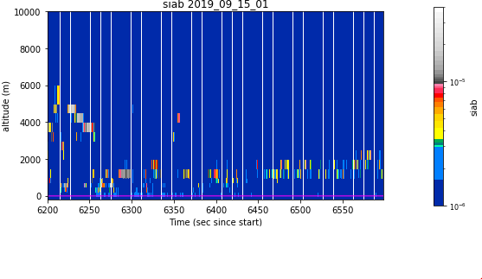
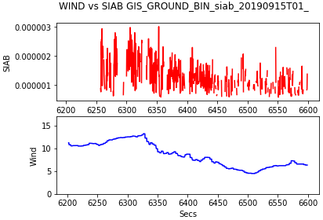
REMINDER: WHAT DO WE ANALYZE?
Integrated Attenuated Backscatter 2019_09_15_01
${AOD}_{ }=$ $\frac{1}{2} ln(\frac{4π(Rs+Rw+Ru)}{γ}$)
“Complex” LARISSA
Integrated Attenuated Backscatter
SIAB
Testing period: Selected Cases of IOP (September 2019)
Retrieval: Non-nadir (complex)
Lidar Surface Return: L2_AEL_PRO
Wind: AUX_MET Aeolus
Reference AOD: AOD from L2_AEL_PRO Extinction
Collocation: KDTree
What do we test: Complex AOD equation, sea slope formulations, flagging, horizontal averaging, subsurface dependence

Slide 23
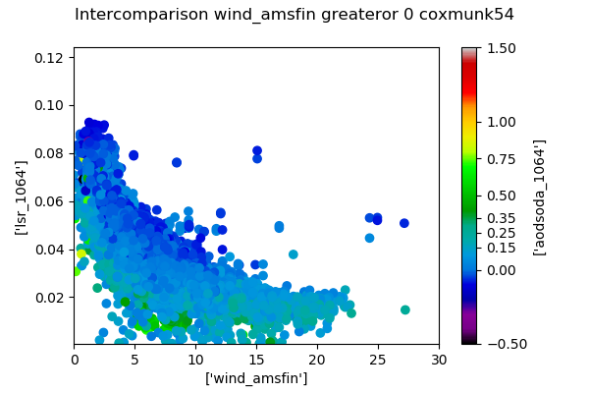
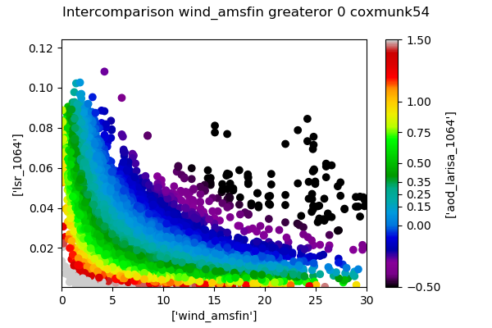
DO YOU REMEMBER THIS PLOT FROM CALIPSO?
SODA
LARISSA CALIPSO
Can we reach something similar? In this case, the sensitivity to wind will be evident

Slide 24
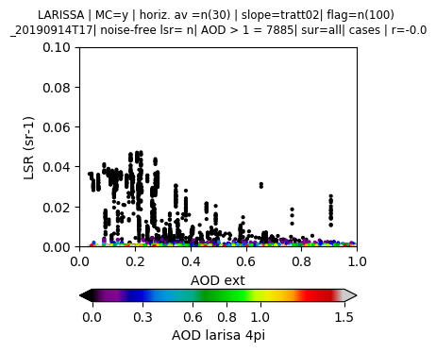
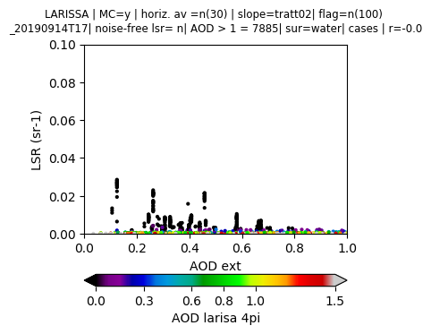
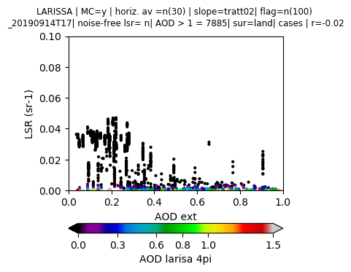
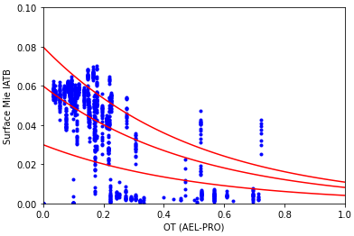
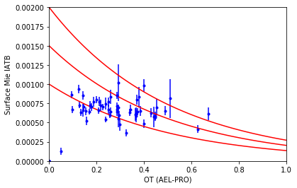
CHECKING DAVE’S DATA AND ORBIT
ALL SURFACES
WATER
LAND
ALL SURFACES / DAVE’S DATA
OVER OCEAN ‘HARDCODED’ BY DAVE’S PROGR.
There is no such large difference between my SIAB and Dave’s SIAB
However, my range is more narrow
This plot is done using my program, not Dave’s program

Slide 25
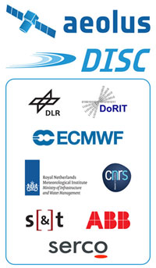
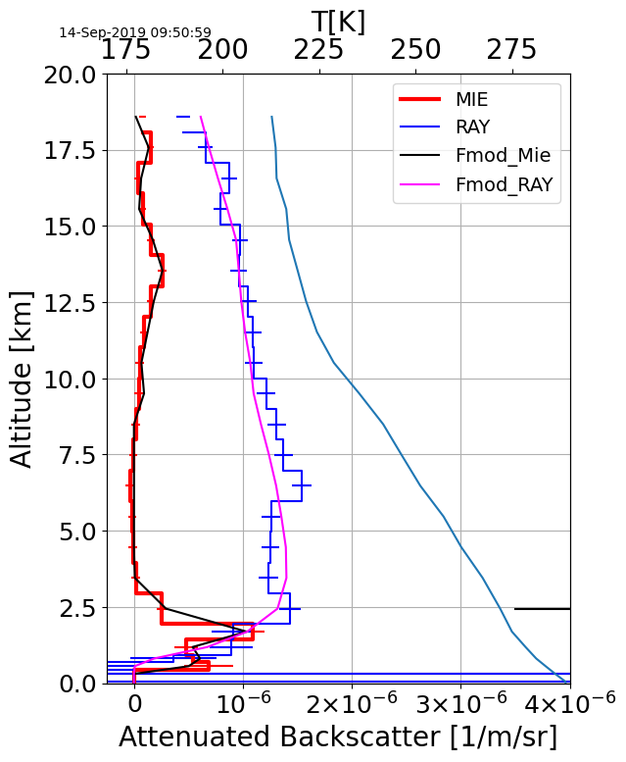
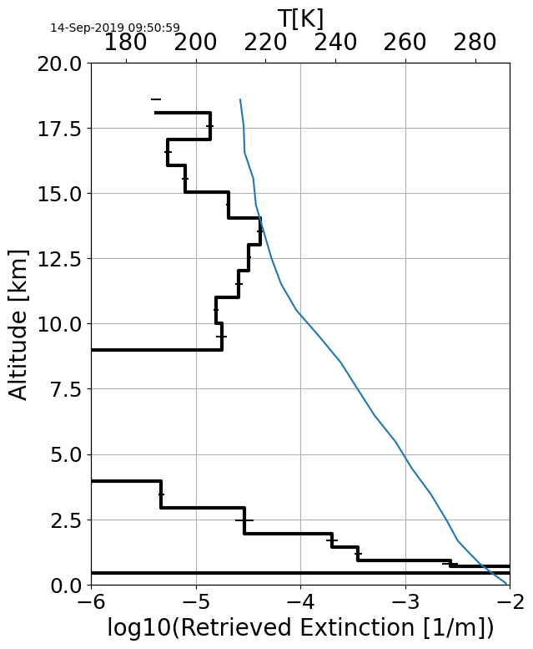
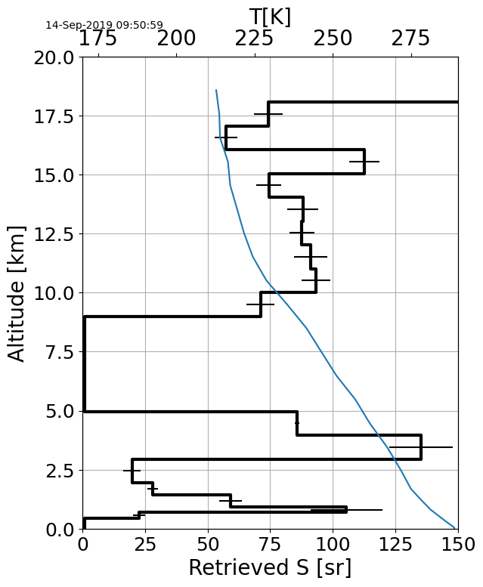
WHAT IS AEL_PRO?
AEL-PRO is an optimal-estimation/forward-modelling approach for retrieving Aeolus extinction and backscatter profiles. It is inspired by the A-PRO algorithm developed for the EarthCARE Lidar (ATLID).
Aeolus
EarthCARE
ATB Mie
ATB Ray
Retrieved Extinction

Slide 26
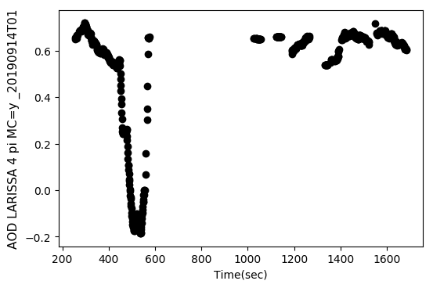
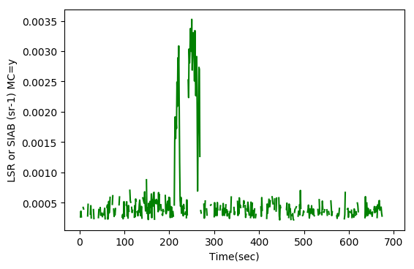
2019_09_17-T01 CASE (SAME BUT AVERAGED)
Google Imagery
Seafloor Depth, NOAA
~ - 1000 m
AOD
Erroneous AOD coming from shallow waters (similar to CALIPSO cases I tested over India)

Slide 27
WHAT IS SEEN AS SEA IS NOT ALWAYS SEA
AOD
What is flagged as ‘sea’ is not always sea
These cases are minor -> To be corrected at the later stage, otherwise confusing erroneous AOD (<0) emerges

Slide 28
COMPARISON OF WIND-DIRECTION-INDEPENDENT AND DEPENDENT SLOPES
COX AND MUNK
WU-1990
Wind
Wind
Slope
Slope
HU-2008
TRATT-2002 (WIND DIRECTION-DEPENDENT)
Piece-Wise functions are not advisable to use
Cox and Munk and Tratt are different
Tratt-02 incorporated to the program SWAILS
Wind
Wind
Slope
Slope

