Slide 1
Ozone Profile Analysis with Umkehr measurements and Satellite Validation for selected Brewer and Dobson spectrophotometers
Katerina Garane¹, MariLiza Koukouli¹, Konstantinos Fragkos^{1, 2}, Koji Miyagawa³,
Panagiotis Fountoukidis¹, Dimitris Balis¹, Irina Petropavlovskikh^{3,4} and Alkiviadis Bais¹
1 Laboratory of Atmospheric Physics, Aristotle University of Thessaloniki, Greece.
2 National Institute of Research and Development for Optoelectronics - INOE 2000, Romania
3 NOAA, Global Monitoring Laboratory USA
4 Cooperative Institute for Research in Environmental Sciences (CIRES), University of Colorado/NOAA Global Monitoring Laboratory, Boulder CO, US

Slide 2
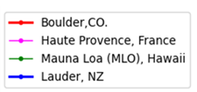
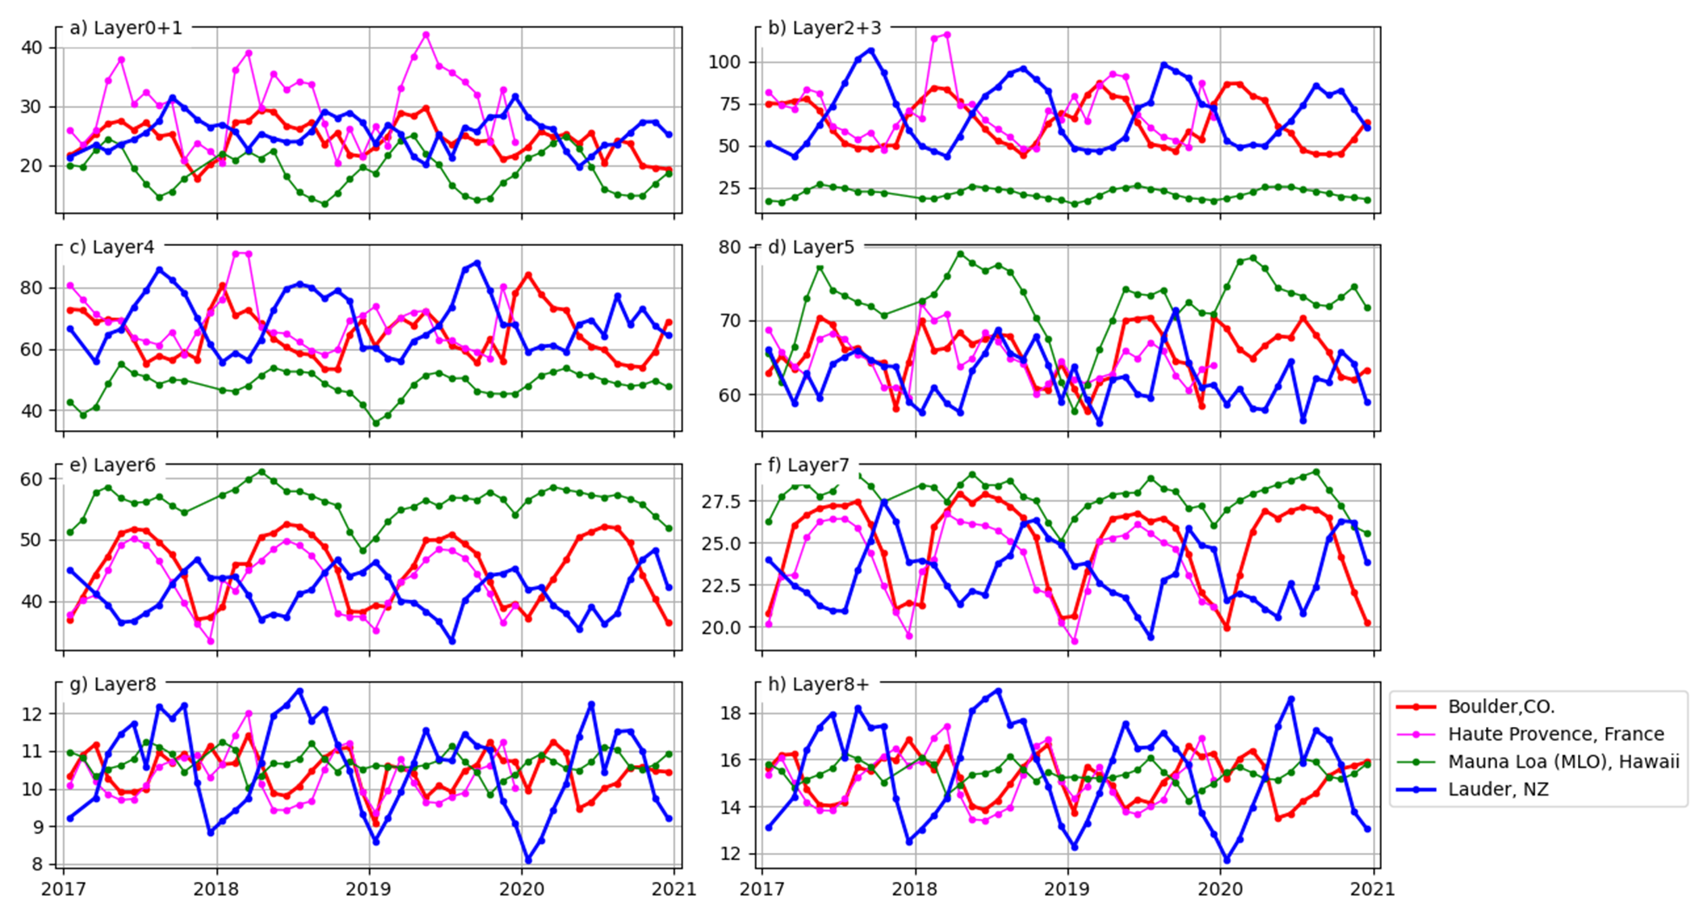
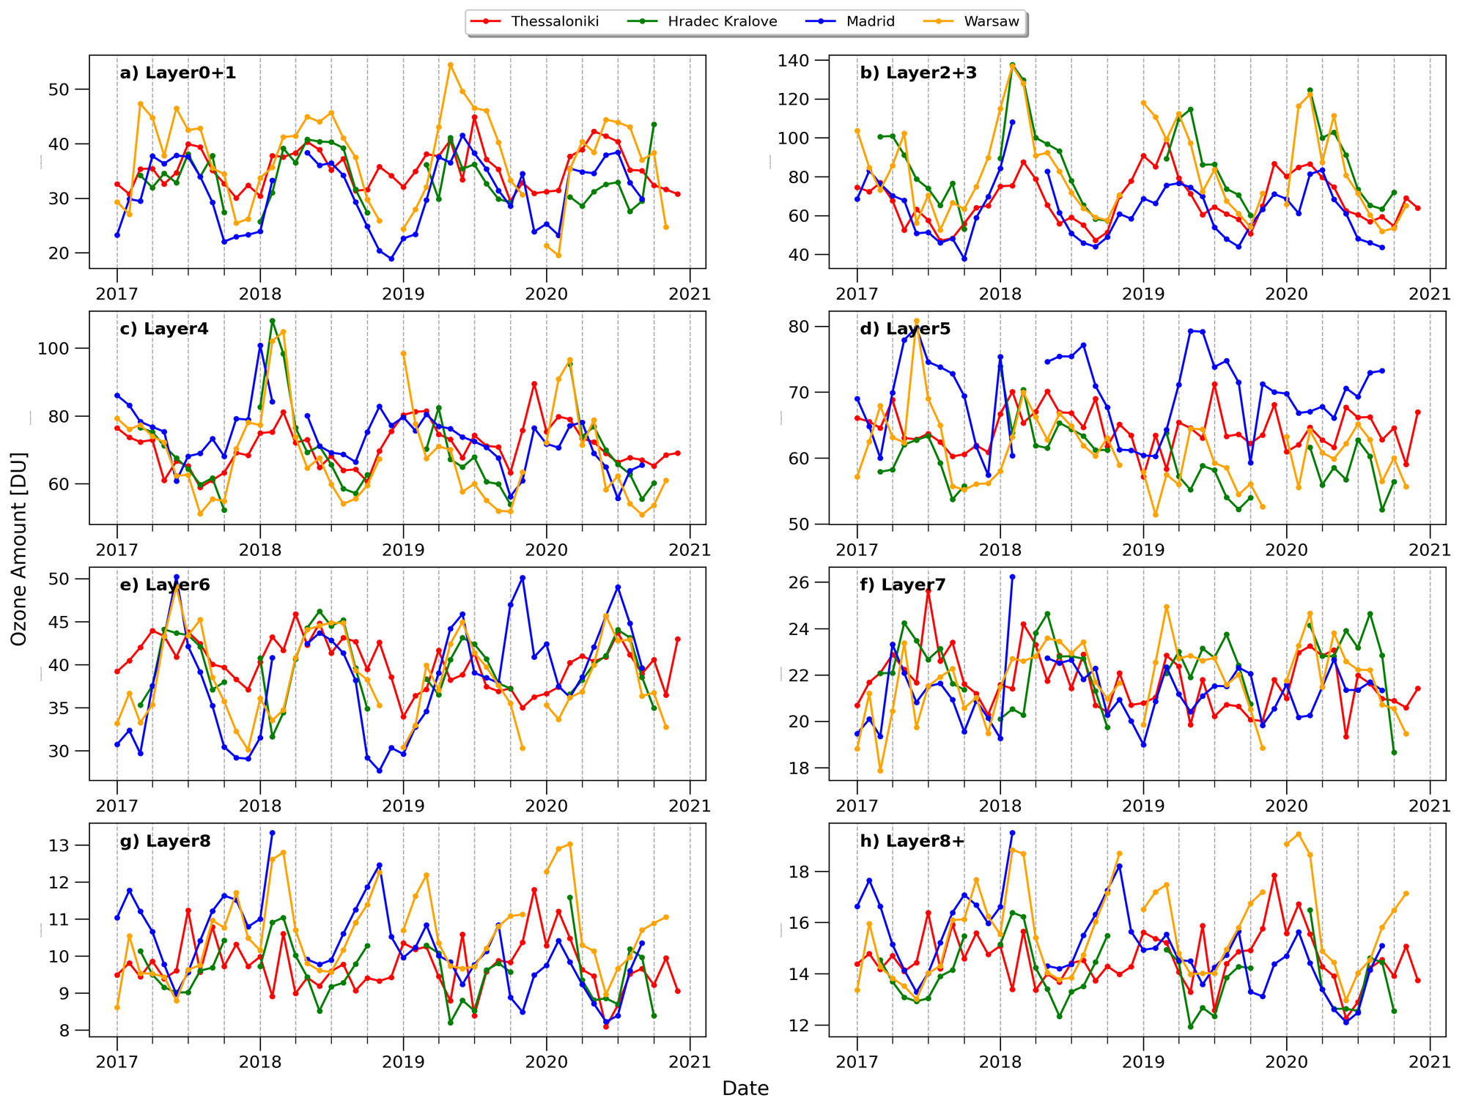
The Umkehr dataset
Umkehr technique: an inexpensive way to retrieve high quality and high vertical resolution ozone profiles that cover both troposphere, UTLS and the stratosphere, from Dobson or Brewer spectrophotometers
Brewer profiles have the same temporal variability, while the small changes in the magnitude is due to the different geographic location of each station and the different sampling rates.
Dobson profiles have different vertical and temporal distribution due to the different geographical location (e.g., Lauder in Southern Hemisphere shows an inverse annual cycle).
An optimization technique has been developed for the analysis of Dobson Umkehr measurements (Petropavlovskikh et al. 2021), expected to be applied on Brewer measurements in the future.
Four Dobson and four Brewer stations have been analyzed for the period 2017 – 2020
Brewer stations: Madrid, Spain; Hradec Kralove, Czech Republic; Warsow, Poland and Thessaloniki, Greece
Dobson stations: Boulder, USA; MLO, USA; Lauder, New Zealand; OHP, France and Arosa, Switzerland

Slide 3
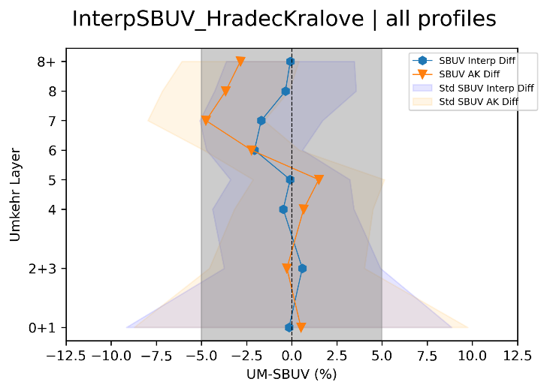
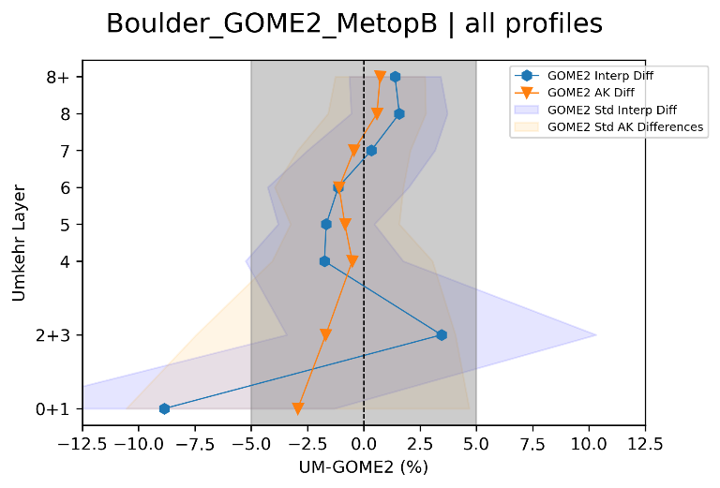
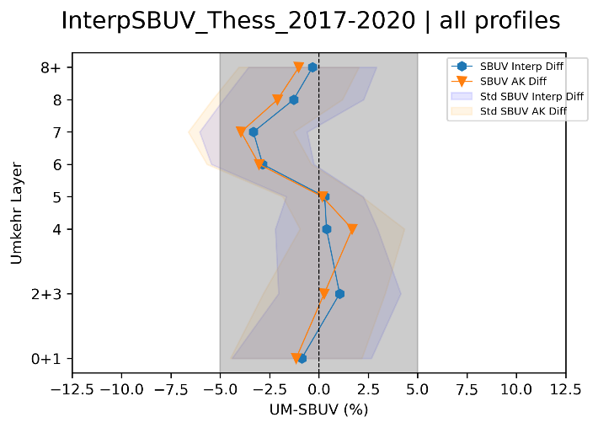
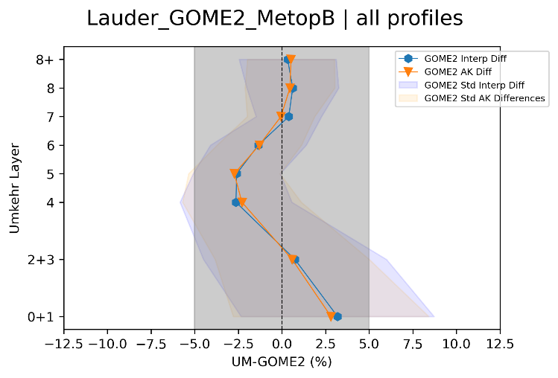
Ozone Profiles Satellite Validation
Brewer vs SBUV
Dobson vs GOME2
Agreement between the Umkehr profile measurements and the satellite ozone profile products is always within ± 5%, for all layers of observation. In the lower stratosphere, some biases remain, possibly due to wide AKs of the Umkehr retrieval.
Best agreement (~±1%) occurs for layers 2+3, 4 and 5, i.e., for the tropopause and the lower half of the stratosphere, where the bulk of the ozone amount is located
Higher discrepancies appear at layers 6 and 7 for the Brewer stations. The original Dobson Umkehr profiles (before the optimization) compared to satellite records had also larger biases in the upper layers, which are eliminated in the optimized Dobson versions
No particular discontinuities were seen in the time series of the comparisons for any of the layers. On the contrary, they were all very stable temporally, with no abrupt changes present for the time span of 2017 to 2020
The optimized, quality controlled and fully characterized Umkehr dataset is anticipated to be an added value for the validation of the expected TROPOMI/S5P ozone profile product.
Satellite ozone profile measurements
SBUV Version 8.7 MOD v2 Release 1: the same core algorithm as Version 8.6 (Firth et al., 2020), but includes new inter-instrument calibration adjustments for instrument records since 2000 (NOAA-16 SBUV/2 though OMPS NP)
GOME2 on board MetopA, -B and –C: retrieved by the Ozone ProfilE Retrieval Algorithm (OPERA), within the EUMETSAT Atmospheric Composition Monitoring Project, ACSAF (Tuinder et al., 2019).

