Slide 1
Harmonized Quality Assessment of Nadir Ozone Profile Data from UV-visible and TIR Satellites within the Climate Change Initiative on Ozone
Arno Keppens (arno.keppens@aeronomie.be), Jean-Christopher Lambert, José Granville, Daan Hubert, Tijl Verhoelst,
Steven Compernolle, Michel Van Roozendael (BIRA-IASB, Belgium), Richard Siddans, Barry Latter, Brian Kerridge (RAL, UK), Cathy Clerbaux, Catherine Wespes, Pierre-François Coheur (ULB, Belgium), Christian Retscher (ESA/ESRIN, Italy)
L2 product | Processing entity | Time period
 |  | 96 | 97 | 98 | 99 | 00 | 01 | 02 | 03 | 04 | 05 | 06 | 07 | 08 | 09 | 10 | 11 | 12 | 13 | 14 | 15 | 16 | 17 | 18 | 19 | 20 | 21
NP_GOME | RAL v3.01
NP_SCIAMACHY | RAL v3.00
NP_GOME2A | RAL v3.02 |  |  |  |  |  |  |  |  |  |  |  |  |  |  |  |  |  |  |  |  |  |  |  |  |  | X
NP_GOME2B | RAL v3.03 |  |  |  |  |  |  |  |  |  |  |  |  |  |  |  |  |  |  |  |  |  |  |  |  |  | X
NP_GOME2C | RAL |  |  |  |  |  |  |  |  |  |  |  |  |  |  |  |  |  |  |  |  |  |  |  | X | X | X
NP_OMI | RAL v2.14 |  |  |  |  |  |  |  |  |  |  |  |  |  |  |  |  |  |  |  |  |  |  |  |  | X | X
NP_TROPOMI | RAL |  |  |  |  |  |  |  |  |  |  |  |  |  |  |  |  |  |  |  |  |  |  | X | X | X | X
NP_GOME2-IASI | RAL |  |  |  |  |  |  |  |  |  |  |  |  |  |  |  |  |  |  |  |  |  |  |  | X | X | X
NP_IASIA | ULB/LATMOS FORLI v20191122
NP_IASIB | ULB/LATMOS FORLI v20191122
NP_IASIC | ULB/LATMOS FORLI v20191122
NP_GOP-ECV (L3) | DLR | X | X | X | X | X | X | X | X | X | X | X | X | X | X | X | X | X | X | X | X | X | X | X | X | X | X
Legend: III available from CCI / III updated within CCI+ / X expected within CCI+
Reference: Ozone_cci+ Product Validation and Intercomparison Report (PVIR) v3.0, 2021
https://climate.esa.int/en/projects/ozone/key-documents/

Slide 2
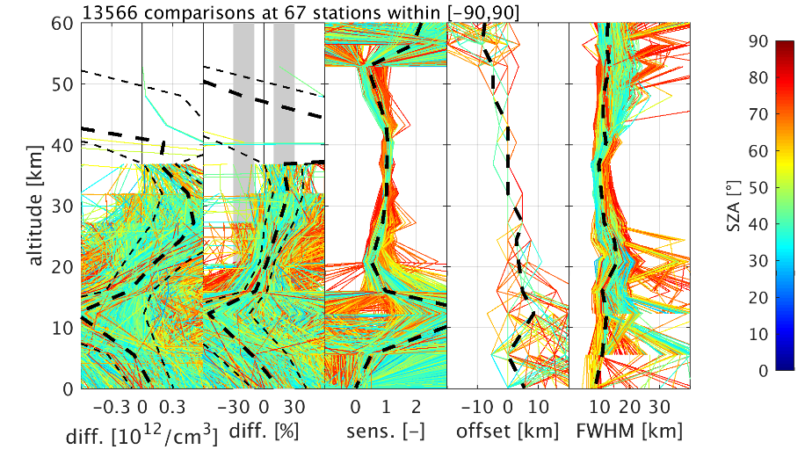
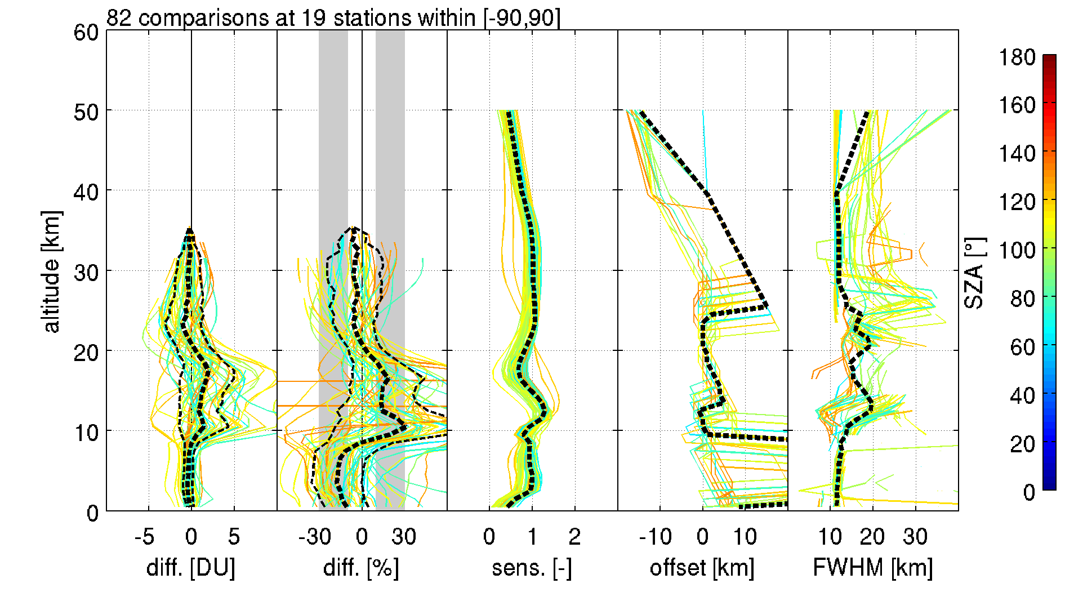
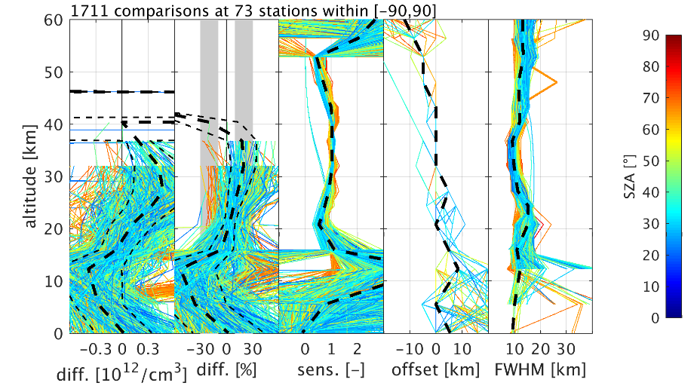
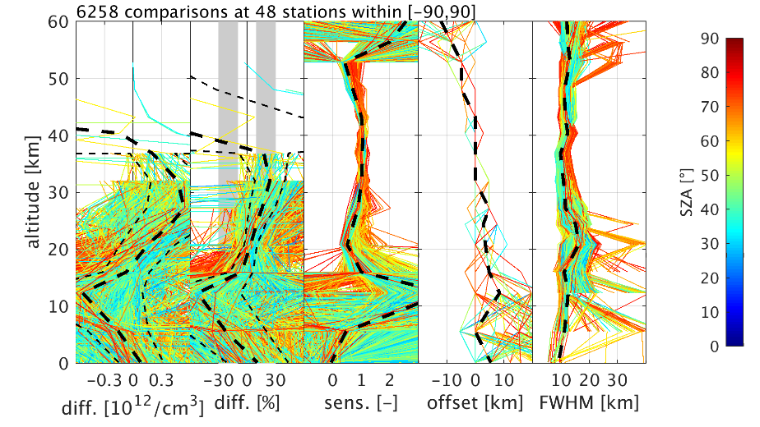
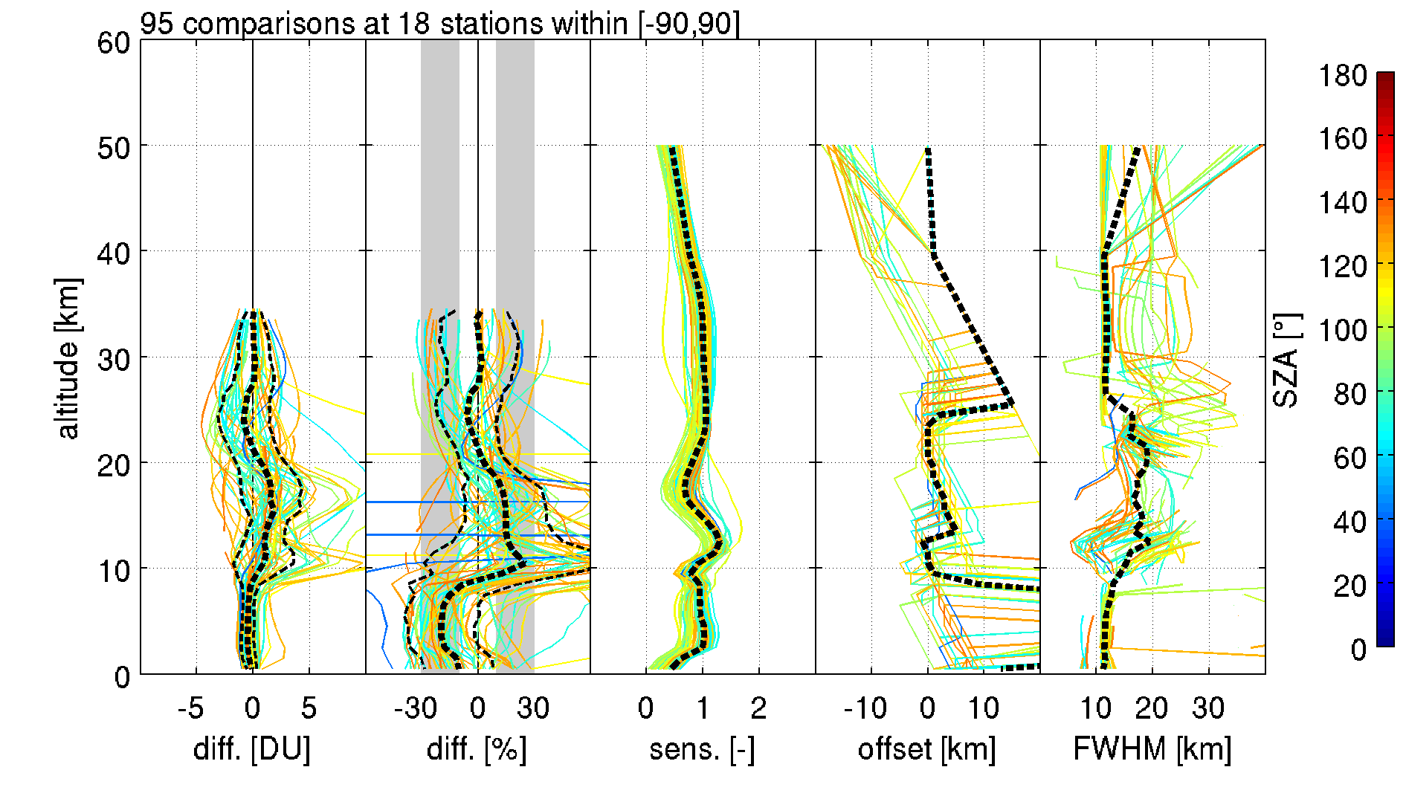
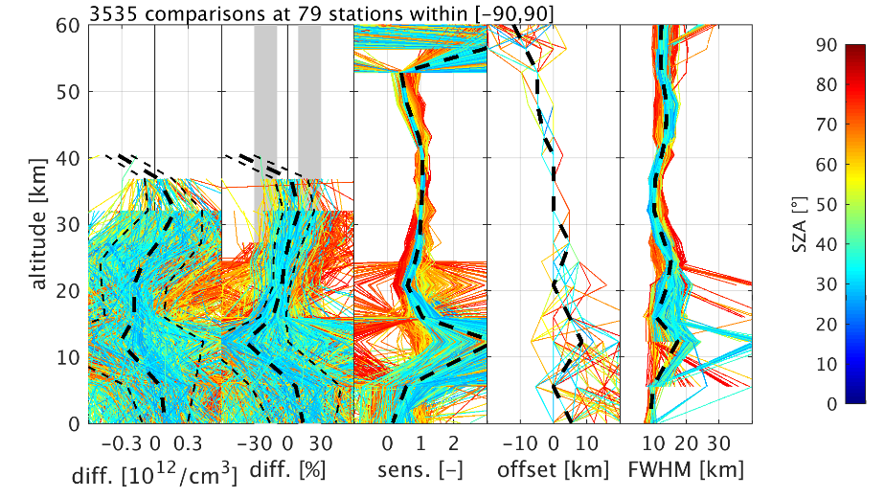
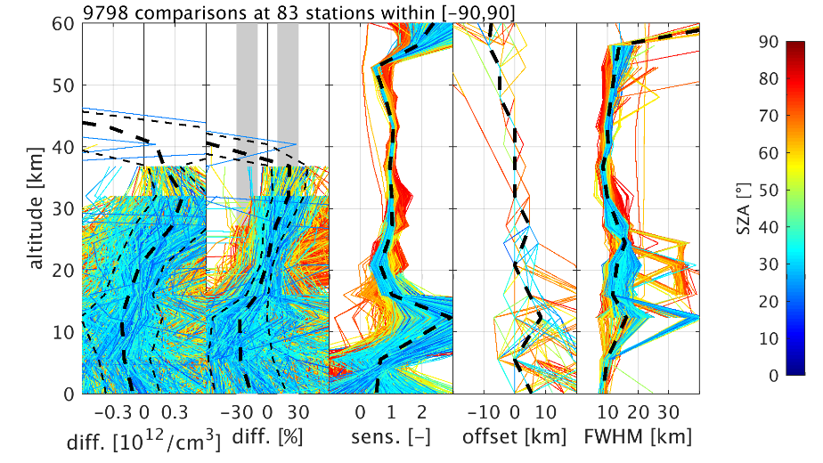
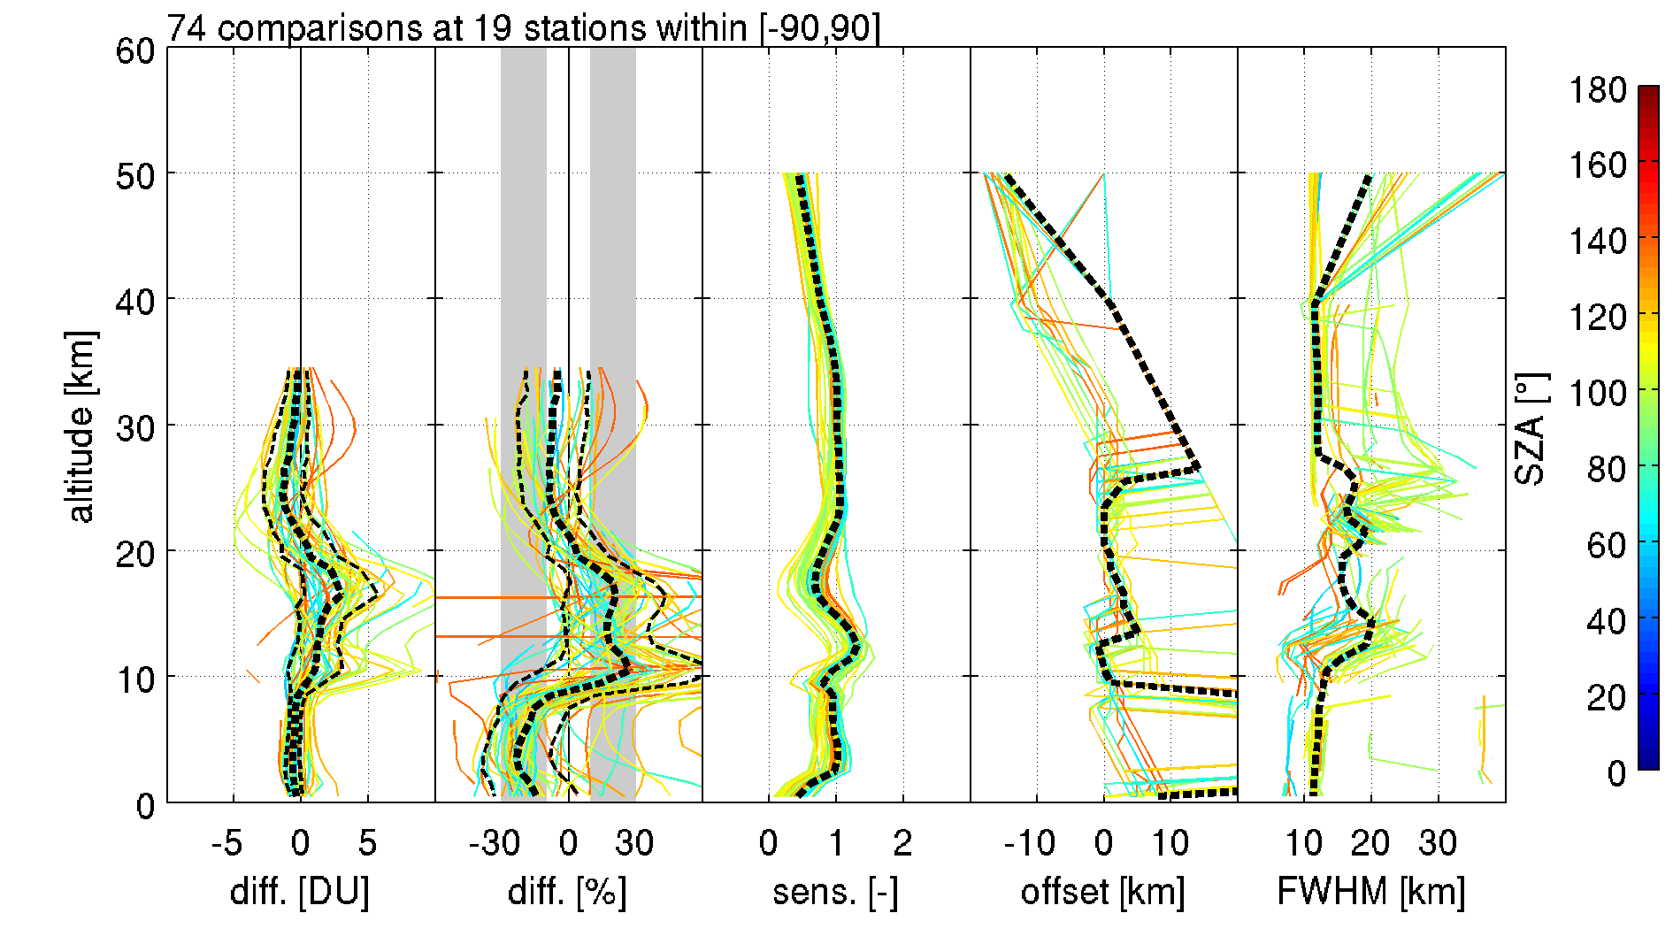
Harmonized Quality Assessment of Nadir Ozone Profile Data from UV-visible and TIR Satellites within the Climate Change Initiative on Ozone
Arno Keppens (arno.keppens@aeronomie.be), Jean-Christopher Lambert, José Granville, Daan Hubert, Tijl Verhoelst,
Steven Compernolle, Michel Van Roozendael (BIRA-IASB, Belgium), Richard Siddans, Barry Latter, Brian Kerridge (RAL, UK), Cathy Clerbaux, Catherine Wespes, Pierre-François Coheur (ULB, Belgium), Christian Retscher (ESA/ESRIN, Italy)
GOME-2A
IASI-A
GOME
GOME-2B
IASI-B
SCIAMACHY
OMI
IASI-C

