Slide 1
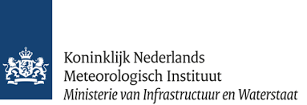
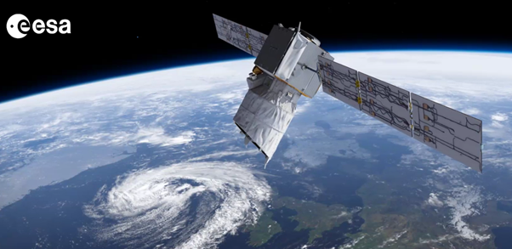
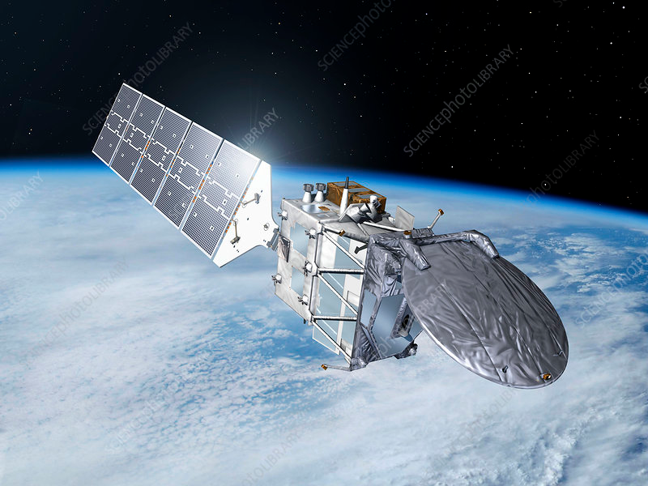
ATLID cloud/aerosol retrieval approaches applied to ALADIN
D.P. Donovan, G-J van Zadelhoff, P. Wang (KNMI, De Bilt, Netherlands)
D. Huber (DoRIT, Fürstenfeldbruck, Germany)

Slide 2
Outline
Outline
Brief Overview of ALADIN and ATLID
The retrieval of Aerosol/Cloud extinction from Space. What are the issues and challenges ?
Overview of EarthCARE (ATLID) approaches.
How these concepts are being applied to Aeolus observations.
Examples
Summary and Outlook.

Slide 3
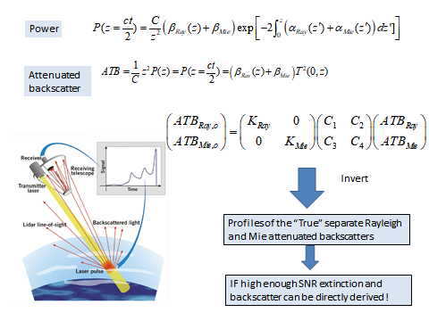
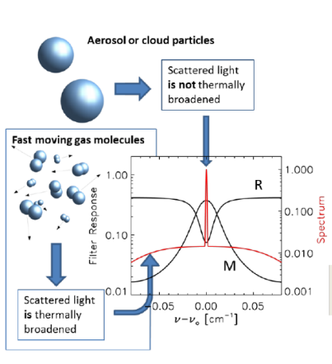
ALADIN and ATLID are HSRL Lidars
ALADIN has two spectrometers and 3 channels
A Dual FP (RSP)
A Fizeau (MSP)
ATLID has one spectrometer and 3 channels
A single FP separating the Mie and Ray co-polar returns and a total cross-polar channel.

Slide 4
ALADIN and ATLID
Optimized for winds
Large power-aperture product
But..
Low resolution
Low optical efficiency
Unfavorable set of cross-talk coefficients (which acts to lower effective SNR of retrieved pure Mie and Ray attenuated backscatters)
Optimized for aerosols and clouds
100m(vert.) resolution
385 m (Hor.) resolution
High optical efficiency
Better cross-talk characteristics
ALADIN
ATLID
ATLID should be (much) better for aerosol/cloud work…but Aeolus is actually flying !

Slide 5
Issues
-
Space-borne lidar signals are noisy !.
The standard Aeolus L2a aerosol product (the SCA) is (fundamentally) a variation of the usual direct (log derivative) approach for deriving extinction. As such, it requires high SNR signals !
Along-track averaging to increase the SNR is one solution. However, one can not mix “strong” (e.g. cloud) and “weak”(e.g. aerosols) returns and hope to get anything quantitatively useful ! The Aeolus standard approach does not screen before averaging.
A strategy (based on ideas taken from ATLID developments) is to:
Separate the `strong’ and `weak’ features at as high a horizontal resolution as possible.
Separately process and merge the strong and weak fields at different resolutions.
This requires:
1) A high resolution mask
2) A quantitative retrieval approach than can be applied at difference scales which is robust to noise.

Slide 6
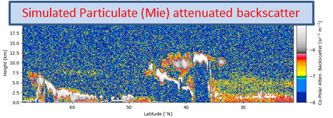
AEL-FM and AEL-PRO
AEL-FM and AEL-PRO are Aeolus algorithms based on EarthCARE developments (A-FM and A-PRO)
AEL-FM provides a feature-mask at the highest available resolution.
AEL-PRO is a Multi-scale Optimal-Estimation procedure for retrieving cloud/aerosol extinction and lidar-ratio(S).
The multi-scale approach is necessary in order to handle the SNR constraints and the physical size scale difference between clouds and aerosols.
Simulated Molecular (Rayleigh) attenuated backscatter
Retrieved Cloud and Aerosol Extinction
A-PRO and A-FM have been developed and tested using extensive realistic simulations (example Right)…but they are only simulations. Aeolus has provided the opportunity to apply these algorithms to real data and benefit both missions !
Retrieved Lidar-Ratio

Slide 7
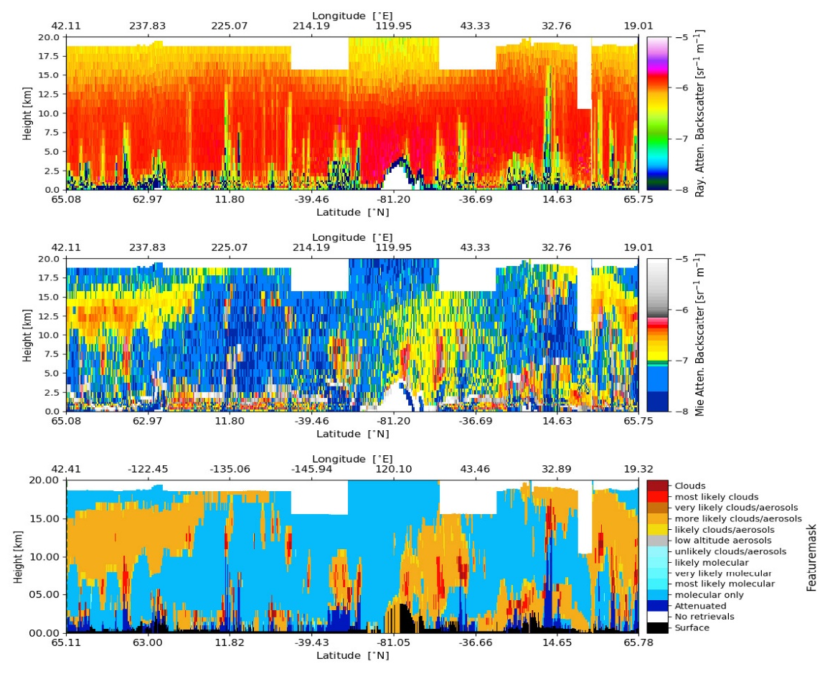
Featuremask (AEL-FM)
Provides a mask on the highest resolution available.
Uses image processing ideas to identify features in the signals.
Edge preserving filter (Hybrid median) to detect strong features.
Iterative smoothing together with signal probability histogram analysis in order to detect weak signal areas.
Dynamic determination of noise thresholds.
Achieved by examining the signal+noise probability histograms
ATB Ray
ATB Mie
AEL-FM mask
Orbit 6180 (16 Sept 2019)

Slide 8
AEL-PRO (simplified structure)
AEL-FM
L1b/L2a
Cost-function to minimize
Initialize state vector and set priors etc..x,Xa
Forward Model ATBs (Y)
Compare with Observations
(Chi^2)
Adjust State-vector (x)
Two passes at different resolutions are performed:
-Low-res pass (aerosols + thin clouds)
-High-Res pass (clouds). Uses pass-1 results as input.
Convergence ?
Done

Slide 9
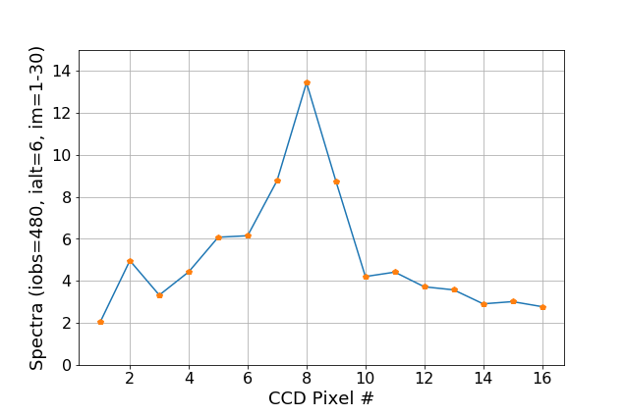
An unexpected spin-off development: ATB inputs from L1b spectrometer data
L1 Mie ATB
The L1-b spectra is divided into Mie and Ray sections. X-talk between the sections is accounted for using a model of the Fizeau spectrometer.
The spectrometer response is corrected for beam-shape and obscuration effects using clear-air returns
L2-A Mie ATB
A large improvement in SNR in the L1-B Mie ATB is apparent even though the photons in the Rayleigh spectrometer are not used at all !
Why ?
The final SNR depends not only on the SNR but also on the magnitude of the X-talk between the channels.
As it happens, the L1a set of cross-talk coefficients is much more favorable than those associated with the conventional (L2a) approach !
Note: For the Rayleigh backscatter a slight reduction in the SNR is realized. Work should continue on improving on the procedure by (re-)incorporating the Rayleigh spectrometer data.
Ray
Ray
Mie

Slide 10
A first IOP period of data has been processed and is being used for evaluation/testing and comparison with other Aeolus aerosol/cloud products. First results indicated the need to take beam-shape/obscuration effects on the Mie Spectrometer ACCD into account Some assorted examples follow……

Slide 11
Sample results
September 2019 (IOP period): Lots of smoke in the lower stratosphere.
+ ➔ Tropopause
Black contour lines ➔ Temperature
Mie ATB
Ray ATB
AEL-PRO Extinction
AEL-PRO Lidar-Ratio
SCA-mid-bin Extinction
SCA-mid-bin S

Slide 12
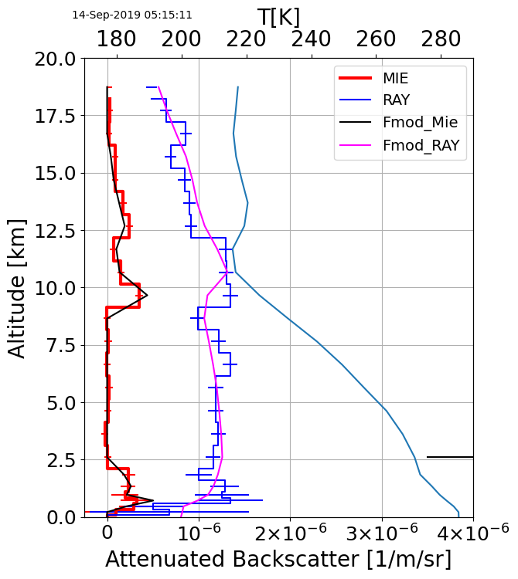
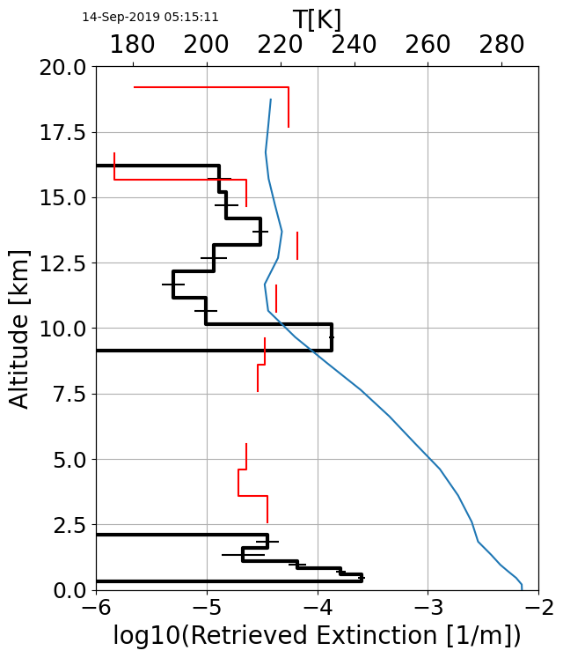
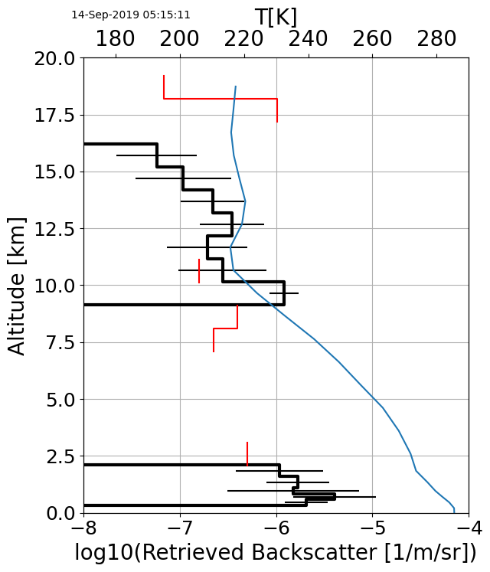
AEL-PRO results tend to be much more precise (less noisy) than the standard L2a
Red: SCA-Mid bin results
Black: AEL-PRO
Obs#=48

Slide 13
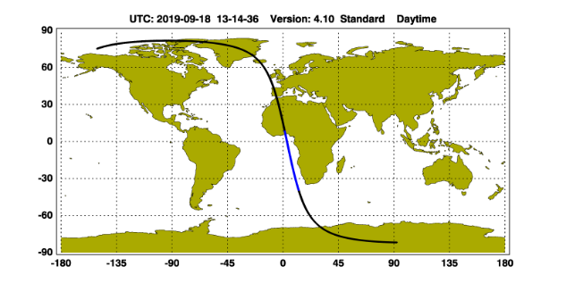
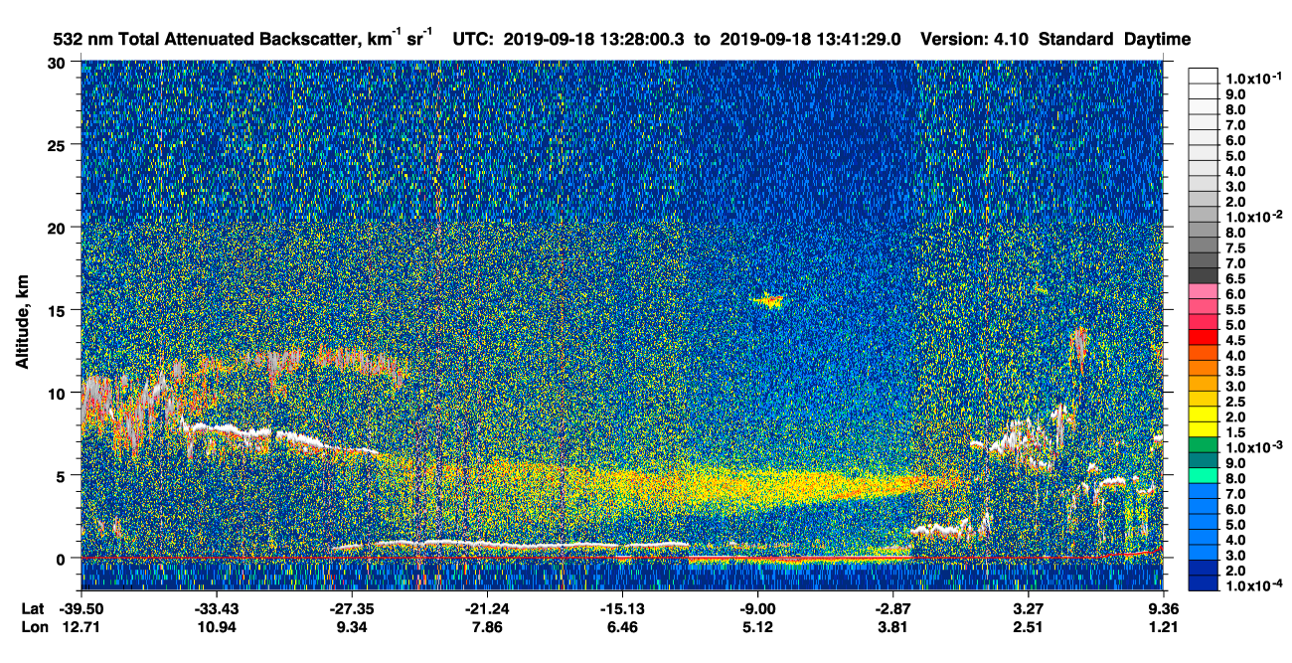
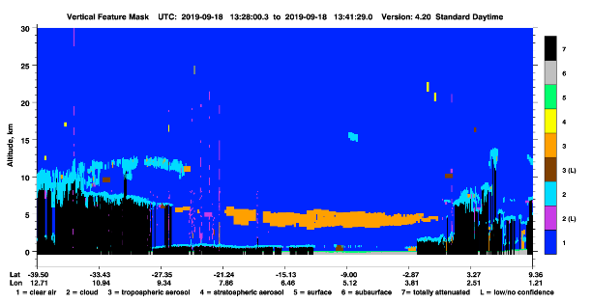
Aerosol event over Netherlands as seen by CALIPSO and Aeolus (2019-09-18)

Slide 14
2021/09/03
Overpass Cape Verde, the
ground-based validation site.

Slide 15
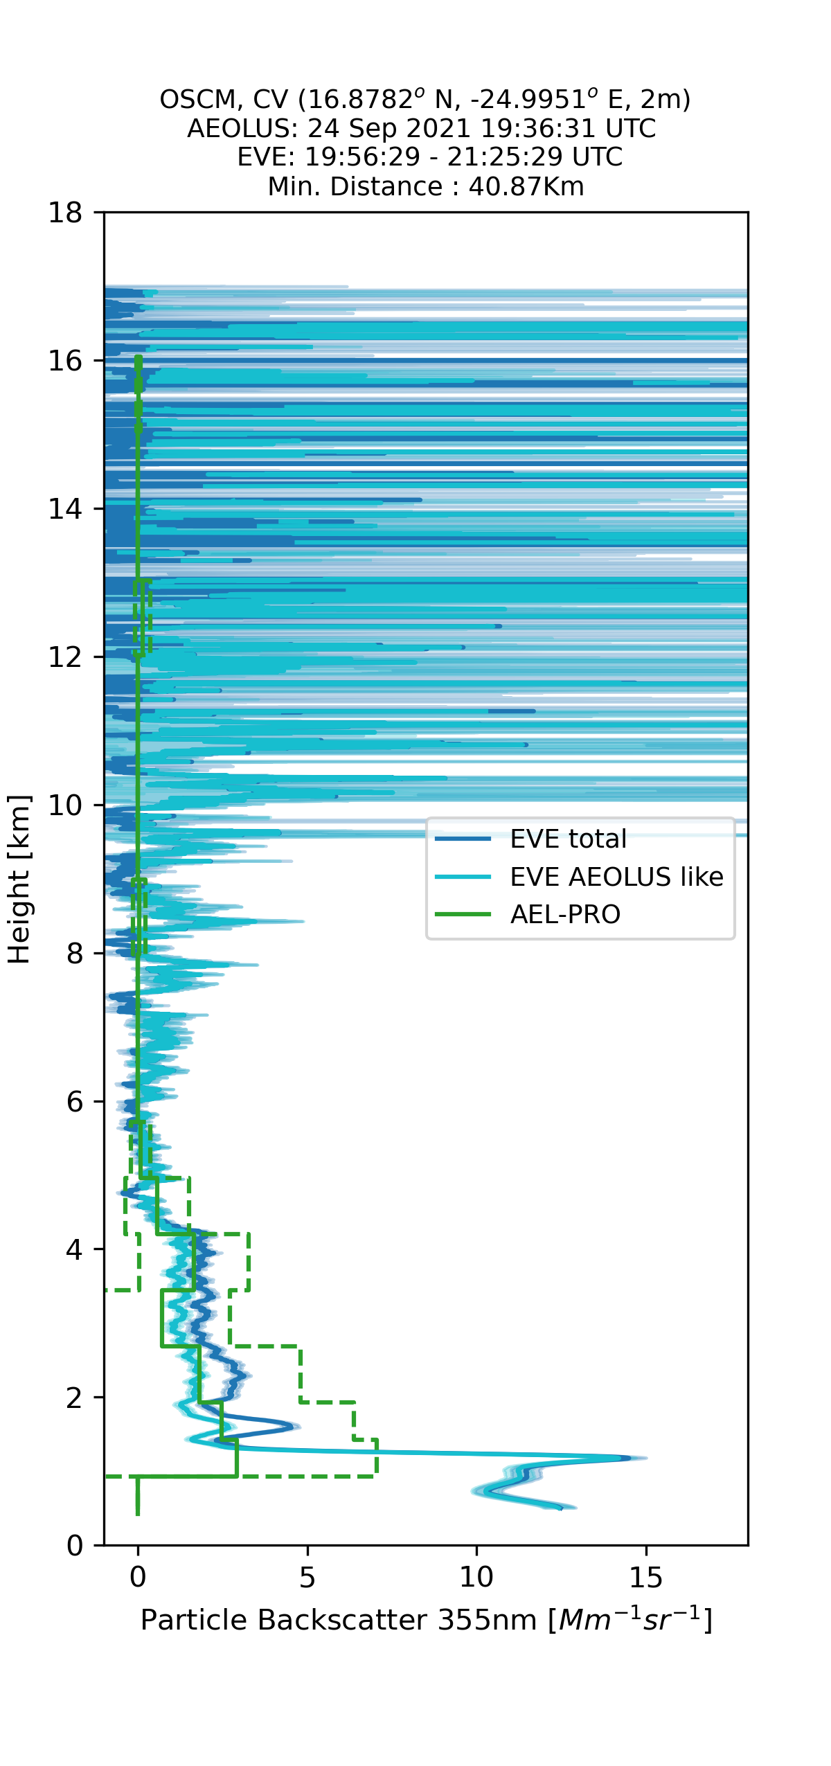
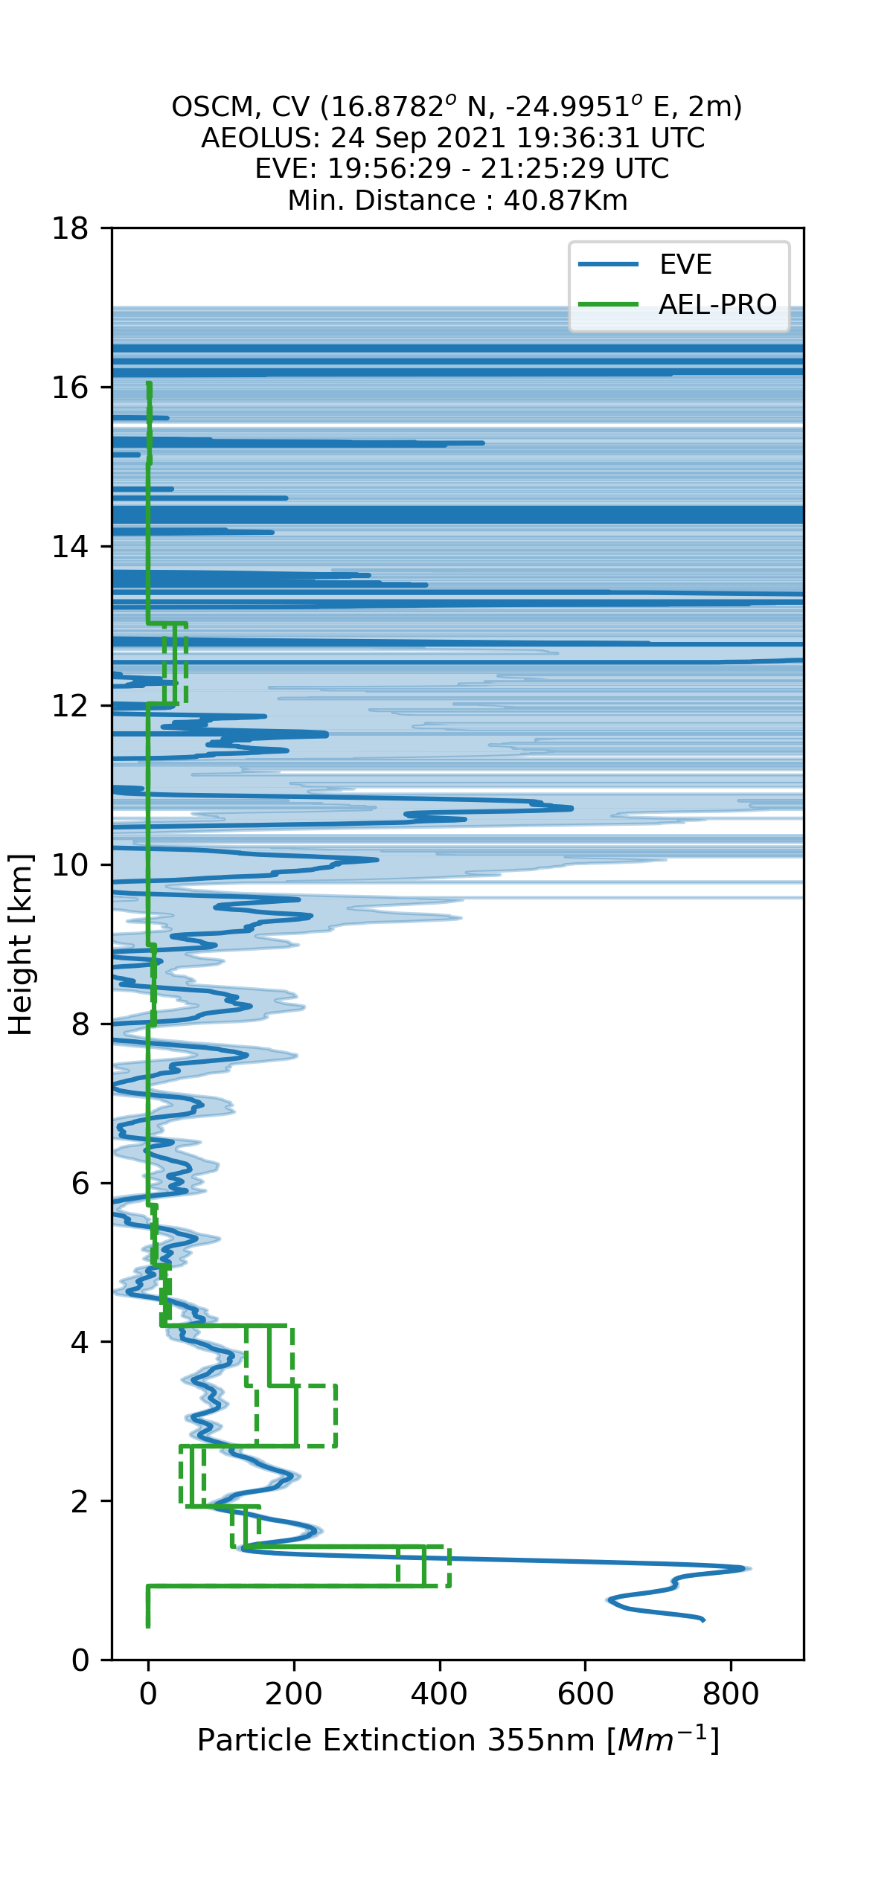
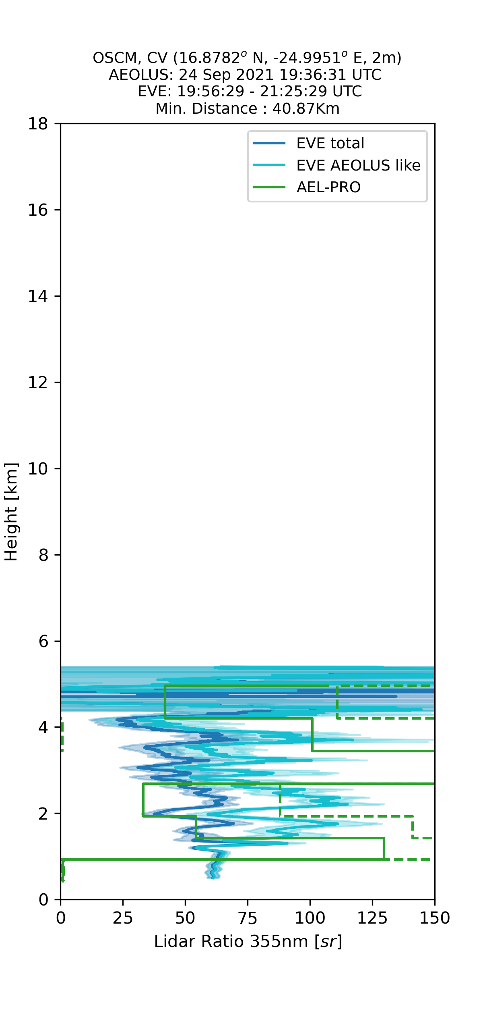
Example comparisons with the EVE 355nm lidar.
Thanks to the EvE lidar team !
Colocation issues, frequent presence of clouds and increasingly lower Aeolus SNR present challenges. However, results are encouraging !
Lowest bin 0 ➔ Bug ?

Slide 16
Summary and Outlook
The application of ATLID inspired techniques to Aeolus is very promising !
Lots of work still to do though.
Impact of priors, classification strategy, surface effects, code speed, validation etc..
Using MSP only gives better results for Mie ATBs (somewhat degraded for Ray ATBs). Further improvements (bringing the RSP data back into play) are likely.
AEL-FM and AEL-PRO are being implemented into the operational processing chain.
Testing, Validation, De-Bugging is ongoing !

Slide 17
Extra Slides

Slide 18
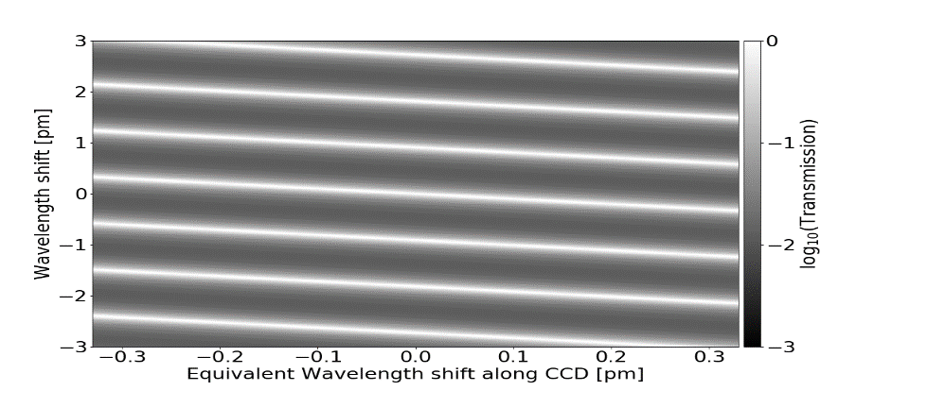
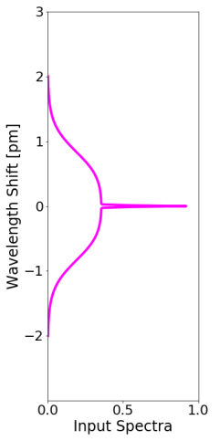
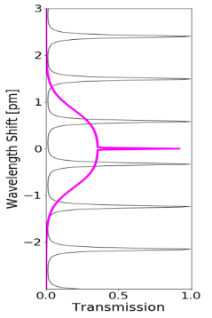
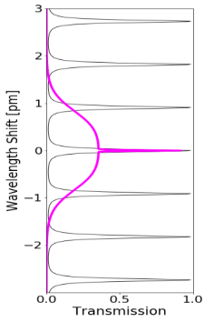
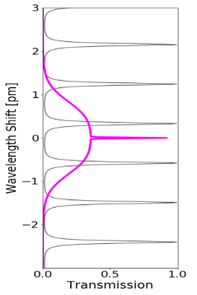
The Fizeau (Mie) Spectrometer
Input Spectrum
The Fizeau Response function is 2D and depends on both the Wavelength and the Wedge-Position
Fizeau Wedge
The pass-band is periodic (FSR=0.91 pm) and shifts with position along the wedge (eqiv. CCD position).
FSR=
Plate separation
1 2 3 4 5 6 7 8 9 10 11 12 13 14 15 16
ACCD Column
Output Spectrum

Slide 19
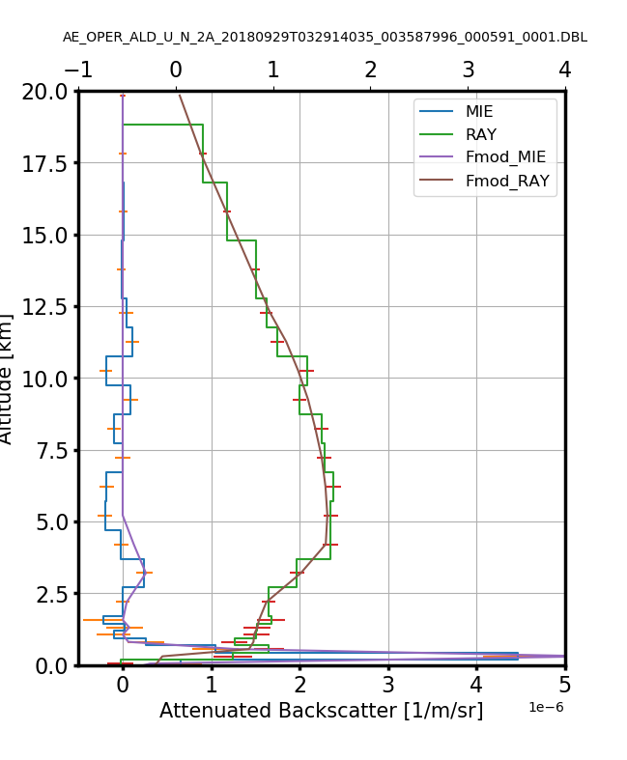
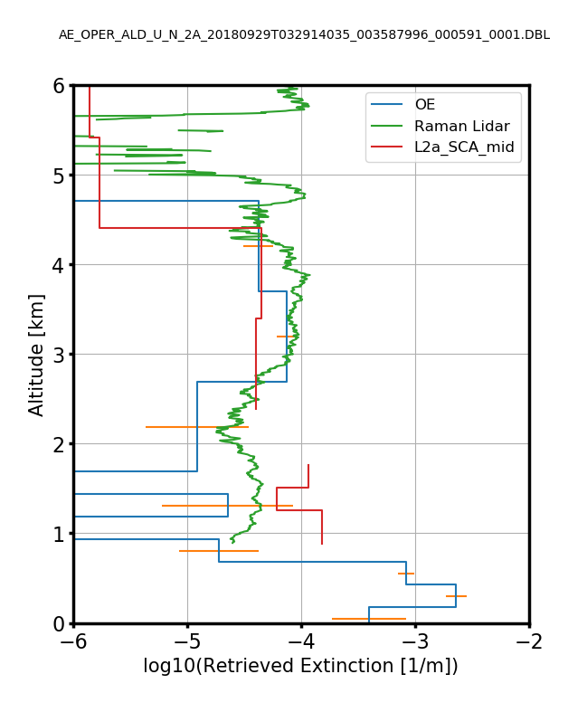
29-09-2018 Haifa
Early Comparison with Ground-based Raman-Lidar observations
Raman lidar results from H. Baars (Tropos)

Slide 20
Mie ATB
Mie ATB
Ray ATB

Slide 21
Extinction
Extinction/Backscatter ratio (S)

