Slide 1
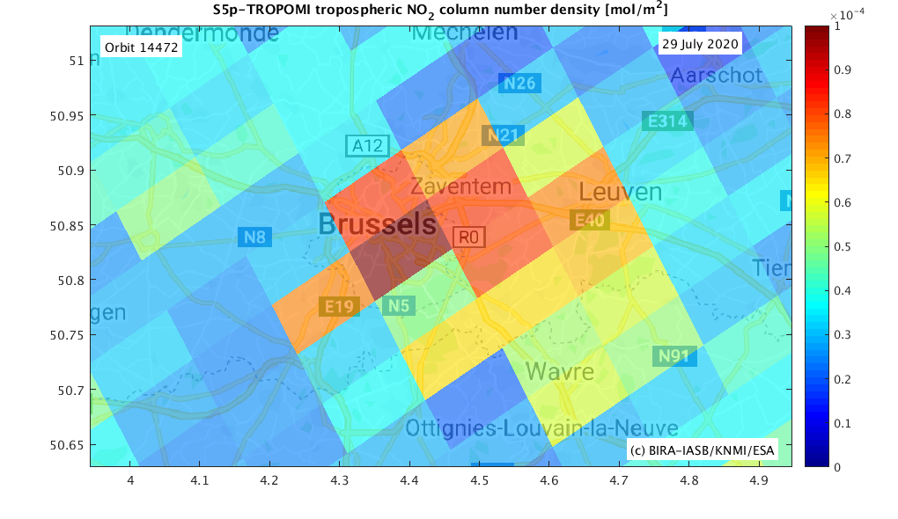
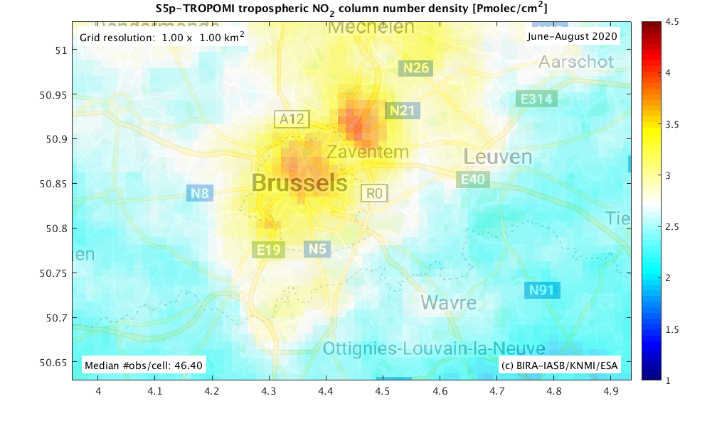
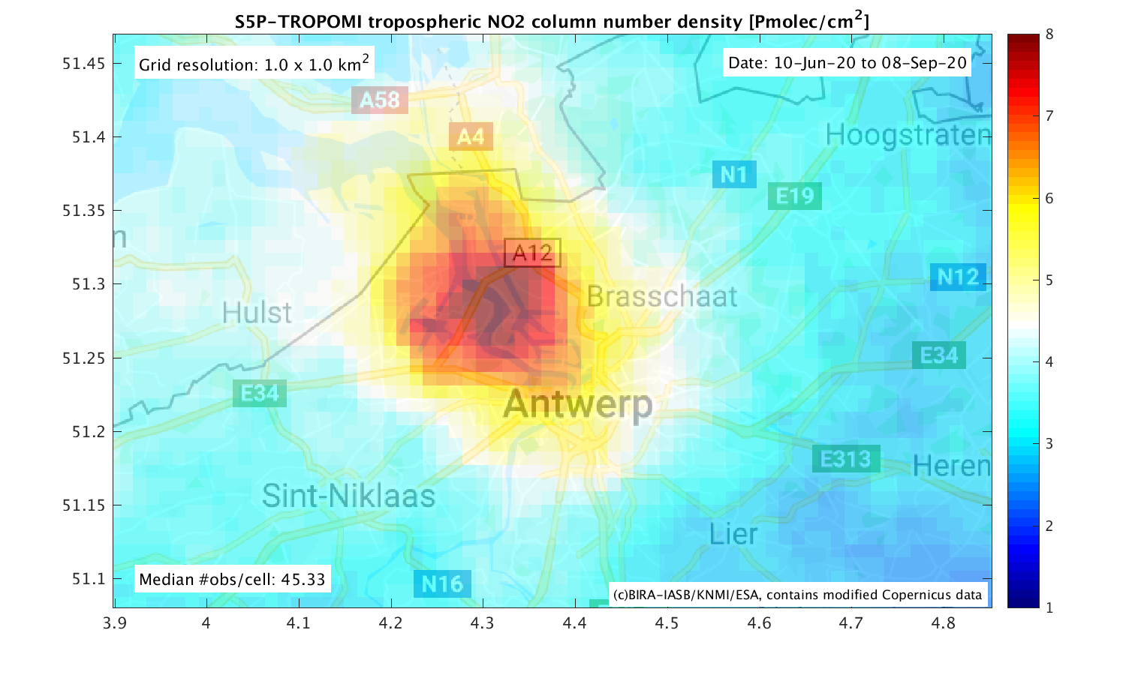
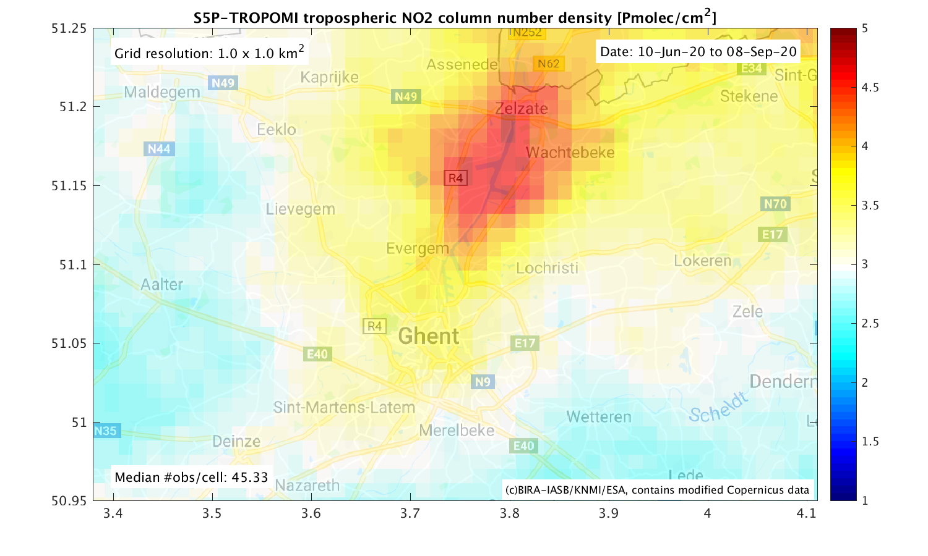
Tailoring Atmospheric Data from the Sentinel-4/5(p) Constellation in Support of Belgian Air Quality Policies
Tijl Verhoelst¹, Steven Compernolle¹, Jean-Christopher Lambert¹, Frans Fierens², Charlotte Vanpoucke²
(1) BIRA-IASB, Belgium (2) IRCEL-CELINE, Belgium
LEGO-BEL-AQ
Gain from downscaling (native S5P pixel size to 1x1km²)
Summer 2020
BELSPO BRAIN-be 2.0 project, 12/2019 – 3/2024
BIRA-IASB and IRCEL-CELINE partnership
Focus: NO₂ over Belgium
Temporal aggregation (from days to months, here: 3 months)
Filtering (on quality, SZA, and winds)
Spatial oversampling with area-overlap weighting
Uncertainty propagation
Gap filling (clouds) with Kriging
Spatio-temporal mapping and downscaling toolbox for satellite data sets
Aggregation, interpolation, uncertainty propagation
Application to Sentinel-5p TROPOMI NO₂ data over Belgium and comparison to in-situ network data
City-level maps and time series; comparison to in-situ and RIO-modelled surface concentrations
Developments for the specific viewing geometry of the geostationary sounders:
3D LEO and GEO observation operators to assess spatial smearing and potential obscuration effects along the measured optical path + impact on perceived diurnal cycle
Outreach and valorisation
Liaison with identified stakeholders, both in AQ policy and in the data retrieval communities
Airport
Ring road
Brussels center
© 2020 Contains modified Copernicus data processed at BIRA-IASB
© 2020 Contains modified Copernicus data processed at BIRA-IASB
Antwerp
Ghent
Ongoing work:
Compilation of catalogue for various aggregation criteria
Operational production
Comparison to in-situ measurements and regional models
GEO developments (preparation for Sentinel-4)
Stakeholder consultation
Both are cities with “Low emission zones” in their centres but harbours to their North.

