Slide 1
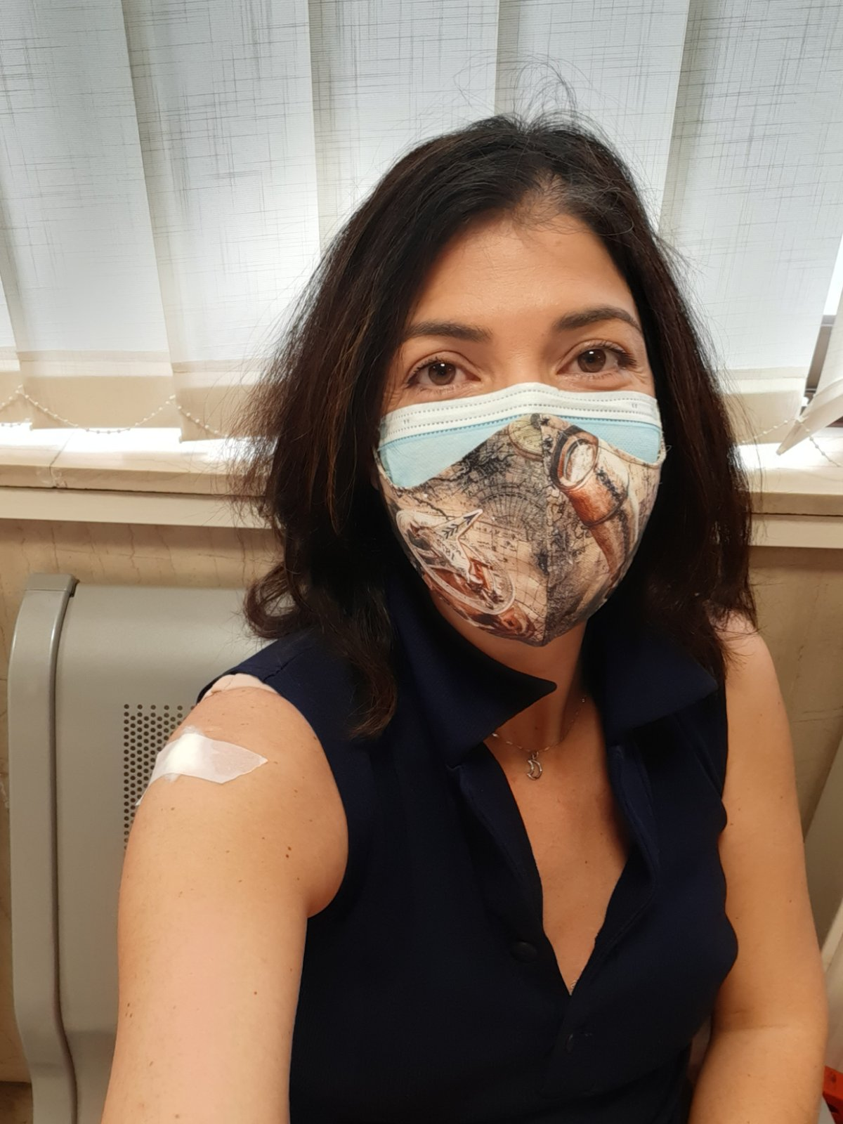
Submitted to ACP
Volcanic SO₂ Layer Height from UV/Vis sensors; inter-comparisons and validation.
Koukouli, M.E.¹, Michailidis, K.¹, Hedelt, P. ², Fedkin, N.³, Clarisse, L.⁴, Balis, D.¹, Li, C.⁵, Krotkov, N. ⁵ and Loyola, D.²
1 Laboratory of Atmospheric Physics, Aristotle University of Thessaloniki, Greece.
2 German Aerospace Center (DLR), Remote Sensing Technology Institute, Oberpfaffenhofen, Germany
3 Department of Atmospheric and Oceanic Science, University of Maryland, College Park, MD, USA
4 Spectroscopie de l'atmosphère, Service de Chimie Quantique et Photophysique, Université Libre de Bruxelles (ULB), Brussels, Belgium
5 NASA Goddard Space Flight Center, Greenbelt, MD 20771, USA
MariLiza Koukouli
Thessaloniki, Greece
25/11/2021

Slide 2
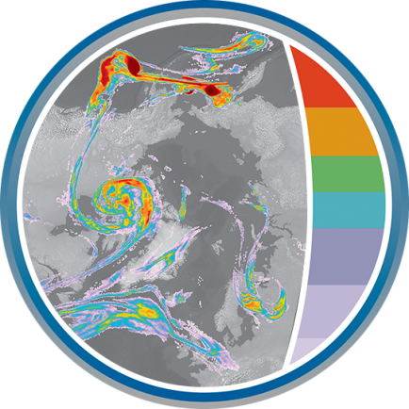
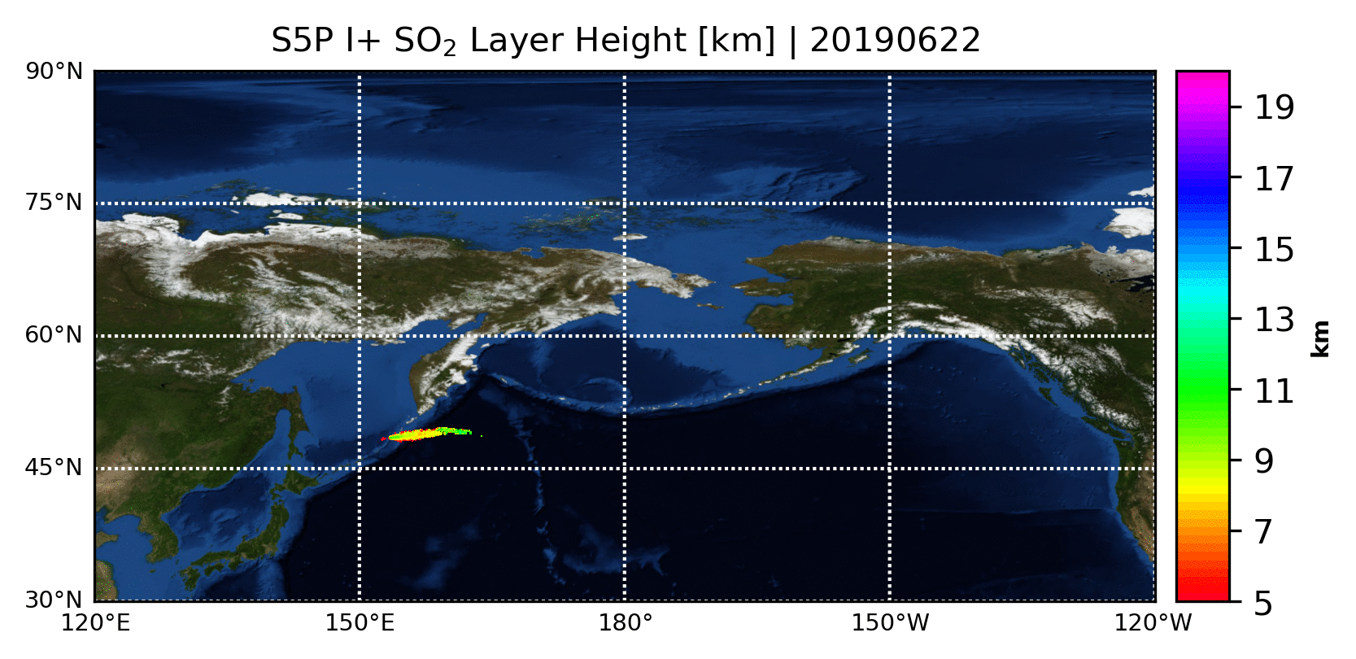
See talk by Pascal Hedelt at 1:30pm - 1:45pm on Friday
The Full-Physics Inverse Learning Machine algorithm The performs an extremely fast, ~3ms per S5P/TROPOMI pixel, yet accurate (<2km) SO₂ layer height [LH] retrieval. The algorithm was optimized and validated in the framework of the ESA Sentinel-5p Innovations project (S5P+I) and is performing S5P SO₂ LH retrievals in a semi-operational near-real time environment in DLR.
Sentinel-5p Innovation - SO₂ Layer Height Project | https://atmos.eoc.dlr.de/so2-lh/

Slide 3
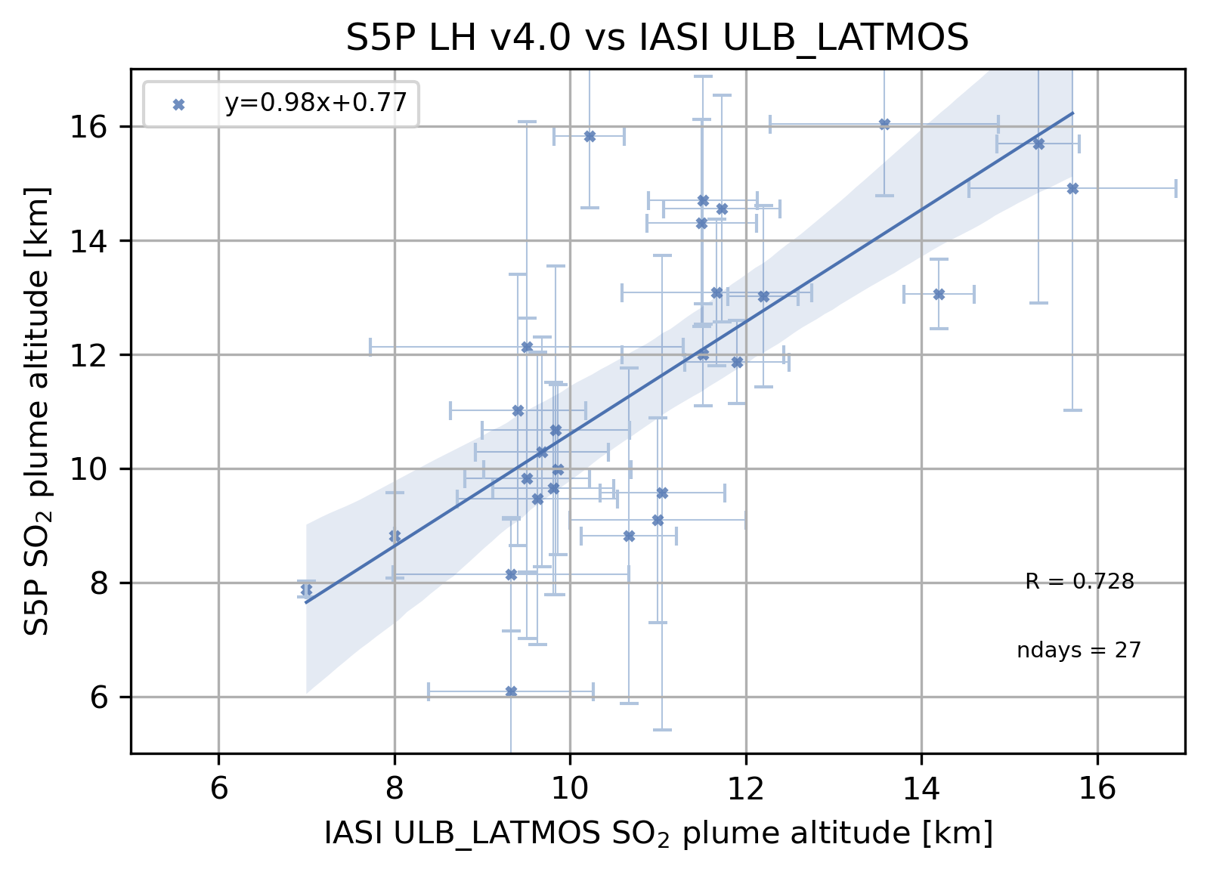
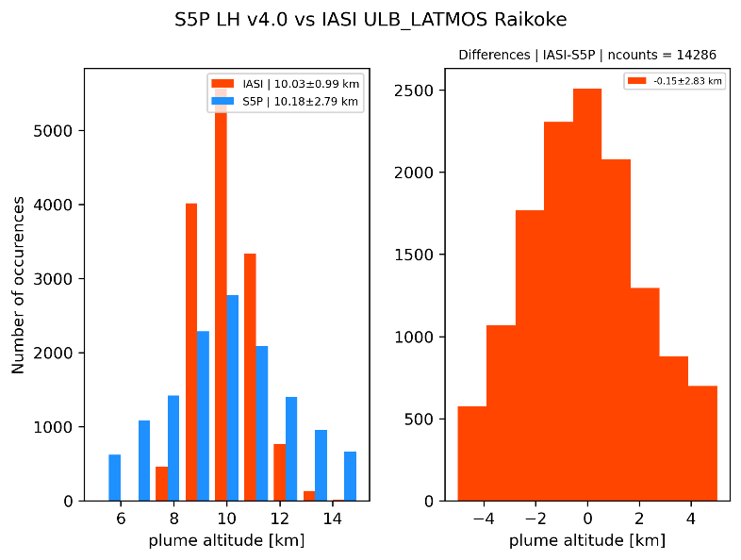
Inter-comparison with the IASI ULB LATMOS SO₂ Layer height
 | Mean S5P | Mean IASI ULB/LATMOS | Mean Difference | Collocations
Raikoke, 2019 | 10.18±2.79km | 10.03±0.99km | -0.15±2.83km | 14286
Taal, 2020 | 12.13±3.95km | 9.51±1.78km | -2.62±3.0km | 17
Nishinoshima, 2020 | 7.73±1.97km | 8.0±1.04km | 0.27±2.79km | 11
La Soufriere, 2021 | 14.94±3.87km | 15.7±1.16km | 0.76±3.69km | 168
Check out the e-poster!

Slide 4
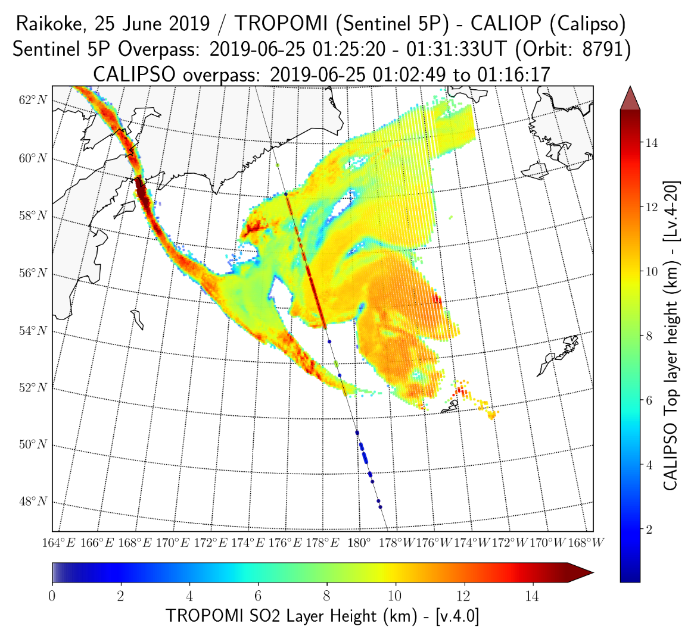
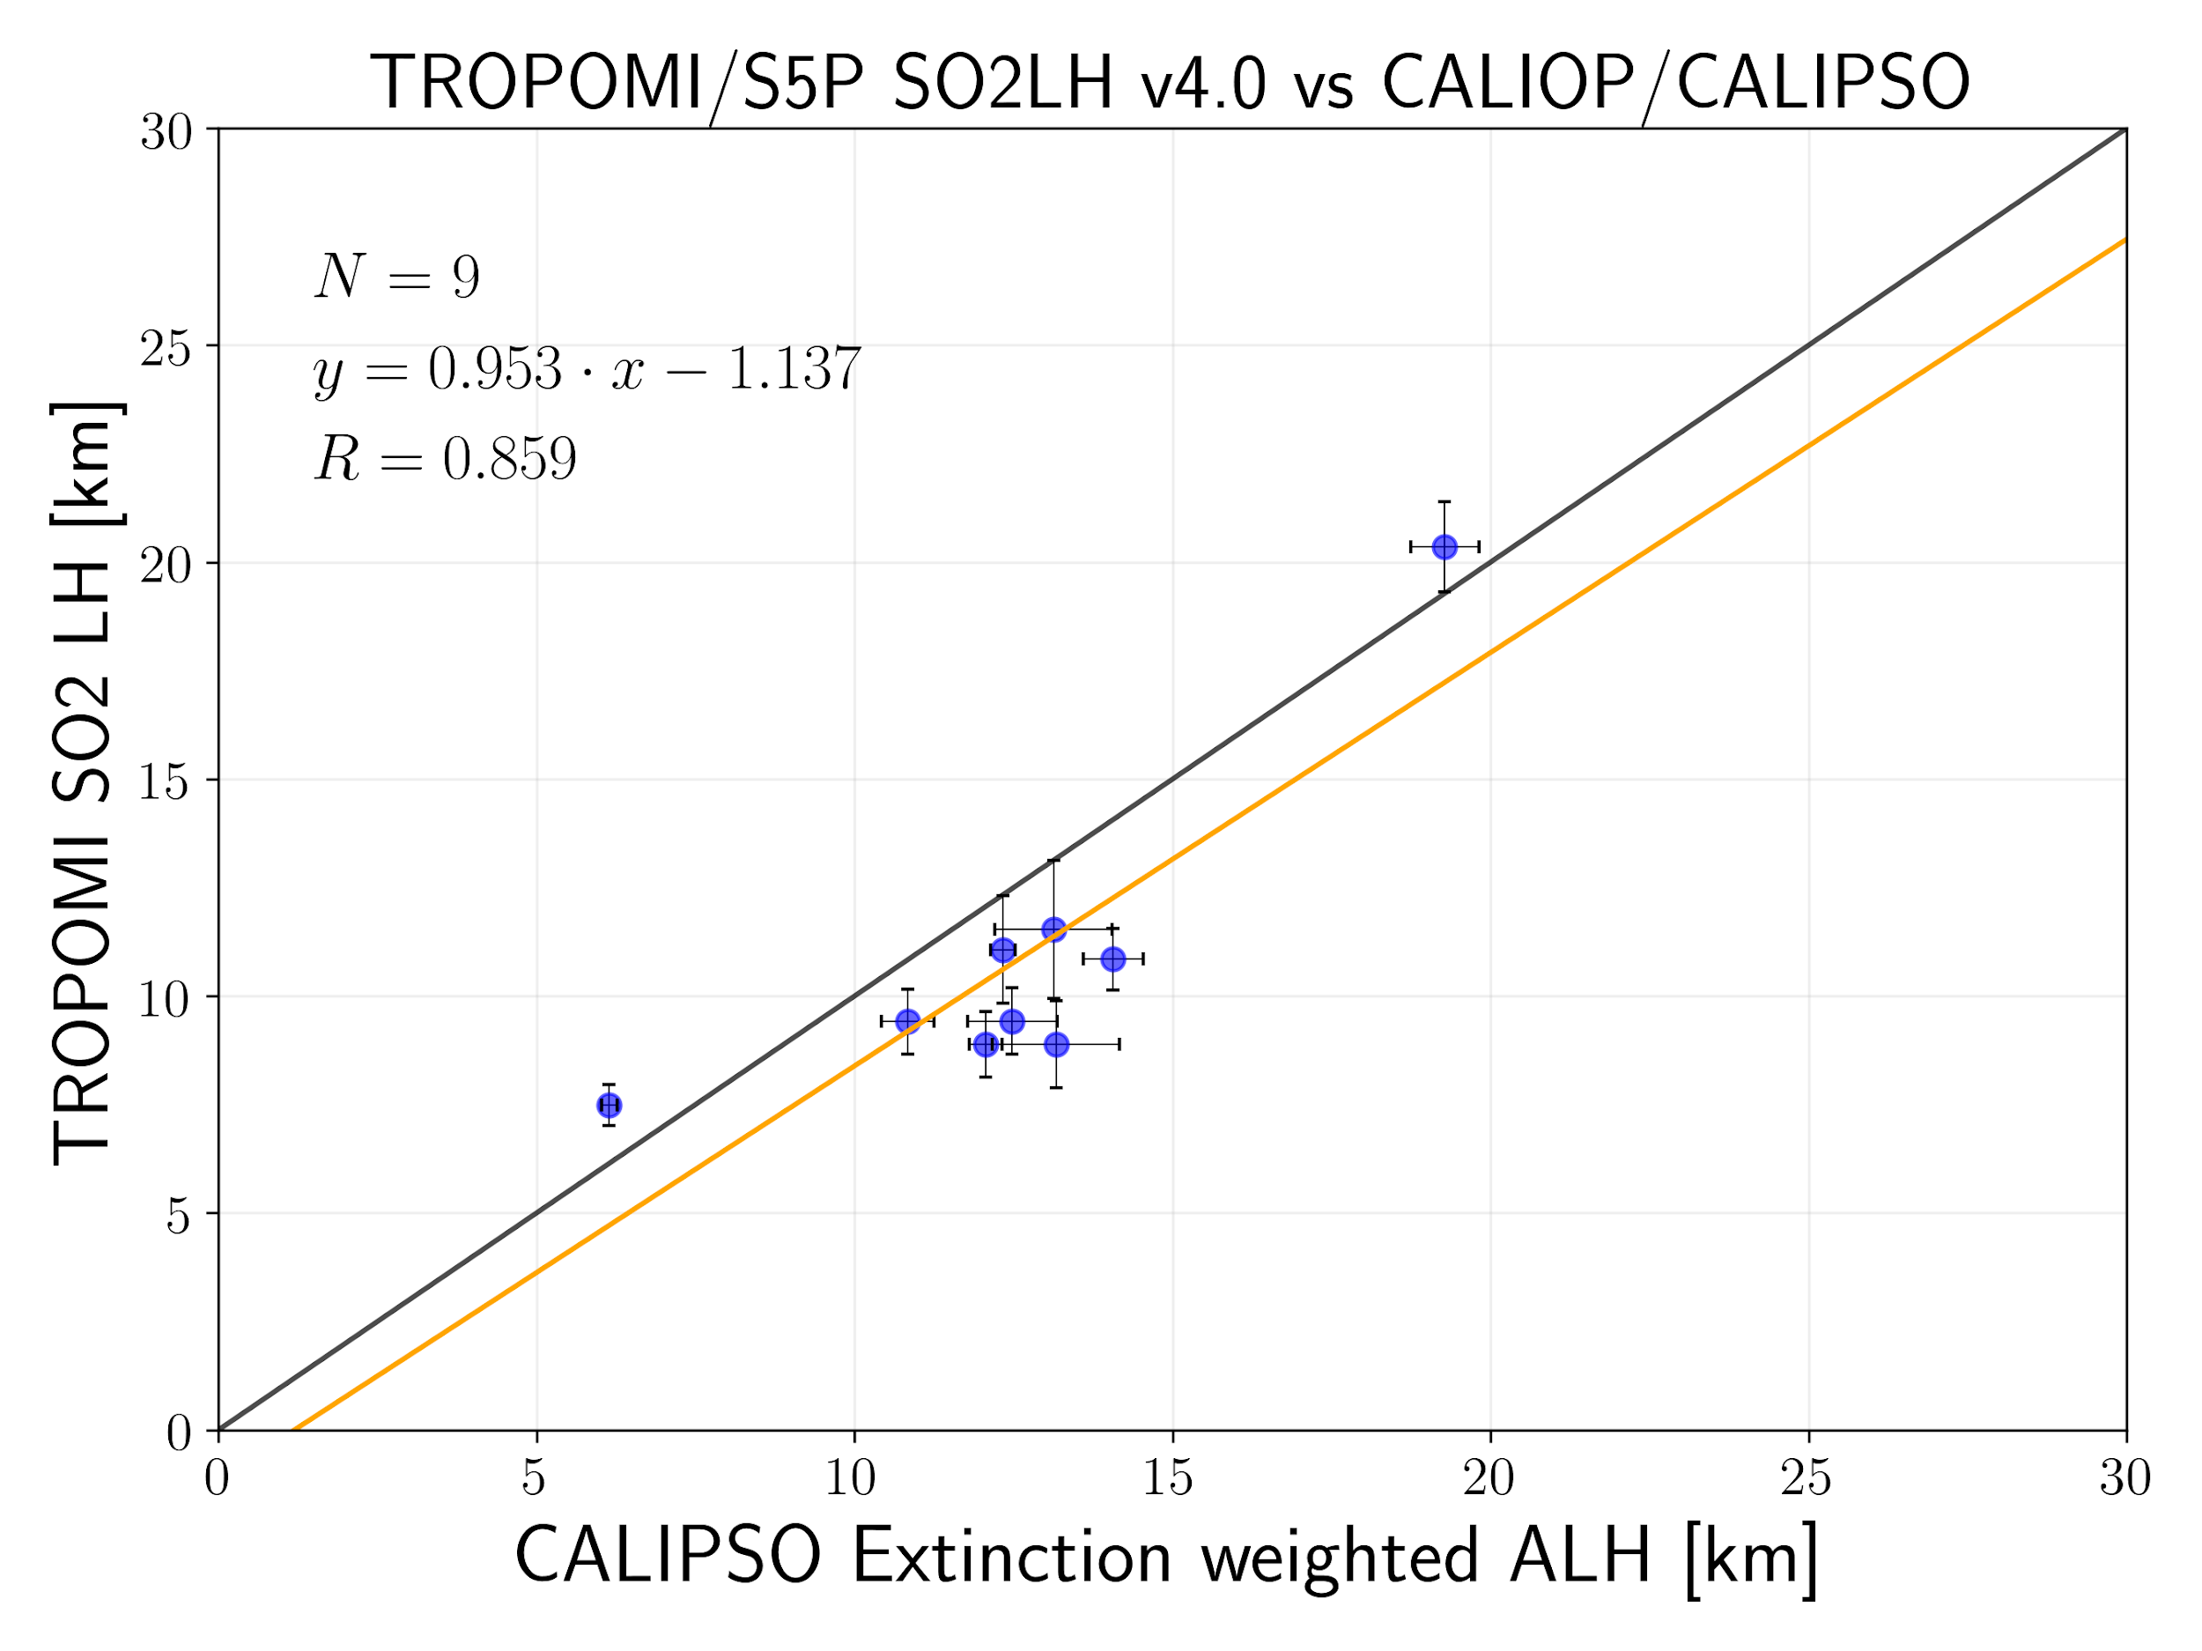
Inter-comparison with the CALIOP/CALIPSO ash Layer height
Eruptive day | Mean CALIPSO LH | Mean S5P Height | Mean Difference | N
22 June 2019 | 10.84±0.4 | 9.40±0.75 | -1.43±0.56 | 8
23 June 2019 | 12.06±0.28 | 8.88±0.76 | -3.17+0.98 | 13
24 June 2019 | 12.33±0.2 | 11.07±1.24 | -1.26±1.40 | 22
25 June 2019 | 12.47±0.1 | 9.41±0.76 | -3.05±0.54 | 57
28 June 2019 | 13.12±0.92 | 11.53±1.6 | -1.59±2.13 | 87
29 June 2019 | 14.06±0.47 | 10.84±0.7 | -3.21±0.99 | 46
30 June 2019 | 13.16±1 | 8.88±1 | -4.28±0.56 | 8
1 August 2020 | 6.14±0.12 | 7.48±0.48 | 1.34±0.46 | 8
11 April 2021 | 19.28±0.54 | 20.35±1.04 | 1.06±1.44 | 12
Check out the e-poster!

