Slide 1
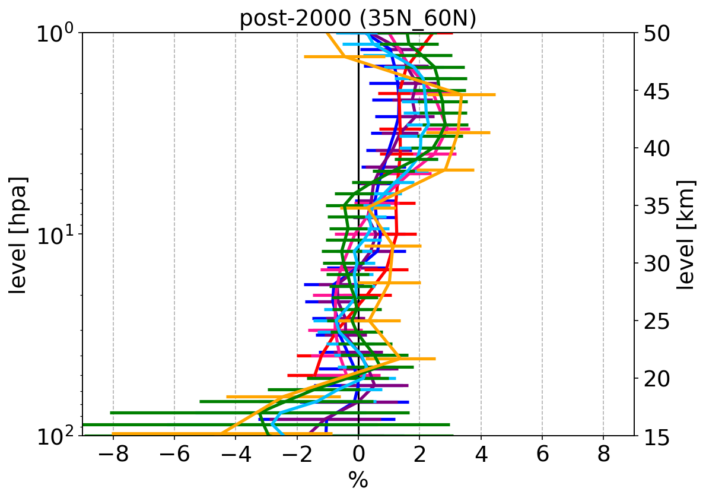
Assessment of (Merged) Ozone Profile Data Records by Limb and Occultation Sounders within ESA’s Climate Change Initiative
D. Hubert (BIRA-IASB), A. Keppens (BIRA-IASB), J.-C. Lambert (BIRA-IASB), T. Verhoelst (BIRA-IASB), S. Compernolle (BIRA-IASB), V. Sofieva (FMI), C. Arosio (U Bremen), A. Rozanov (U Bremen), M. Van Roozendael (BIRA-IASB), C. Retscher (ESA/ESRIN)
Trends are close to detection threshold
1. Drift satellite measurements
2. Inhomogeneity ground-based observations
What are the causes of the differences in trends in merged satellite & ground-based records?
Study of linear change in difference between co-located limb/occultation satellite and ground-based O3 profiles.
Study of temporal artefacts in difference between ground-based and multiple satellite data records.
35°N – 60°N
7 satellite records
45
MWR
45
40
40
Courtesy: Azouz et al.
Update of Hubert et al. (2016)
35
Lidar
35
30
30
25
25
Ozonesonde
20
20
15
15
-8
-4
0
+4
+8
-10
-5
0
+5
+10
2000-2020 trend [%/dec.]
Drift SAT/LIDAR -1 [%/dec.]
-10
-5
0
+5
+10
GND – Aura MLS anomaly [%]
Conclusion
Requirements on long-term stability are extremely stringent for past/current instruments. Multi-instrument intercomparisons remain vital (a) to identify drift, inhomogeneities, … and (b) to provide pointers to improve the ozone Climate Data Records.

