Slide 1
Surface and aerosol characterization from S5P/TROPOMI: validation, inter-comparison and expected performance
P. Litvinov¹, O. Dubovik², C. Chen¹, A. Lopatin¹, T. Lapionok², D. Fuertes¹, C. Matar¹, Y. Karol¹, L. Bindreiter³, C. Holter³, V. Lanzinger³, A. Hangler³, M. de Graaf⁴, G. Tilstra⁴, P. Stammes⁴, and C. Retscher⁵
1:
2:
3:
4:
5:

Slide 2
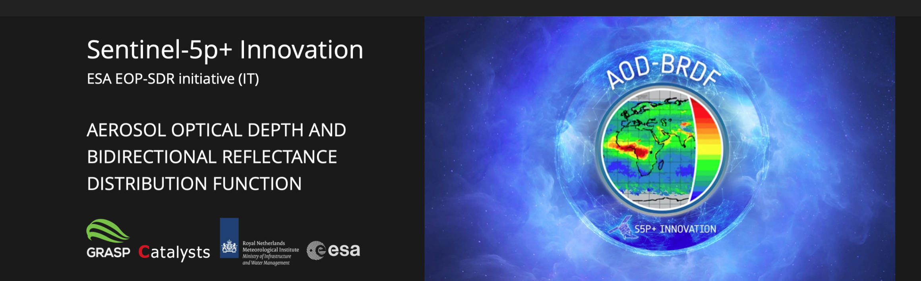
Aerosol and surface product S5p+I AOD/BRDF project
www.grasp-sas.com/projects/aod-brdf_sentinel-5p-innovation/
GRASP aerosol and surface BRDF products
KNMI surface DLER and OMI-heritage AOD products
Two products complement and extend each other

Slide 3
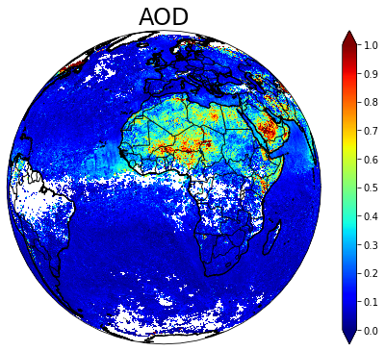
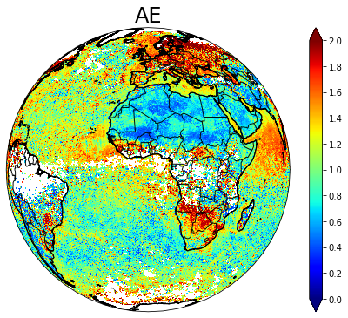
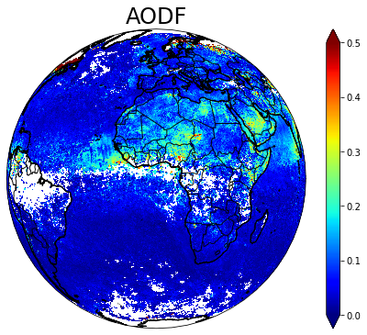
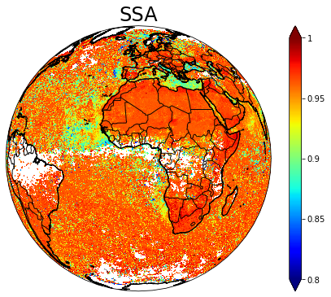
GRASP aerosol products
10 wavelengths:
0.340 0.367 0.380 0.416 0.440 0.494 0.670 0.747 0.772 2.313
Spectral AOD, AE, AODF and AODC
Spectral AAOD
Spectral SSA
4 aerosol model concentrations

Slide 4
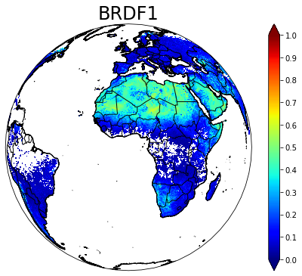
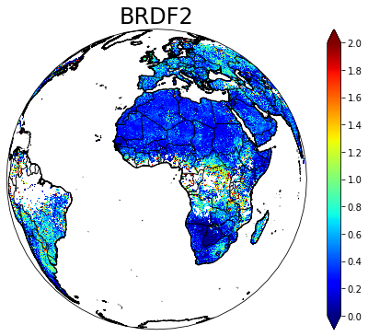
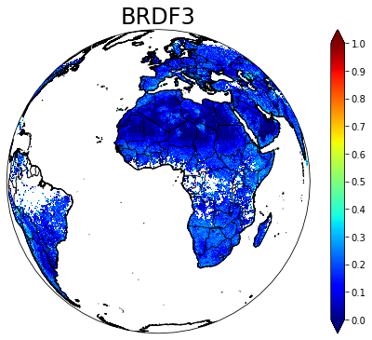
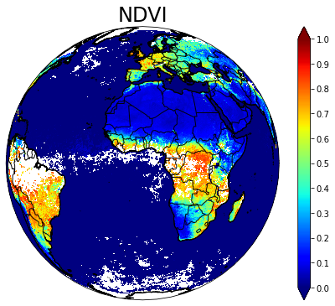
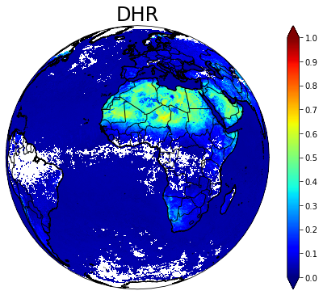
GRASP Surface products
10 wavelengths:
0.340 0.367 0.380 0.416 0.440 0.494 0.670 0.747 0.772 2.313
Spectral BRDF1 (land)
BRDF 2nd and 3rd parameters (land)
NDVI
Spectral water body reflectance (sea/ocean)
Spectral DHR, BHR_iso

Slide 5
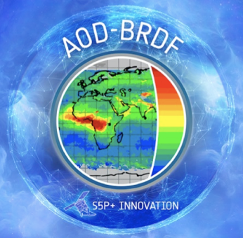
Specified requirements on aerosol (ESA S5p+I AOD/BRDF)
Characteristic | Required Uncertainty
 | Based on GCOS and aerosol CCI | Target: relaxed
AOD | 0.04 or 10% (whatever is bigger) | 0.05 or 20% (whatever is bigger)
Fine mode AOD (AODf) | 0.04 or 10% (whatever is bigger) | 0.05 or 20% (whatever is bigger)
SSA | 0.02 - 0.03 | 0.04 - 0.05
Requirements on surface (ESA S5p+I AOD/BRDF)
Requirements BRDF/albedo | Uncertainties
 | Albedo <= 0.03 | Albedo > 0.03
Target | 0.04 | 0.03 or 10% (whatever is bigger)
Optimal | 0.02 | 0.01 or 5% (whatever is bigger)

Slide 6
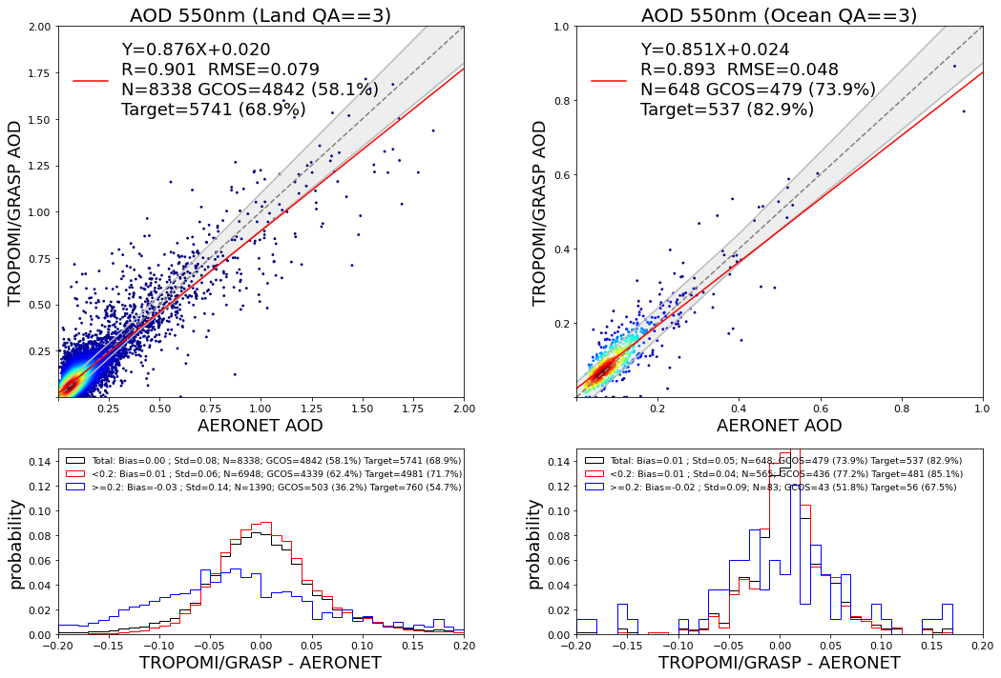
Aerosol product validation. AOD GRASP/S5p vs AERONET

Slide 7
Site by site validation statistics of GRASP/S5p AOD 550nm
R
BIAS
RMSE
GCOS

Slide 8
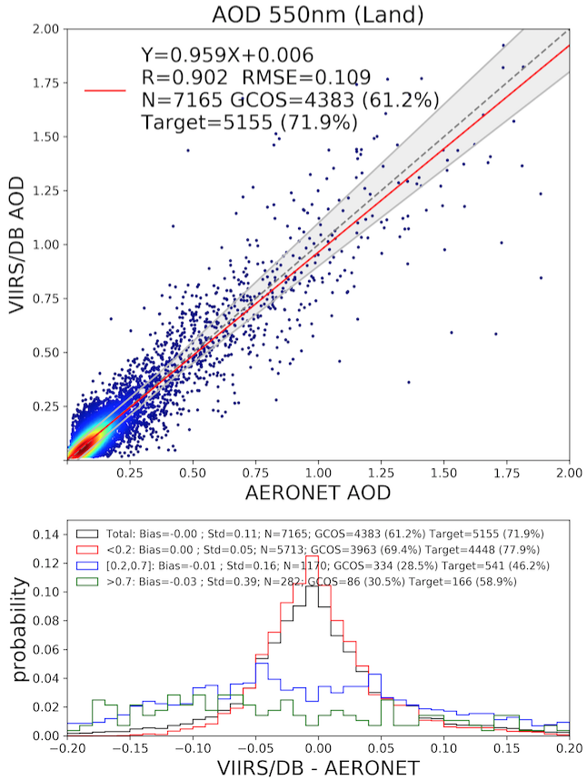
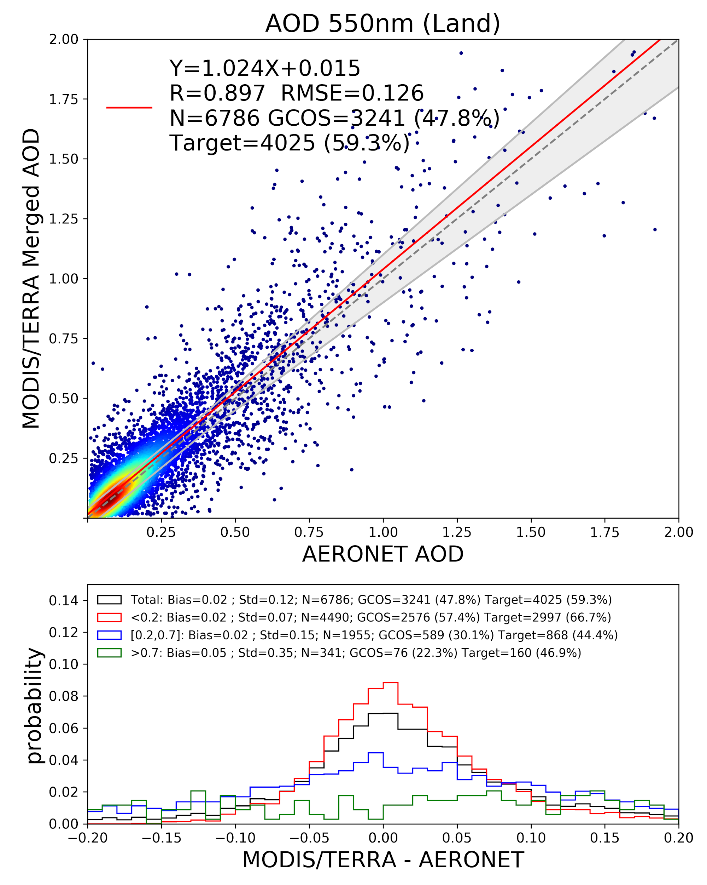
Inter-comparison over AERONET: GRASP/S5p, VIIRS, and MODIS. 550nm
GRASP/S5p
VIIRS
MODIS
Beside AOD, GRASP/TROPOMI provides extended aerosol properties!

Slide 9
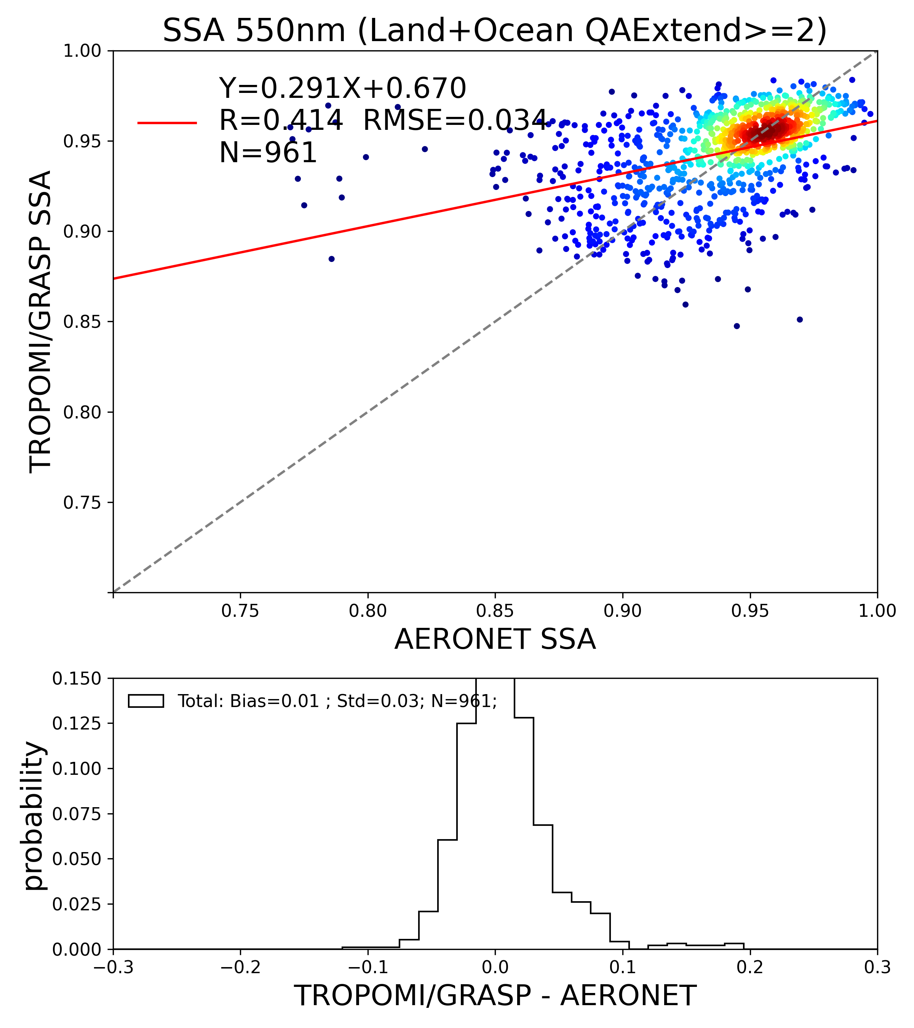
Aerosol product validation. Aexp and SSA GRASP/S5p vs AERONET

Slide 10
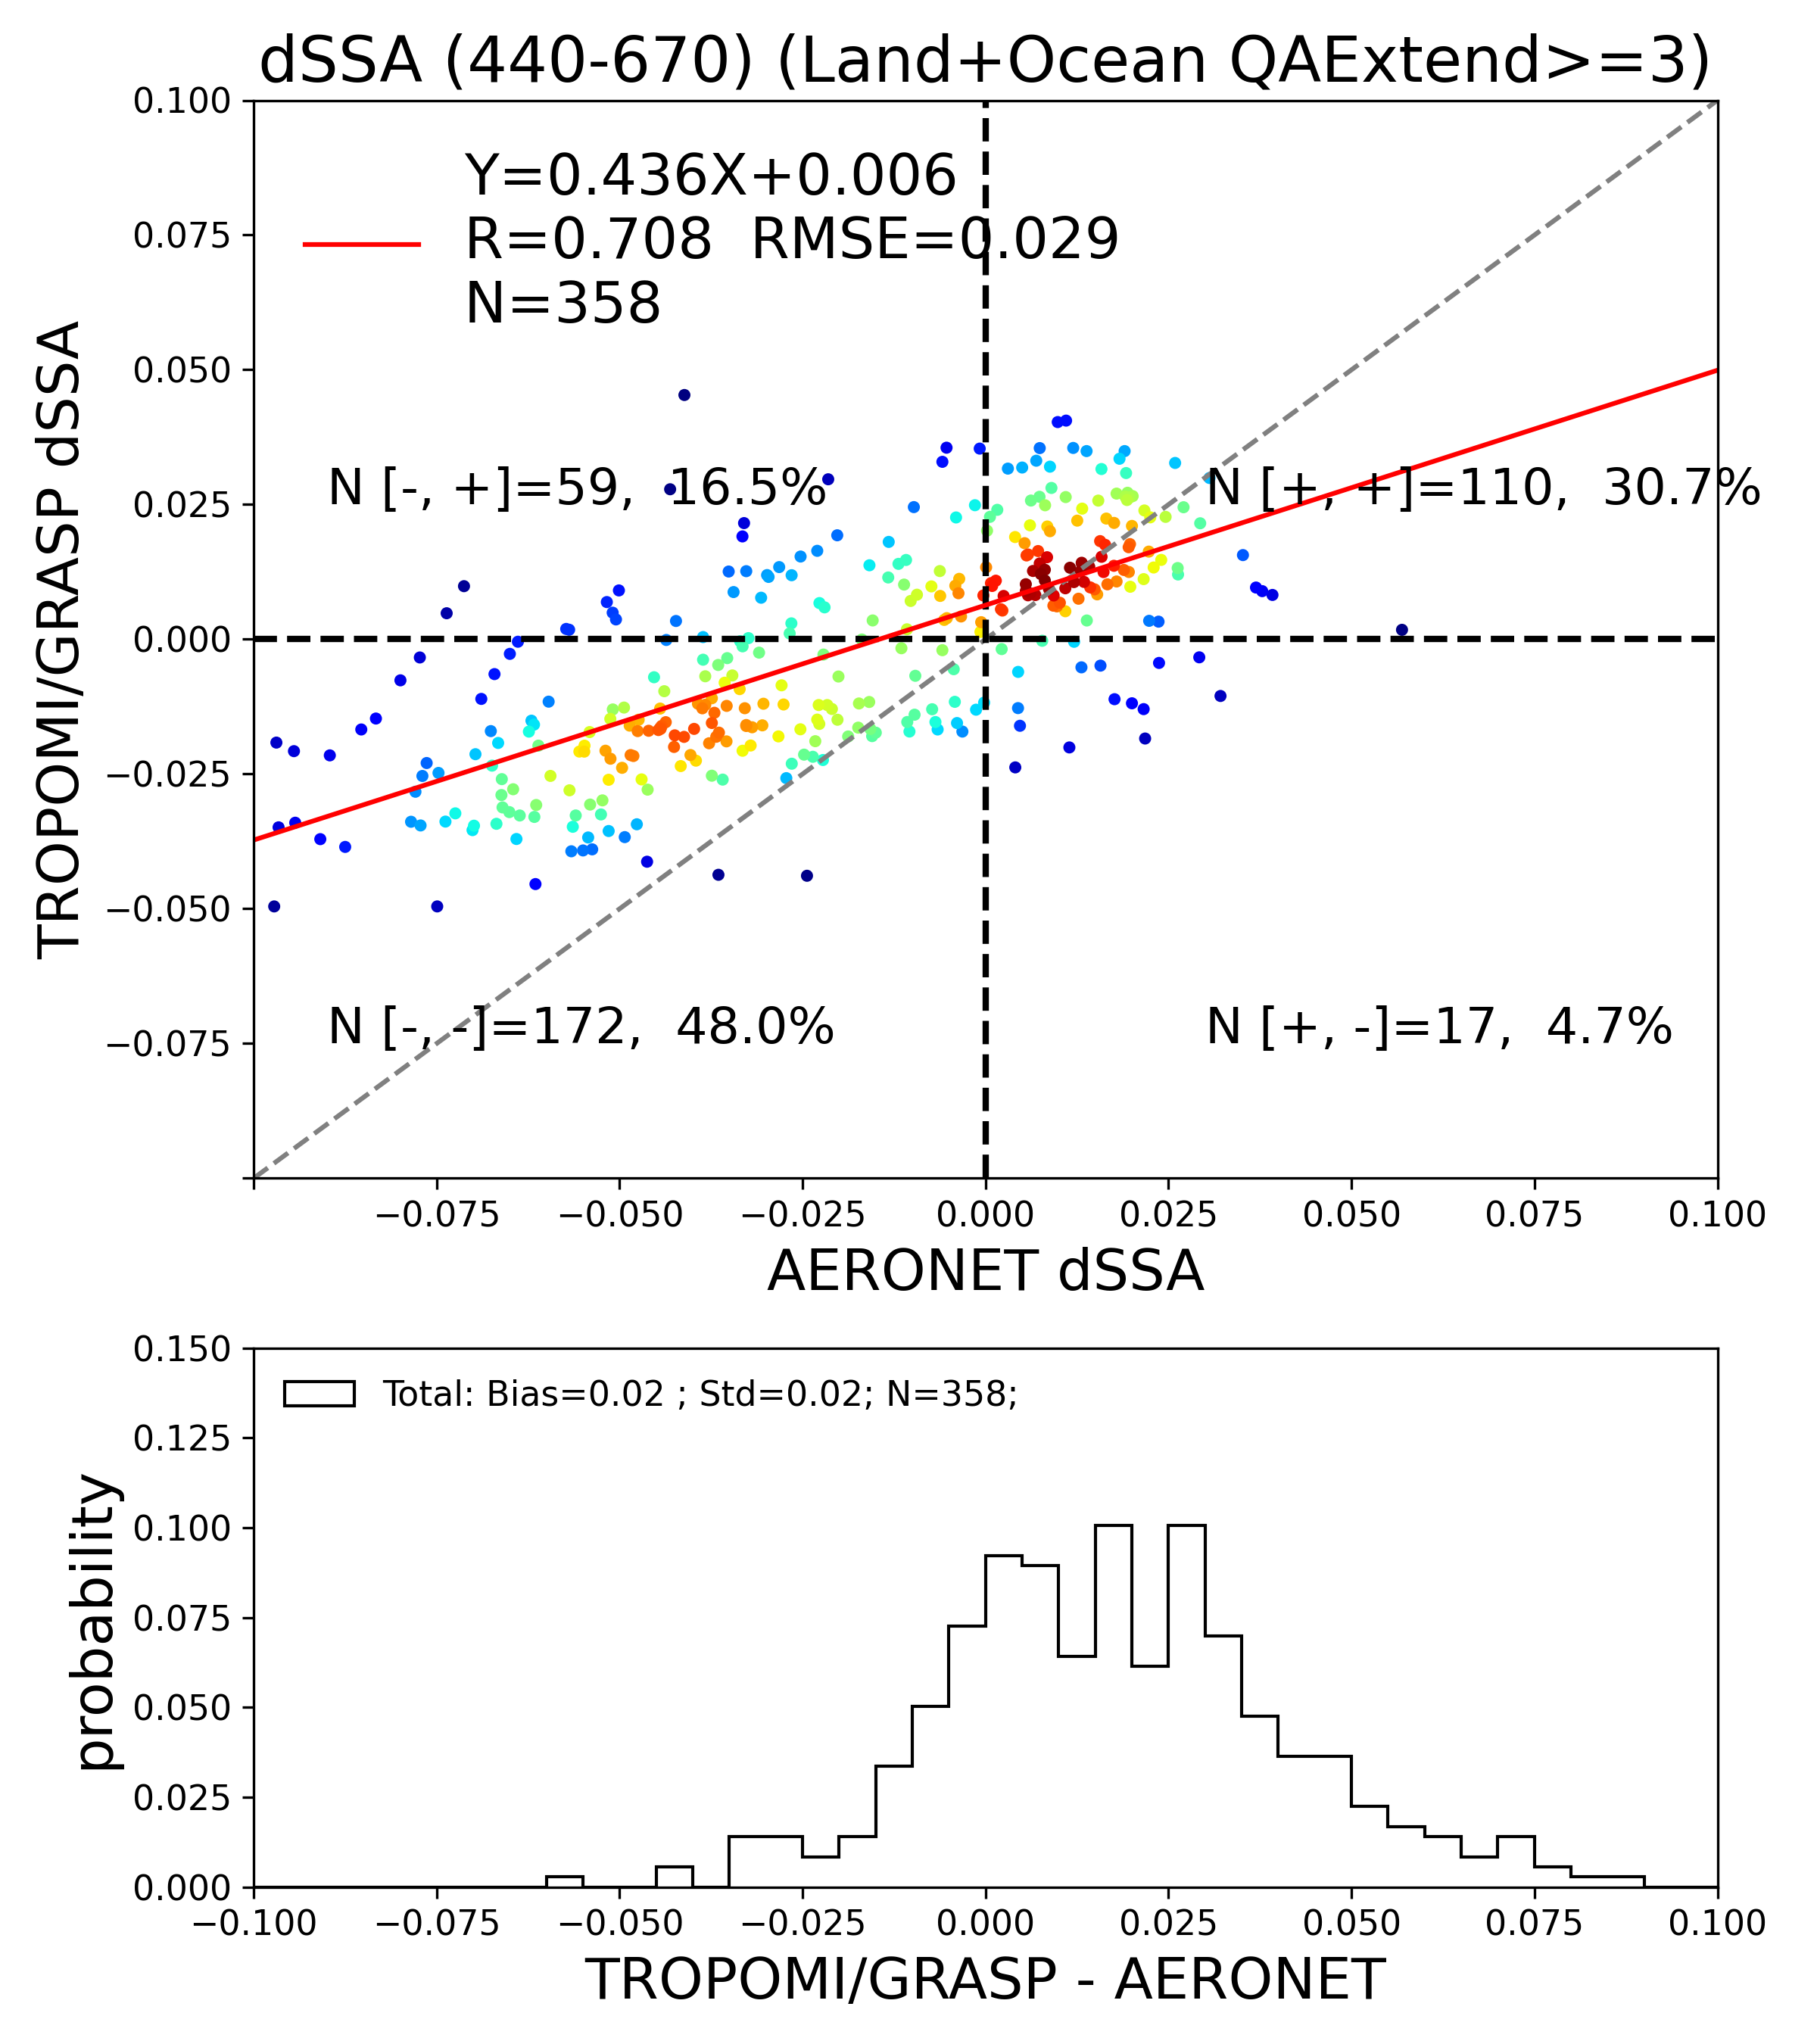
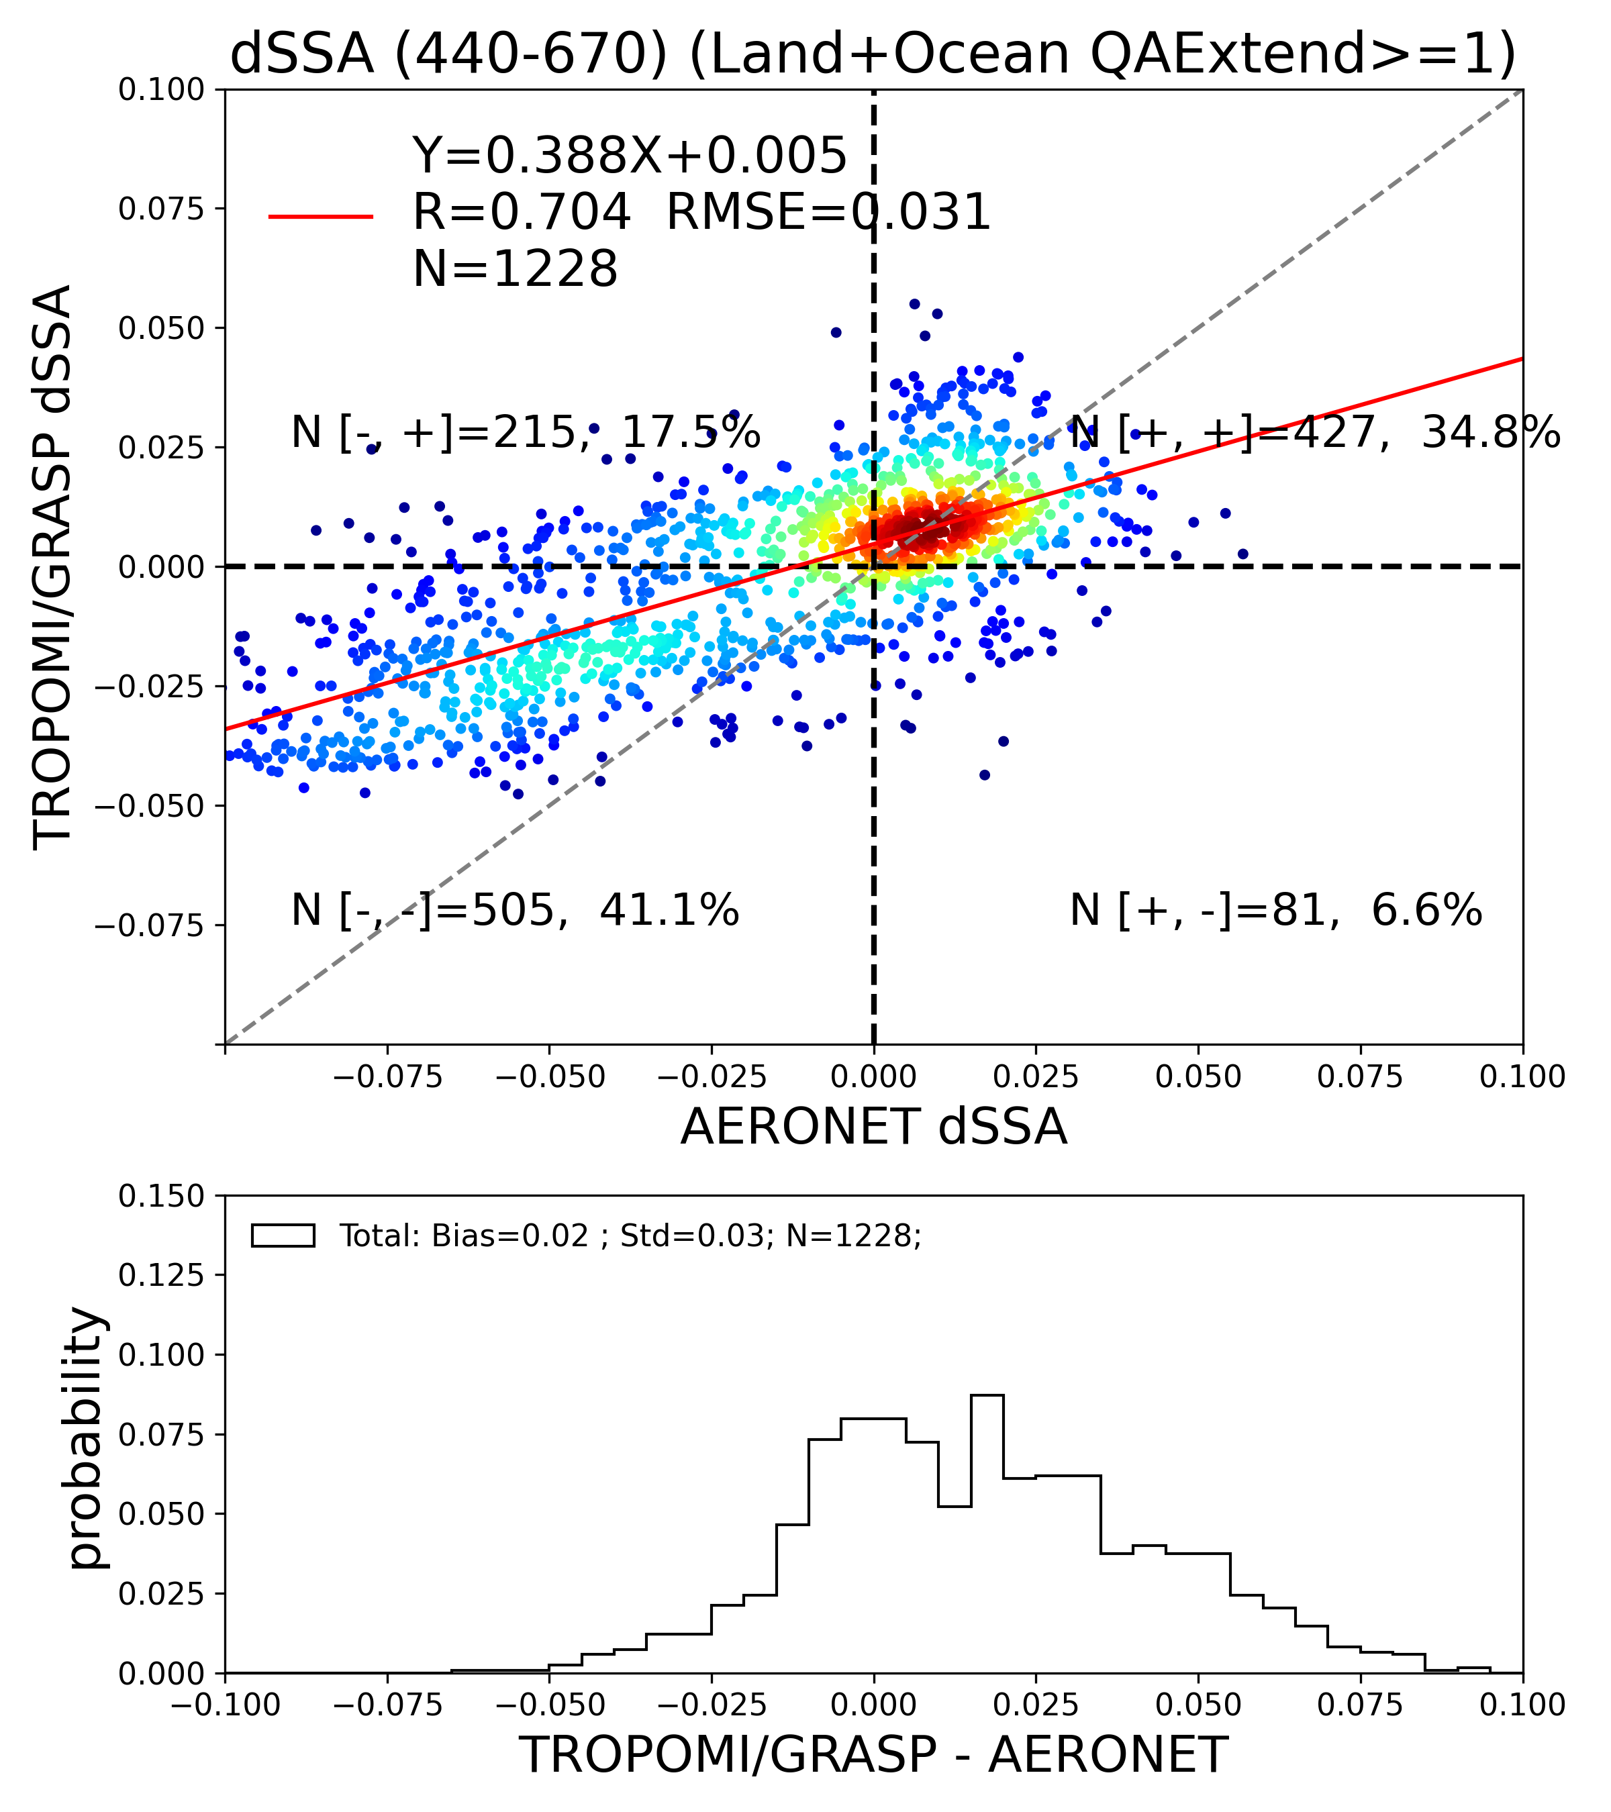
Aerosol product validation. Spectral dependence of SSA GRASP/S5p vs AERONET
Correct
Correct
Correct
Correct
Spectral dependence of SSA (dSSA) sensitive to aerosol type.
In GRASP/S5p product dSSA depends less on “quality” assurance index than AExp and SSA.

Slide 11
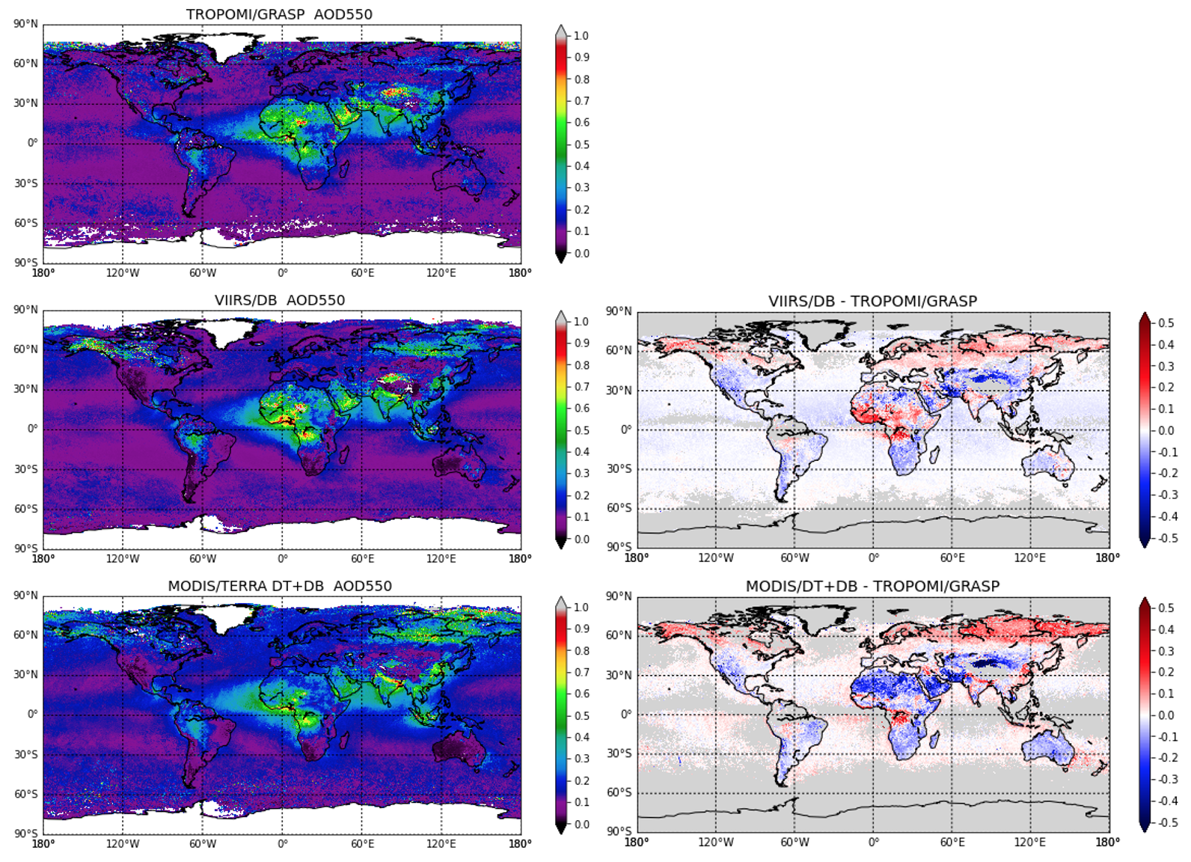
Global inter-comparison. AOD. GRASP/S5p vs VIIRS and MODIS
GRASP/S5p AOD
VIIRS - GRASP
VIIRS AOD
The differences in AOD are mainly over land
MODIS - GRASP
MODIS AOD

Slide 12
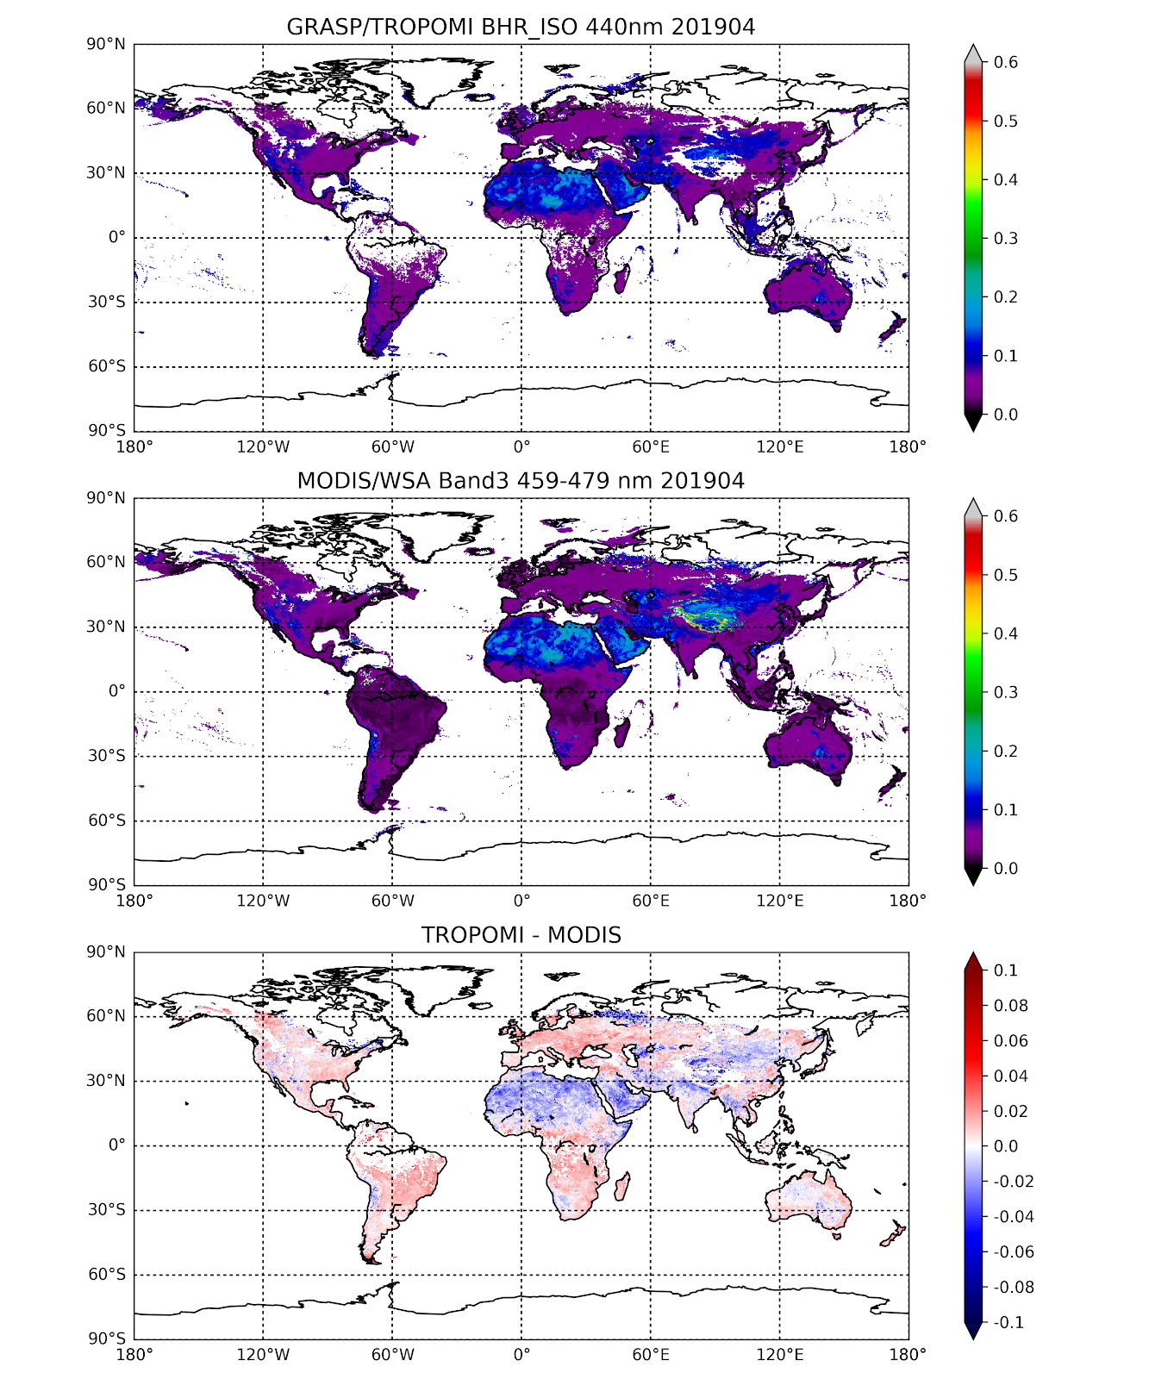
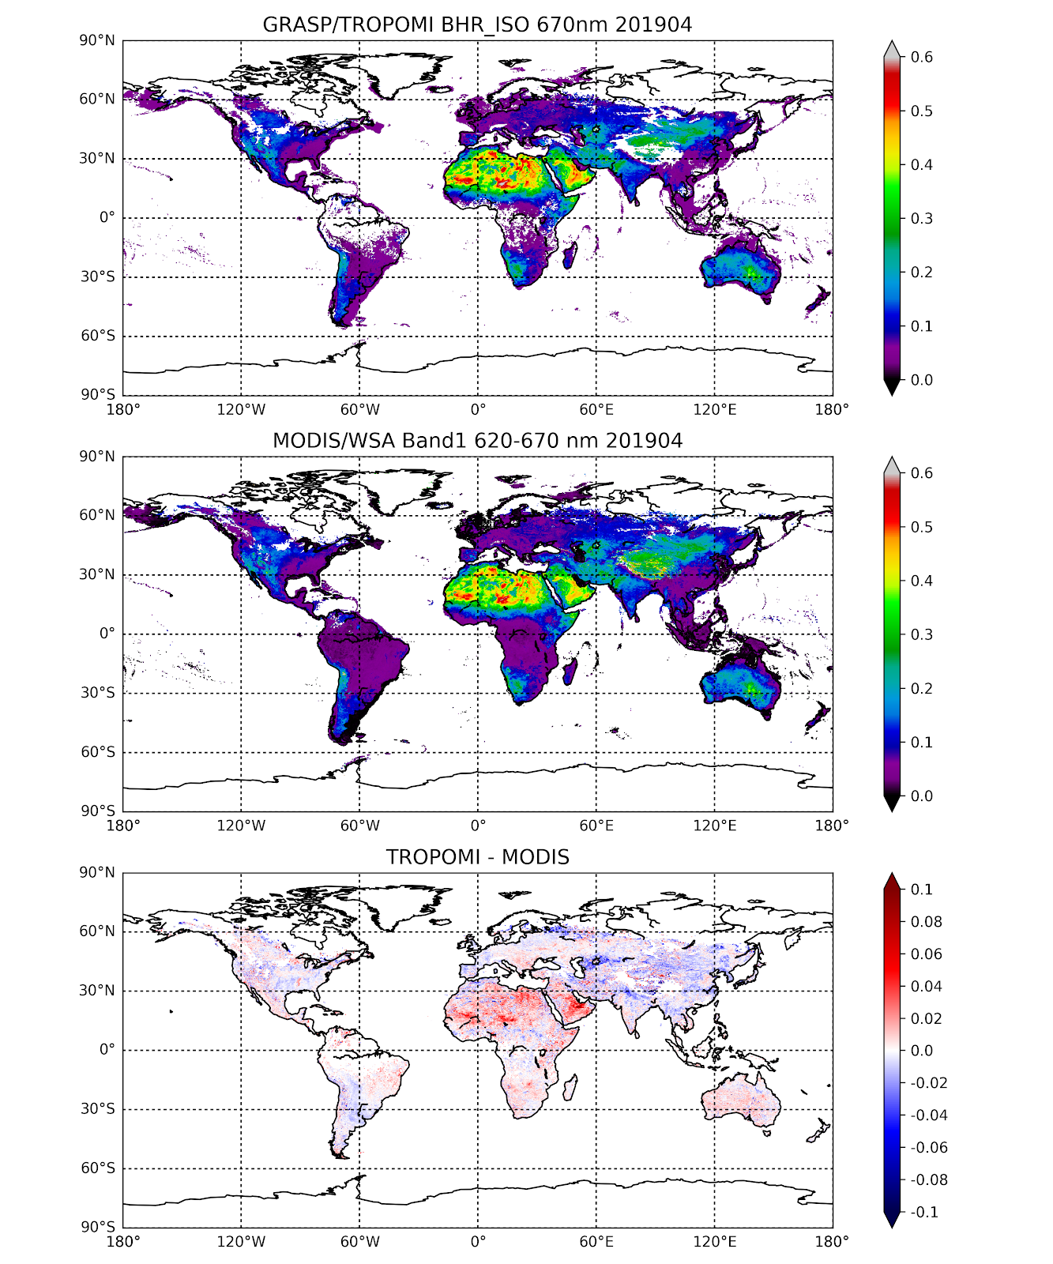
Global inter-comparison. Surface. GRASP/S5p vs MODIS
GRASP (BHR_iso)
MODIS (White Sky Albedo (WSA) MCD43C3)
GRASP - MODIS

Slide 13
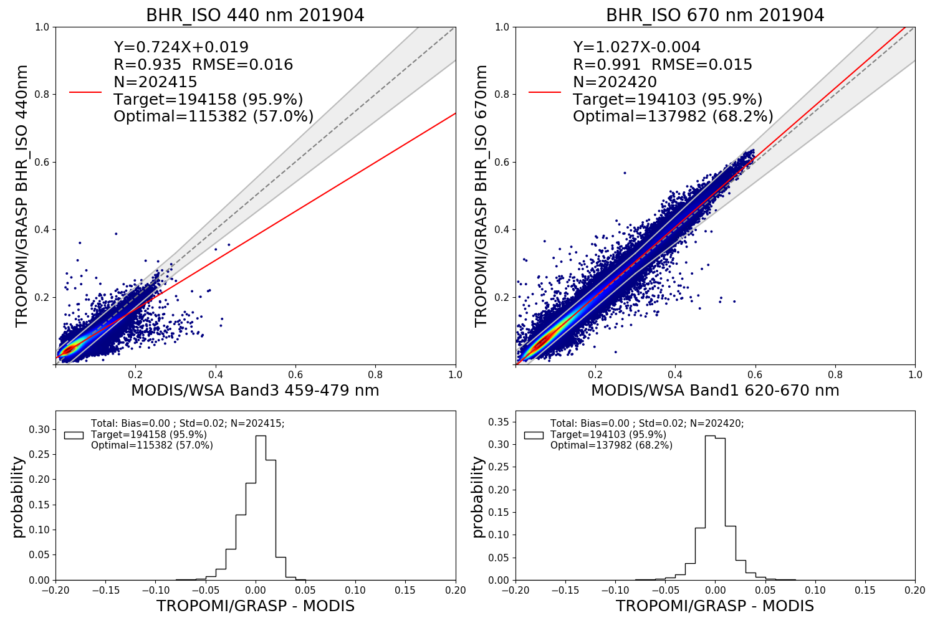
GRASP/S5p (BHR_ISO ) vs MODIS (MCD43C3 WSA)
Requirements BRDF/ albedo | Uncertainties
 | Albedo <= 0.03 | Albedo > 0.03
Target | 0.04 | 0.03 or 10% (whatever is bigger)
Optimal | 0.02 | 0.01 or 5% (whatever is bigger)
Good correspondence between GRASP and MODIS surface products globally!

Slide 14
Summary. GRASP/S5p+I product
Global aerosol product of high quality (daily, monthly)
New information from GRASP/S5p:
AOD in UV, VIS and SWIR
Aerosol size (AEexp, AODF, AODC)
Absorption properties (SSA, dSSA, AAOD)
Full BRDF, Black Sky (DHR) and White Sky (BHR_iso) albedos from S5p/TROPOMI of high quality (daily, monthly).
}
Required information for aerosol type

Slide 15
GRASP/S5p+I products. Expected performance
Surface GRASP/S5p+I product (10 wavelengths: 0.340 0.367 0.380 0.416 0.440 0.494 0.670 0.747 0.772 2.313)
 | UV | VIS | NIR | SWIR | Coverage | Uncertainties
 |  |  |  |  |  | Target requirements | Optimal requirements
BRDF | ✔ | ✔ | ✔ | ✔ | Daily / Monthly | 0.03 or 10% (60 - 95%) depending on spectral band | 0.01 or 5% (50 - 80% ) depending on spectral band
Albedos | ✔ | ✔ | ✔ | ✔
Aerosol GRASP/S5p+I product (10 wavelengths: 0.340 0.367 0.380 0.416 0.440 0.494 0.670 0.747 0.772 2.313)
 | UV | VIS | NIR | SWIR | Coverage | Uncertainties
 |  |  |  |  |  | Target: 0.05 or 20% | Optimal: 0.04 or 10%
AOD, AODF | ✔ | ✔ | ✔ | ✔ | Daily / Monthly | Ocean: 65 - 90% Land: 45 – 80% | Ocean 60-85 % Land: 40-70 %
SSA, AAOD | ✔ | ✔ | ✔ | ✔ |  | < 0.05 ( for AOD > 0.3 ) | < 0.03
Aerosol type, aerosol height |  |  |  |  |  | Under validation

Slide 16
Conclusions and Outlook
S5p+I AOD/BRDF studies show rich information content of S5p/TROMOMI for aerosol and surface characterization.
Wide TROPOMI swath (Global daily coverage) provides the possibility of detailed surface characterisation:
- Full BRDF characterisation.
- Possibilities for accurate separation of the atmosphere and surface signals.
Wide spectral range + global daily coverage provide new possibilities for extended aerosol characterisation:
Aerosol absorption properties (SSA, dSSA, AAOD etc)
Aerosol size (fine and coarse AOD, AExp etc)
In combination with GRASP retrieval algorithm aerosol and surface products of high quality can be derived from S5p/TROPOMI measurements:
Good agreement with AERONET.
Good global agreement with well-validated aerosol and surface products (MODIS, VIIRS).
Operational generation of advanced aerosol and surface products from S5P/TROPOMI should advance global climate studies and can be used in different climate applications.

