Slide 1
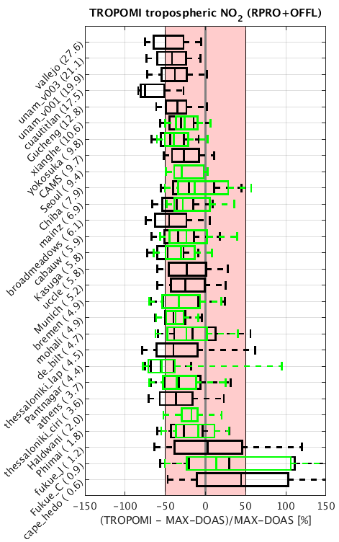
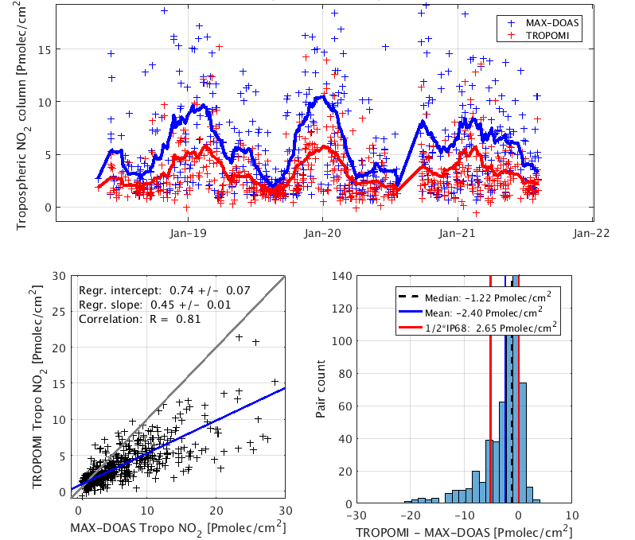
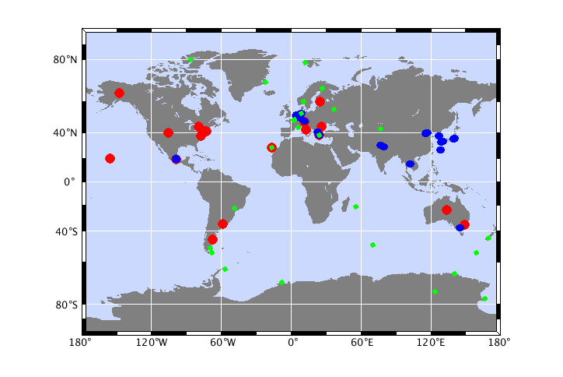
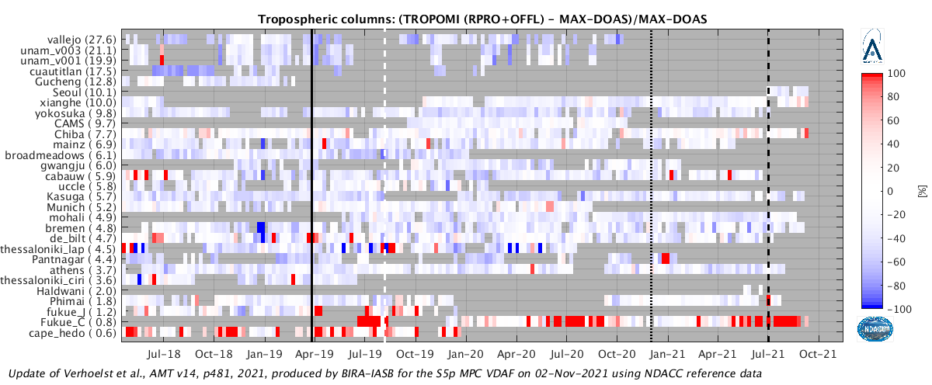
Assessment of the Improvements in S5P-TROPOMI NO2 Data Quality through Ground-based Validation with NDACC MAX-DOAS, ZSL-DOAS and PGN Global Network Data.
Tijl Verhoelst¹, S. Compernolle¹, G. Pinardi¹, J.-C. Lambert¹, H. Eskes², J. van Geffen², J. Douros², K.-U. Eichmann³, S.Niemeijer⁴, NDACC PIs, PGN Team
(1) BIRA-IASB, Belgium (2) KNMI, The Netherlands (3) IUP-Bremen, Germany, (4) s[&]t corporation, The Netherlands
Correlative measurements used as reference:
Stratospheric column: 26 ZSL-DOAS instruments
Tropospheric column: 27 MAX-DOAS instruments
Total column: 35 PGN instruments
TROPOMI vs. ground-based tropospheric NO₂
at a typical MAX-DOAS site
Up to v1.3
From v1.4
Results
S5P-TROPOMI tropospheric NO₂ measurements are found to underestimate the ground-based measurements by approx. 30%, with a dispersion on the differences of approx. 50%.
This is within the mission requirements regarding bias (<50%). The dispersion requirement (<0.7 Pmolec/cm2, or <10% for polluted conditions) is seemingly exceeded, but this is caused in part by the difference in horizontal and vertical sensitivity of the measurements. Correlations range from 0.5 to 0.8 indicating that S5P does track the reference well.
As the underestimation is mostly relative w.r.t. the NO₂ column, relative changes in column are more accurate than absolute changes.
Processor v1.4, introduced in December 2020, tends to increase tropospheric columns at polluted sites, reducing the bias. Users must deal carefully with this change in bias properties for trend assessment.
Unexpectedly, replacing the TM5 a priori profile with a CAMS-regional profile only improves the overall bias, but not the correlation w.r.t. the ground-based measurements.
V1.3
V1.4
V2.1
Latest results @ S5P-TROPOMI Validation Data Analysis Facility: https://mpc-vdaf.tropomi.eu/index.php/nitrogen-dioxide & https://tinyurl.com/rocvr
Refereed papers: Verhoelst et al., 2021 (https://amt.copernicus.org/articles/14/481/2021/), Van Geffen et al. (submitted), Douros et al. (in prep.)
Acknowledgments: We thank ESA (S5P MPC) & BELSPO (ProDEx TROVA-2) for funding and Instrument PIs and staff at MAX-DOAS, NDACC and PGN
stations for reference data.

Slide 2
Assessment of the Improvements in S5P-TROPOMI NO2 Data Quality through Ground-based Validation with NDACC MAX-DOAS, ZSL-DOAS and PGN Global Network Data.
Tijl Verhoelst¹, S. Compernolle¹, G. Pinardi¹, J.-C. Lambert¹, H. Eskes², J. van Geffen², J. Douros², K.-U. Eichmann³, S.Niemeijer⁴, NDACC PIs, PGN Team
(1) BIRA-IASB, Belgium (2) KNMI, The Netherlands (3) IUP-Bremen, Germany, (4) s[&]t corporation, The Netherlands
Correlative measurements used as reference:
Stratospheric column: 26 ZSL-DOAS instruments
Tropospheric column: 27 MAX-DOAS instruments
Total column: 35 PGN instruments
TROPOMI vs. ground-based tropospheric NO₂
at a typical MAX-DOAS site
Results
S5P-TROPOMI tropospheric NO₂ measurements are found to underestimate the ground-based measurements by approx. 30%, with a dispersion on the differences of approx. 50%.
This is within the mission requirements regarding bias (<50%). The dispersion requirement (<0.7 Pmolec/cm2, or <10% for polluted conditions) is seemingly exceeded, but this is caused in part by the difference in horizontal and vertical sensitivity of the measurements. Correlations range from 0.5 to 0.8 indicating that S5P does track the reference well.
As the underestimation is mostly relative w.r.t. the NO₂ column, relative changes in column are more accurate than absolute changes.
Processor v1.4, introduced in December 2020, tends to increase tropospheric columns at polluted sites, reducing the bias. Users must deal carefully with this change in bias properties for trend assessment.
Unexpectedly, replacing the TM5 a priori profile with a CAMS-regional profile only improves the overall bias, but not the correlation w.r.t. the ground-based measurements.
Up to v1.3
From v1.4
Results
S5P-TROPOMI tropospheric NO₂ measurements are found to underestimate the ground-based measurements by approx. 30%, with a dispersion on the differences of approx. 50%.
This is within the mission requirements regarding bias (<50%). The dispersion requirement (<0.7 Pmolec/cm2, or <10% for polluted conditions) is seemingly exceeded, but this is caused in part by the difference in horizontal and vertical sensitivity of the measurements. Correlations range from 0.5 to 0.8 indicating that S5P does track the reference well.
As the underestimation is mostly relative w.r.t. the NO₂ column, relative changes in column are more accurate than absolute changes.
Processor v1.4, introduced in December 2020, tends to increase tropospheric columns at polluted sites, reducing the bias. Users must deal carefully with this change in bias properties for trend assessment.
Unexpectedly, replacing the TM5 a priori profile with a CAMS-regional profile only improves the overall bias, but not the correlation w.r.t. the ground-based measurements.
V1.3
V1.4
V2.1
Latest results @ S5P-TROPOMI Validation Data Analysis Facility: https://mpc-vdaf.tropomi.eu/index.php/nitrogen-dioxide & https://tinyurl.com/rocvr
Refereed papers: Verhoelst et al., 2021 (https://amt.copernicus.org/articles/14/481/2021/), Van Geffen et al. (submitted), Douros et al. (in prep.)
Acknowledgments: We thank ESA (S5P MPC) & BELSPO (ProDEx TROVA-2) for funding and Instrument PIs and staff at MAX-DOAS, NDACC and PGN
stations for reference data.

