Slide 1
P3.5.5
Tropospheric bromine monoxide time-series from GOME-2 and a possible extension using TROPOMI
Sora Seo¹, Klaus-Peter Heue^{1,2}, Nicolas Theys³, Alexis Merlaut³, Francois Hendrick³,
Andreas Richter⁴,William Simpson⁵, Udo Frieß⁶, Pieter Valks¹, Diego Loyola¹
Deutsches Zentrum für Luft- und Raumfahrt (DLR), IMF, Oberpfaffenhofen, Germany
Technische Universität München (TUM), Munich, Germany
Royal Belgian Institute for Space Aeronomy (BIRA-IASB), Brussels, Belgium
Institute of Environmental Physics, University of Bremen, Bremen, German
Department of Chemistry and the Geophysical Institute, University of Alaska Fairbanks, Fairbanks, AK, USA
Institute of Environmental Physics, University of Heidelberg, Heidelberg, Germany
Notes:
1

Slide 2
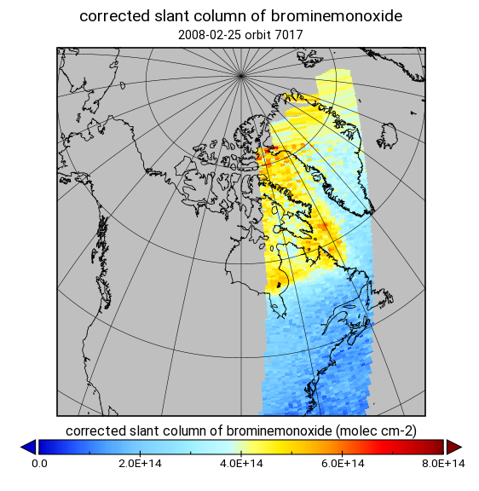
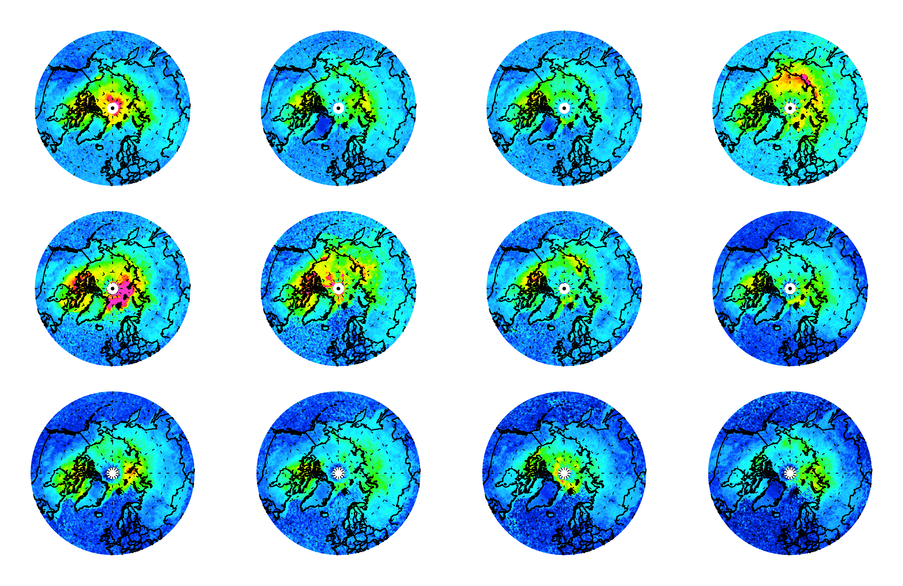
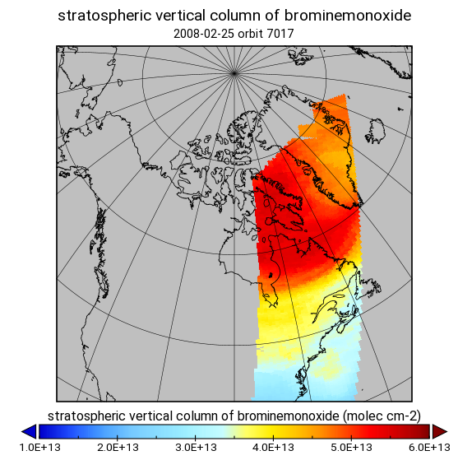
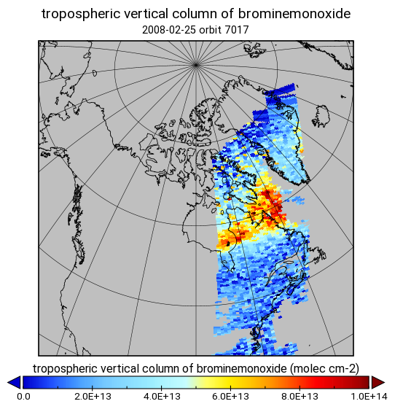
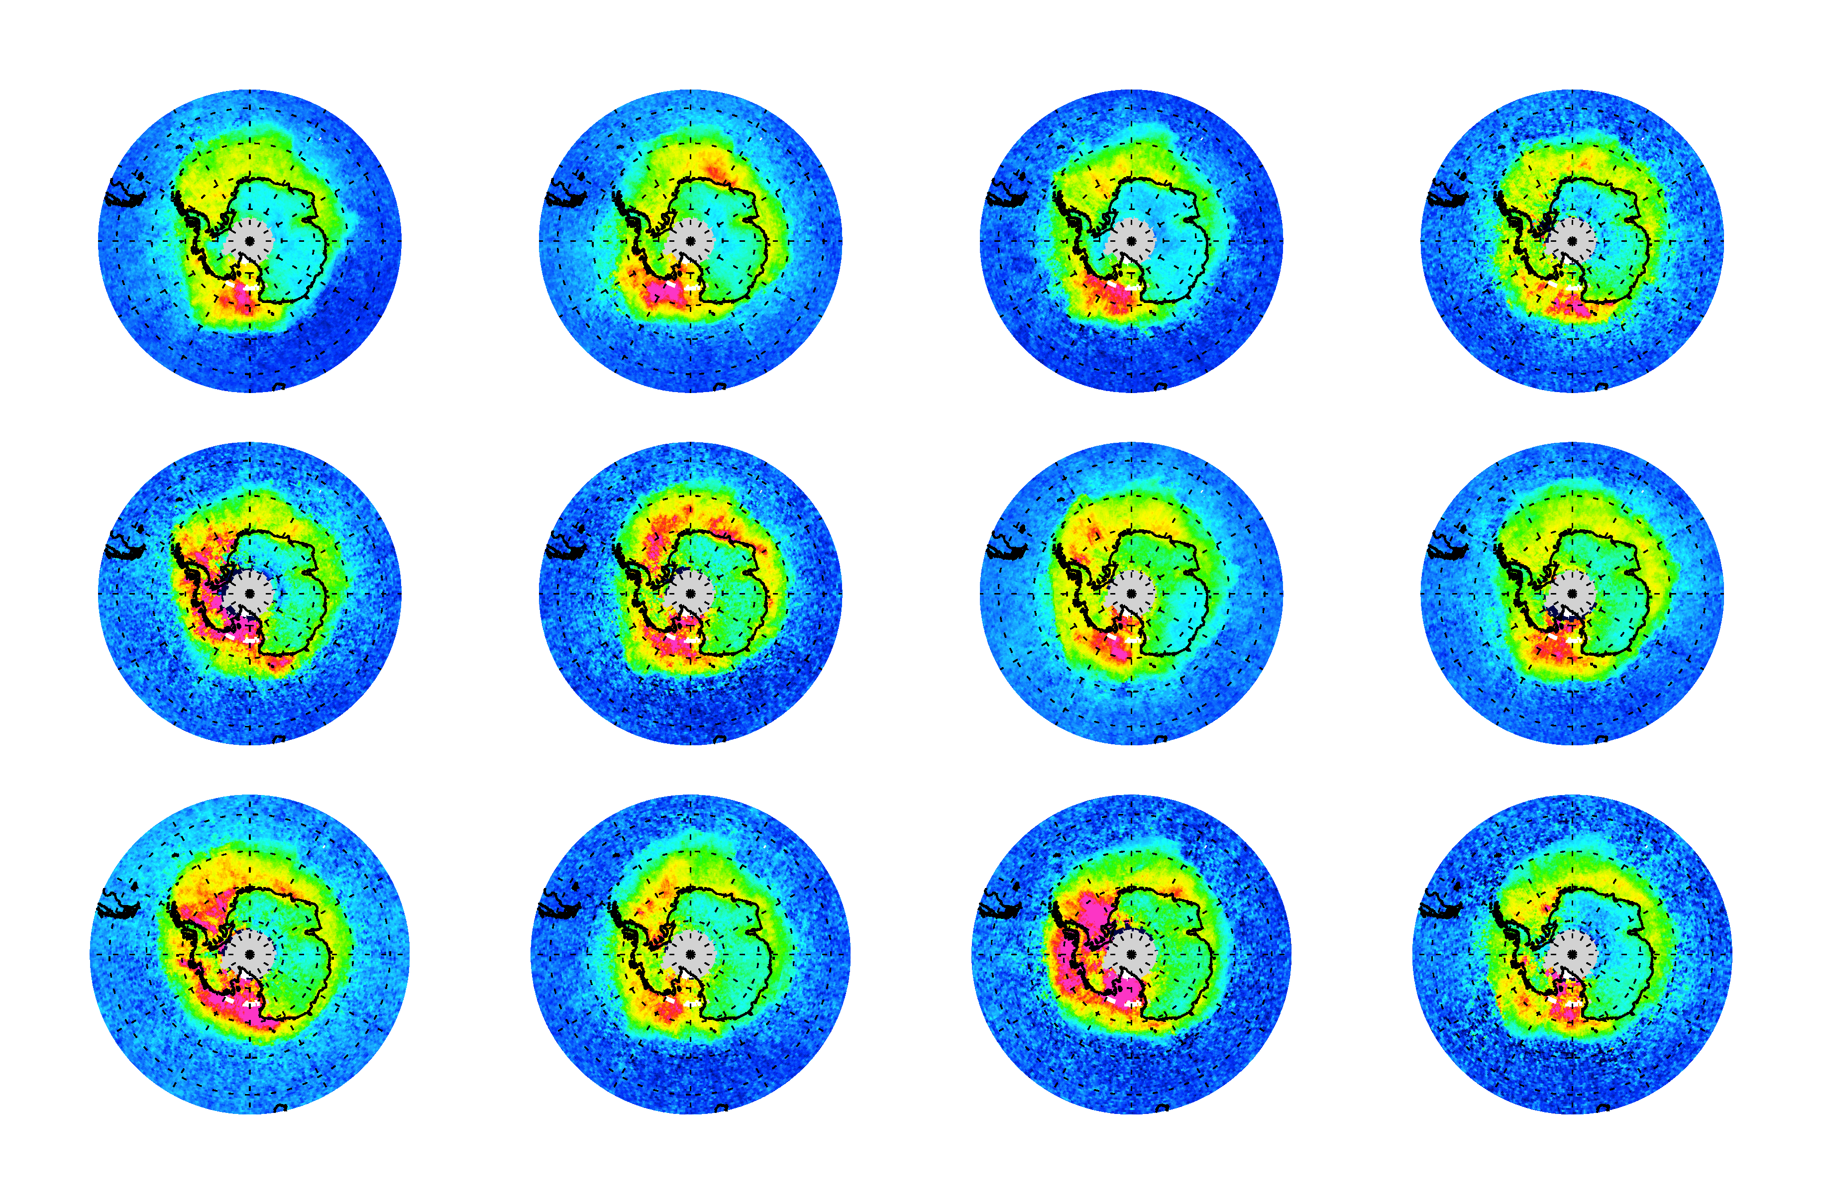
P3.5.5
Satellite tropospheric BrO column retrieval
DOAS BrO slant column retrieval
Fitting window: 332 – 359 nm
Solar reference
Absorption cross sections: BrO (223 K), O₃ (223 K and 243 K), NO₂ (220 K), HCHO (298 K), OClO (293 K), 2 pseudo-cross sections for O₃ at 223 K, Ring
(2) Stratospheric correction
Stratospheric BrO profiles from the climatology based on the output of the BASCOE
Stratospheric vertical column derived from the Theys et al. (2009) method via BrO/Bry ratio, O₃ and NO₂ columns from GOME-2 data
(3) Tropospheric air mass factor and vertical column computation
Residual method
The altitude-dependent air mass factors (AMF) are calculated with the LIDORT
Viewing geometry, surface albedo (GOME-based monthly minimum GLER; Tilstra et al., 2017), surface pressure, clouds, a priori BrO profile
March
2007
2008
2009
2010
2011
2012
2013
2014
2015
2016
2017
2018
* Monthly average of tropospheric BrO vertical columns from GOME-2
September
2007
2008
2009
2010
2011
2012
2013
2014
2015
2016
2017
2018
Notes:
2

Slide 3
P3.5.5
Satellite tropospheric BrO column retrieval
DOAS BrO slant column retrieval
Fitting window: 332 – 359 nm
Solar reference
Absorption cross sections: BrO (223 K), O₃ (223 K and 243 K), NO₂ (220 K), HCHO (298 K), OClO (293 K), 2 pseudo-cross sections for O₃ at 223 K, Ring
(2) Stratospheric correction
Stratospheric BrO profiles from the climatology based on the output of the BASCOE
Stratospheric vertical column derived from the Theys et al. (2009) method via BrO/Bry ratio, O₃ and NO₂ columns from GOME-2 data
(3) Tropospheric air mass factor and vertical column computation
Residual method
The altitude-dependent air mass factors (AMF) are calculated with the LIDORT
Viewing geometry, surface albedo (GOME-based monthly minimum GLER; Tilstra et al., 2017), surface pressure, clouds, a priori BrO profile
March
2007
2008
2009
2010
2011
2012
2013
2014
2015
2016
2017
2018
* Monthly average of tropospheric BrO vertical columns from GOME-2
September
2007
2008
2009
2010
2011
2012
2013
2014
=> Long-term tropospheric BrO records (14 yrs) from the GOME-2 instruments on Metop-A/B
2015
2016
2017
2018
Notes:
3

Slide 4
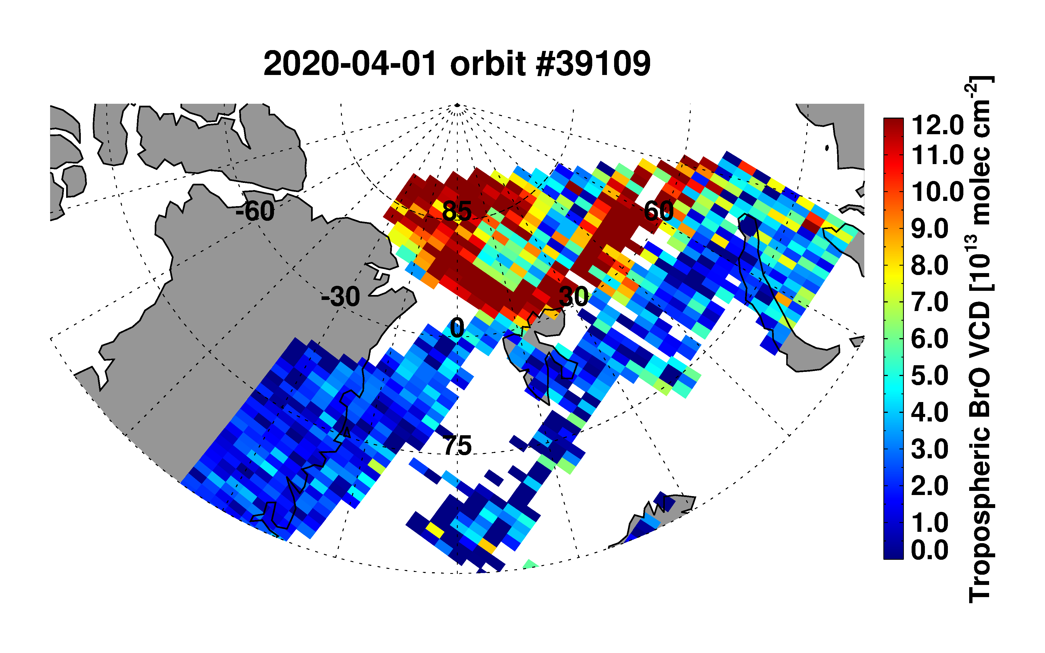
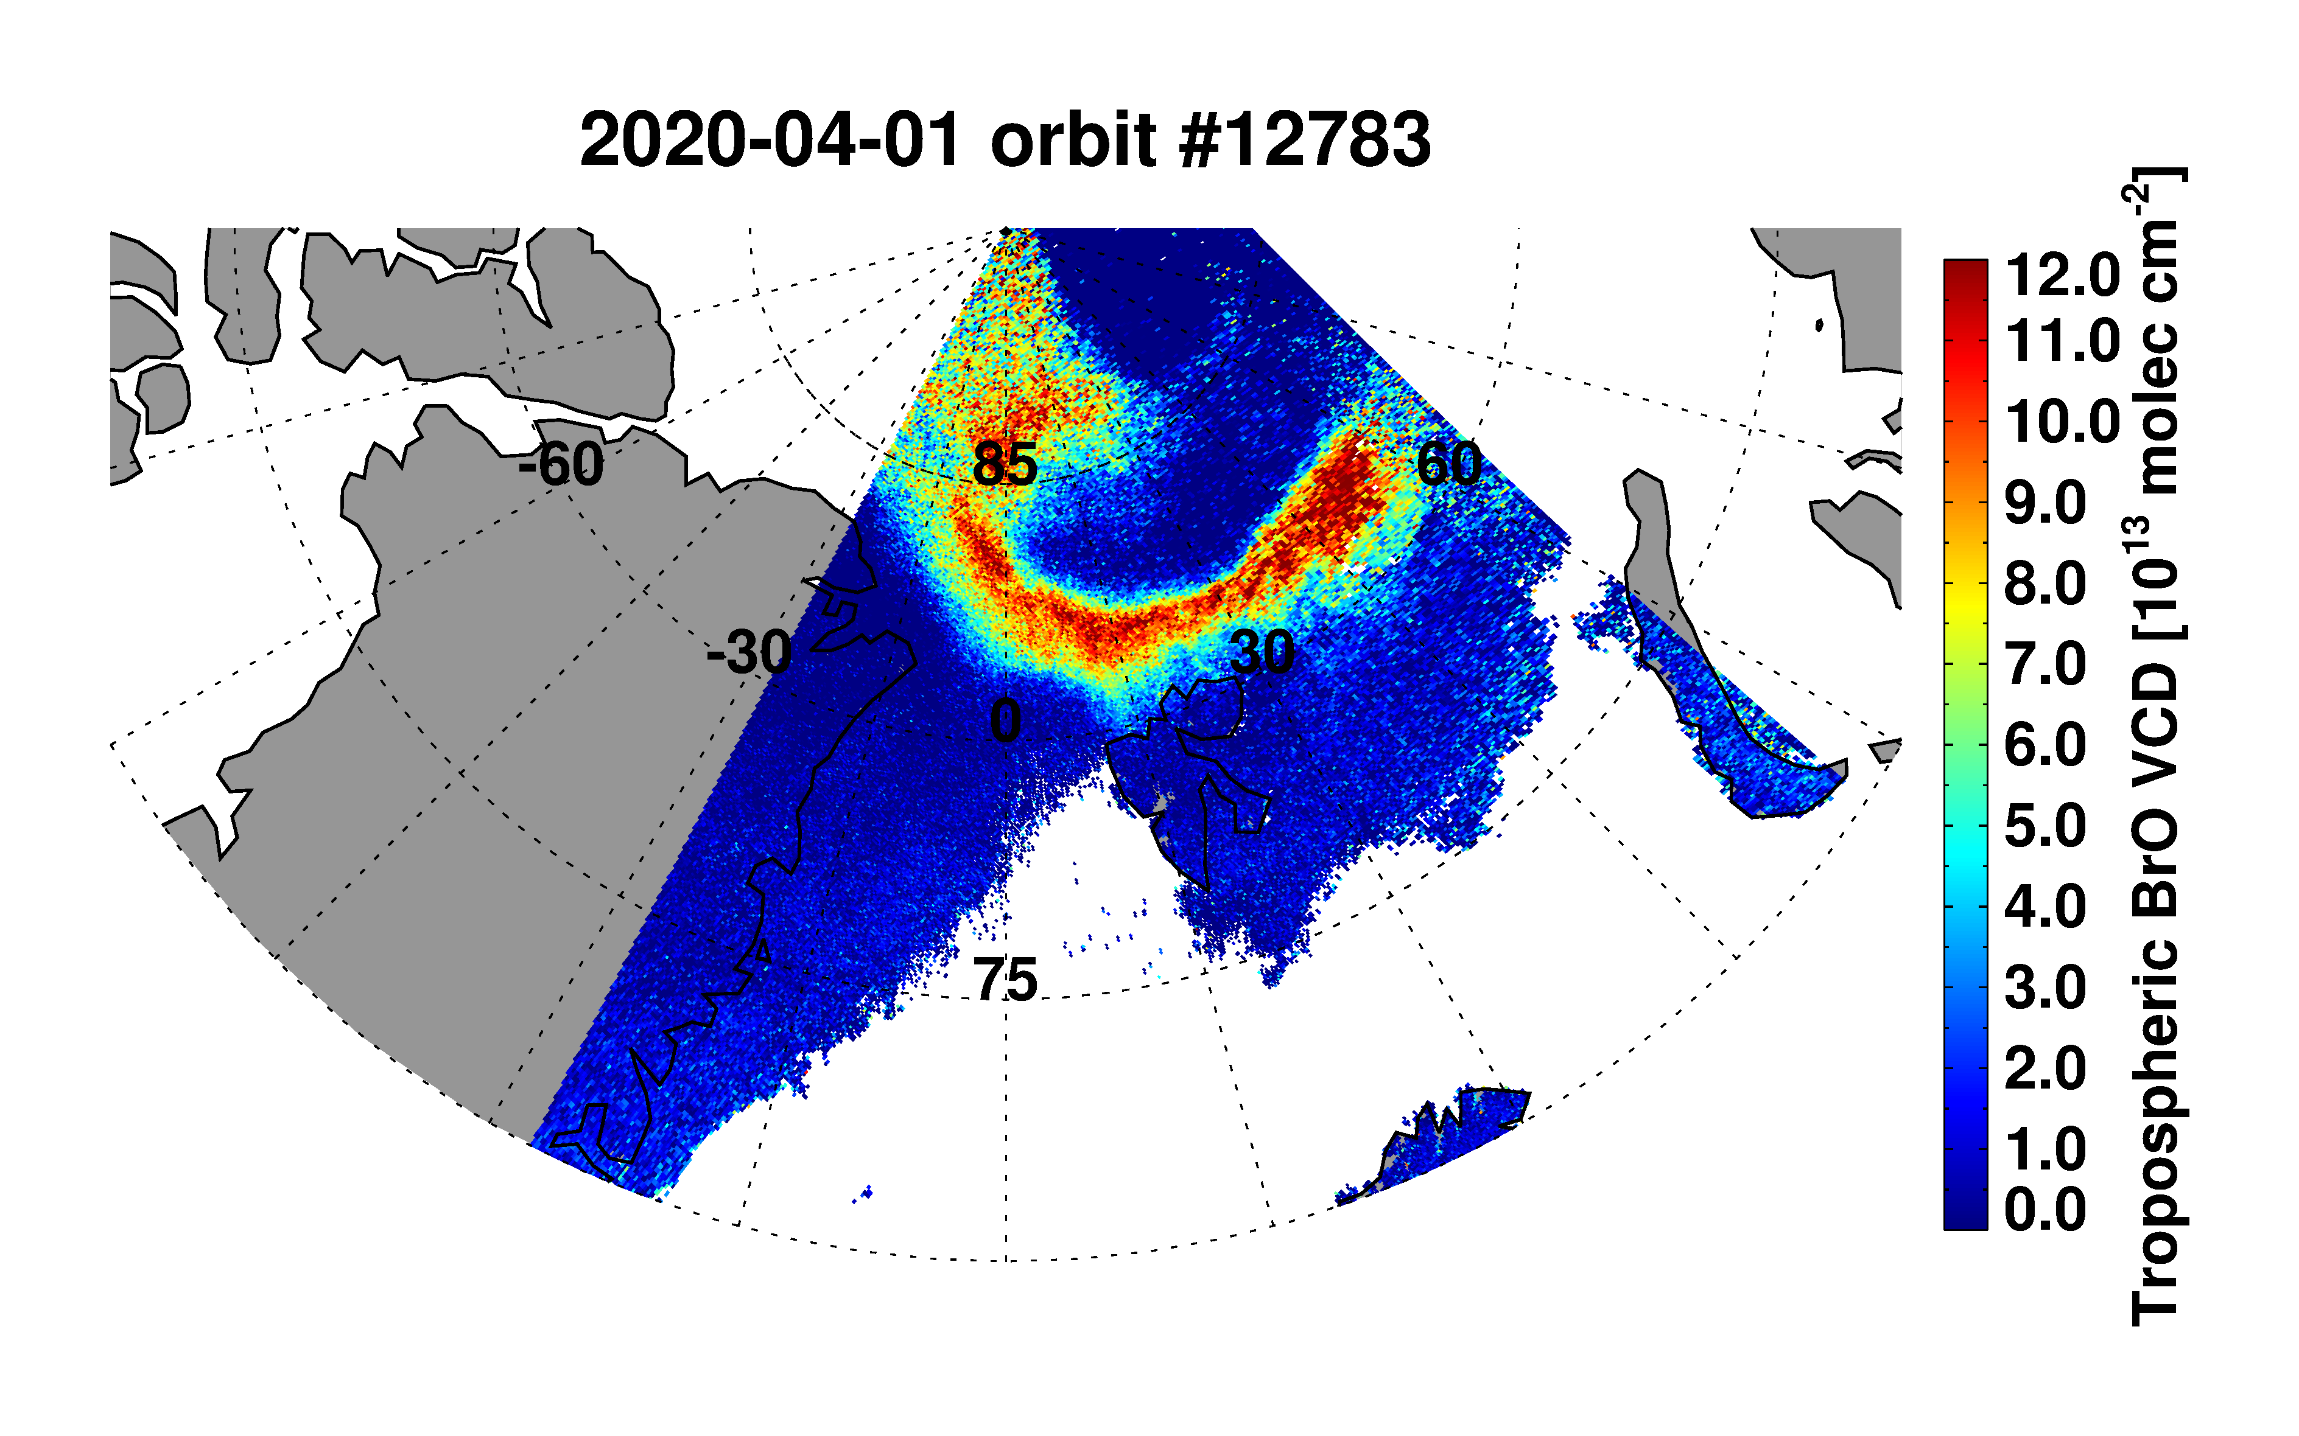
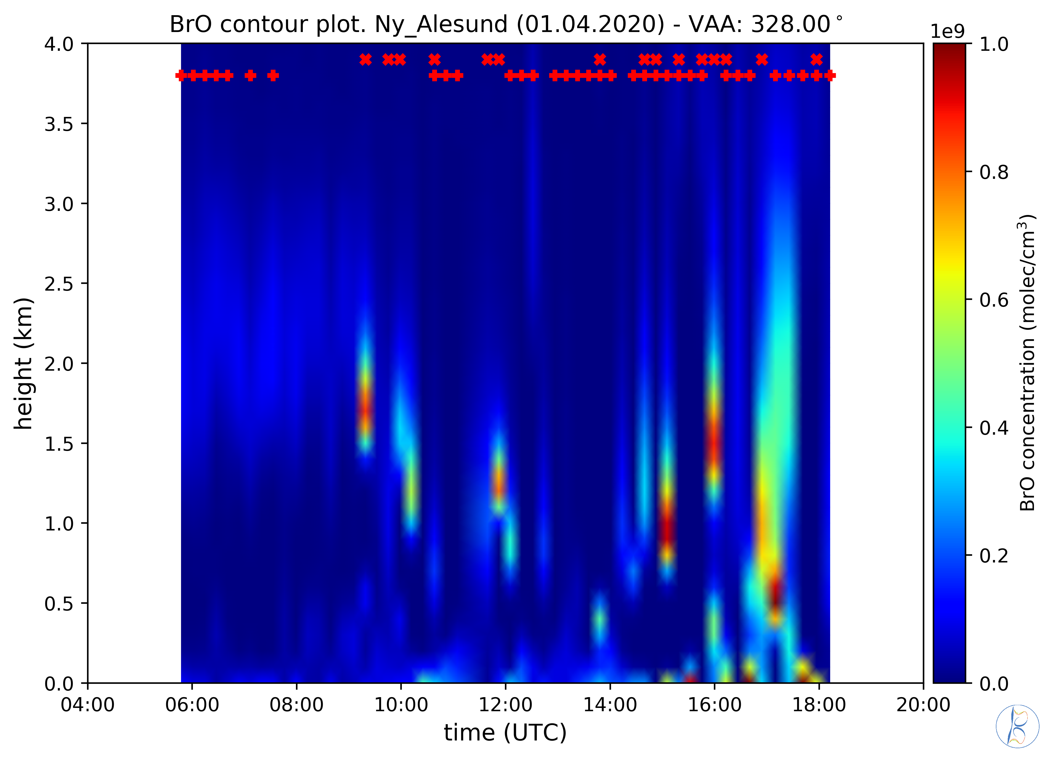
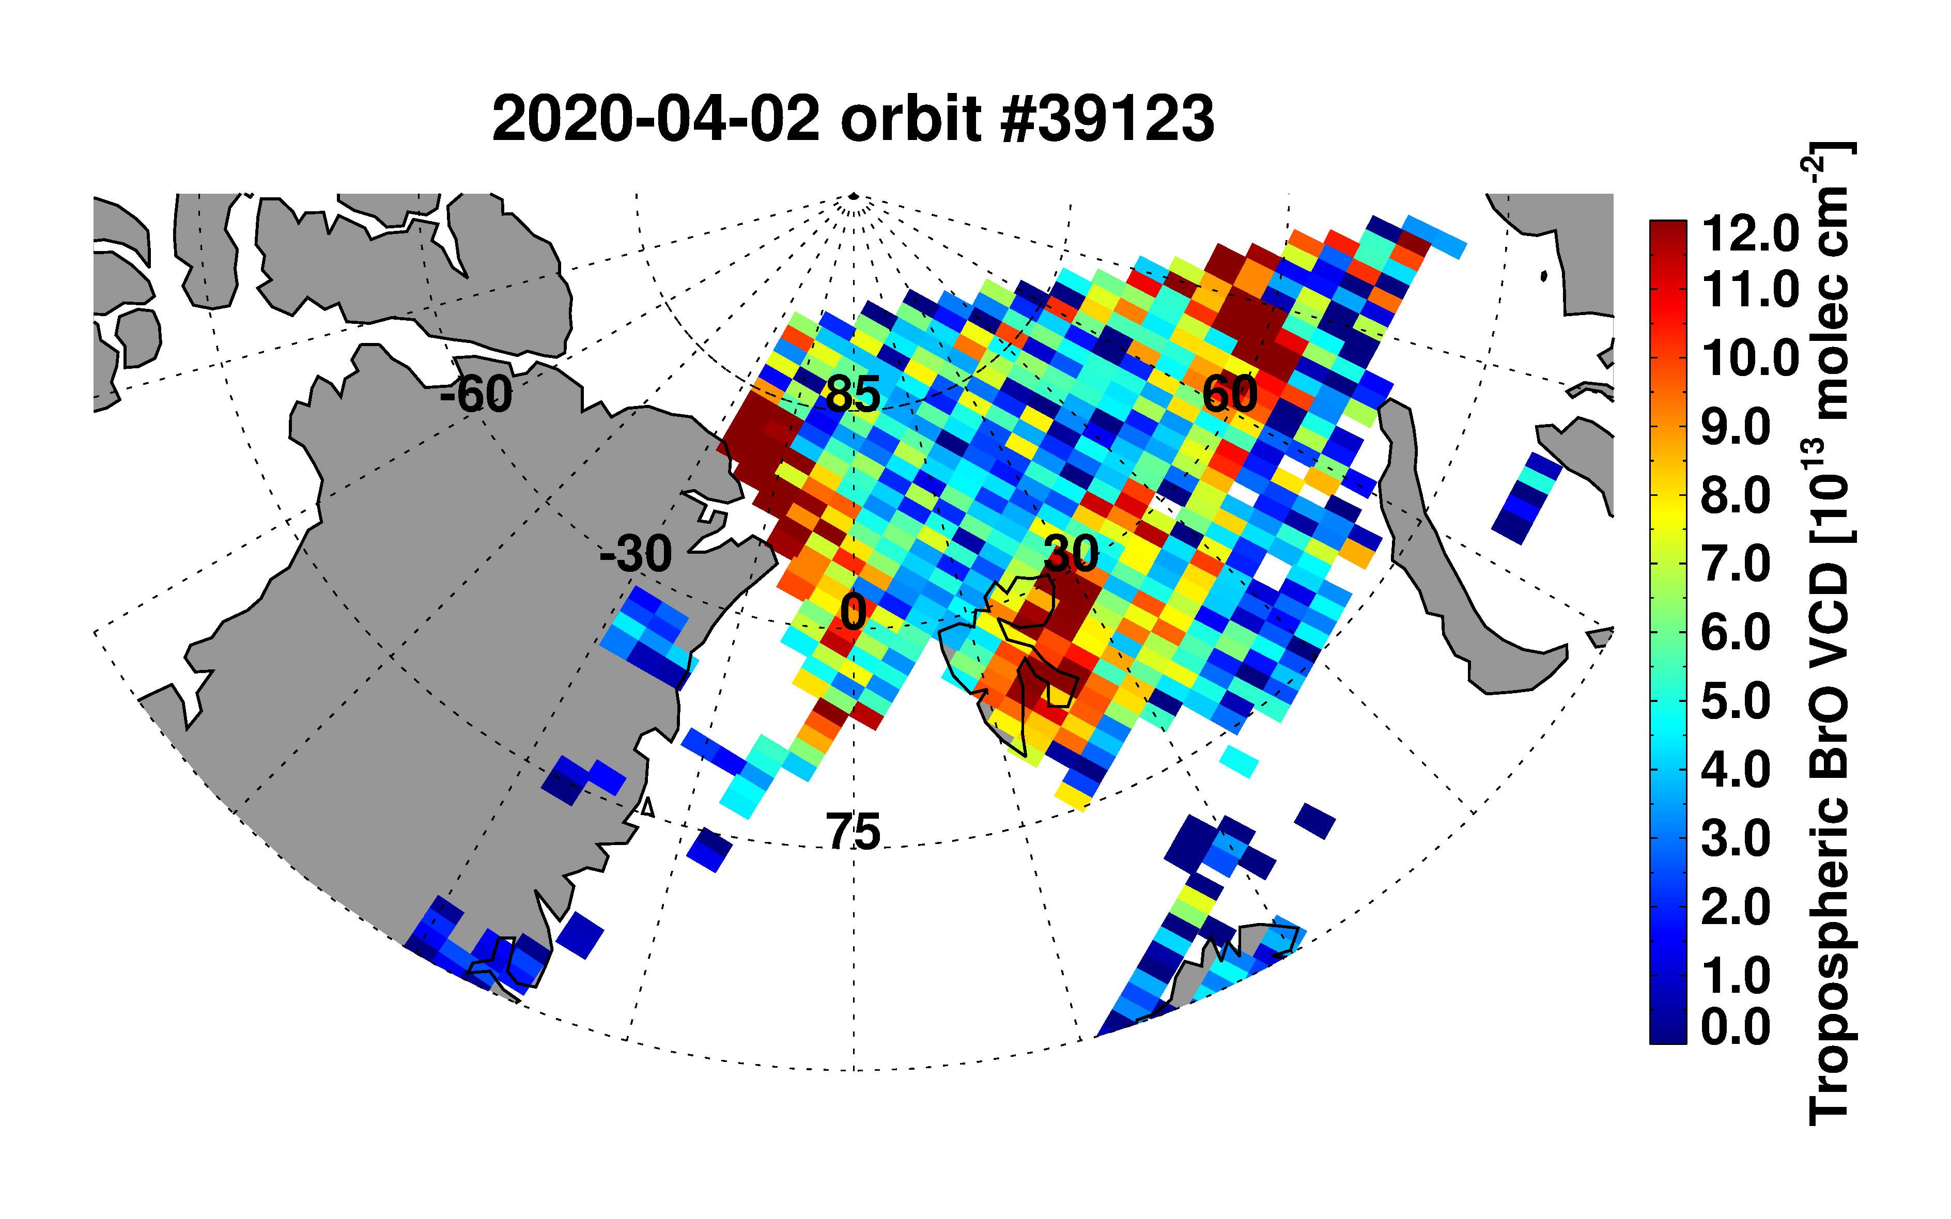
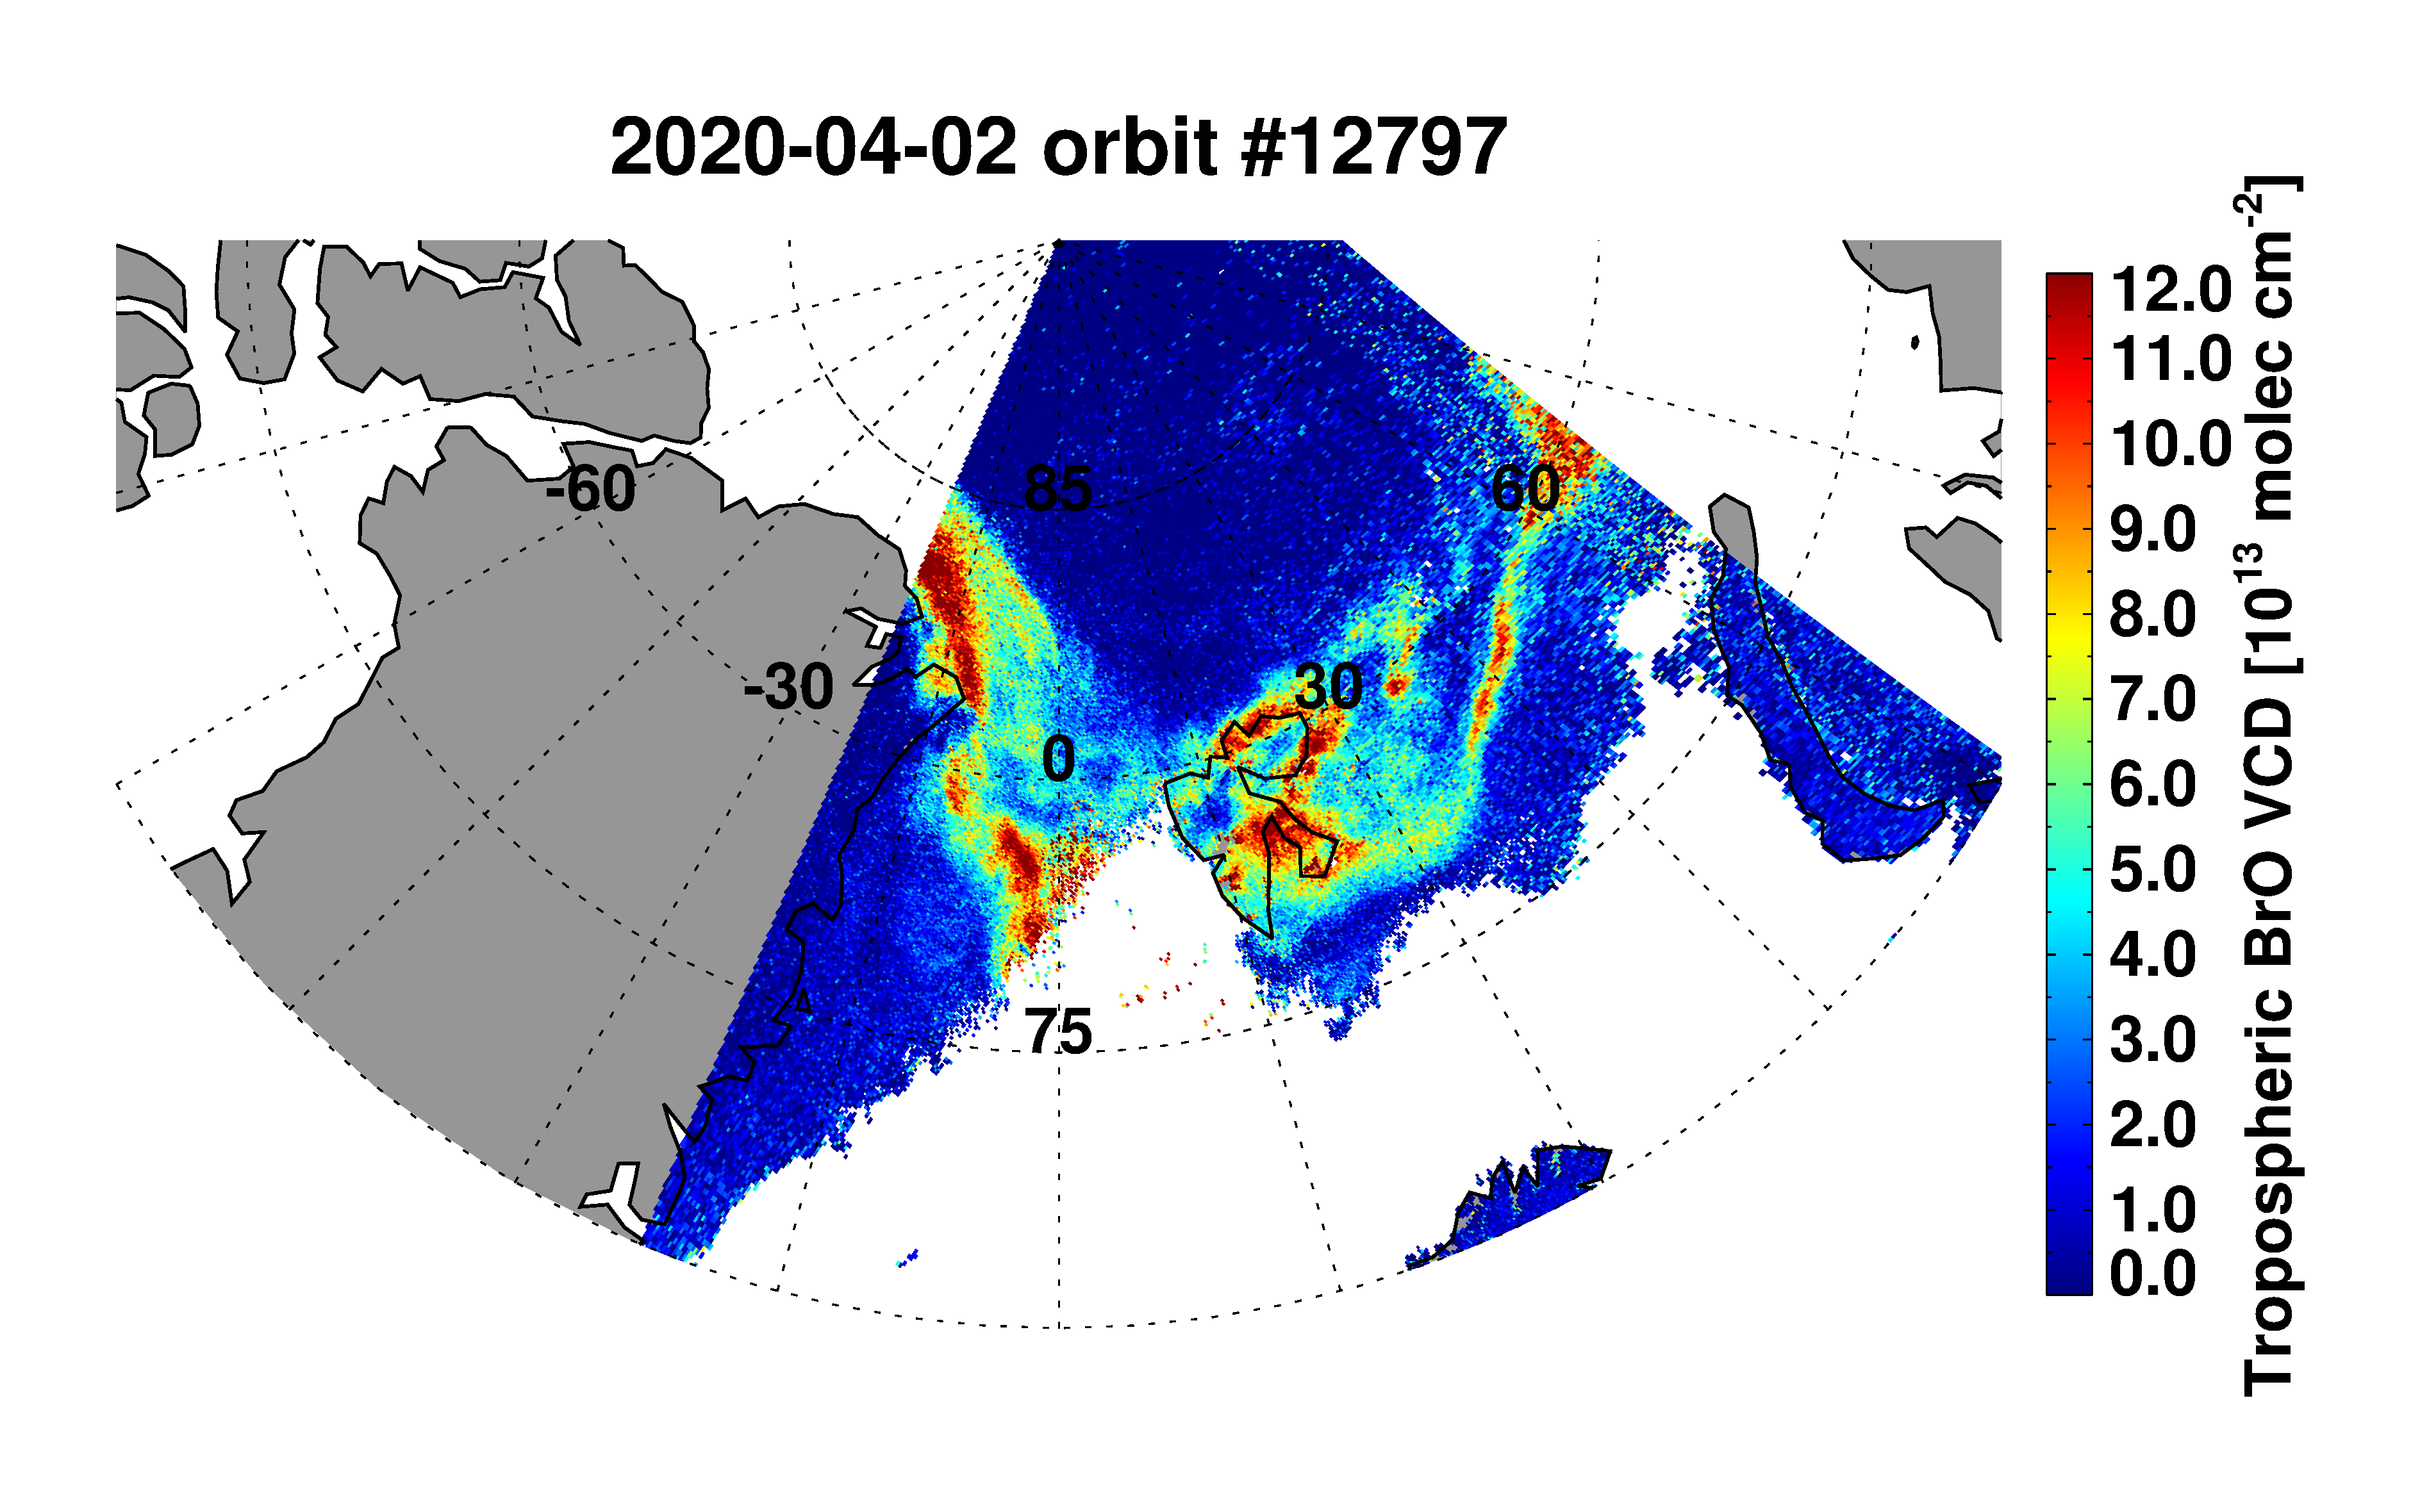
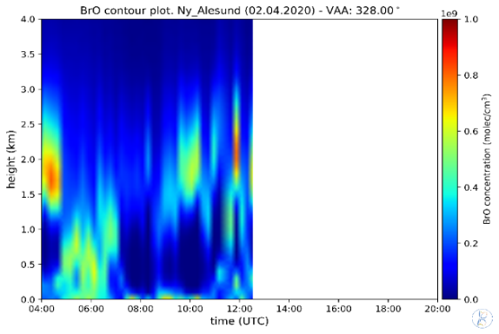
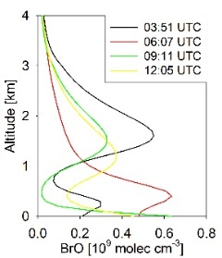
P3.5.5
Comparison to TROPOMI and ground-based measurements
GOME-2B
TROPOMI
MAX-DOAS
GOME-2B
TROPOMI
MAX-DOAS
GOME-2 and TROPOMI show similar spatial distributions of tropospheric BrO columns in spite of the differences in instrument resolution and overpass times
Small scale variations of tropospheric BrO can be observed by TROPOMI with a high spatial resolution (3.5x5.5km)
The present algorithm is planned to be applied to TROPOMI measurements, which makes it possible to extend the time series and monitor the spatial variations with a high spatial resolution
Notes:
4

