Slide 1
Detection Of Cloud Condensation Nuclei Using Multiple Products From A Single Instrument - Sentinel-5P Case Study
Alexandru Dandocsi, Daniele Gasbarra, Christian Retscher
ESA/ESRIN
25/11/2021

Slide 2
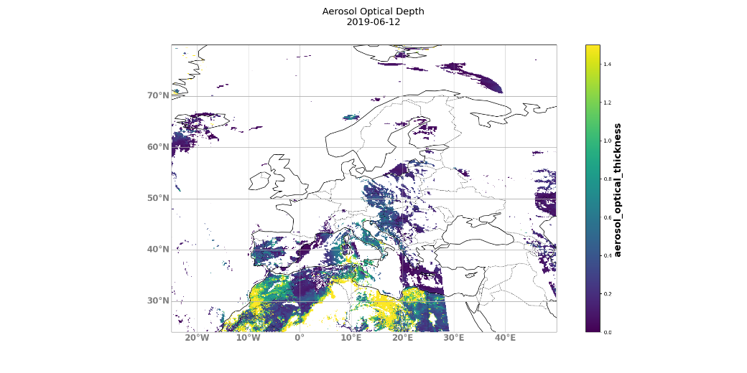
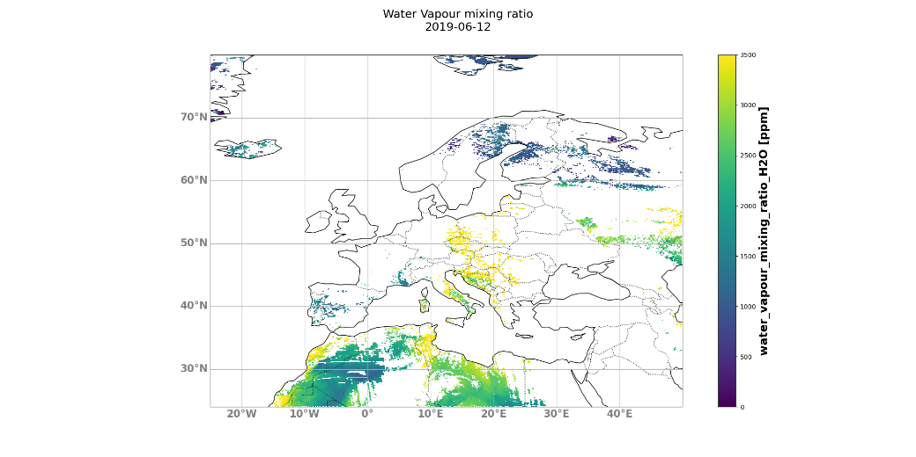
Motivation & Methodology
Feasibility study that uses a single instrument to detect cloud condensation nuclei
Innovation (H₂O, pres. 3.1.1 & 3.1.2; and AOD, pres. 4.3.6 & 4.3.7) and operational products (AI, ALH, CF) are considered in this study
Innovation H₂O:
SWIR sensor (7 x 7 km)
Algorithm based on Leicester Full Physics
Land coverage
Innovation AOD
UV-VIS sensor (3.5 x 5.5 km)
OMI heritage
5 wavelengths (340, 380, 416, 440, 494 nm)
Cloud free scenes
Time frame: March – October 2019
ROI: Europe [24º – 80º Lat; -25º – 50º Lon]
Daily re-gridding to 0.1 x 0.1 degrees of both datasets

Slide 3
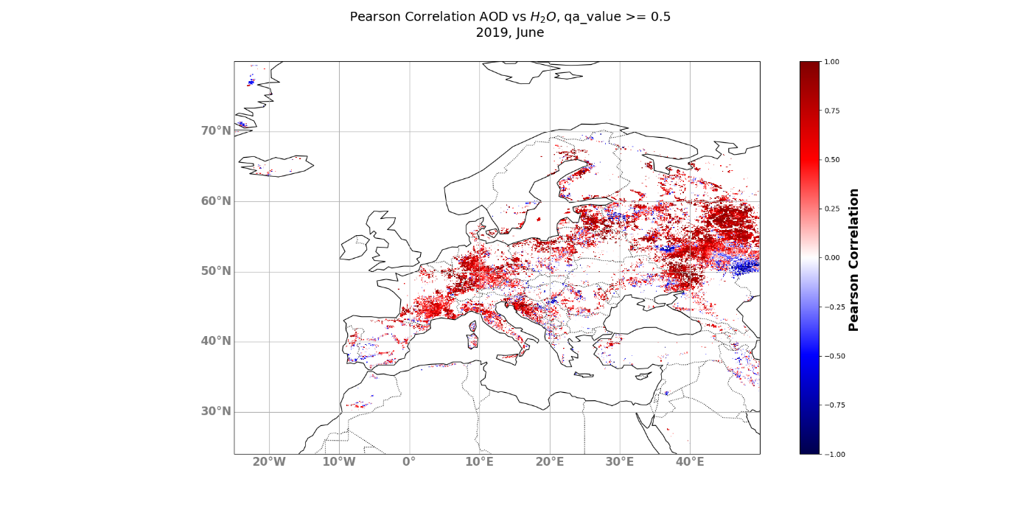
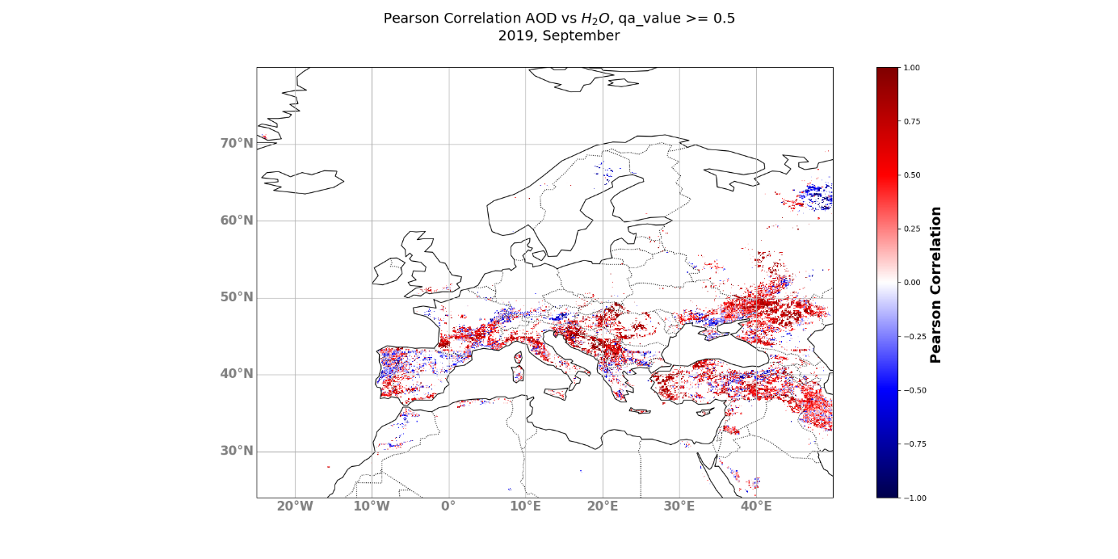
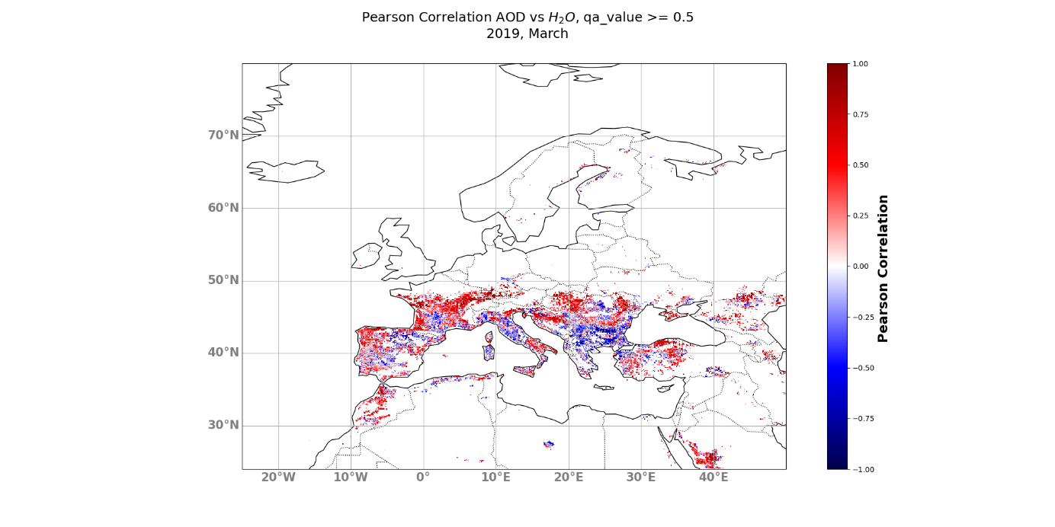
Quality assured filters (qa_value > 0.5) according to each of the product’s ATBD
Monthly and weekly maps with the Pearson correlation coefficient for the interested ROI; each pixel needs to have at least 5 measurements from both products in the same days
Examples of March, June, and September 2019; Monthly correlations between water vapour mixing ratio and AOD (494 nm) show almost nominal values (central Europe) but also negative correlations
Methodology & Results

Slide 4
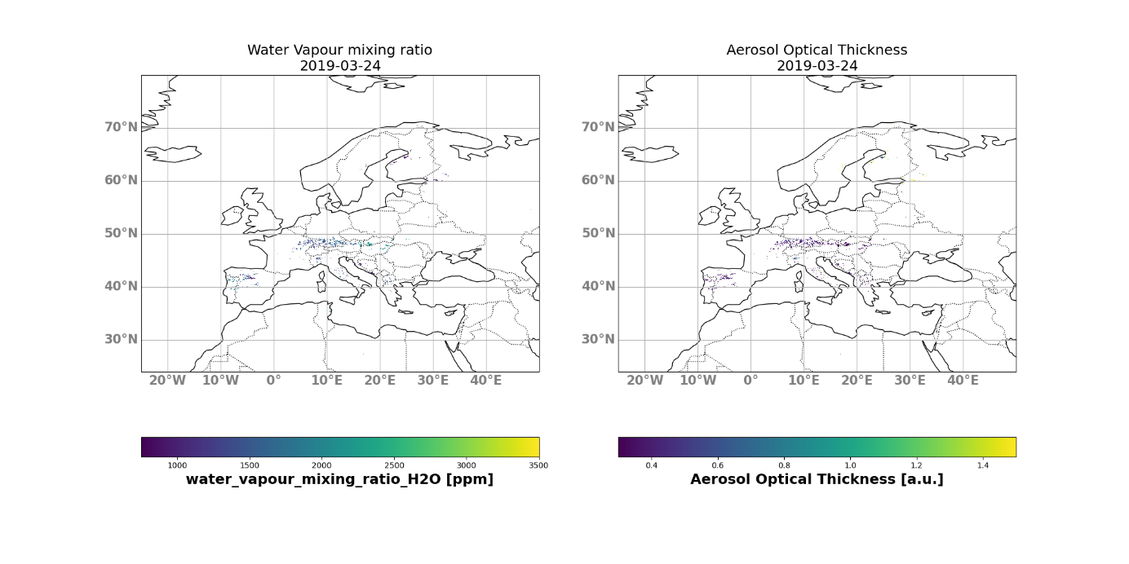
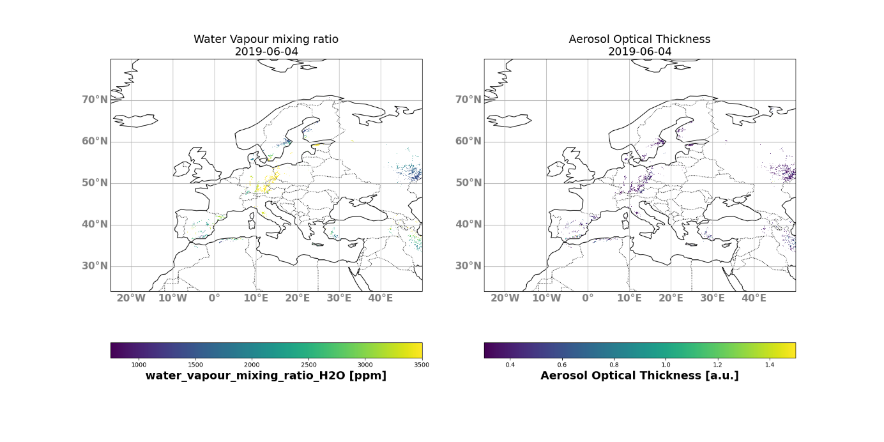
Results, Conclusion & Future steps
High correlation -> hygroscopic particles
Include information on AI, AE
Threshold on water vapour and AOD values
Daily plots on data only with AOD > 0.3 and WV > 750 ppm
Validation on cloud formation after Tropomi sensing time
Other satellite, e.g. S1
Ground based, e.g. ceilometers, photometers
Define empirical values for WV, AOD, AI that indicates presence of CCN
Quasi-operational procedure
Suitable for upcoming missions, S4 + S5

