Slide 1
Use of aerosol information from the CO2M multi-angle polarimeter in the University of Leicester full physics XCO2 retrieval A. Di Noia¹, P. Litvinov, H. Boesch, O. Dubovik, C. Chen, D. Fuertes, T. Lapyonok, A. Lopatin, C. Matar, and Y. Meijer

Slide 2
GRASP – UoL sequential CO₂ retrieval
Full physics CO₂ retrieval scheme for CO2M with aerosol a priori informed by MAP
Aerosol microphysical properties retrieved from MAP using GRASP
Optical properties in CO2 bands computed via kernel-based LUT
GRASP
MAP aerosol parameters
Kernel LUT
SWIR aerosol optical properties
UoL-FP
CO2I XCO2 retrieval

Slide 3
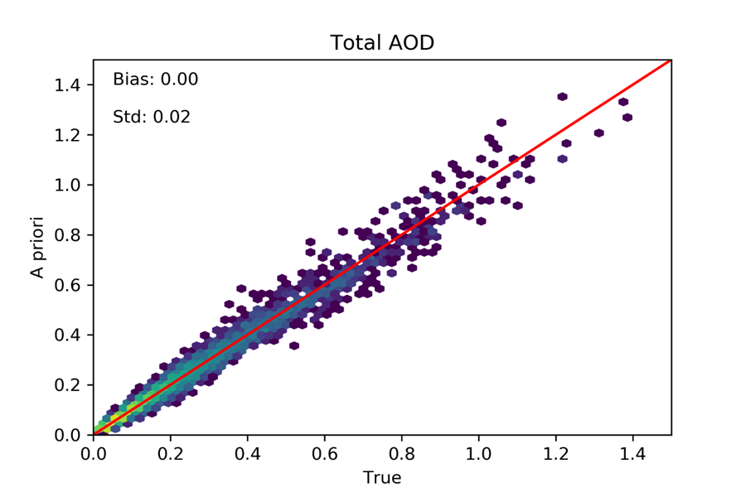
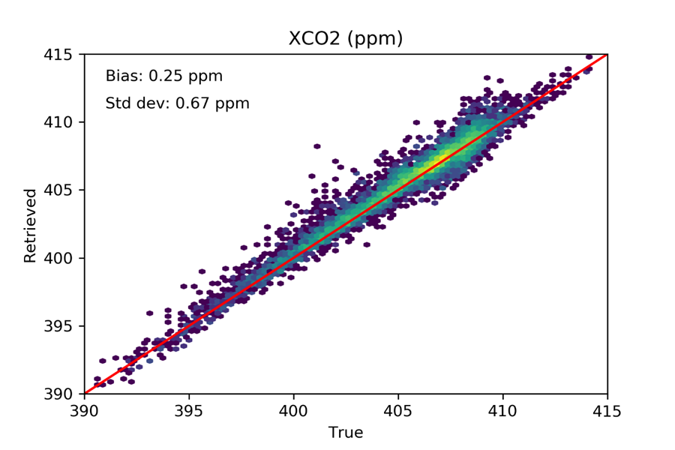
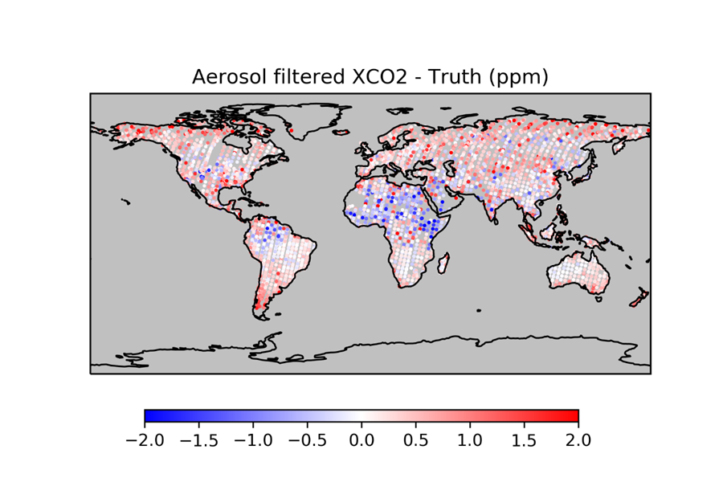
Early results
Interface between GRASP and UoL retrieval schemes successfully established
First simple XCO2 retrievals with GRASP aerosol inputs carried out
Early results are promising, but further optimization needed both in GRASP and in
the UoL CO₂ retrieval

