Slide 1
AEOLUS Aerosol Assimilation in the DISC (A3D)
ATMOS 2021
Julie Letertre-Danczak, Angela Benedetti, Drasko Vasiljevic, Alain Dabas, Thomas Flament and Dimitri Trapon
With the support of Melanie Ades, Zak Kipling, Tomas Kral, Gabor Radnoti, Roberto Ribas and many others

Slide 2
Objectives
This Photo by Unknown Author is licensed under CC BY-NC

Slide 3
Why do we want to assimilate lidar backscatter profile in COMPO-IFS?
COMPO-IFS is doing a good job already having a strong model for aerosol and a beneficial assimilation of AOD coming from MODIS (AQUA and TERRA) and PMAp.
The problem is the AOD is an column integrated data, no vertical distribution information is available.
Attributing the plume to an altitude can have a detrimental effect.
The backscatter profile is providing a key information that can only have positive effect in the system assimilation.

Slide 4
First step: Monitoring

Slide 5
Importance to monitor the instrument
The benefits to monitor an instrument are:
Observe any deviation of the instrument
Validate the quality of data
Notice any degradation
Recognise any artefacts introduce by the algorithm
….

Slide 6
Monitoring of AEOLUS L2A for October 2019 and April 2020
When looking at the first result comparing the observations with the first guess departure, it is clear that some artefact are left in the observations. It can be observed in both periods.
The standard deviation is out of range

Slide 7
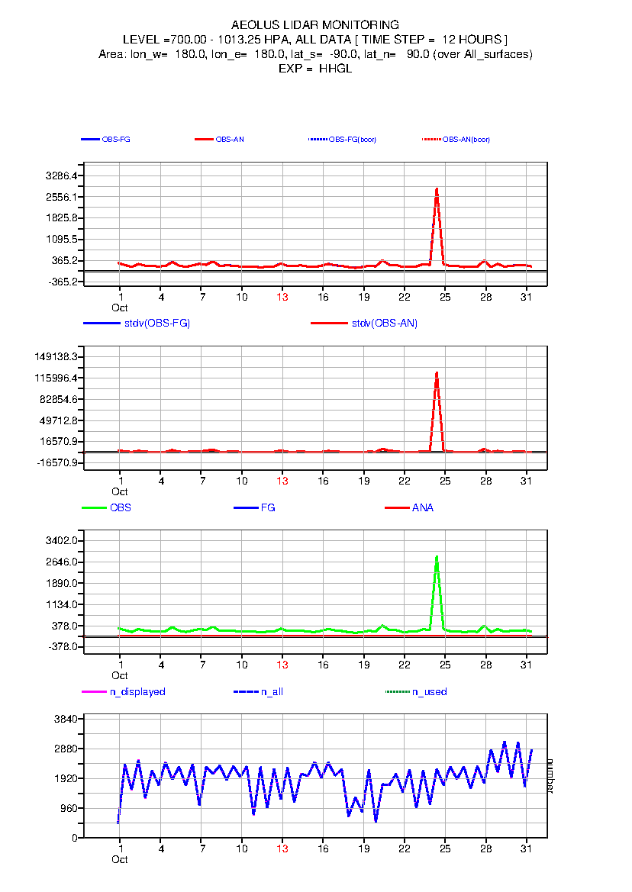
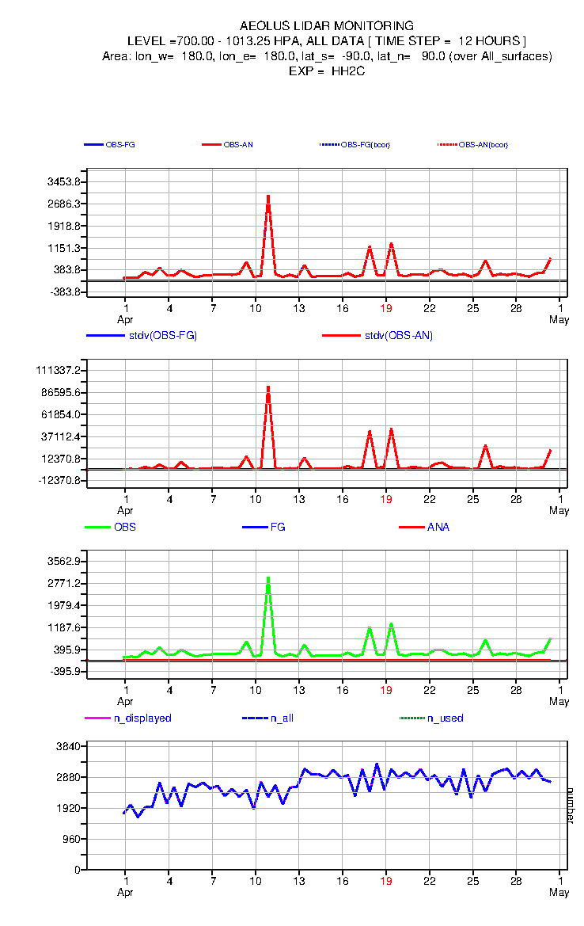
Monitoring of AEOLUS L2A for October 2019 and April 2019

Slide 8
Monitoring of AEOLUS L2A
The monitoring shows:
Some artefacts are present for some days for AEOLUS.
No link can be done with the AEOLUS time line status
Will the assimilation be able to remove these artefacts?

Slide 9
Second step: Assimilation

Slide 10
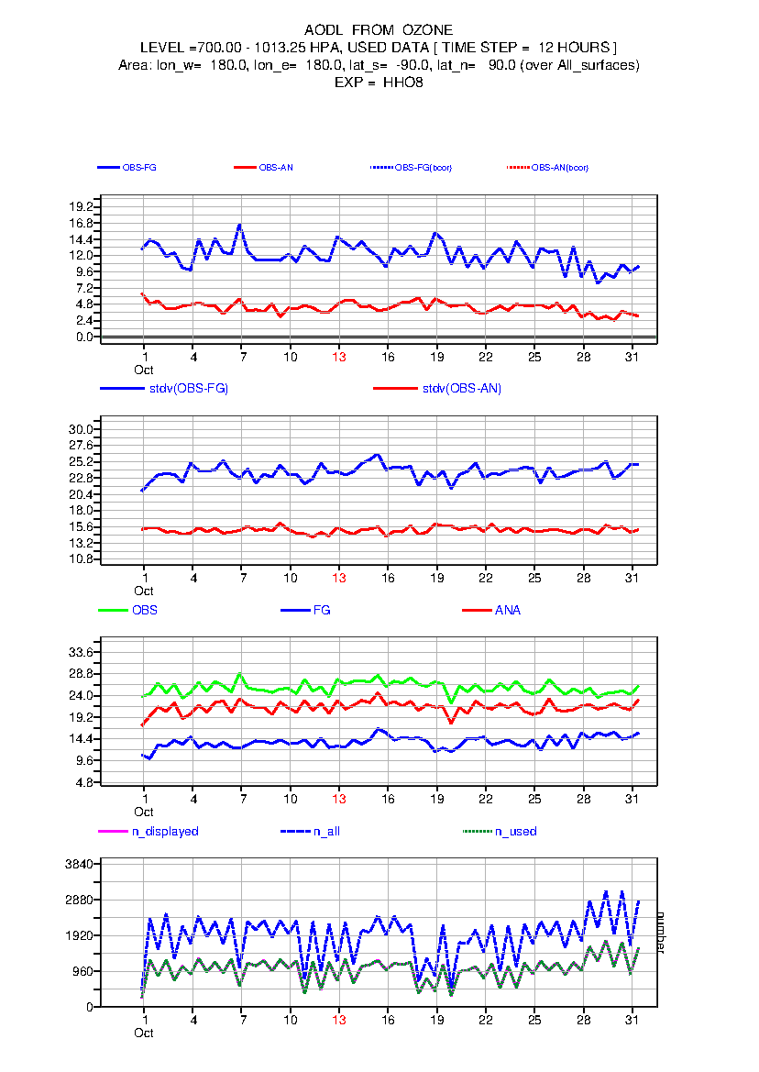
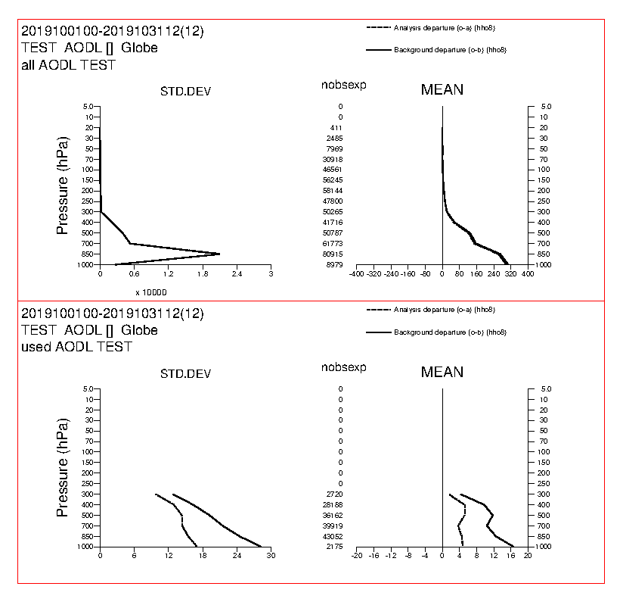
Assimilation of AEOLUS L2A for October 2019
bias
Large reduction of the range of data

Slide 11
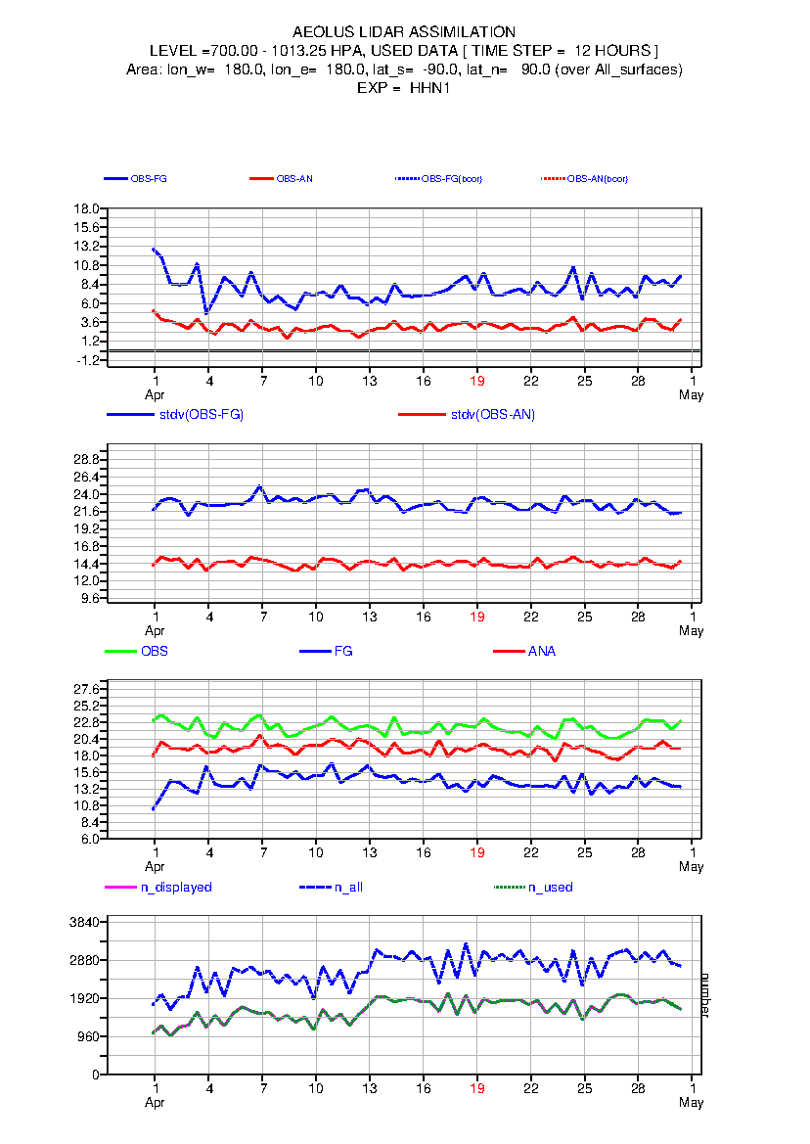
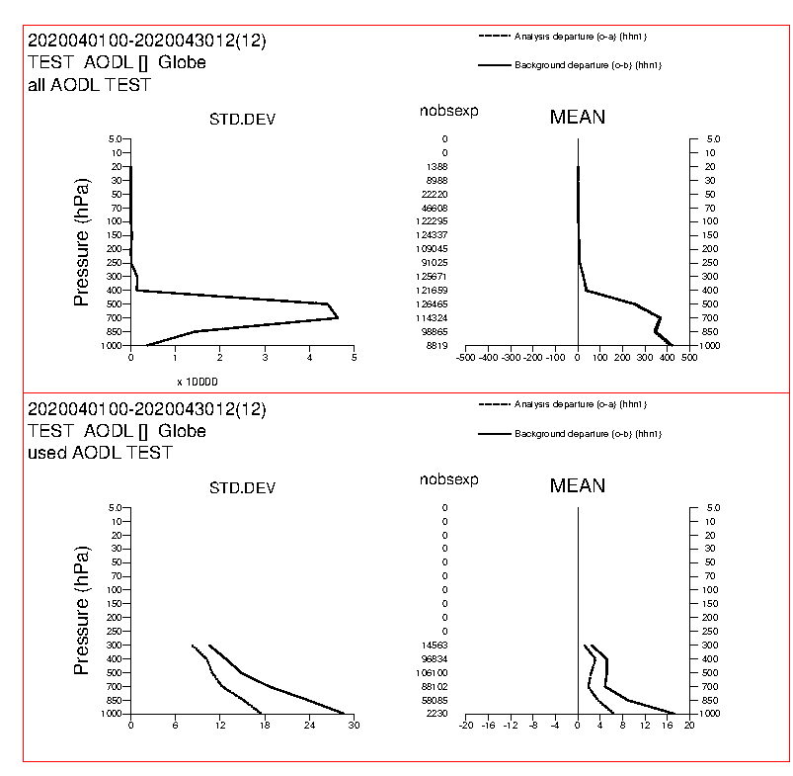
Assimilation of AEOLUS L2A for April 2020
bias
Large reduction of the range of data

Slide 12
Assimilation results
The assimilation shows:
Elimination of major artefact for AEOLUS L2A
Decrease of 50% of data for AEOLUS L2A
Decrease of the bias between the observation and the model but still a bias left after assimilation.
Positive impact of the assimilation as it is bringing the model closer to the observation
Will a cloud screening based on the model be able to remove the residual bias for AEOLUS L2A?

Slide 13
Third step: Cloud screening

Slide 14
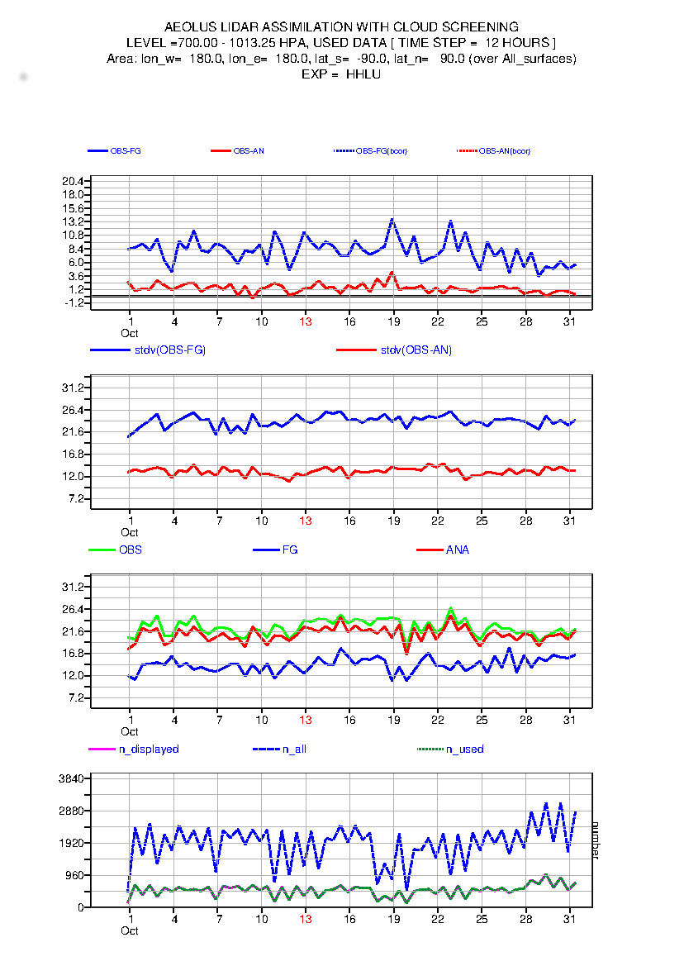
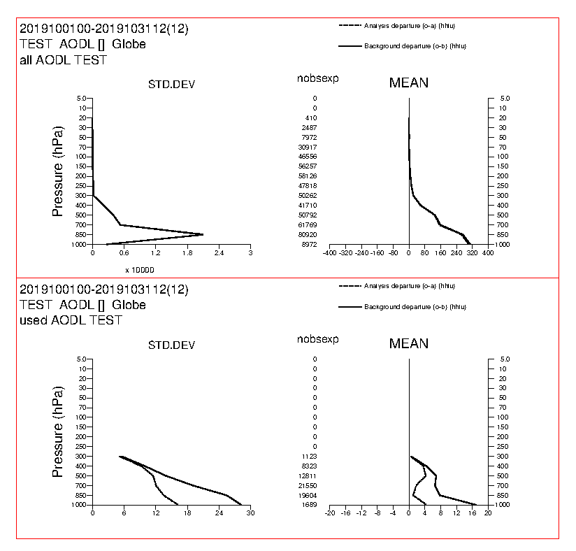
Assimilation with cloud screening for October 2019
Bias reduction

Slide 15
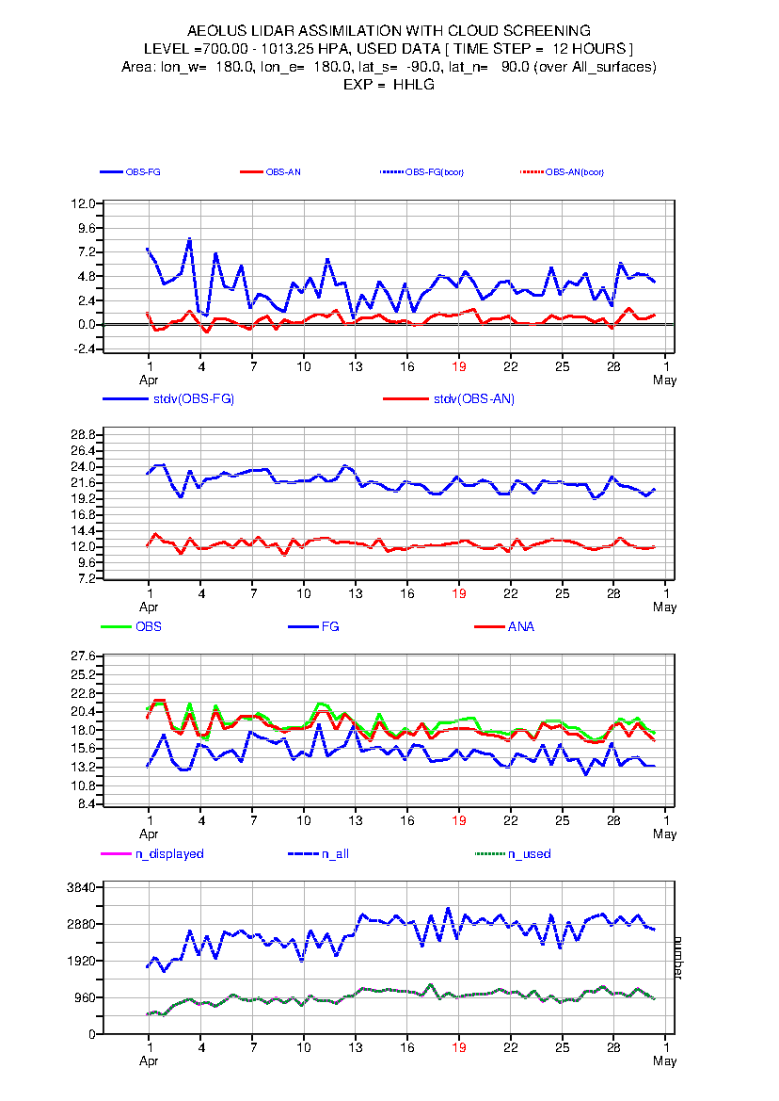
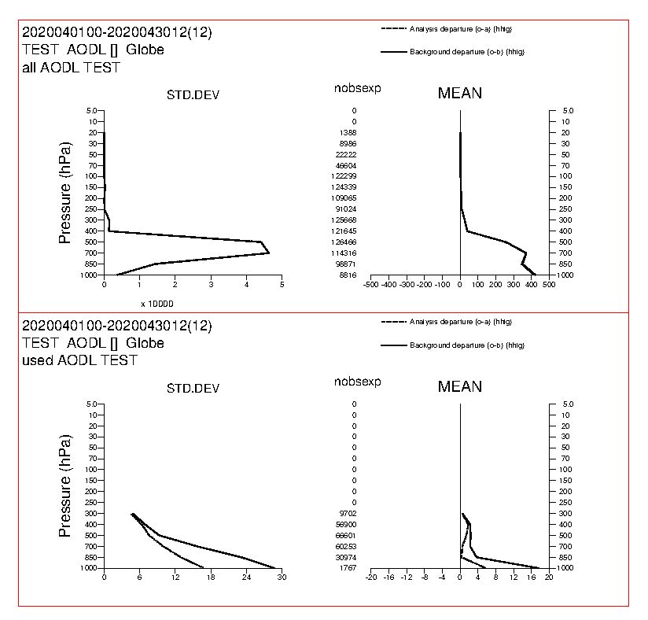
Assimilation with cloud screening for April 2020
Bias reduction
The assimilation is reaching the no bias

Slide 16
Assimilation with cloud screening results
The cloud screening shows:
Elimination of the residual bias
Decrease of 75% of data
Positive impact of the assimilation as it is bringing the model even closer to the observation
Will the comparison with independent data be improved by the backscatter profile assimilation?

Slide 17
Forth step: Comparison with AERONET

Slide 18
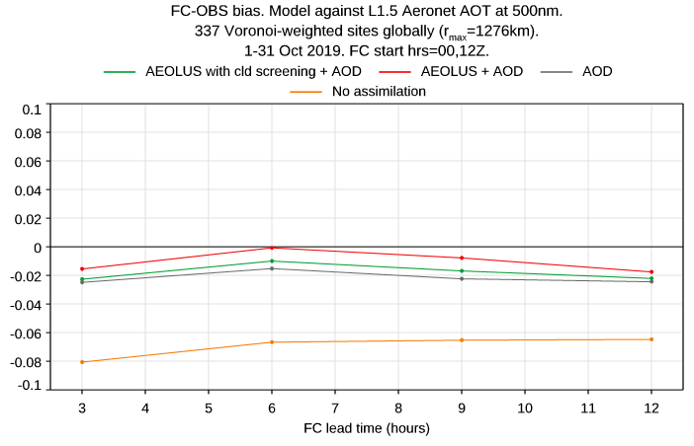
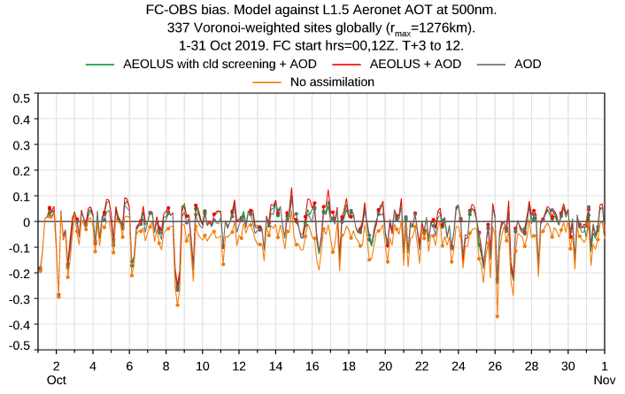
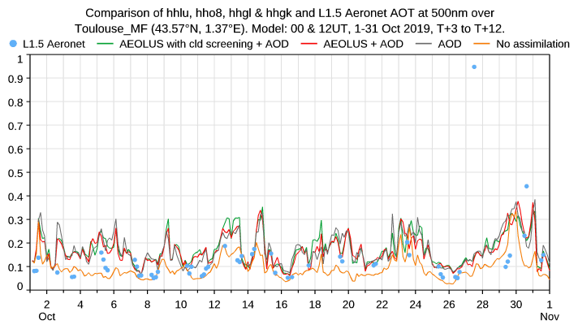
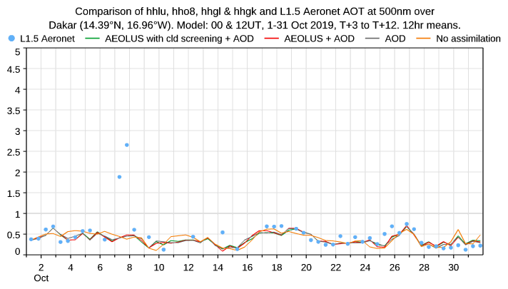
October 2019 AEOLUS

Slide 19
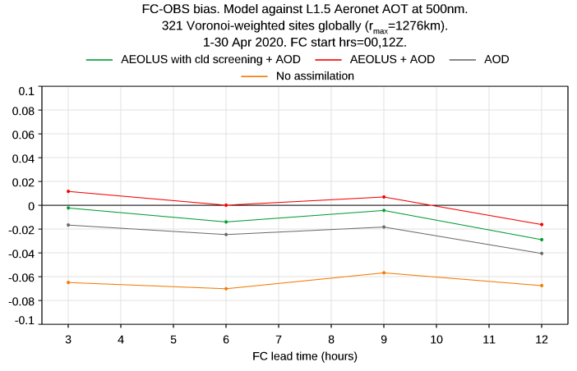
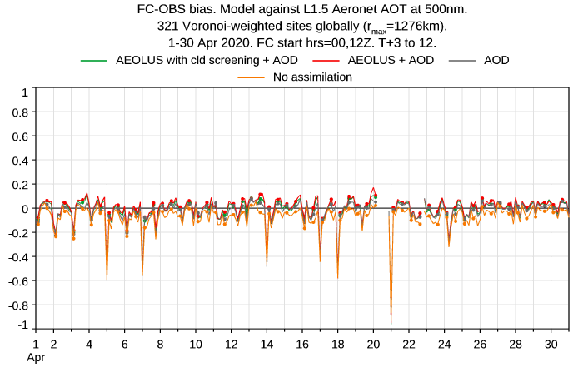
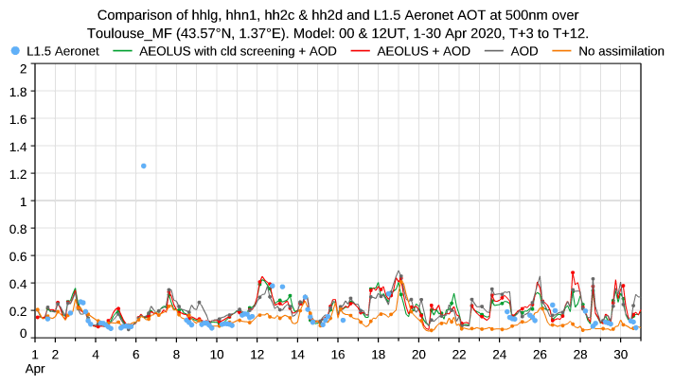
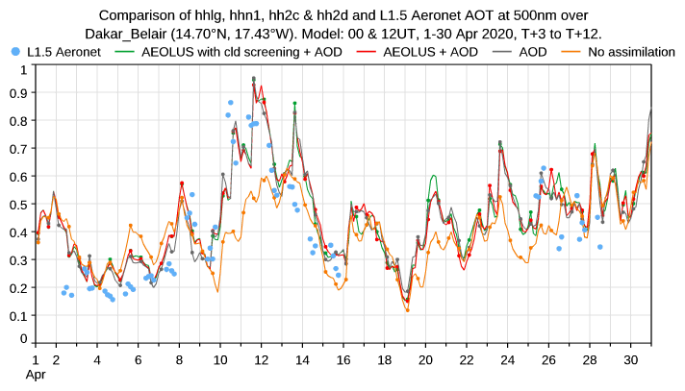
April 2020 AEOLUS

Slide 20
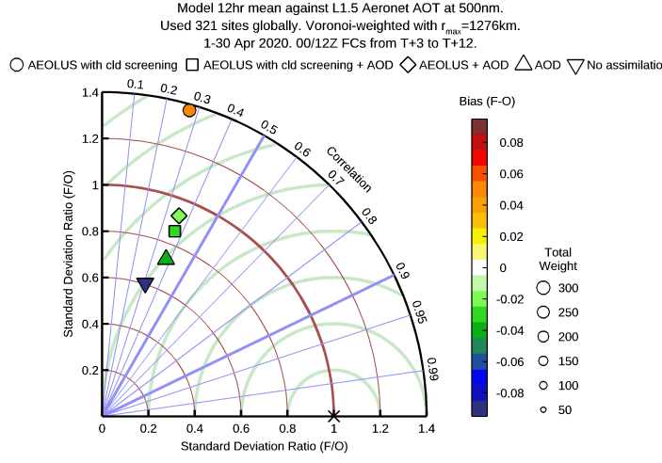
Taylor diagrams AEOLUS
The best results are given by the assimilation of AOD and AEOLUS. The assimilation of AEOLUS only shows a positive bias

Slide 21
Assimilation with cloud screening results
The comparison with AERONET shows that the assimilation of AEOLUS on top of the AOD is improving the AOD estimate by the model.
The improvement done by the cloud screening on the observation assimilation is not perceptible here.

Slide 22
Conclusion

Slide 23
Conclusion
During the first part of the project, Aeolus L2A data have been used to demonstrate the positive impact that the assimilation of aerosol backscatter can have on COMPO-IFS.
The impact and necessity of monitoring has also been demonstrated.
A cloud screening based on the model using internal or AUX files can improve the quality of data.
AEOLUS was not dedicated to aerosol but the scientific teams have managed to extract a product of good quality from the data.

