Slide 1
P1.3.5
TROPOMI Aerosol Index: Overview & Outlook
Deborah Stein Zweers, ESA Atmos
KNMI – The Netherlands?
23 November 2021

Slide 2
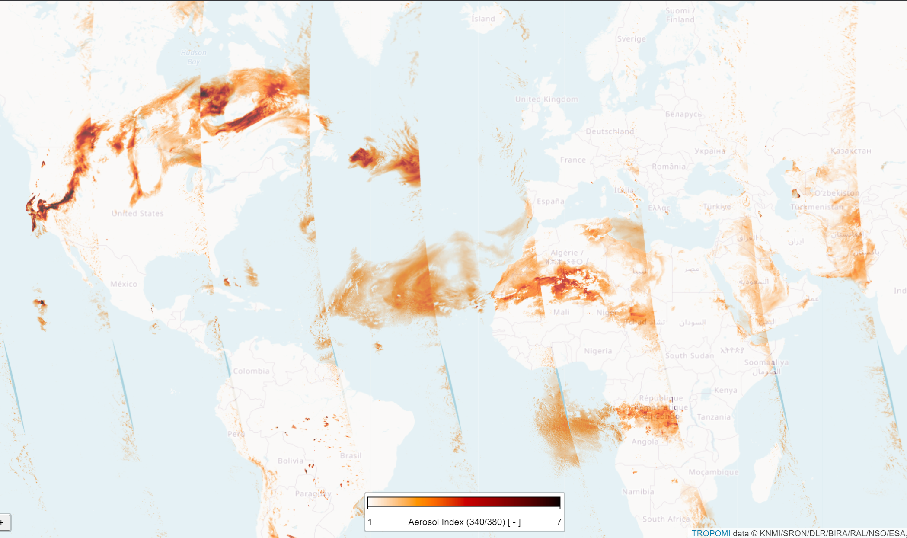
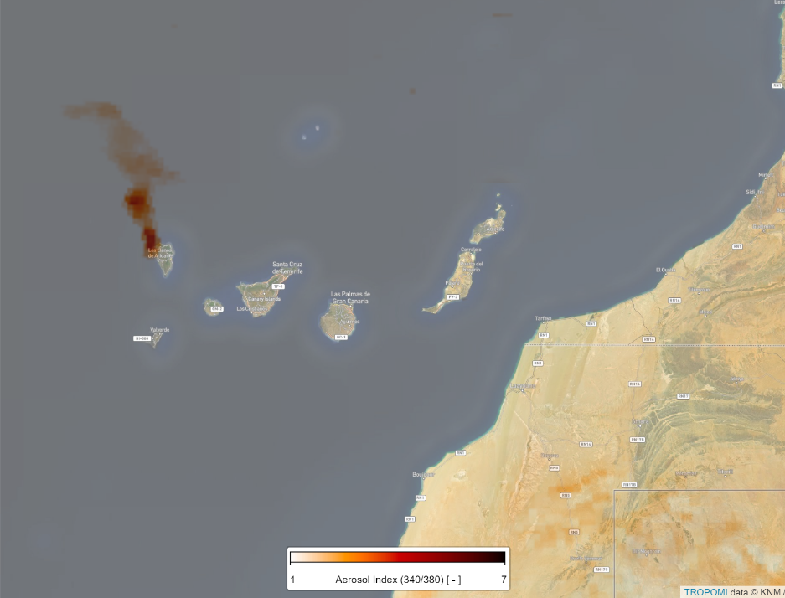
OVERVIEW: TROPOMI Aerosol Index [AER_AI]
Aerosol Index:
13 Aug 2021, OFFL
Ash Plume, La Palma
31 Oct 2021, OFFL
Transported Smoke
Fresh Smoke
Saharan Dust Transport
TROPOMI aerosol index good for large and small plumes of:
-- Volcanic Ash
-- Desert Dust
-- Biomass Burning Smoke
Hotspots Amazon Basin Burning
Smoke Transport

Slide 3
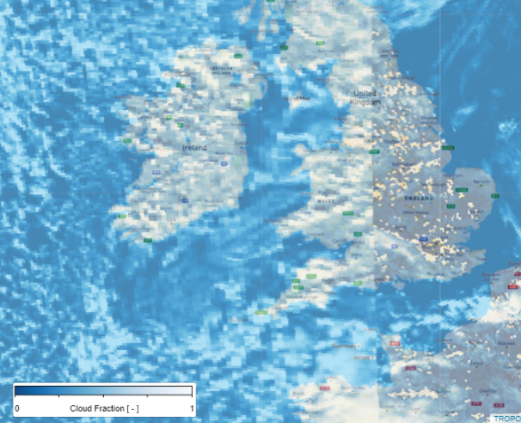
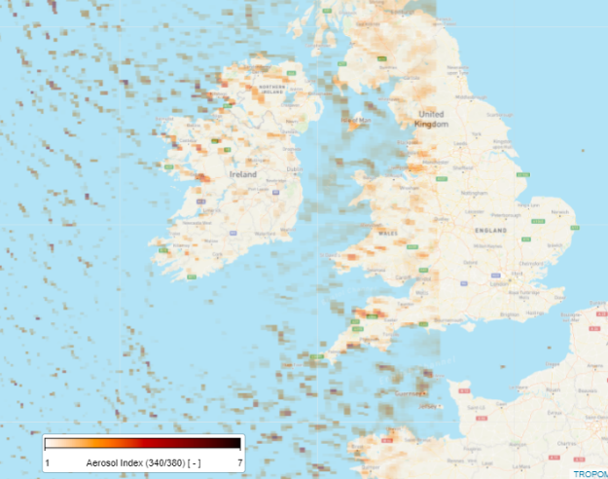
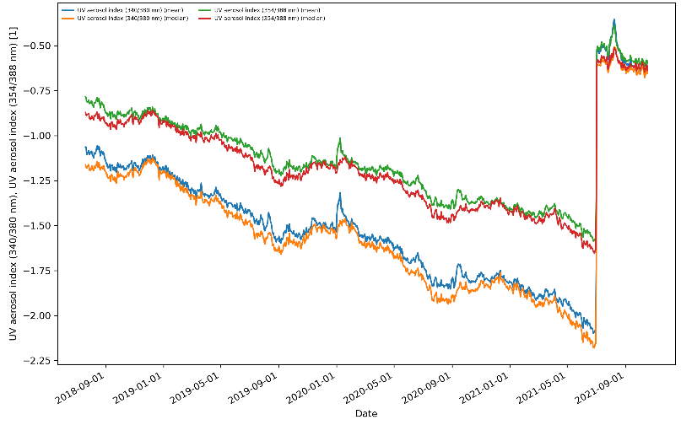
OUTLOOK: future changes TROPOMI AER_AI
ADVANTAGES | DISADVANTAGES | ISSUE | (Possible) SOLUTION
Small pixels: as of Aug 2019 3.5 x 5.5 km | Breakdown Lambertian (LER) assumption for some cloud types | Some cloud features & structures +AI values, Cloud appears as aerosol | Application of 2 LER layer model (1 for cloud)
Highly sensitive to any change in (irr)radiance | Highly sensitive to any change in (irr)radiance | Degradation in both L1 irradiance & radiance results in biases | Corrected L1b data; and application of offset factors to resolve biases

