Slide 1
Enhancing and Detecting CO₂ Plumes in Satellite Images Using Computer Vision Denoising, Inpainting, and Ridge Tracing
Erik Koene, Gerrit Kuhlmann, Dominik Brunner
Empa, Dübendorf, Switzerland
24/11/2021

Slide 2
Content
Background
Denoising
Inpainting
Ridge tracing
Discussion & summary
Simple examples followed by an application to satellite data

Slide 3
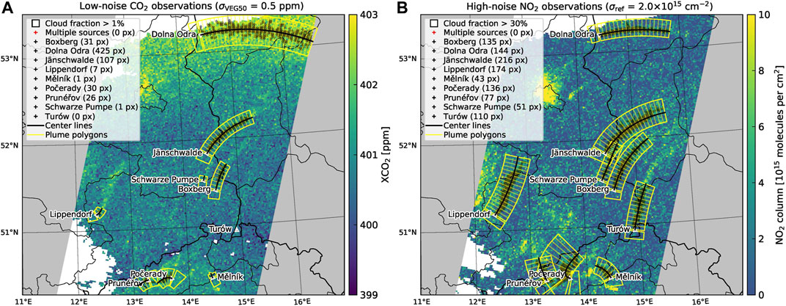
Background
Copernicus Carbon Dioxide Monitoring (CO2M) satellite constellation
To be launched in 2025
2$×$2 km² resolution
Measures CO₂ [$σ_{VEG50}≈0.7$ ppm] and NO₂ [$σ_{ref}≈{10}^{15}$ molecules/cm²] images
Purpose of this study
Evaluate potential of established computer-vision techniques on satellite images
Focus on detecting plumes in future CO2M satellite images
Used input data:
Synthetic data generated in SMARTCARB project [Kuhlmann et al., 2021]

Slide 4
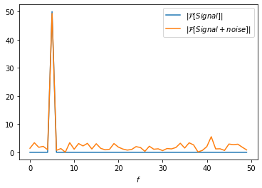
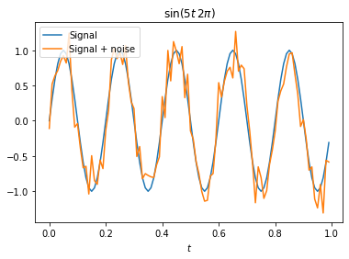
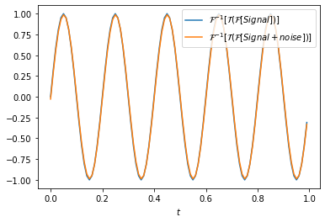
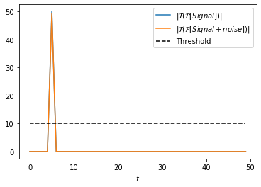
Denoising – example 1: hard thresholding
Denoising (suppress incoherent noise)
Domain transform
Mute values below threshold
Inverse transform

Slide 5
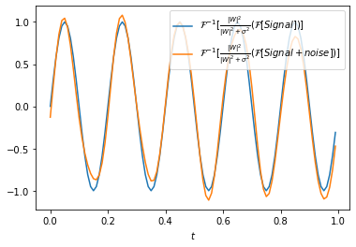
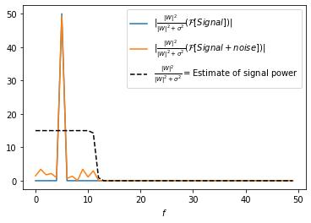
Denoising – example 2: Wiener filtering
Denoising (suppress incoherent noise)
Domain transform
Multiply with expected S/N
Inverse transform

Slide 6
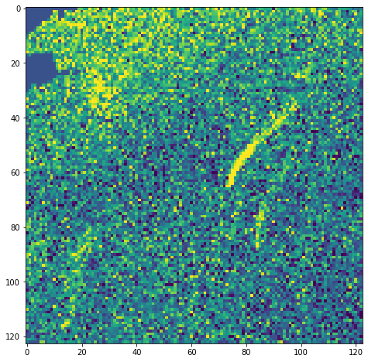
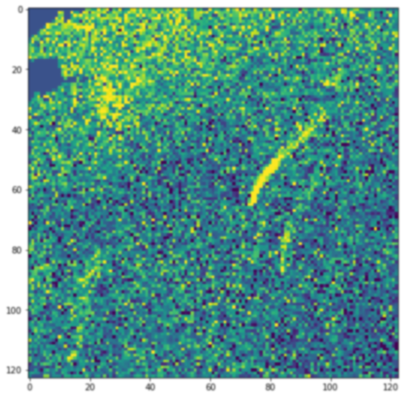
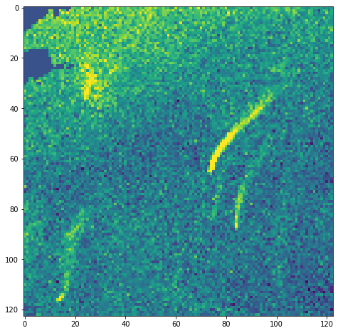
Denoising – BM3D
Hard threshold
Wiener filtering
Noisy input
Initial denoised estimate
Denoised result
Initial denoising
Original input
Select similar looking patches
Aggregate patches
Aggregate patches
3D (e.g., Wavelet) transform followed by hard threshold
and inverse 3D transform
3D (e.g., Wavelet) transform followed by Wiener filtering
and inverse 3D transform
[Dabov et al. (2007)]

Slide 7
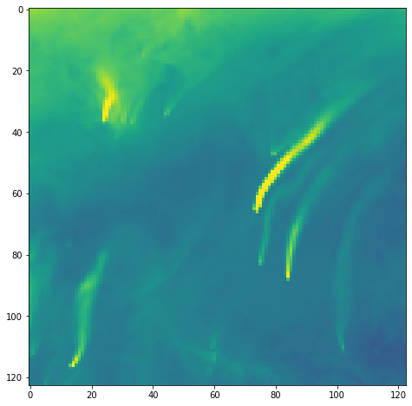
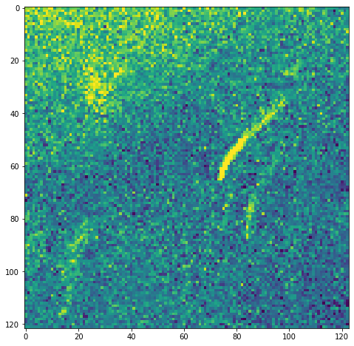
BM3D applied to satellite data
BM3D applied to satellite data
Noise free CO₂ image
Noisy XCO₂ image ($σ_{VEG50}=0.7 ppm$)
BM3D denoised
Berlin
Power plants
4% structural similarity
17% structural similarity; +6 dB PSNR

Slide 8
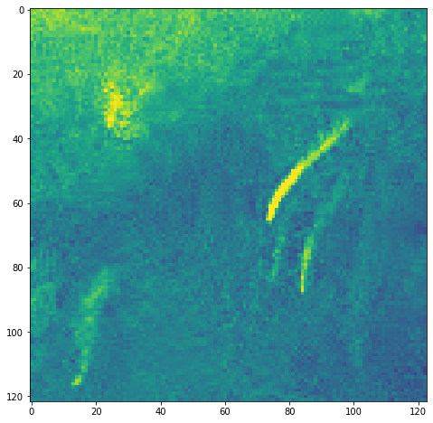
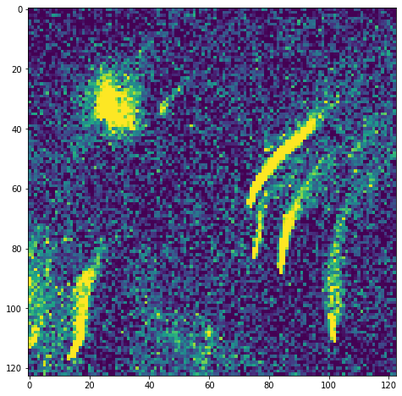
BM3D applied to satellite data
BM3D applied to satellite data
Noise free CO₂ image
Noisy XCO₂ and NO₂ images
BM3D denoised using both inputs
Berlin
Power plants
4% structural similarity
53% structural similarity; +12 dB PSNR

Slide 9
Inpainting is like a jigsaw puzzle without pieces
We complete jigsaw puzzles by trying to match patches that fit well with the surrounding data.
We perform inpainting in a similar way, but teach a computer to generate the missing jigsaw pieces, such that:
1. The filled patches look structurally similar to rest of image
2. The filled patches connect well to the rest of the image
3. The filled images looks ‘plausible’

Slide 10
Inpainting with a neural network
Neural network
Similarity
How (dis)similar are the generated patches to existing patches?
L₁ difference
How similar to the groundtruth?
Neural network
How fake does it look compared to the groundtruth?
[Zeng et al. (2021)]

Slide 11
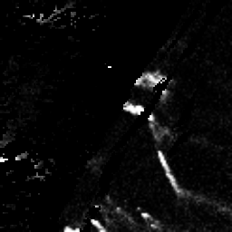
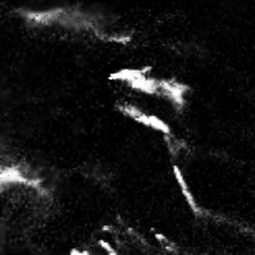
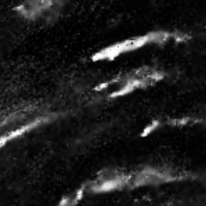
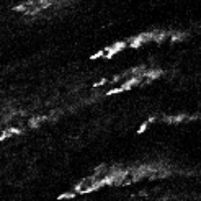
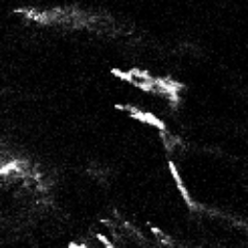
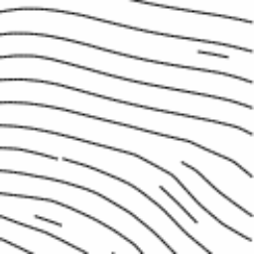
Example application on satellite data
Image masked by cloud cover
Inpainted image
Ground truth
The inpainted images appear realistic, and correctly connect plumes that were disjoint by cloud cover
Note: at this stage, we do not recommend to use inpainted data for emissions estimations, just as a way to connect disjoint plume patches.
Wind field
(addition of wind field reduces average L₁ error by 55%)

Slide 12
Example application on satellite data
Image masked by cloud cover
Inpainted image
Ground truth
The inpainted images appear realistic, and correctly connect plumes that were disjoint by cloud cover
Note: at this stage, we do not recommend to use inpainted data for emissions estimations, just as a way to connect disjoint plume patches.
Wind field
(addition of wind field reduces average L₁ error by 55%)

Slide 13
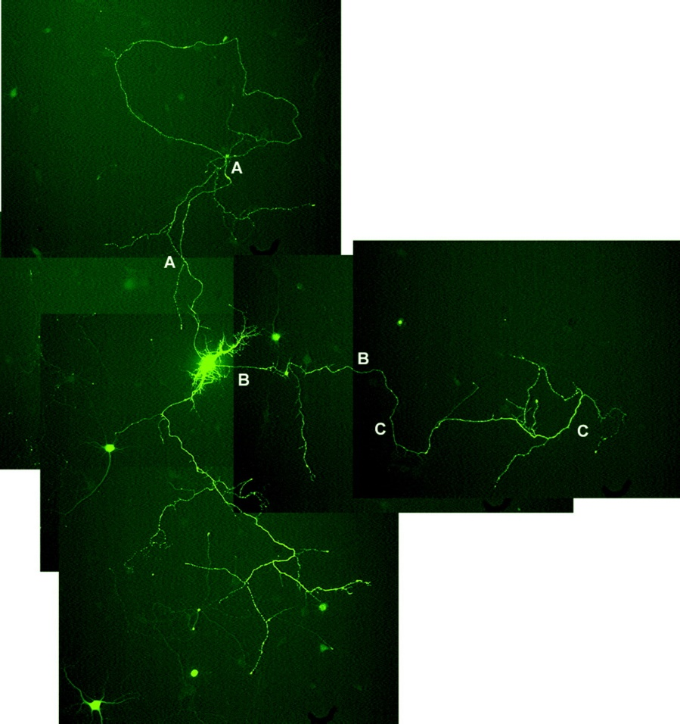
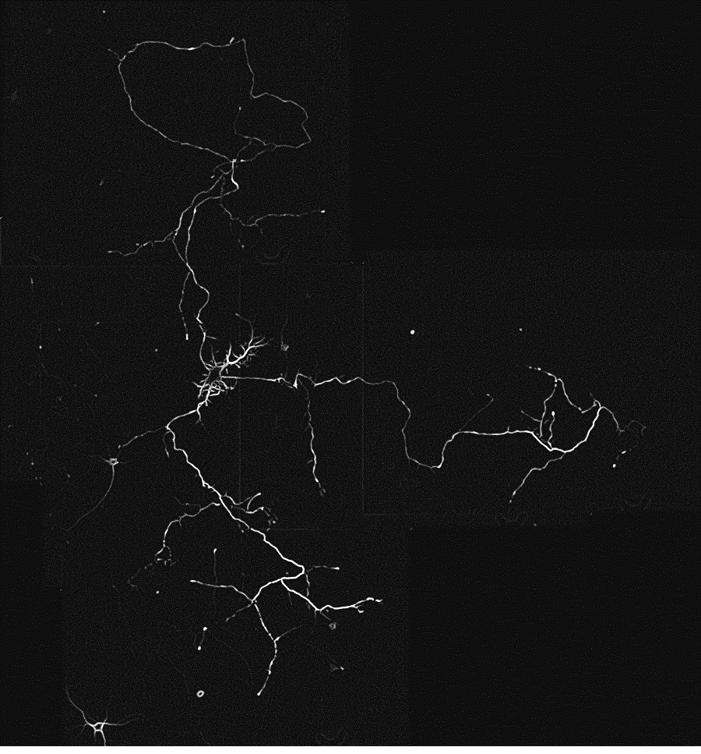
Neurite detection
$$\acute{∇_{i}∇_{j}I}=UλU^{T} \\ neuriteness=\frac{λ_{max}}{λ_{min}}$$
Varying background strengths (due to stitched microscope images), varying contrast, in presence of noise
[Meijering et al. (2004)]

Slide 14
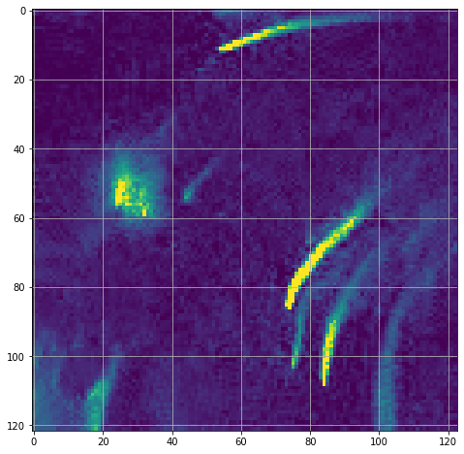
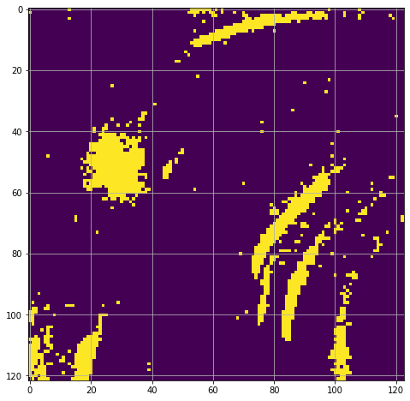
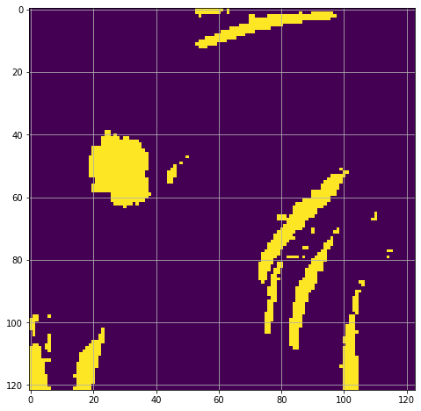
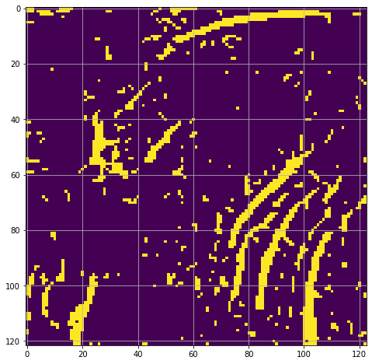
Plume detection
Too sensitive…
NO₂ (BM3D denoised)
$$\frac{NO2−μ}{σ^{2}}>P_{z}(0.99)$$
$$\frac{BM3D[NO2]−μ}{σ^{2}}>P_{z}(0.99)$$
Meijering
[Kuhlmann et al., 2019, 2021]

Slide 15
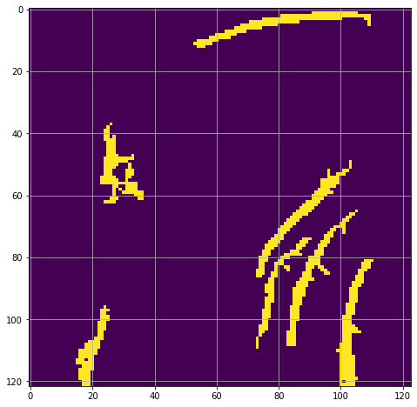
Plume detection
Selecting plume bodies fixed
to large sources only
NO₂ (BM3D denoised)
$$\frac{NO2−μ}{σ^{2}}>P_{z}(0.99)$$
$$\frac{BM3D[NO2]−μ}{σ^{2}}>P_{z}(0.99)$$
Meijering
[Kuhlmann et al., 2019, 2021]

Slide 16
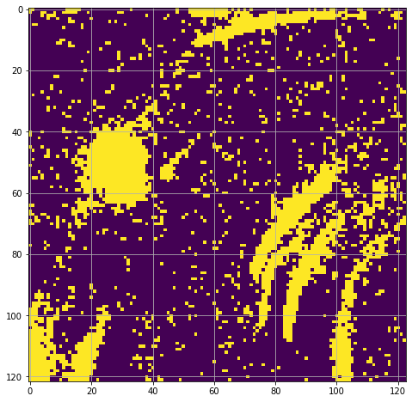
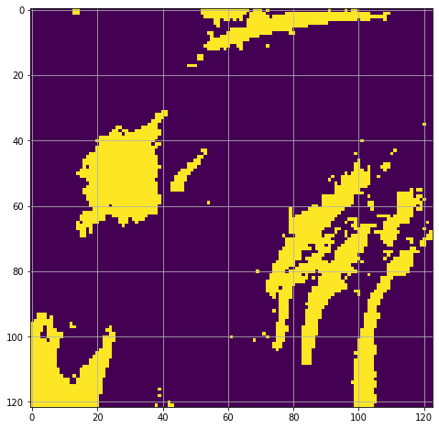
Plume detection
Selecting plume bodies fixed
to large sources only
NO₂ (BM3D denoised)
$$\frac{NO2−μ}{σ^{2}}>P_{z}(0.85)$$
$$\frac{BM3D[NO2]−μ}{σ^{2}}>P_{z}(0.85)$$
Meijering
Plumes are detected about 10% longer without connecting to close-by plumes
[Kuhlmann et al., 2019, 2021]

Slide 17
Discussion & Conclusion
The methods thus far were only applied or trained on SMARTCARB data, but as of yet untested on real satellite images
Meijering method not well-suited for broad point-sources (such as city of Berlin), and detection of the late tail of plumes is only of limited value as emissions are more dispersed at that stage
Many further uncertainties remain to not just detect but also quantify plume emissions
BM3D shows a great potential for improving image quality by considering joint XCO₂ and NO₂ images
Image inpainting can connect disjoint plume pixels due to cloud cover remarkably well. NB: we recommend to use this for small cloud clover fractions only, as the data quality will be bad for large cloud cover fractions.
Meijering method can detect narrow plume features for long distances

Slide 18
References
Dabov, K., Foi, A., Katkovnik, V., & Egiazarian, K. (2007). Image denoising by sparse 3-D transform-domain collaborative filtering. IEEE Transactions on image processing, 16(8), 2080-2095.
Kuhlmann, G., Broquet, G., Marshall, J., Clément, V., Löscher, A., Meijer, Y., & Brunner, D. (2019). Detectability of CO₂ emission plumes of cities and power plants with the Copernicus Anthropogenic CO₂ Monitoring (CO2M) missions. Atmospheric Measurement Techniques, 6695-6719.
Kuhlmann, G., Henne, S., Meijer, Y. & Brunner, D. (2021) Quantifying CO₂ Emissions of Power Plants With CO₂ and NO₂ Imaging Satellites. Front. Remote Sens. 2:689838. doi: 10.3389/frsen.2021.689838
Meijering, E., Jacob, M., Sarria, J. C., Steiner, P., Hirling, H., & Unser, M. (2004). Design and validation of a tool for neurite tracing and analysis in fluorescence microscopy images. Cytometry Part A: the journal of the International Society for Analytical Cytology, 58(2), 167-176.
Zeng, Y., Lin, Z., Lu, H., & Patel, V. M. (2021). CR-Fill: Generative Image Inpainting With Auxiliary Contextual Reconstruction. In Proceedings of the IEEE/CVF International Conference on Computer Vision (pp. 14164-14173).

