Slide 1
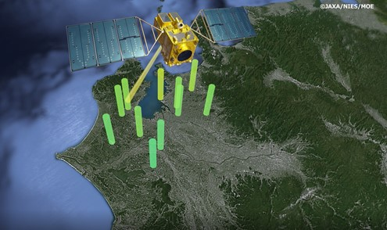
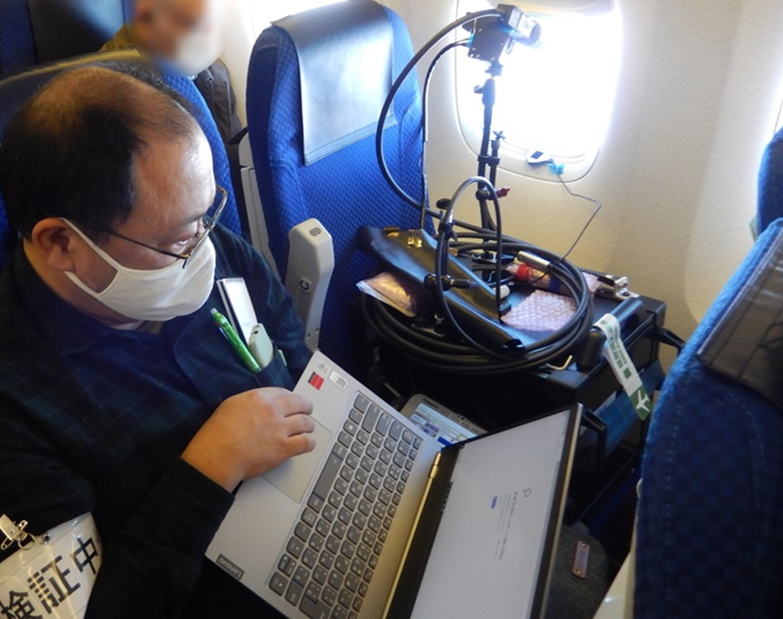
JAXA trace gas products
using GOSAT and Airborne spectrometers
Nov. 22, 2021
Akihiko KUZE

Slide 2
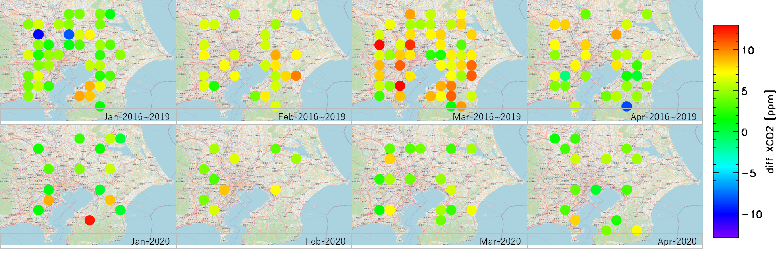
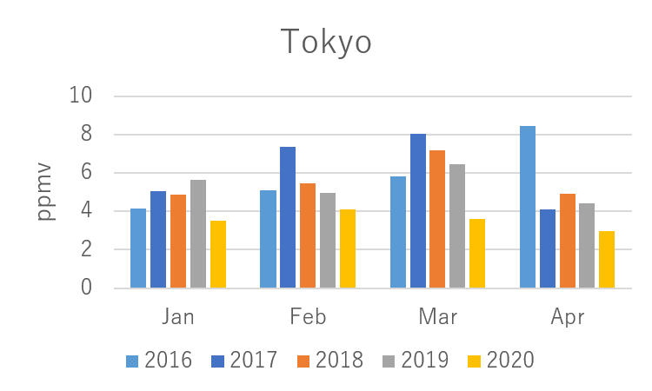
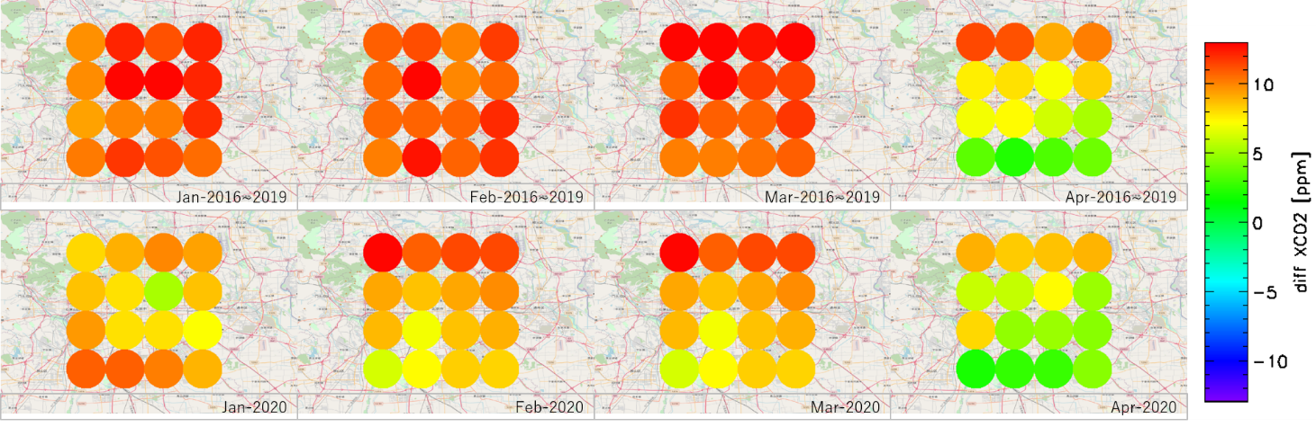
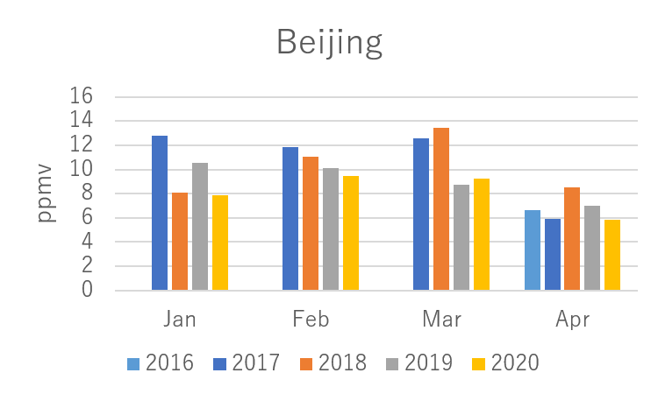
tri-lateral EO-dashboard: COVID-19
Average monthly abundances of CO₂ in the lower troposphere for the past 4 years (upper, reference) and 2020 (lower) from GOSAT
Tokyo
The difference in CO₂ density in the upper and lower troposphere is smaller in 2020 compared to 2016-2019 in Tokyo and Beijing.
Beijing
Analyzed by JAXA/EORC
Analyzed by JAXA/EORC
Analyzed by JAXA/EORC
CO₂ has accumulated in the atmosphere since the Industrial Revolution. We assume the average density of the upper troposphere is a background.
XCO₂ anomaly: XCO₂(LT)-XCO₂(UT_{average}), Partial column of lower troposphere (0-4 km)– Monthly-Area averaged upper troposphere (4-12 km)
Analyzed by JAXA/EORC

Slide 3
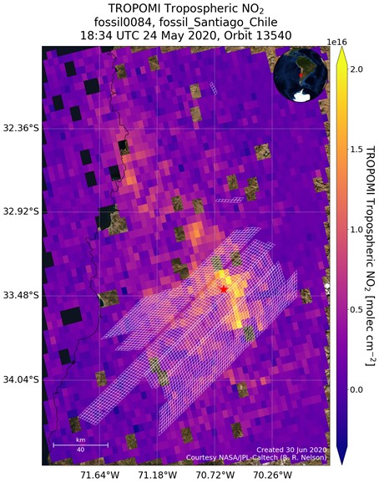
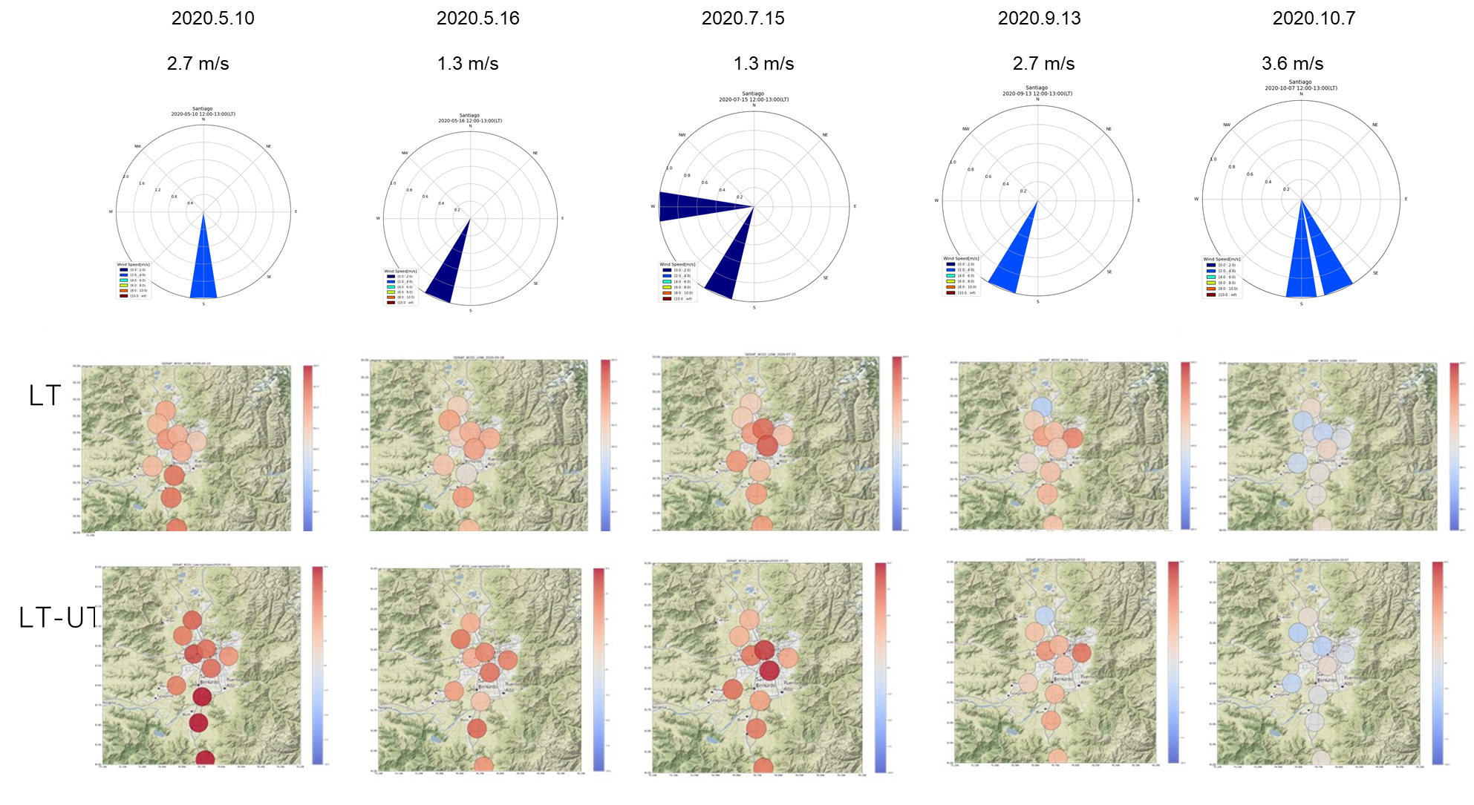
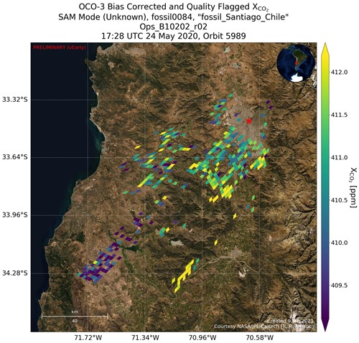
tri-lateral EO-dashboard: post COVID-19
Santiago
EO dashboard (AQ & GHG) TROPOMI-OCO-3-GOSAT-GOSAT-2

Slide 4
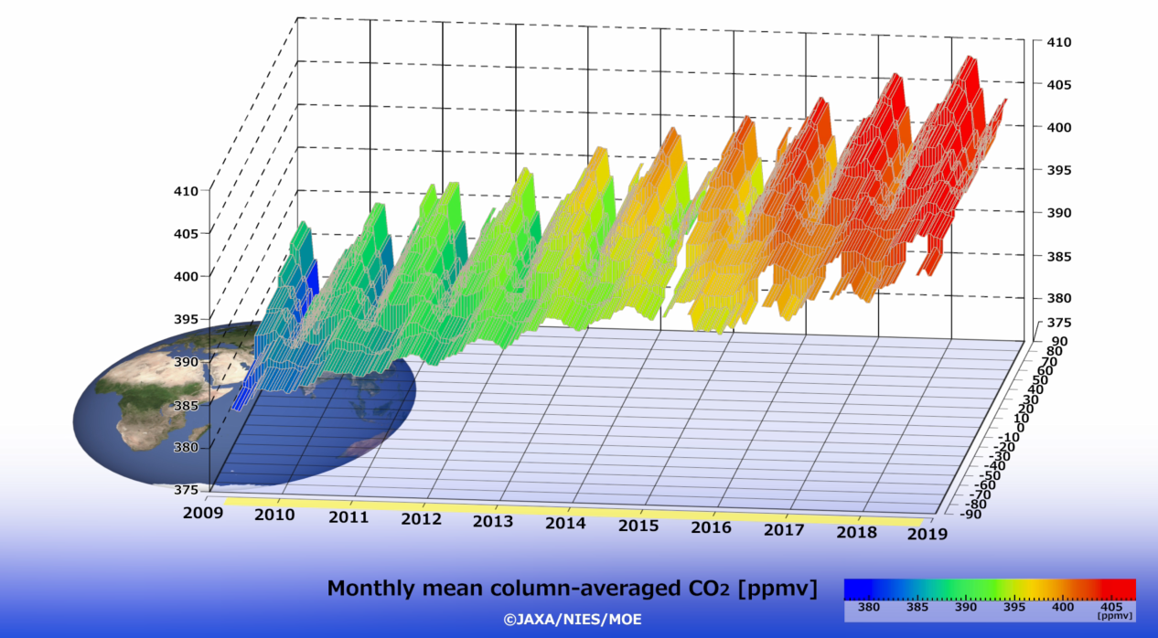
GOSAT 12-year operation in space
<Demonstrated in early years>
Accurate and precise CO₂ (1.6 ppm (0.4 %)) CH₄ (13 ppb (0.7 %)) distribution measurements from space.
Reduce the uncertainties in global and regional flux inverse estimates
Since 2015
Urgent needs for monitoring carbon emissions from intense localized sources, such as cities and power plants to contribute to the global stocktake of the Paris Agreement.
4

Slide 5
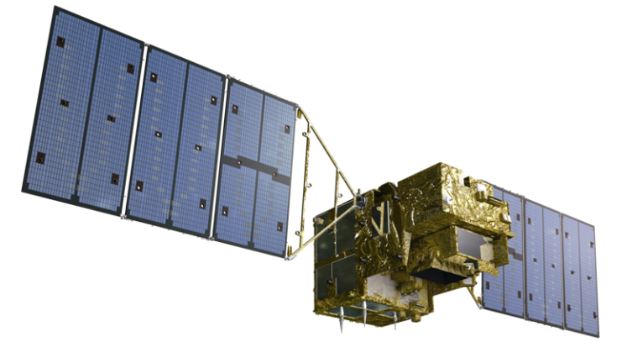


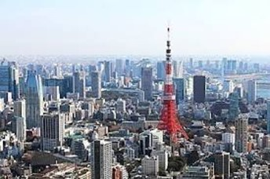
JAXA EORC Partial Column Products
FTS multiplex advantage
(1) SWIR constrains column density
(2) Two independent linear polarization data remove aerosol contamination.
(3) TIR provides difference in partial column density between lower and upper troposphere.
12 year GOSAT and 2 year GOSAT-2 products are available at https://www.eorc.jaxa.jp/GOSAT/GPCG/index_GOSAT2.html
One file for one month global clear sky conditions,
CSV format, only 2 M byte per month file
XCO₂, XCH₄, XCO₂ (LT, UT), XCH₄ (LT, UT), XCO (GOSAT-2 only), aerosol optical thickness (AOT),Retrieved surface pressure (P), solar-induced chlorophyll fluorescence (SIF) time, geometry
©MOE/JAXA/NIES
12km
4km
Delta CO₂ = XCO2 (LT) –CO2(UT)
GOSAT-1 Version 1
yyyy/mm/dd hh:mm:ss Latitude Longitude LSFLG XCO2_apr XCO2_tot XCO2_low XCO2_upp XCH4_apr XCH4_tot XCH4_low XCH4_upp XCO_apr XCO_tot Psrf_apr Psrf_ret AOT_076 AOT_160 AOT_206 SIF Cloud scanID
2019/01/01 01:13:04 -41.3061 173.4926 0 406.5682 397.9352 395.1537 399.3747 1.7439 1.7464 1.8315 1.7634 0.00000 0.00000 967.86 977.05 0.0963 0.0886 0.0820 10.4642 -1.000000 F190101011304
2019/01/01 02:46:15 -23.9153 151.2222 0 407.7506 402.3643 402.1988 403.2452 1.7683 1.8030 1.7950 1.8469 0.00000 0.00000 1007.32 1001.42 0.3487 0.3636 0.3583 1.2205 -1.000000 F190101024615
2019/01/01 02:47:06 -23.9548 148.3777 0 407.6141 404.1903 401.7923 406.6639 1.7696 1.8011 1.8437 1.8281 0.00000 0.00000 990.35 989.26 0.0255 0.0134 0.0110 -0.1822 -1.000000 F190101024706
5

Slide 6
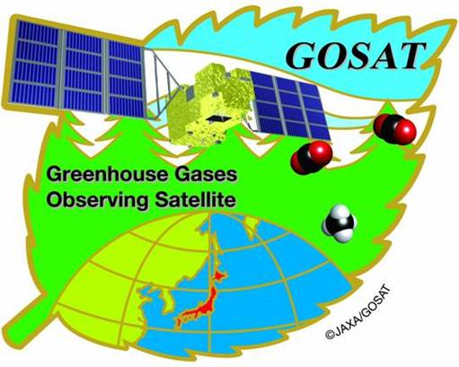

EO dashboard (AQ & GHG)
TROPOMI-OCO-3-GOSAT-GOSAT-2
GOSAT: long term data (2009-) Intense urban data since 2015
Number of target cities are limited due to onboard memories (about 500 targets per day)
High clear sky ratio cities:
Present dashboard cities: Beijing, Shanghai, Tokyo, New Deli, Mumbai, Dhakka, NYC
+ Santiago, Madrid, Lahore, Riyadh
GOSAT-2 Fully-customized target observation
About 50 world mega cities
10 US cities Atlanta, Baltimore-Washington, Boston, Chicago, Denver, LA Basin, Las Vegas, NYC + 2
Atlanta, Baltimore-Washington, Boston, Chicago, Denver, LA Basin, Las Vegas, NYC

Slide 7
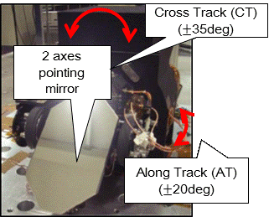
Target Observations with 2-axis Agile Pointing System
After the pointing mechanism was switched from primary to secondary on 26 January 2015, more frequent target observations
uploading AT and CT pointing angles and observation timing as commands from the ground every day
About 1000 locations are allocated to target observations such as calibration and validation site, megacities, or large emission sources.
7

Slide 8
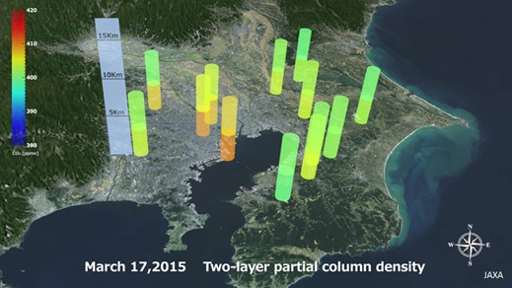
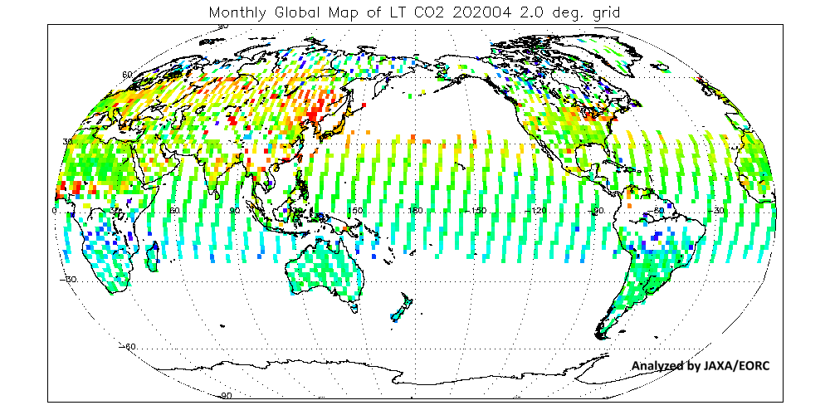
Global and Local Flux
Global Flux
Local flux from large emission sources
Only satellites can provide global data
Large footprint and/or sparse sampling
Flux estimation needs models.
Fit models well
By adding satellite data, uncertainty in global flux has been reduced but still large.
Intense measurement using targeting capability.
More direct estimation when wind direction and speed data are available
Emission area information is needed.
Plume structure helps estimation from individual source sectors.
CO₂: long life, small enhancement, quantitative information for flux estimation
NO₂: short life, higher sensitivity, identifying emission sources and characterizing plumes
8
Notes:
8

Slide 9
Why NO₂ observation by an air-borne spectrometer is needed.
Local flux estimations using GOSAT include large uncertainties due to too large footprint, lack of proper upwind reference observation, and lack of wind information.
To contribute to the global stocktake of the Paris Agreement, we need an observation system to estimate local flux from individual source sectors.
We have developed imaging spectrometer suites with optimized spectral resolution and coverage for air borne observations.
We flew over industrial zone and we acquired imaging data oxygen (O₂), CO₂, CH₄ and nitrogen dioxide (NO₂) under different wind conditions.
The NO₂ image with plume direction and spreading have detected CO₂ sources and provided wind information.
9

Slide 10
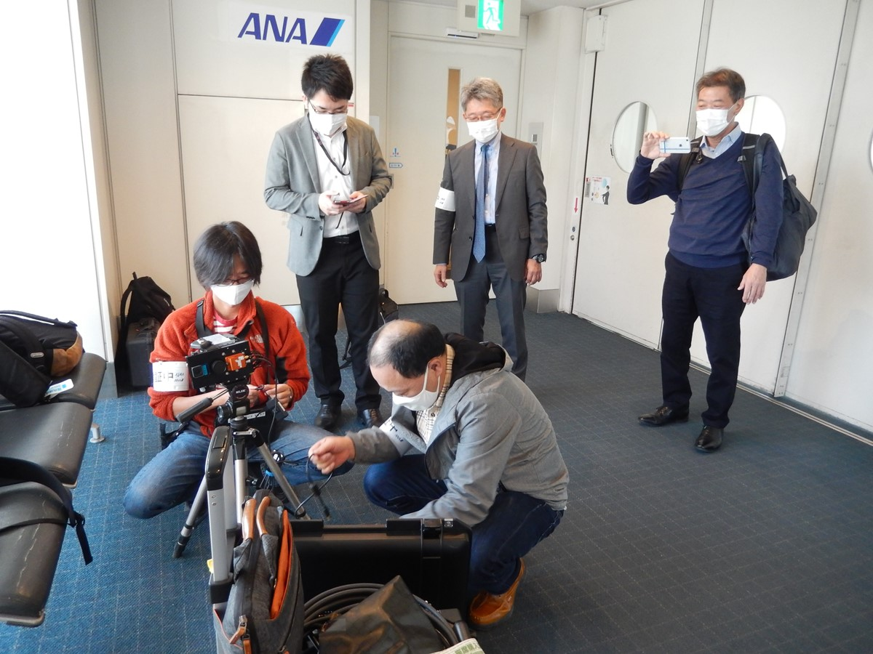
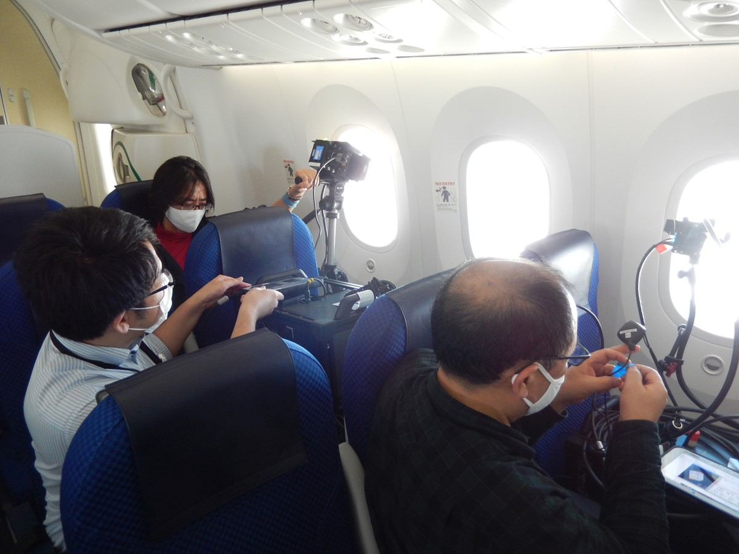
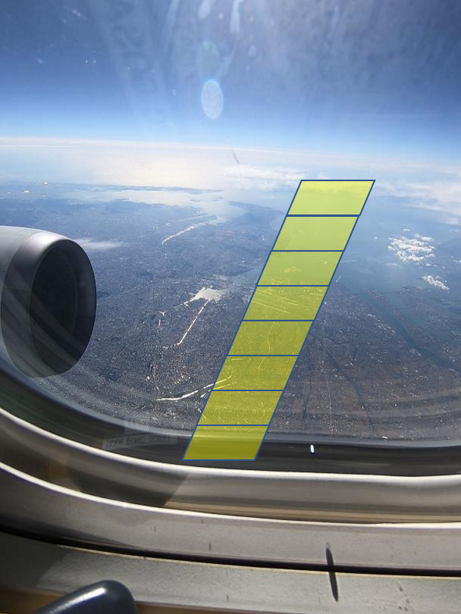
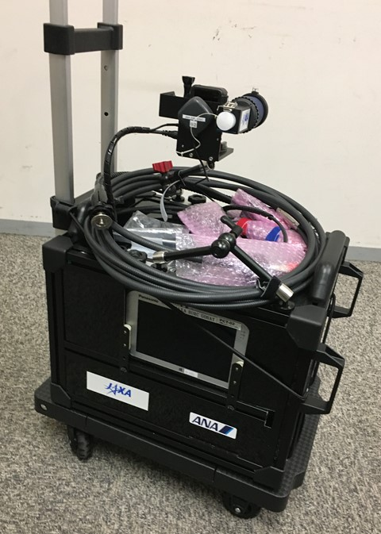
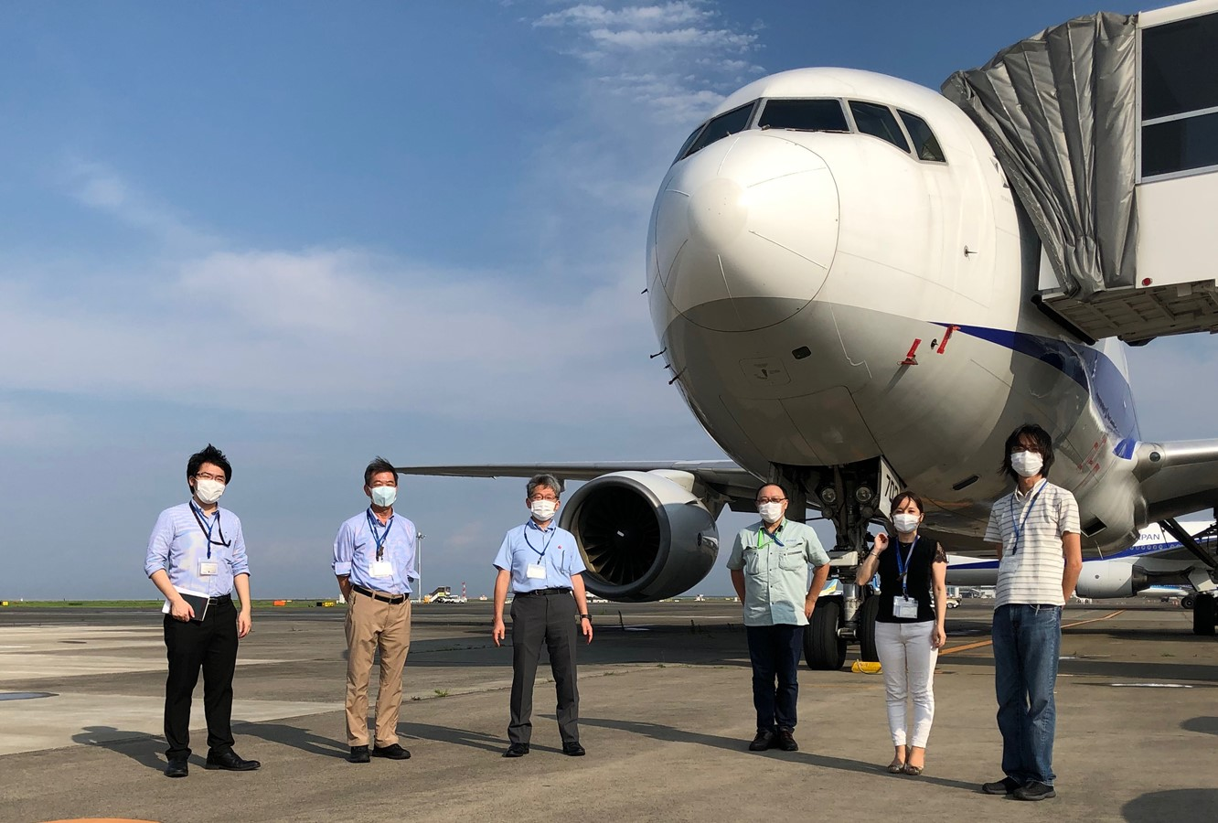
Identifying emission sources and polluted area
Simultanious measurements of NO₂, CO₂, CH₄, O₂A SIF using passenger aircrafts collaborating with ANA. Boeing 767 flight between Tokyo Haneda and Fukuoka-city
NO₂
Tokyo
Clouds
Okayama
Akashi
Fukuyama
Fukuoka
Clouds
Preliminary
TROPOMI NO2, Oct. 26, 2020
First flight on Oct. 26 from Tokyo Haneda to Fukuoka flew over Tokyo Bay area, Nagoya , Osaka, Okayama, Hiroshima, Kita-Kyushu, and Fukuoka
Most of the major mega cities in Japan were included.
Carry-on size
10
Set up before boarding
3 imaging spectrometers on cabin seats

Slide 11
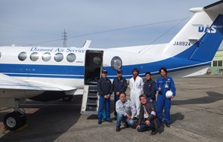
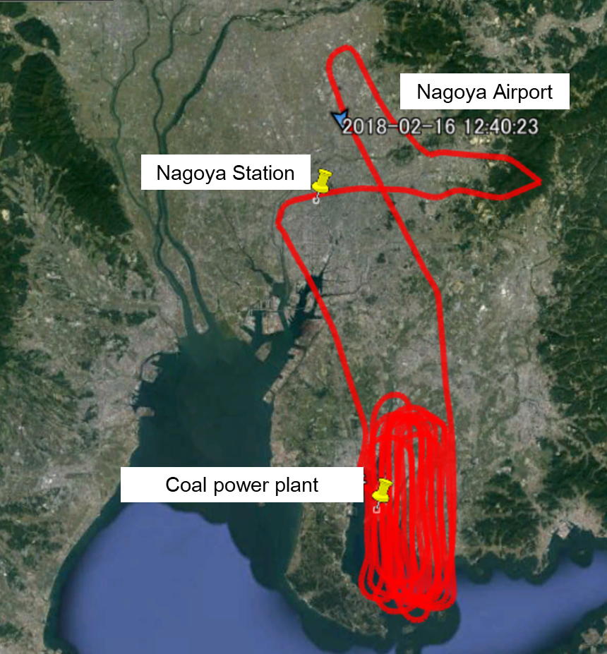
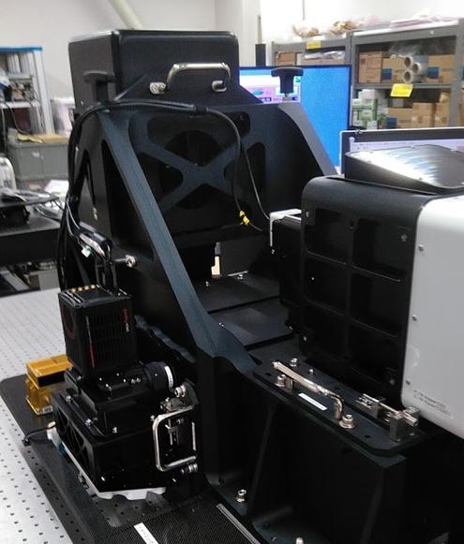
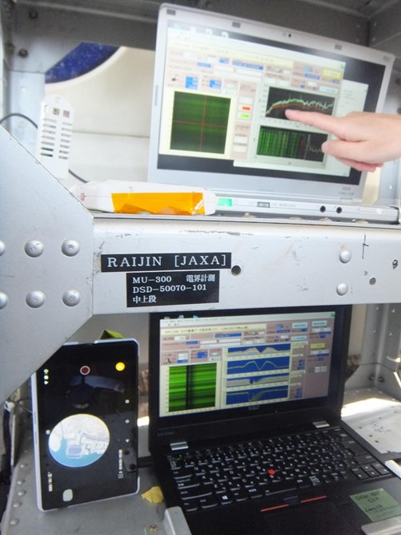
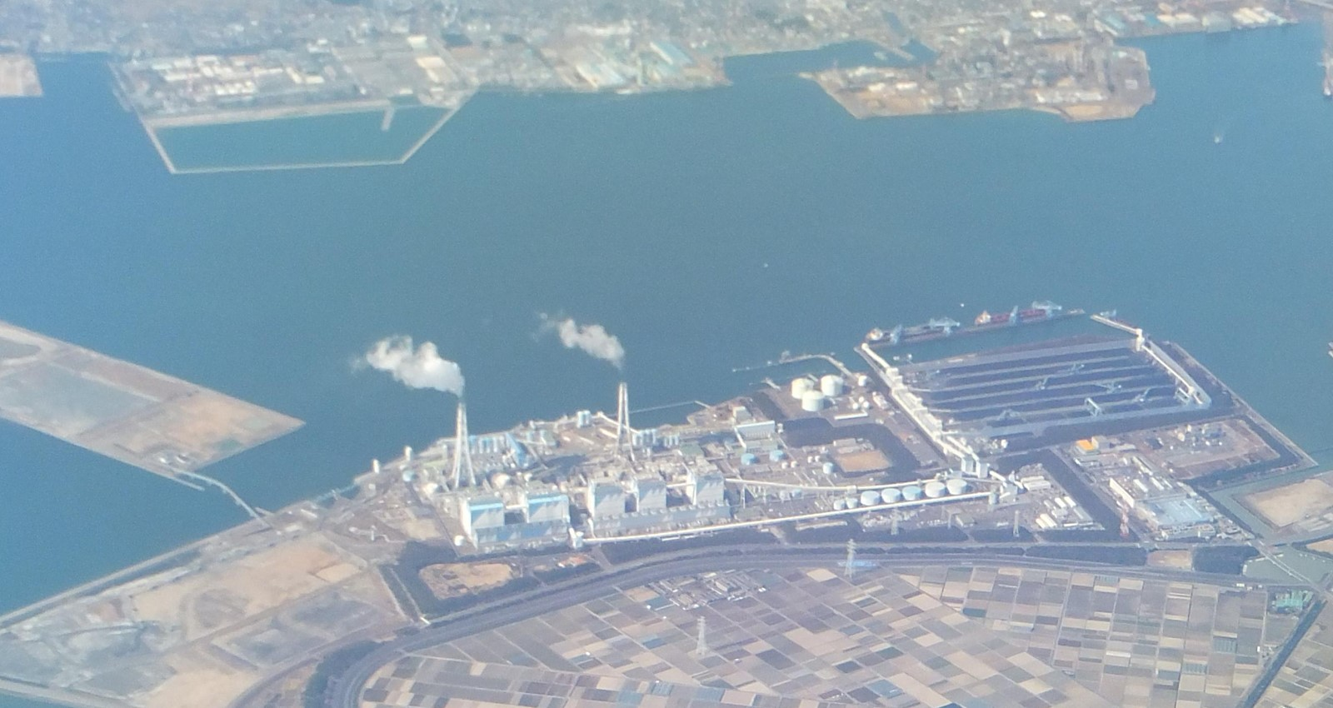
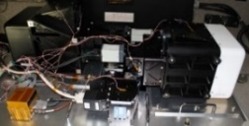
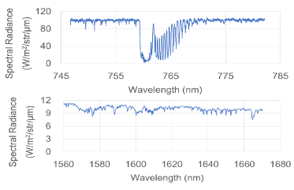
Characterizing Plumes with fine scale CO₂ and NO₂ map
We confirmed coincident plume shape of CO₂ and NO₂
Can NO₂ map constrain plume and wind (speed and direction)?
0.76μm for Surface pressure and SIF
NO₂
1.6μm for CO₂, CH₄
0.47μm for NO₂
Feb 2018 flight over greater Nagoya
cruising altitude of 2893 m
The wind direction and speed at the Nagoya Chubu Airport at noon were northwest and 3 m/s
Different GHG source sector location of greater Nagoya
CO₂: Poser plant, traffic, industry
CH₄: Waste water, liver stock, Gas production
CO₂
Upgraded spectrometers waiting for a next flight
11
3 imaging spectrometers (1.6, 0.76 µm, wide U-V) CO₂ CH₄ O₂ NO₂
NO₂ Fujinawa et al. 2019
XCO₂ Kawashima et al. 2019

